Slide 1
CENTRIFUGATION TECHNIQUE

Slide 2
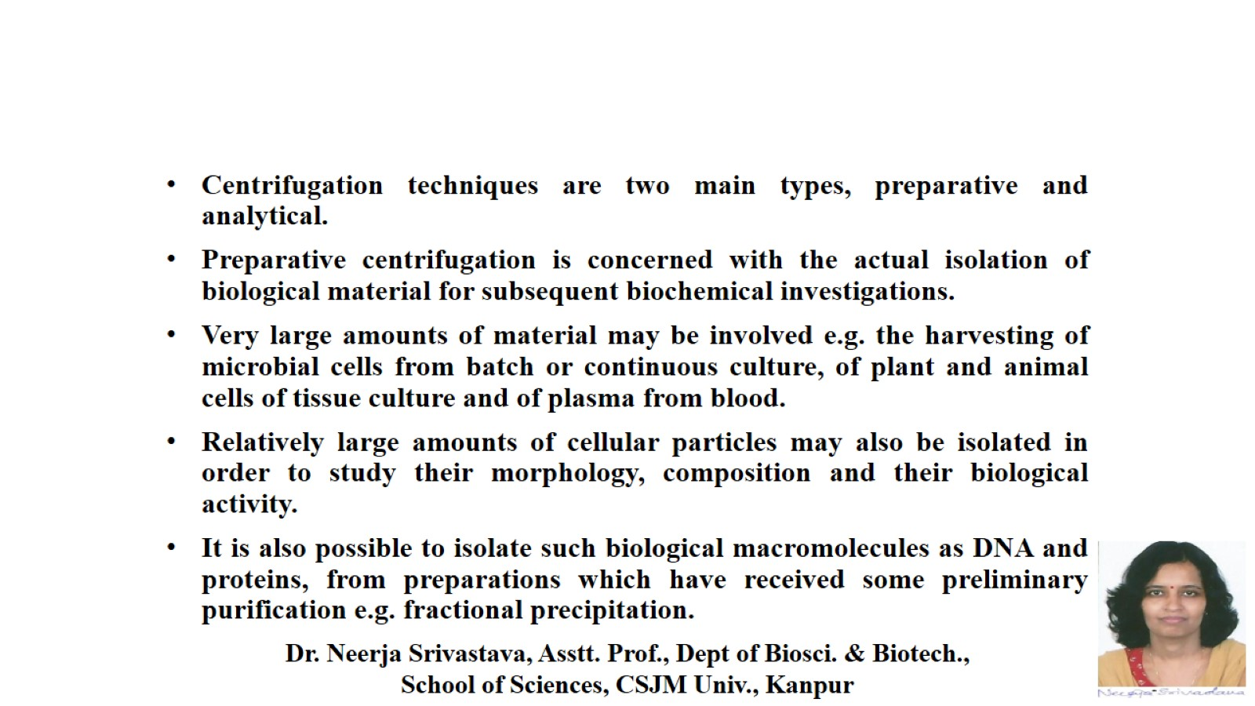

Slide 4
PREPARATIVE CENTRIFUGATION

Slide 5
Differential sedimentation of a particulate suspension in a centrifugal field. a) Particles uniformly distributed throughout the centrifuge tube (b-e).Sedimentation of particles during centrifugation dependent upon their size and shape.

Slide 8
Schematic illustration of the homogenization and subcellular fractionation protocol

Slide 9
RATE-ZONAL CENTRIFUGATION

Slide 11
ISOPYCNIC (EQUAL DENSITY) CENTRIFUGATION

Slide 14
EQUILIBRIUM ISODENSITY CENTRIFUGATION

Slide 15
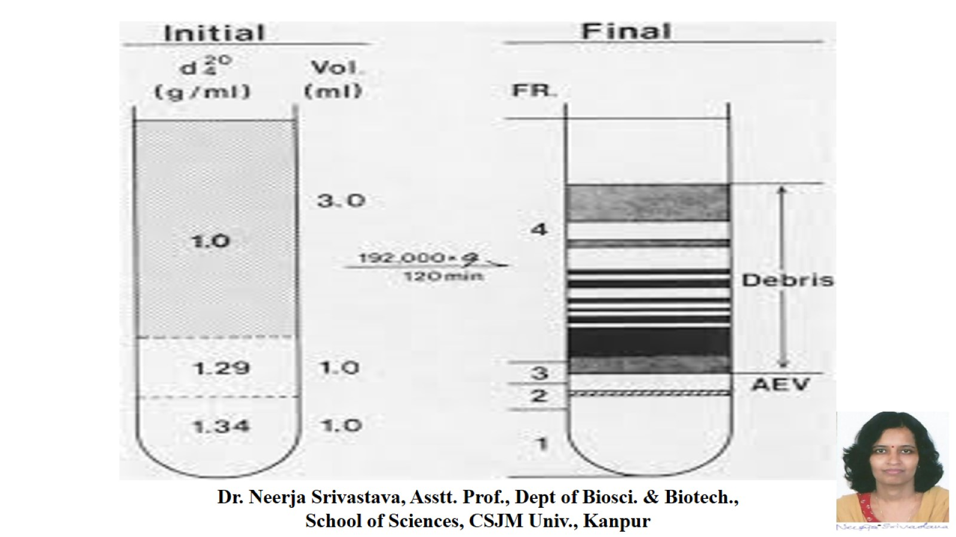

Slide 16
APPLICATIONS OF PREPARATIVE CENTRIFUGATION

Slide 17
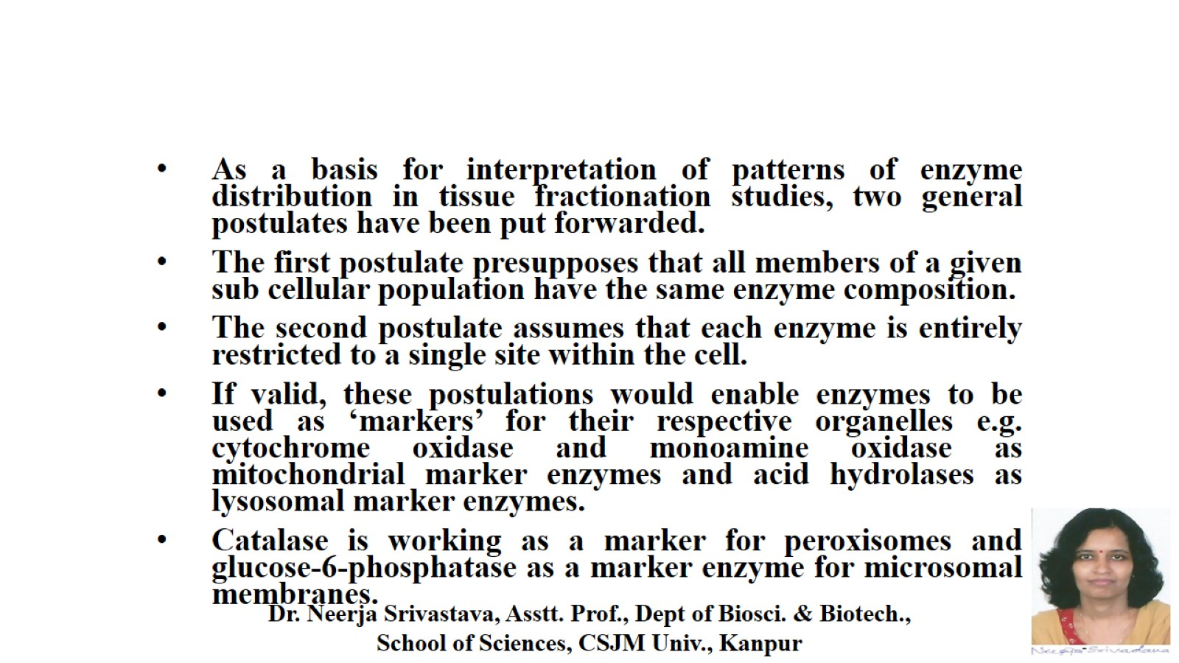

Slide 19
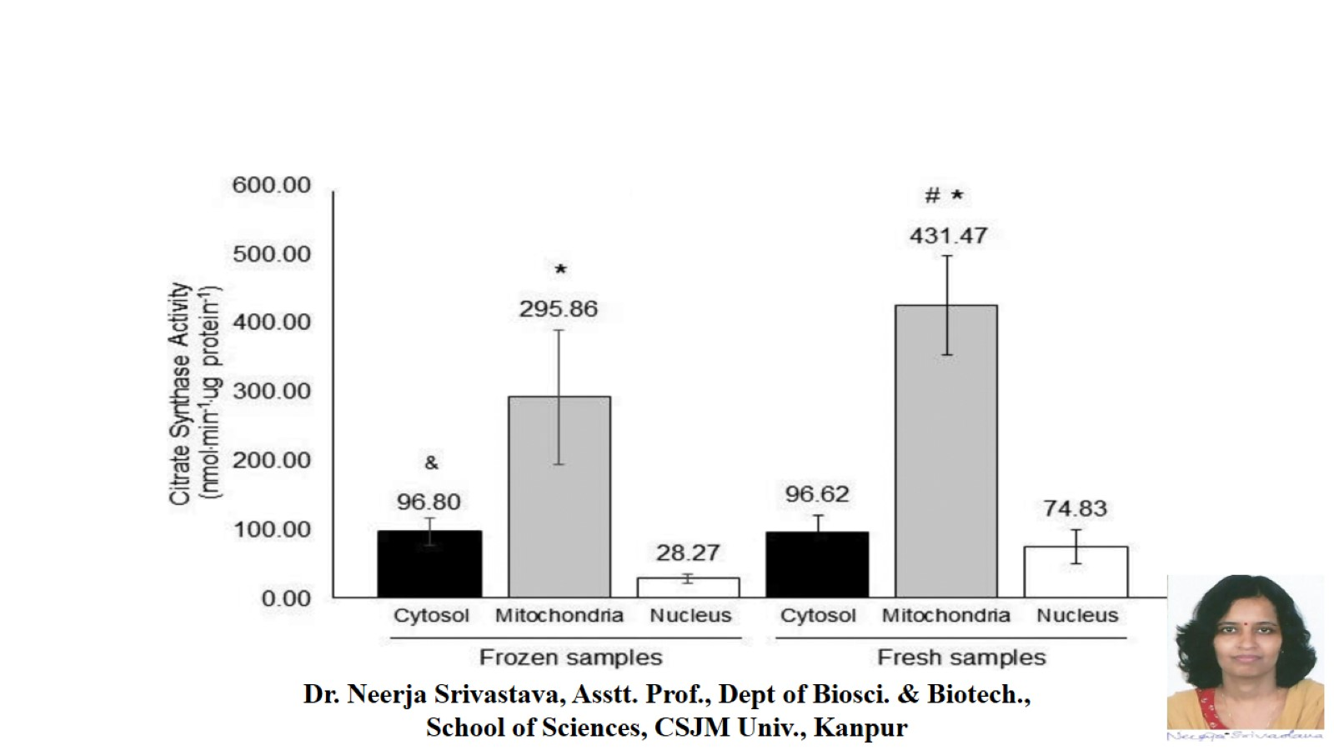

Slide 20
FRACTIONATION BY DIFFERENTIAL CENTRIFUGATION

Slide 21
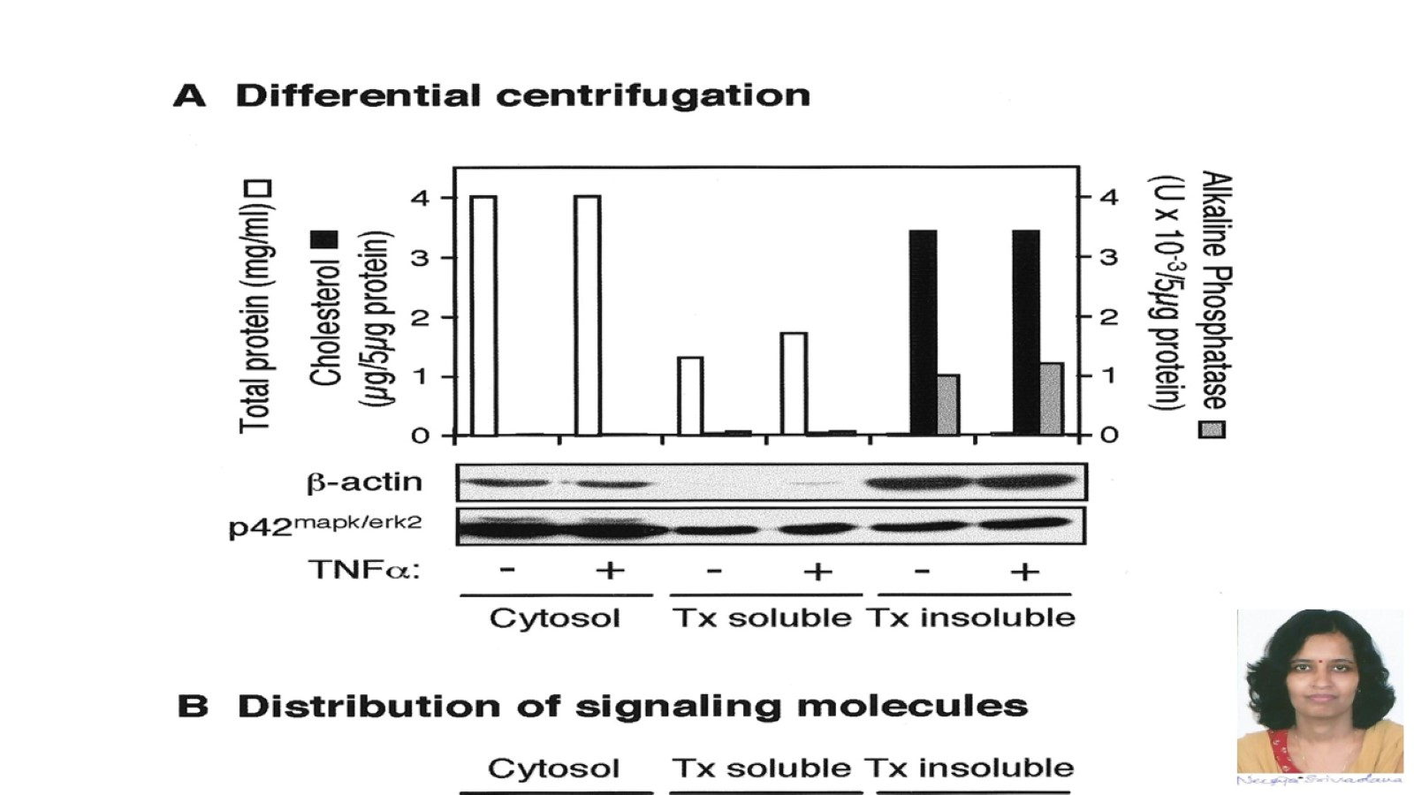

Slide 22
References: 1. Physical Biochemistry By Freifelder 2. Modern Experimental Biochemistry By Boyer

