Slide 1
ELECTROPHORESIS

Slide 2
ISOELECTRIC FOCUSING (IEF)

Slide 3
ISOELECTRIC FOCUSING (IEF)

Slide 4
ISOELECTRIC FOCUSING (IEF)

Slide 5
AMPHOLYTES

Slide 6
AMPHOLYTES

Slide 7
Properties of Ampholytes

Slide 8
Formation of pH Gradient

Slide 10
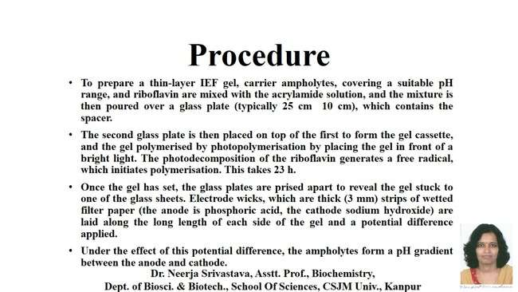
Procedure

Slide 13
A typical isoelectric focussing gel

Slide 15
Applications of IEF

Slide 17
Two-dimensional polyacrylamide gel electrophoresis(2 D-PAGE)

Slide 18
Two-dimensional polyacrylamide gel electrophoresis(2 D-PAGE)

Slide 19
First Dimension Electrophoresis

Slide 20
First Dimension Electrophoresis

Slide 21
Second Dimension Electrophoresis

Slide 22
A typical two-dimensional gel

Slide 23
Result and Image Analysis

Slide 24
Applications

Slide 25
ELECTROPHORESIS OF NUCLEIC ACIDS

Slide 27
Preparation of agarose

Slide 31
Agarose Gel

Slide 32
Pulsed-field gel electrophoresis (PFGE)

Slide 34
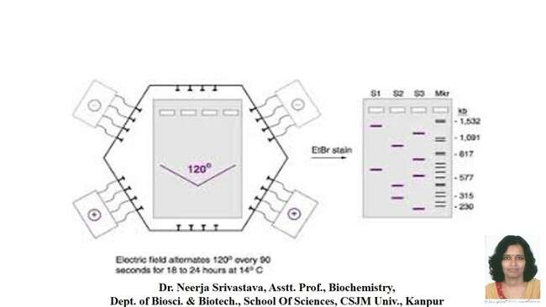

Slide 36
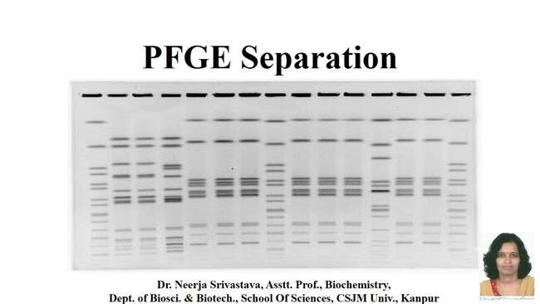
PFGE Separation

Slide 37
Density Gradient Electrophoresis

Slide 38
References: 1. Physical Biochemistry By Freifelder 2. Modern Experimental Biochemistry By Boyer

