Slide 1
Defined medium
Such a medium in which all components are known is a defined medium or synthetic medium.
Medium for Escherichia coli Amount (g/liter)
Glucose 1.0
Na₂HPO₄ 16.4
KH₂PO₄ 1.5
(NH4)₂SO₄ 2.0
MgSO₄7H₂O 200.0 mg
CaCl₂ 10.0 mg
FeSO₄7H₂O 0.5 mg
Final pH 6.8–7.0

Slide 2
Complex media
Media that contain some ingredients of unknown chemical composition are complex media.
Nutrient Broth Amount (g/liter)
Peptone (gelatin hydrolysate) 5
Beef extract 3
Agar
Agar is a sulfated polymer composed mainly of D-galactose, 3,6-anhydro-L-galactose,and D-glucuronic acid
It usually is extracted from red algae. Agar is well suited as a solidifying agent because after it has been melted in boiling water, it can be cooled to about 40 to 42°C before hardening and will not melt again until the temperature rises to about 80 to 90°C.

Slide 3
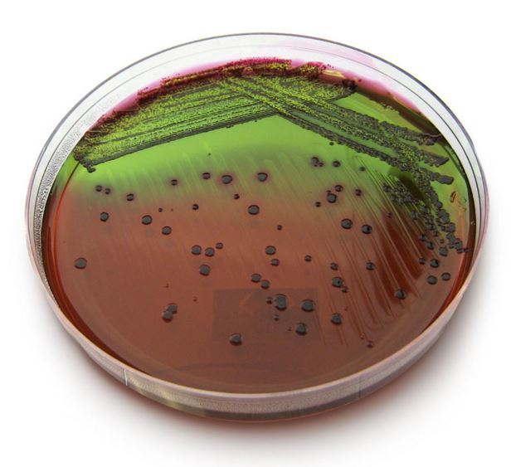
Selective media favor the growth of particular microorganisms.
Bile salts or dyes like basic fuchsin and crystal violet favor the growth of gram-negative bacteria by inhibiting the growth of gram-positive bacteria without affecting gram-negative organisms.
Endo agar, eosin methylene blue agar, and MacConkey agar three media widely used for the detection of E. coli and related bacteria in water supplies and elsewhere, contain dyes that suppress gram-positive bacterial growth

Slide 4
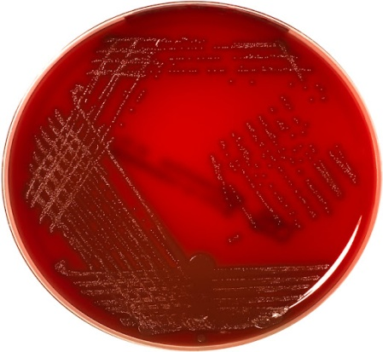
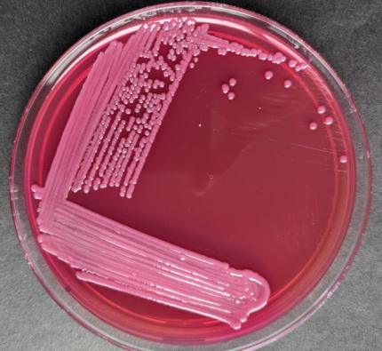
Differential media are media that distinguish between different groups of bacteria and even permit tentative identification of microorganisms based on their biological characteristics.
Blood agar is both a differential medium and an enriched one. It distinguishes between hemolytic and nonhemolytic bacteria. Hemolytic bacteria (e.g., many streptococci and staphylococci isolated from throats) produce clear zones around their colonies because of red blood cell destruction.
MacConkey agar is both differential and selective. Since it contains lactose and neutral red dye, lactose-fermenting colonies appear pink to red in color and are easily distinguished from colonies of non-fermenters.

