Slide 1
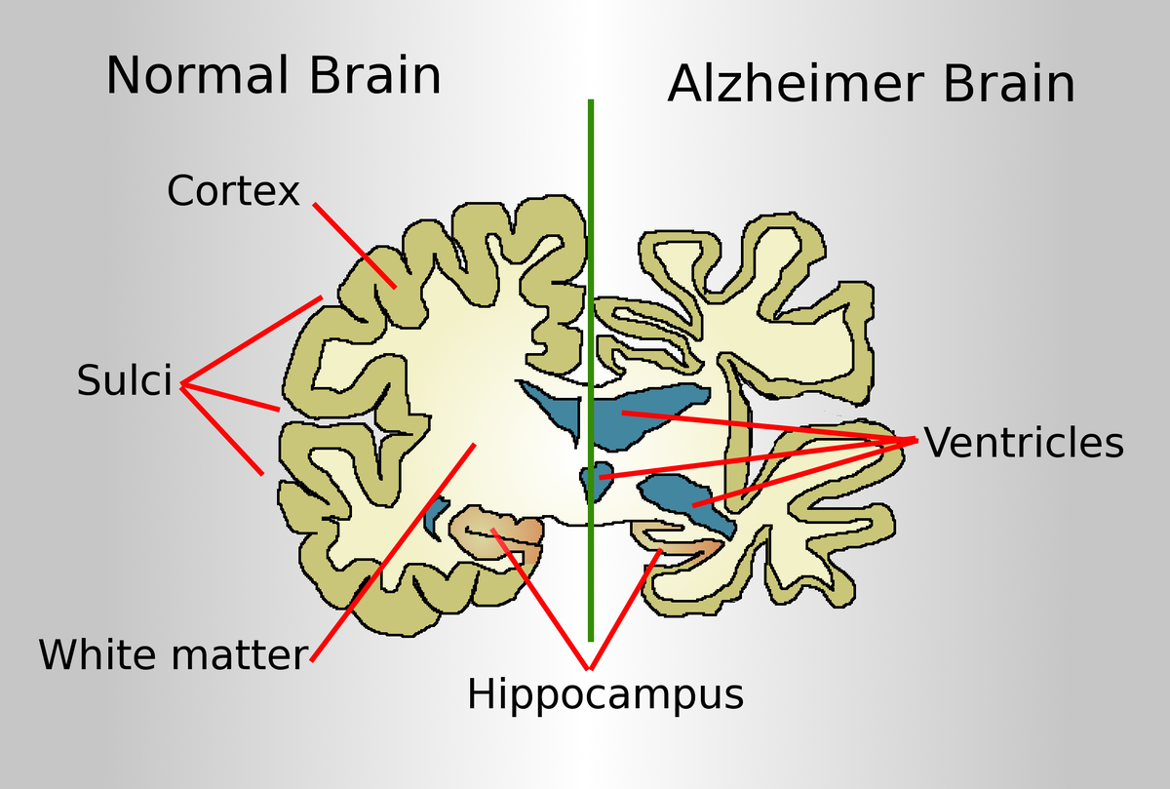
SCREENING MODELS FOR
ANTI-ALZHEIMER DRUGS
Notes:
Presented By :
Sangeeta Rajpoot

Slide 2
INTRODUCTION
Alzheimer’s disease is a neurodegenerative brain disorder.
It is the most common form of dementia.
It usually starts in late middle age or old age (above 50 years )
It is characterized by progressive memory loss.
Formation of Neurofibrillary tangles and plaques containing beta-amyloid cells.
SYMPTOMS
Loss of memory
Difficulty with communication
Behavioral changes
Difficulty in completing tasks.
Notes:
Presented By :
Sangeeta Rajpoot

Slide 3
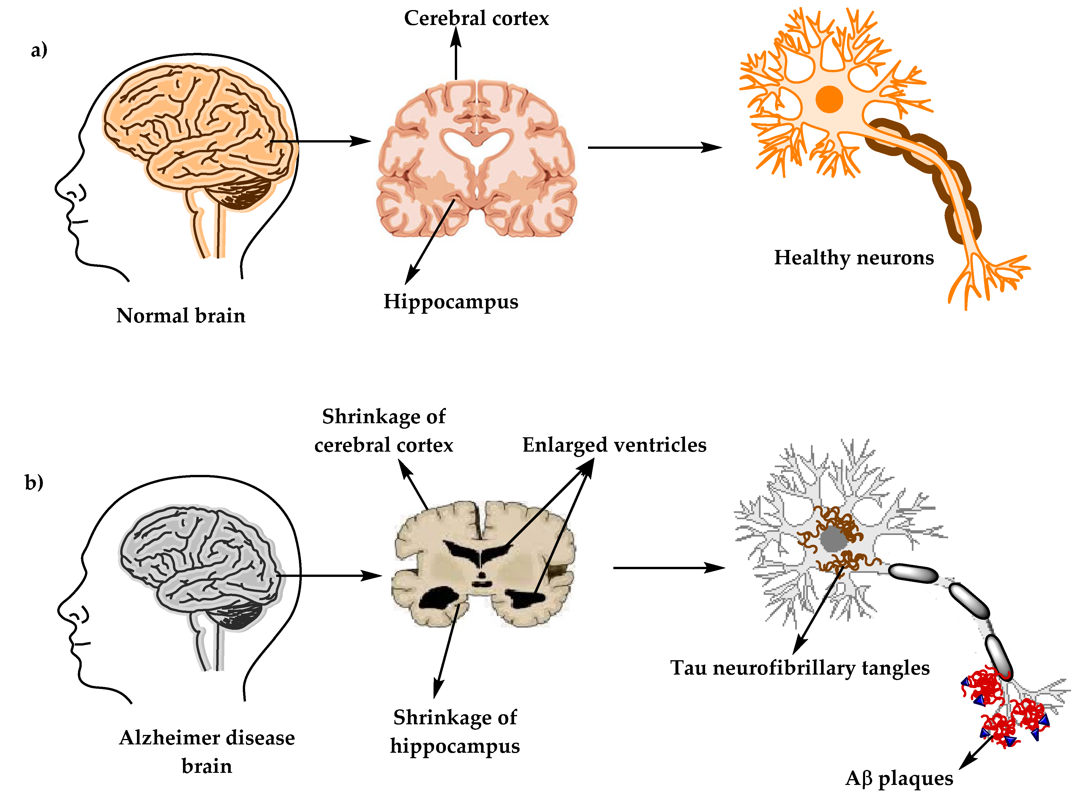
ETIOLOGY AND RISK
Strong genetic components.
Tobacco
Head-injury.
Hypertension.
Depression.
Obesity
Elevated serum cholesterol
Elevated serum homocysteine
Lack of intellectual stimulation/education
Notes:
Presented By :
Sangeeta Rajpoot

Slide 4
PATHOPHYSIOLOGY OF ALZHEIMER’S DISEASE
Notes:
Presented By :
Sangeeta Rajpoot

Slide 5
SCREENING MODELS
IN-VITRO
IN-VIVO
Notes:
Presented By :
Sangeeta Rajpoot

Slide 6
IN-VITRO SCREENING MODELS
In Vitro Inhibition of Acetylcholine Esterase Activity in Rat Striatum
2. In Vitro Inhibition of Butyrylcholine Esterase Activity in Human Serum
3. [3H]N-Methylscopolamine Binding in the Presence and Absence of Gpp (NH)p
4. Stimulation of Phosphatidylinositol Turnover in Rat Brain Slices
5. [3H]N-Methylcarbamylcholine Binding to Nicotinic Cholinergic Receptors in Rat Frontal Cortex
6. Uncompetitive NMDA Receptor Antagonism.
Notes:
Presented By :
Sangeeta Rajpoot

Slide 7
In Vitro Inhibition of Acetylcholine Esterase Activity in Rat Striatum
PURPOSE AND RATIONALE:
To screen drugs for inhibition of acetylcholine-esterase activity.
As it is generally accepted that the physiological role of AChE is rapid hydrolysis and inactivation of Ach.
Thus, inhibitors of of AChE show marked cholinomimetic effects in cholinergically -innervated effectors organs.
Recent studies have suggested that AChE inhibitors may be beneficial for the treatment of AD.
PROCEDURE:
1. Reagents:
a. 0.05 M Phosphate buffer, pH 7.2
b. Substrate in buffer(198 mg acetylthiocholine chloride)
c. DTNB in buffer (19.8 mg 5,5-dithiobisnitrobenzoic acid)(0.5mM)
d. A 2mM stock sol. of test, drug is made up of a suitable solvent and q.s to volume with 0.5mM DTNB. Drugs are serially diluted(1:10) such that the final conc. In the cuvette is 10-4 M and screened for the activity.
Notes:
Presented By :
Sangeeta Rajpoot

Slide 8
2. TISSUE PREPARATION:
I. Rat are decapitated
↓
II. Brains are rapidly removed, corpora raita dissected free
↓
III. Weighed and homogenized in 19 volumes (approx. 7 mg protein/ml) of 0.05 M nah2 PO4, pH 7.2.
↓
IV. 25μl aliquot of this suspension is added to 1ml of the vehicle and various concentrations of test drugs are prepared.
↓
V. Reincubated for 10 min at 37⁰c.
Notes:
Presented By :
Sangeeta Rajpoot

Slide 9
Inhibition of butyrylcholine-esterase activity in human serum:
Purpose and Rationale:
This method is used in conjunction with the acetylcholine-esterase assay to determine the enzyme selectivity of various cholinesterase inhibitors.
Butyrylcholine-esterase preferentially hydrolyses butyrylcholine.
This enzyme is found in the highest amount in serum, but its physiological role is not known.
Ethopropazine and Tetra-Isopropyl Pyrophosphoramide (ISO-OMPA) are selective inhibitors of 110% butyrylcholinesterase.
Notes:
2. INHIBITION OF BUTYRYLCHOLINE-ESTERASE ACTIVITY IN HUMAN SERUM:

Slide 10
Procedure:
Reagents:
0.05 M Phosphate buffer, ph 7.2
Substrate in buffer (225.8 mg s- butyrylthiocholine chloride)
DTNB in buffer (19.8 mg 5,5-dithiobisnitrobenzoic acid) (0.5mM)
A 2mM stock sol. of test drug is made up in a suitable solvent and q.s to volume with 0.5mM DTNB. Drugs are serially diluted(10) such that determined from the inhibitory activity of subsequent conc.
Notes:
2. INHIBITION OF BUTYRYLCHOLINE-ESTERASE ACTIVITY IN HUMAN SERUM:

Slide 11
2. ENZYME PREPARATION:
A VIAL OF LYOPHILIZED HUMAN SERUM
↓
RECONSTITUTED IN 3ML OF DISTILLED WATER
↓
25 ml ALIQUOT OF THIS SUSPENSION
↓
ADDED TO 1ml OF THE VEHICLE & VARIOUS CONC. OF TEST DRUGS ARE PREPARED
↓
PRE-INCUBATE FOR 10MIN AT 37⁰C.
Notes:
2. INHIBITION OF BUTYRYLCHOLINE-ESTERASE ACTIVITY IN HUMAN SERUM:

Slide 12
3. EVALUATION:
For IC 50 determinations: Substrate conc. is 10 mM diluted 1:2 in an assay yielding a final conc. of 5 mM.
DTNB conc. is 0.5 mM yielding 0.25 mM final concentration.
% Inhibition= slope control - slope drug x 100
slope control
IC 50 values are calculated from the log-probit analysis.
Notes:
2. INHIBITION OF BUTYRYLCHOLINE-ESTERASE ACTIVITY IN HUMAN SERUM:

Slide 13
IN-VIVO SCREENING MODELS
IN-VIVO MODELS
Passive Avoidance
Active Avoidance
Two\compartment Test
Jumping Avoidance (One-Way Shuttle Box)
Step Down
Step Through
Scopolamine induced amnesia in mice
Up Hill Avoidance
Shuttle Box Avoidance
(Two-Way Shuttle Box)
Notes:
Presented By :
Sangeeta Rajpoot

Slide 14
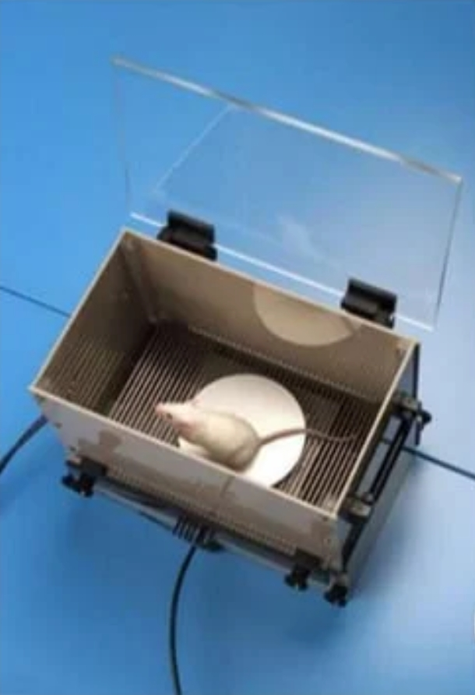
1. STEP-DOWN:
Purpose and Rationale:
An animal(mouse or rat) in an open spends most of the time close to the walls and in corners.
When placed on an elevated platform in the center of a rectangular compartment, it steps down almost immediately to the floor to explore the encloser and approach the wall.
This technique is employed in different modifications.
Notes:
2. INHIBITION OF BUTYRYLCHOLINE-ESTERASE ACTIVITY IN HUMAN SERUM:

Slide 15
PROCEDURE:-
REQUIREMENTS:
a) Mice or rats of either sex are used.
b) A rectangular box (50×50) with an electrifiable grid floor of 35 fits over the
block.
c) Grid floor is connected to the shock device.
A typical paradigm consists of:
a) Familiarization
b) Learning
c) Retention test

Slide 16
A) FAMILIARIZATION:
Animal is placed on the platform
Released after raising the cylinder
After 10 seconds of exploration, it is returned to the home cage
Latency to descend is measured

Slide 17
B) LEARNING:
Immediately the animal has descended from the platform
An avoidable shock is applied(foot shock: 50Hz: 1.5 mA; 1 sec
Animal is returned to the home cage

Slide 18
C) RETENSION TEST:
24 hrs after the learning trail
The animal is again placed on the platform
The test is finished when the animal steps down or remains on the platform(cut-off time:60 sec)
step-down latency is measured

Slide 19
EVALUATION:
The time of descent during the learning phase and the time during the retention test is measured.
A prolongation of the step-down latency is defined as learning.
Notes:
2. INHIBITION OF BUTYRYLCHOLINE-ESTERASE ACTIVITY IN HUMAN SERUM:

Slide 20
2. SCOPOLAMINE-INDUCED AMNESIA
IN MICE:
Purpose and Rationale:
The administration of anti-muscarinic agent scopolamine to young human volunteers produces transient memory deficits.
Similarly, scopolamine impairs memory retention when given to mice.
The ability of different cholinergic drug agonists to reverse the amnesic effects of scopolamine is now well documented in animal and human volunteers.
Notes:
2. INHIBITION OF BUTYRYLCHOLINE-ESTERASE ACTIVITY IN HUMAN SERUM:

Slide 21
PROCEDURE:
The scopolamine test is performed in groups of 10 male NMRI mice weighing 26-32 g in one trial
↓
Five min after I.P. administration of 3mg/kg of scopolamine hydrobromide.
↓
Each mouse is placed individually in the bright part of two chambered apparatus.
↓
After a brief orientation period, the mouse enters the second or darker chamber.
↓
Once inside the second chamber, the doors are closed to avoid escape.
↓
A 1 mA, 1-sec foot shock is applied through the grid floor.
↓
The mouse then returns to the home cage.
↓
Notes:
2. INHIBITION OF BUTYRYLCHOLINE-ESTERASE ACTIVITY IN HUMAN SERUM:

Slide 22
24 hrs. later, testing is performed by placing the animal again in the bright chamber.
↓
The latency in entering the dark chamber within 5 min test session is measured electronically.
↓
Whereas, untreated control animals enter the darker chamber in the second trial with a latency of about 250sec.
↓
Treatment with scopolamine reduces the latency to 50 sec.
↓
Test compounds are administered 90 min before training.
↓
The prolonged latency indicates that the animal remembers that it has been punished and, therefore, avoids the darker chamber.
Notes:
2. INHIBITION OF BUTYRYLCHOLINE-ESTERASE ACTIVITY IN HUMAN SERUM:

Slide 23
EVALUATION:
After treatment with various doses of test drug latencies obtained were expressed as % latencies.
In some cases, a straight dose-response curve is obtained whereas with other drugs inverse U-shaped dose responses are observed.
Notes:
2. INHIBITION OF BUTYRYLCHOLINE-ESTERASE ACTIVITY IN HUMAN SERUM:

