Slide 1
Coordination and balance
Aakanksha Bajpai
Assistant Professor
School of Health Sciences

Slide 2
Coordination
The ability to select the right muscle at the right time with proper intensity to achieve proper action.
The ability to execute smooth accurate motor response depends on:
Deep sensations.
Vision.
Vestibular system and cerebellum.
Motor system.
Flexibility and ROM.

Slide 3
Coordination
Dexterity: skillful use of the fingers during line motor tasks.
Agility: the ability to rapidly and smoothly initiate, stop, or modify movement while maintaining postural control.
Visual-motor coordination: refers to the ability to integrate both visual and motor abilities with the environmental context to accomplish a goal.

Slide 4
Co-ordination exercises
Goals
Develop the ability to reproduce automatic motor behavior that is faster, more precise , and stronger than movement.
Enhancing proprioceptive feedback and visual guidance .

Slide 5
Balance
The dynamic process by which the body’s position is maintained in equilibrium.
Equilibrium means that the body is either at rest (static equilibrium) or in steady-state motion (dynamic equilibrium).
The body’s center of gravity (COG) is maintained over its base of support (BOS).

Slide 6
Center of Gravity (COG)
It is an imaginary balancing point where the body weight can be assumed to be concentrated and equally distributed.
Ant. 2nd sacral vertebra (adult)

Slide 7
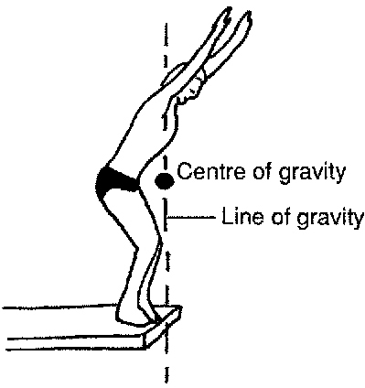
Line of Gravity (LOG)
The vertical line passing through the COG called Line of Gravity (LOG).

Slide 8
The boundaries of the contact area between the body & its support surface.
Base of Support (BOS)

Slide 9
Co-ordination exercises
Principles of co-ordination exercises
It is a carefully planned series of exercises designed to overcome incoordination & proprioception loss by visual and auditory feedback.
Improving attention to and accuracy of movement performance will be reflected on efficacy and correctness of functional activities.

Slide 10
Mechanism of Neuromuscular Coordination
The motor pathway: the action of each muscle group is determined by the afferent impulses which reach it by the motor pathways.
The cerebral cortex: Voluntary movement is initiated in response to sensory stimulus. An initiation Centre exists in the brainstem which alerts the cerebral cortex which then is responsible for planning the pattern of movement. This plan is based on memories of patterns used on previous occasions.

Slide 11
The Cerebellum: The Cerebellum is a receiving station of information which reaches it by the afferent pathways conveying impulses of kinesthetic sensation from the periphery and from other parts of the brain.
Kinesthetic sensation: The afferent impulses of kinesthetic sensation arise from proprioceptors situated in muscles, tendons and joints and they record contraction or stretching of muscle and the knowledge of movement and position of limbs.

Slide 12
Incoordination
Interference with the function of any one of the factors which contribute to the production of a coordinated movement will result in jerky, arrhythmic or inaccurate movement which is said to be in coordinated.
Four main types of incoordination based on the location of lesion causing it.
1. Incoordination associated with weakness or flaccidity of a particular muscle group.
Lesion of LMN prevents appropriate impulses from reaching the muscles or the condition of the muscles modifies their normal reaction to these impulses.

Slide 13
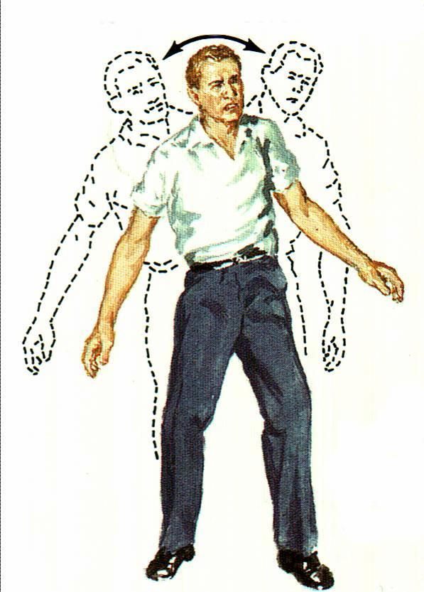
2. Incoordination associated with spasticity of the muscles.
- Lesion affecting the motor area of the cerebral cortex or the UMN .
3. Incoordination resulting from cerebellar lesions
- Generally known as cerebellar ataxia where movement is irregular and swaying with a marked intention tremor.

Slide 14
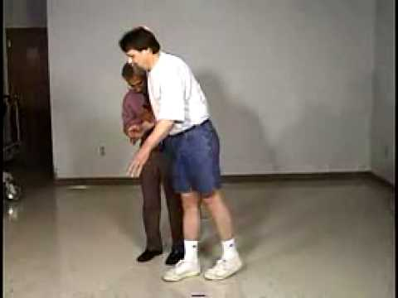
4. Incoordination resulting from loss of kinesthetic sensation
Sensory ataxia
Here the patient is completely unaware of the position of the body in space or of the position of joints.
Hypotonic muscles and sensation of fatigue present.

Slide 15
Re-education
Principles of re-education
1.Weakness or flaccidity of a particular muscle group
Treatment is designed to correct imbalances by emphasis on the activity of weak or ineffective muscles and to restore the normal integrated action of muscles in the performance of pattern of functional movement.
This is achieved most successfully by slow reversal techniques with normal timing.

Slide 16
2. Spasticity of muscles
Treatment is designed to promote relaxation, to stimulate effort, to give confidence in the ability to move and to train rhythm.
3. Cerebellar ataxia
The aim of treatment is to restore stability of the trunk and proximal joints to provide a stable background for movement.
4. Loss of kinesthetic sense
Substitution of the sense of sight to compensate for the loss of the kinesthetic sense forms the basis of re-education.
Exercises based on Frenkel’s principles are used to train smooth movement and precision.

Slide 17
Co-ordination exercises
Vision is essential in teaching the patient with proprioception deficiency the accurate coordinated purposeful movements.
Therapist’s command should be informative, clear and rhythmic.
Patient attention and focusing in each exercise is an essential issue.

Slide 18
Co-ordination exercises
Frenkel’s Exercises:
Is a group of graduated exercises applied for the LL and designed to overcome the in coordination and proprioception loss by visual feedback.
Principles:
Four basic positions should be used:
supine, sitting, standing or walking.

Slide 19
Co-ordination exercises
Frenkel’s Exercises principles :
Start unilateral then bilateral.
Start fast then slow movement.
Start by proximal then by distal joints.
Start by symmetrical then asymmetrical movement.
The patient must see the movements and verbal feedback is very important.

Slide 20
Four Basic position
Lying
Sitting
Standing
Walking

Slide 21
A. Lying Position
Starting position:
Lie on a bed with a smooth surface along which the feet maybe moved easily. Your head should be raised on a pillow so that you can watch every movement.

Slide 22
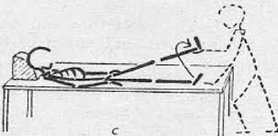
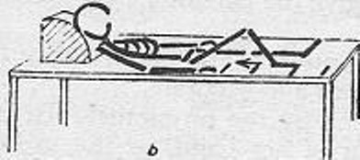
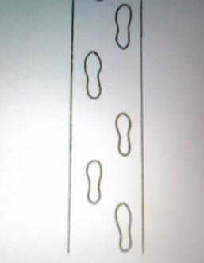
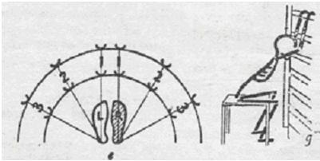

Slide 23
B. Sitting Position
Starting position:
Sit on a chair with feet flat on the floor.
2) Make two cross marks on the floor with chalk. Alternately glide the foot over the marked cross: forward, backward, left and right.
1) Raising just the heel. Then progress to alternately lifting the entire foot and placing the foot firmly on the floor upon a traced foot print.
3) Learn to rise from the chair, at one, bend trunk forward; at two, rise by straightening the hips and knees and then the trunk. Reverse the procedure to sit down.

Slide 24
C. Standing Position
Starting position:
Stand erect with feet 4 to 6 inches apart between parallel bars.
3) Learn how to move one limb sideway & forward while standing on the other limb to specific target (lines or foot print)
2) Learn how to move one limb sideway & forward while standing on the other limb
1) Weight Shift

Slide 25
D. Walking Position
Starting position:
Stand erect with feet 4 to 6 inches apart.
4) Turn to the right. At one, raise the right toe and rotate the right foot outward, pivoting on the heel; at two, raise the left heel and pivot the left leg inward on the toes; at three, completing the full turn, and then repeat to the left.
3) Walk forward placing each foot on a footprint traced on the floor. Foot prints should be parallel and 2 inches from a center line. Practice with quarter steps, half steps, three-quarter steps, and full steps.
5) Walk up and down the stairs one step at a time. Place the right foot on one step and bring the left up beside it. Later practice walking up the stairs placing one foot on each step. At first use the railing, then as balance improves, dispense with the railing.
1) Walk sideways beginning with half steps to the right. Perform this exercise to a counted cadence: At one, shift the weight to the left foot, at two, place the right foot 12 inches to the right; at three, shift the weight to the right foot; at four, bring the left foot over to the right. Repeat exercise with half steps to the left. The size of the step taken to right or left may be varied.
2) Walk forward between two parallel line 14 inches apart placing the right foot just inside the right line, and the left foot just inside the left line. Emphasize correct placement. Rest after 10 steps.

Slide 26
Balance Training
Static balance control
Maintaining sitting.
Half-kneeling,
Tall kneeling,
Standing postures on a firm surface,
Tandem, Single-leg stance.
Squat positions
Working on soft surfaces (e.g., foam, sand, grass),
Narrowing the BOS, moving the arms, or closing the eyes.

Slide 27
Balance Training
Balance training with Perturbation:
Perturbations to balance can be either internal or external.
The COG follows the moving body parts.
Learning adaptation: characterized by a significant reduction in the reactive response.

Slide 28
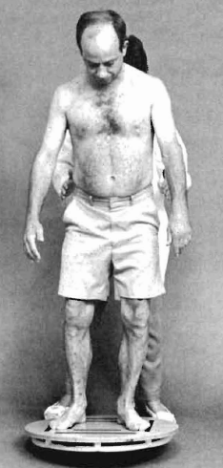
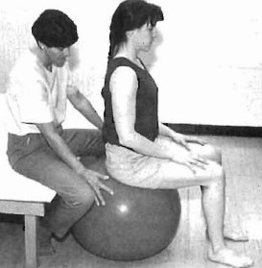
Balance Training
Dynamic Balance Exercises Using Movable Surfaces:
Swiss Ball
Tilt Boards

Slide 30
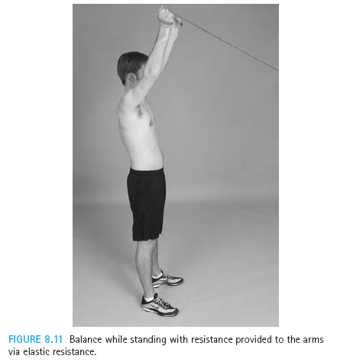
Balance Exercise

Slide 31
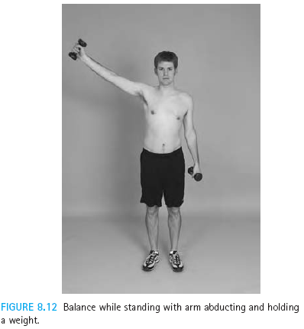

Slide 32
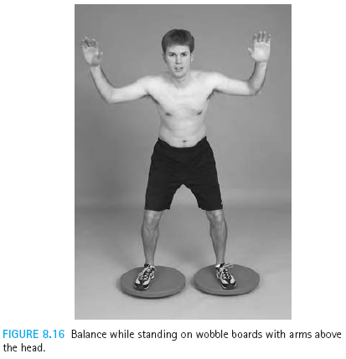

Slide 33
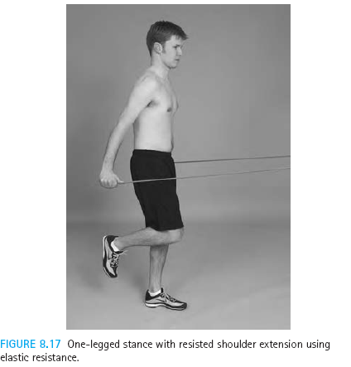

Slide 34
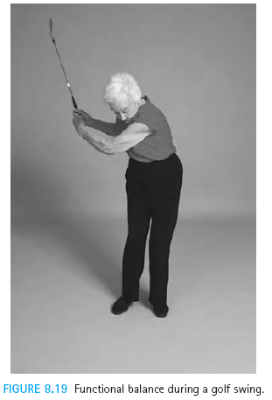

Slide 35
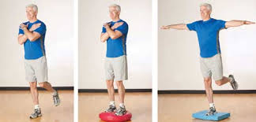

Slide 36
THANK YOU

