Slide 1
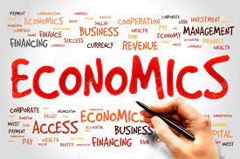
Demand- Meaning and Determinants
Dr. Pooja Singh Assistant Professor, Department of Economics, School of Arts Humanities And Social Sciences, Chhatrapati Shahu Ji Maharaj University, Kanpur

Slide 2
Demand- Meaning
Demand- Meaning and Determinants
Desire to buy
Ability to buy
Willingness to buy
Demand

Slide 3
Demand- Meaning and Determinants
Demand is the mother of production
Demand may be defined as “ the quantity of goods or services desired by an individual, backed by the ability and willingness to pay”.

Slide 4
Types of Demand
Demand- Meaning and Determinants
Individual- The quantity of a commodity which an individual is willing to buy at a particular price during a specific time period, given his money income, his taste and price of other commodities is called individual’s demand for commodity.
Market Demand- The quantity which all the consumers of a commodity are willing to buy at a given price per time unit, given their money income, his taste and price of other commodities is called individual’s demand for commodity.
Firm’s Demand- The quantity of a firm’s product that can be disposed of at a given price over a time period.
Industries Demand- The aggregate of demand for the product of all the firms of an industry.
Autonomous Demand- Arises on its own due to natural desire to consume or possesses a commodity
Derived Demand- Arises because of the demand for some other commodity.

Slide 5
Demand- Meaning and Determinants
Demand for Durable goods : Goods that does not quickly wear out or, more specifically, one that yields utility over time rather than being completely consumed in one use.
Non- Demand for Durable goods: Goods that are immediately consumed in one use or ones that have a lifespan of less than three years.
Short term Demand- Demand for goods that are demanded over a short period
Long term Demand- Demand which exists over a long period.
Price Demand- The amount of a commodity which a person is willing to purchase at a particular price.
Income Demand- The amount of a commodity which a person would purchase at a given level of income.
Cross Demand- When demand of a commodity depends not on its own price but also on the price of other commodity.

Slide 6
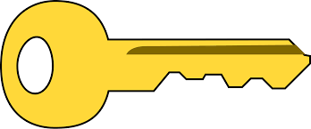
Key Points
Demand- Meaning and Determinants
In oligopolistic market structure, a distinction between the demand for a firms' product and for the industry’s product is useful from the managerial point of view
Autonomous demand is also known as direct demand
Demand for complementary or supplementary goods is derived demand.
Durable goods create replacement demand whereas non durable goods do not
Demand of superior goods is directly related to income but in case of inferior goods this relationship is inverse.

Slide 7
Determinants of Demand
Demand- Meaning and Determinants
Climatic Conditions
Price of product
Government Policies
Determinants
Demographic Conditions
Price of related goods
Wealth of a consumer
Consumer’s Income
Taste & Preferences of consumer

Slide 8
References
Demand- Meaning and Determinants
Dwivedi D N, Managerial Economics, Vikas Publishing House Pvt. Ltd, 2006

