Slide 1
Dr. Pooja Singh Assistant Professor, Department of Economics, School of Arts, Humanities And Social Science, Chhatrapati Shahu Ji Maharaj University, Kanpur
Law of Equi-Marginal Utility

Slide 2
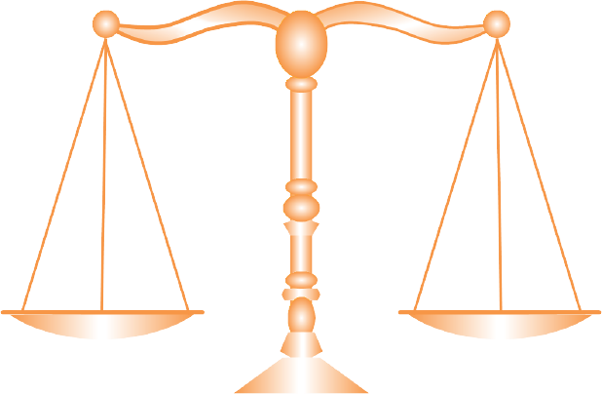
Law of Equi-Marginal Utility
Law of Equi-Marginal Utility
Propounded by Hermann Heinrich Gossen (1810-1858)
Marginal Utility from A
Marginal Utility from B
A
B
Also Known as Law of Substitution or Law of Mximum Satisfaction
Also Known as Gossen’s Second Law

Slide 3
Law of Equi-Marginal Utility
According to Marshall, 'If a person has a thing which can be put to several uses, he will distribute it among these uses in such a way that it has the same marginal utility in all’.
A consumer, generally is confronted with the problem of buying from among several goods and services, given his limited income.
This law explains the behavior of a consumer in distributing his limited income among various goods and services as to obtain maximum satisfaction.
$$\frac{\text{MU}\text{X}}{\text{P}\text{X}}=\frac{\text{MU}\text{Y}}{\text{P}\text{Y}}$$
Where , MUx = Marginal Utility of Good x
MUy= Marginal Utility of Good y
Px = Price of Good x
Py = Price of Good y
MUm = Marginal Utility of Money
= MUm

Slide 4
Law of Equi-Marginal Utility
Assumptions-
The consumer should behave rationally.
He has full knowledge about the commodities i.e their attributes, price, etc. in the market.
Utility is measurable cardinally in terms of utils.
Commodities that are chosen are divisible and substitutable.

Slide 5
Law of Equi-Marginal Utility
For Example:
A man purchases two goods X and Y whose prices are P_{X} and P_{Y}, respectively.
By purchasing these combinations of X and Y (= Rs. 4 x 5 + Rs. 5 x 3) gets maximum satisfaction [10 + 9 + 8 + 7 + 6] + [11 + 10 + 6] = 67 units.
Purchase of any other combination other than this involves lower volume of satisfaction.
Unit Consumed | MU_{x} | MU_{y}
1 | 40 | 55
2 | 36 | 50
3 | 32 | 30
4 | 28 | 20
5 | 24 | 15
6 | 20 | 5
Unit Consumed | $$\frac{\text{MU}\text{X}}{\text{P}\text{X}}$$ | $$\frac{\text{MUY}}{\text{PY}}$$
1 | 10 | 11
2 | 9 | 10
3 | 8 | 6
4 | 7 | 4
5 | 6 | 3
6 | 5 | 1
Let P_{x}= 4
Let P_{y}= 5

Slide 6
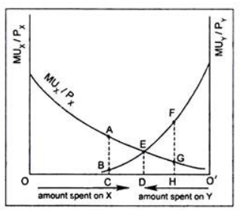
Law of Equi-Marginal Utility
consumer maximizes his total utility by spending OD amount on good X and O’D amount on good Y.
the consumer equalizes marginal utilities per rupee spent on X and Y at point E (i.e., MU_{X}/P_{X} = MU_{Y}/P_{Y} = ED).
No other combination will give greater satisfaction.

Slide 7
Limitations-
The law of equi-marginal utility is based on the measurability of utility in cardinal numbers.
This law assumes that the consumer acts rationally.
No consumer, in fact, purchases commodity in accordance with this principle of substitution.
This law cannot be applied in the case of indivisible commodities like motor car, refrigerator, etc. Since these commodities are not divisible into smaller units, the law may seem to be inoperative.

Slide 8
References
Dwivedi D N, Managerial Economics, Vikas Publishing House Pvt. Ltd, 2006

