Slide 1
Nature of demand curve
Dr. Pooja Singh Assistant Professor, Department of Economics, School of Arts ,Humanities And Social Science, Chhatrapati Shahu Ji Maharaj University, Kanpur

Slide 2
Nature of demand curve
Nature of demand curve
Nature
Movement Along the Demand Curve
Extension in Demand
Contraction in Demand
Shifting of the Demand Curve
Increase in Demand
Decrease in Demand

Slide 3
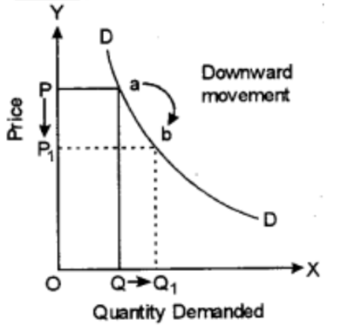
Movement Along the Demand Curve-
Nature of demand curve
Extension in demand –
Other’s things being equal, when the price of the commodity falls, quantity demanded of the commodity will increase this is extension or expansion in demand.

Slide 4
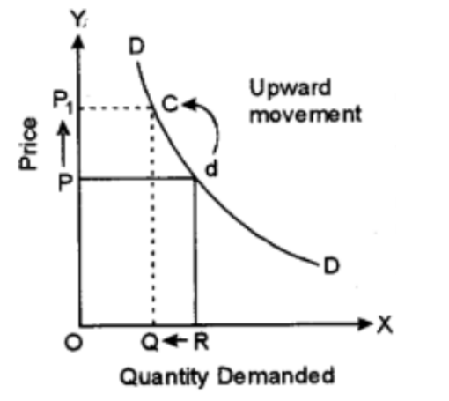
Nature of demand curve
Contraction in Demand –
Other thing equal, when the price of a commodity rises, the quantity demanded falls. This situation is known as contraction in demand.

Slide 5
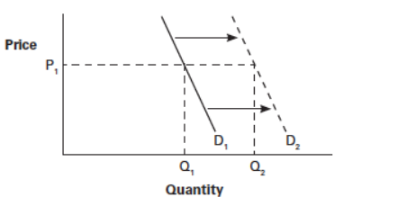
Shift of Demand Curve-
Nature of demand curve
Increase in demand-
When demand for a commodity increase because of favourable change in its determinants and no change in its price, it is called increase in demand. In this case, demand curve shifts to the right from the original curve.

Slide 6
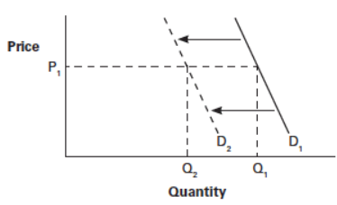
Nature of demand curve
Decrease in demand-
When demand for a commodity decreases because of change in determinants but no change in price it is called decrease in demand. In this curve demand curve shift towards left from original curve.

Slide 7
Difference Between Movement Along Demand Curve and Shifting Demand Curve
Nature of demand curve
Basis | Movement along demand curve | Shifting demand curve
Meaning | It refers to association when demand curve moves along the same curve up and down | It is association when a demand of a commodity changing resulting a shift in the demand curve
Concepts | There are two concepts under this extension in demand and contraction in demand. | There are also two concepts under this increase in demand and decrease in demand
Cause | Change in price of the commodity is the cause for the movement along the demand curve. | Change in various factor of demand other than price of the commodity are the cause for shift in demand
Assumptions | All the factors influencing demand accept price of the commodity are assumed to remain constant | Price of the commodity is assumed remain constant
Other names | This is known as change in quantity demanded | This is also known as change in demand
Demand curve | There will be same demand curve on which the demand keeps moving | There will be different demand curve showing a shift upward and downward curve to the original curve

Slide 8
References
Nature of demand curve
Samuelson, Paul A; Nordhaus, William D. (2014). Economics. Boston, Mass: Irwin McGraw-Hill
Dwivedi D N, Managerial Economics, Vikas Publishing House Pvt. Ltd, 2006

