Slide 1
OpEN EDucatIon
Anupama Yadav ,Assistant Professor, Department of Education ,Chhatrapati Shahu Ji Maharaj University,Kanpur

Slide 2
Topic
OpEN EDucatIon

Slide 3
Open Education
Open education is that form of distance education which is free from the bindings of formal education and the doors of which are open to all and in which multimedia approach is used.

Slide 4
Definition Of Open University
“Open university is the university viewed as an educational resources from which student of all ages may attain a degree by completing work at home by correspondence, by TV, by attending classes and than appearing for challenges”.
According to dictionary of education.

Slide 5
Characteristics Of Open Education/University
Flexibility
Quality Of Education
With the permission of self
Various programs
Easy access process
Home based education
Free system

Slide 6
Objectives Of Open University
Arrangement of access to higher education to the masses of those parts of country which are deprived of facilities.
To provide maximum equal opportunities to get higher education.
To introduce business workers to the new developments in their expert sector, as well as to provide them training during their time of service.

Slide 7
Contd…..
Helping learners who want to study new subjects and want to update their knowledge.
To provide educational facilities to the children at home at their work places, the child could also get education and also work.

Slide 8
Teaching Method Of Open Universities
1- Audio Visual-Aids
Radio
Doordarshan
Computer
Audio Visual Cassettes.
2- Printed Material
3- Student Study Centre

Slide 9
Work Procedure Of Open University
Students are continuously evaluated in this method.
Teachers are returned to the students with evaluated based text suggestion.
Contact lectures are organized for students. Contact lectures provide personal education to the students and their problems are addressed.

Slide 10
Contd……
In order to facilitate the students a study centre is set up in each area, in which the system of radio, TV and tape recorder etc is maintained.
To provide complete information about the subject matter, the students are provided with a text cassettes, video cassettes rental system.
The curriculum teachers the medium of teaching and accessories for the students themselves.

Slide 11
Contd….
In all the courses, students must be present in the study centers for a week or two weeks or attendance is mandatory for B.ed and M.ed courses.

Slide 12
Establishment Of Open Universities In India
Indra Gandhi National Open University, 1985, New Delhi.
Dr. B. R. Ambedkar University, 1982, Hydrabad.
Vardhman Mahavir Open University Open University, 1987, Kota, Rajasthan.
Nalanda Open University, 1987, Patna, Bihar.
Yashwant Rao Chahhar Open University, 1989, Maharastra.

Slide 13
Contd…
Madhya Pradesh Bhoj Open University, 1991, MP.
Dr. Baba Sahib Ambedkar Open University, 1994, Gujarat.
Karnataka State Open University, 1996, Karnataka.
Neta Ji Subhash Open University, 1997, Kolkata.

Slide 14
Contd…..
Uttar Pradesh Rajshri Tandon Open University, 1998, UP.
Tamilnadu Open University, 1992, Chennai, Tamilnadu.
Pt. Sunder Lal Sharma Open University, 2005, Chhattisgarh.
Uttrakhand Open University, Uttaranchal.
Krishnakant Handaki Open University, Assam.
Global Open University.

Slide 15
Advantages Of Open Universities
The choice of public curriculum succeeds in better knowledge by conforming to its interest and qualification.
Higher education is spreading rapidly in the country.
Due to limited selected entrance, qualitative improvement in the level of higher education has been possible.
Higher education for women and men deprived of education is open to them.

Slide 16
Contd…..
Open Universities are also providing to be beneficial for the area on social economic reforms.

Slide 17
Problems Of Open Education and Remedies
Lack of able teachers of open education
Problem of construction of suitable material
Problem of broadcast of study material
Problem of unsuitability of study centers
Problem of execution contact programs

Slide 18
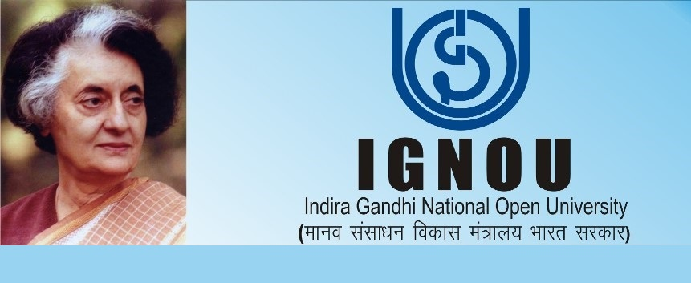
Indira Gandhi National Open University

Slide 20
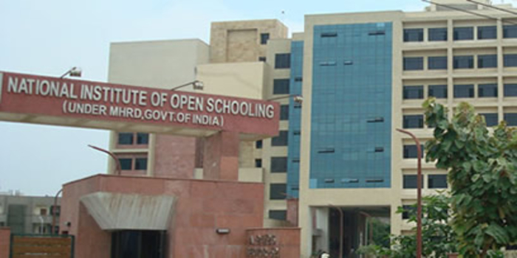
Headquarter : NIOS

Slide 21
SUGGESTIONS FOR OPEN UNIVERSITIES
Start a useful course for students.
They should be selected only after watching the authority of the teachers and their writing ability.
Teaching material should be prepared by the subjects experts.
Arrangements should be made to send material to the students on time.
Based on the answers received from the students, their problems should be resolved regularly.

