Slide 1
PN JUNCTION (ESC-S101) (Atul Kr. Agnihotri )

Slide 2
P-N Junction
We create a p-n junction by joining together two pieces of semiconductor, one doped n-type, the other p-type.

Slide 3
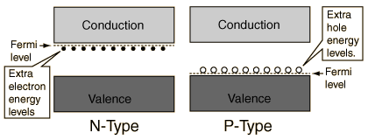
P-N Junction
In the n-type region there are extra electrons and in the p-type region, there are holes from the acceptor impurities .

Slide 4
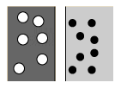
P-N Junction
In the p-type region there are holes from the acceptor impurities and in the n-type region there are extra electrons.

Slide 5
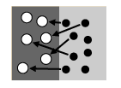
P-N Junction
When a p-n junction is formed, some of the electrons from the n-region which have reached the conduction band are free to diffuse across the junction and combine with holes.

Slide 6
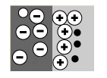
P-N Junction
Filling a hole makes a negative ion and leaves behind a positive ion on the n-side.
A space charge builds up, creating a depletion region.

Slide 7
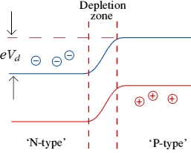
P-N Junction
This causes a depletion zone to form around the junction (the join) between the two materials.
This zone controls the behavior of the diode.

Slide 8
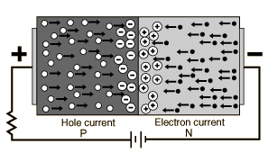
Forward Biasing
Forward biasing the p-n junction drives holes to the junction from the p-type material and electrons to the junction from the n-type material.

Slide 9
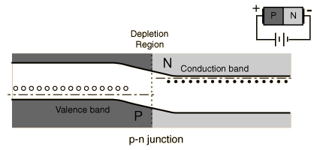
Forward Biasing
At the junction the electrons and holes combine so that a continuous current can be maintained.

Slide 10
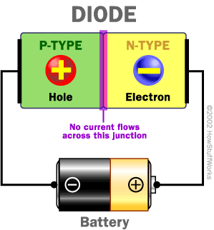
Diode
A diode is the simplest possible semiconductor device.

Slide 11
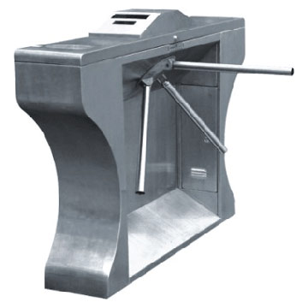
One Way Electric “Turnstile”
A diode allows current to flow in one direction but not the other.

Slide 12
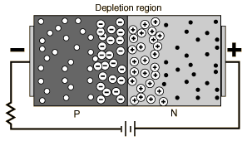
Reverse Biasing
The application of a reverse voltage to the p-n junction will cause a transient current to flow as both electrons and holes are pulled away from the junction.

Slide 13
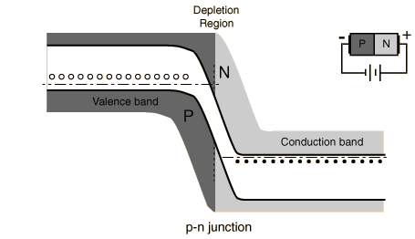
Reverse Biasing
When the potential formed by the widened depletion layer equals the applied voltage, the current will cease except for the small thermal current.

Slide 14
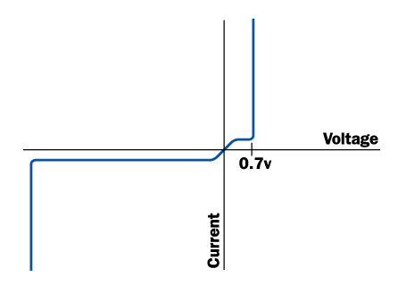
When forward-biased, there is a small amount of voltage necessary to get the diode going. In silicon, this voltage is about 0.7 volts.
This voltage is needed to start the hole-electron combination process at the junction.

Slide 15
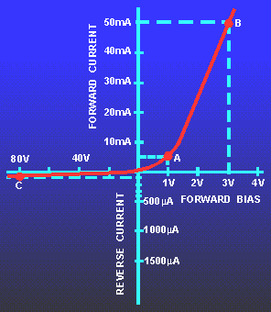
Diode Characteristic
When reverse-biased, an ideal diode would block all current. A real diode lets perhaps 10 microamps through -- not a lot, but still not perfect.

Slide 16
Diode Characteristic
Usually, the breakdown voltage is a lot more voltage than the circuit will ever see, so it is irrelevant.

