Slide 1
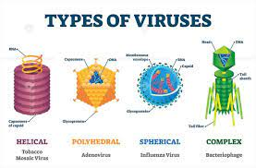
Viruses
Smallest unicellular organisms that are obligate intracellular.
Viruses are the most primitive microorganisms infecting man.

Slide 2
General properties
Obligate intracellular
Possess either DNA (deoxyribonucleic acid) or RNA (ribonucleic acid), but never both
Smaller than bacteria, can be passed through the bacterial filters
Cannot be grown on artificial cell free media (grow in animals, embryonated eggs or tissue culture)

Slide 3
Viruses differ from bacteria :-
Multiply by a complex method (not by binary fission).
Do not have a proper cellular organisation.
Do not have cell wall or cell membrane or cellular organelles including ribosomes
Lack the enzymes necessary for protein and nucleic acid synthesis. ­
Not susceptible to antibacterial antibiotics

Slide 4
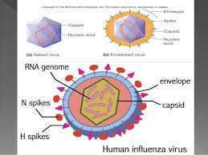
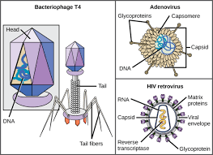
MORPHOLOGY OF VIRUS Nucleic acid
Nucleic acid may be single or double stranded, circular or linear, segmented or un-segmented.
Viruses are classified based on nucleic acid as DNA viruses and RNA viruses.

Slide 5
Capsid
Composed of a number of repeated protein subunits (polypeptides) called capsomeres.
Functions:
Protects the nucleic acid core from the external environment
In non-enveloped viruses - initiates the first step of viral replication.
Antigenic and specific for each virus.

Slide 6
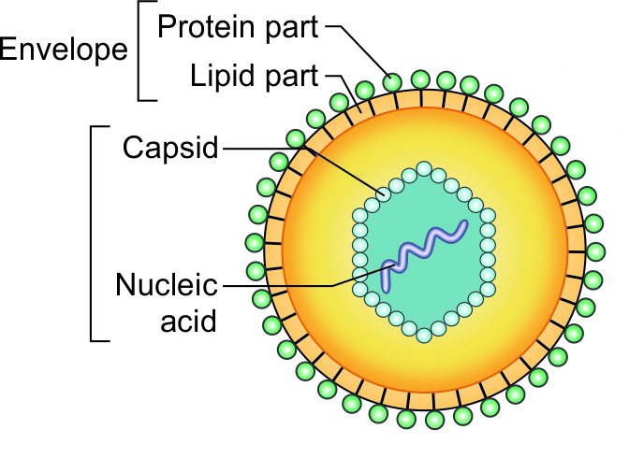
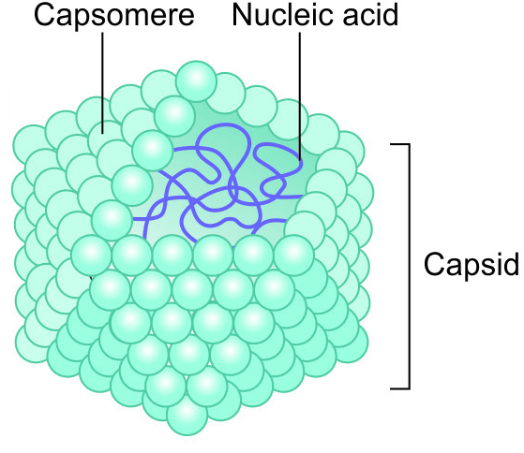
Symmetry – Based on arrangement of capsomeres
Type of symmetry | Explanation | Examples
Icosahedral (cubical) symmetry | Capsomeres are arranged as if they lay on the faces of an icosahedron 20 triangular facets and 12 corners or vertices Rigid structure. | All DNA viruses (except poxviruses) Most of the RNA viruses have icosahedral symmetry

Slide 7
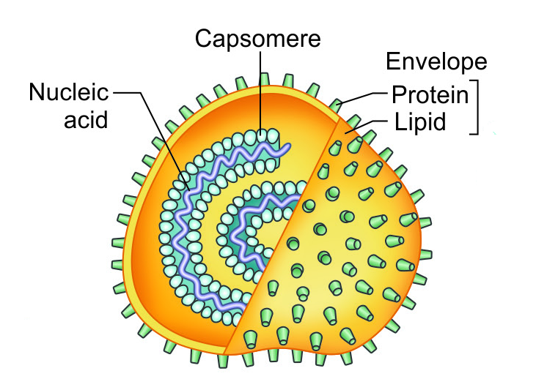
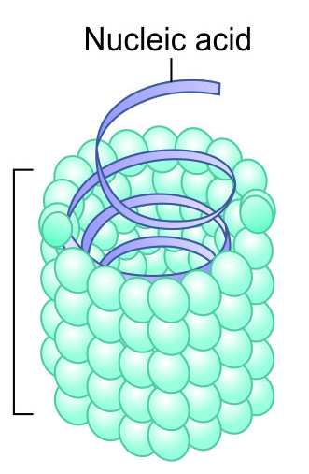
Symmetry – Based on arrangement of capsomeres
Type of symmetry | Explanation | Examples
Helical symmetry | Capsomeres are coiled surrounding the nucleic acid in the form of a helix or spiral. Flexible structure. | RNA viruses such as-myxoviruses, rhabdoviruses, filoviruses, bunyaviruses, etc.

Slide 8
Symmetry – Based on arrangement of capsomeres
Type of symmetry | Explanation | Examples
Complex symmetry | Do not have either of the above symmetry. | Poxviruses

Slide 9
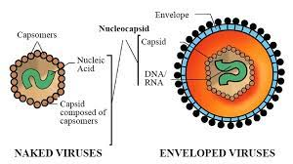
Envelope
Envelope surrounding the nucleocapsid.
Lipoprotein in nature.
Lipid part is derived from host cell membrane
Protein part is virus coded, made up of subunits called peplomers.
Peplomers - project as spikes on the surface of the envelope.

Slide 10
Envelope
More susceptible to heat and lipid solvents like ether
Antigenic - facilitates entry of the virus
More than one kind of peplomers can be seen in some viruses, e.g. Influenza viruses possess haemagglutinin and neuraminidase peplomers.

Slide 11
Envelope
Most viruses are enveloped except:
Non-enveloped DNA viruses- parvovirus, adenovirus and papovavirus
Non-enveloped RNA viruses-picornavirus, hepatitis A virus &hepatitis E virus.

Slide 12
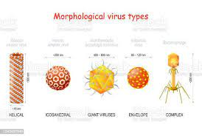
Size of the viruses
Size vary from 20-300nm in size.
Smallest virus - parvovirus(20 nm)
Largest - poxvirus (300nm).
Because of the small size, viruses can pass through bacterial filters and they cannot be visualized under light microscope.

Slide 13
Size of the viruses – Determined by
Electron microscope (best method)
Ultracentrifugation- Viral particles suspended in liquid medium when subjected to ultracentrifugation, will settle down at a sedimentation rate that is proportional to their size.
Passage through membrane filters of different pore sizes- The maximum pore size that prevents a virus to pass through multiplied by 0.64 yields the approximate diameter of the viral particle.

Slide 14
CLASSIFICATION
Family | DNA type | Envelope | Symmetry | Size (nm) | Representative Viruses
Herpesviridae | ds, linear | Yes | Icosahedron | 150-200 | Herpes simplex virus - 1 Herpes simplex virus- 2 Varicella-zoster virus Epstein-Barr virus Cytomegalovirus Human herpes virus 6,7 & 8
Hepadnaviridae | ds, circular, incomplete | Yes | Icosahedron | 40–48 | Hepatitis B virus
Parvoviridae | ss, linear | Absent | Icosahedron | 18–26 | Parvovirus B19
Papovaviridae | ds, circular | Absent | Icosahedron | 45-55 | Human papillomaviruses JC virus and BK virus
Poxviridae | ds, linear | Yes | Complex | 230 x 400 | Variola (smallpox) Molluscum contagiosum virus
Adenoviridae | ds, linear | Absent | Icosahedron | 70–90 | Human adenoviruses

Slide 15
CLASSIFICATION
RNA Viruses | RNA type | Envelope | Symmetry | Size(nm) | Representative Viruses
Picornaviridae | ss, +ve sense | Absent | Icosahedral | 28–30 | Poliovirus Coxsackievirus Echovirus Enterovirus Rhinovirus Hepatitis A virus
Caliciviridae | ss, +ve sense | Absent | Icosahedral | 27-40 | Norwalk agent Hepatitis E virus
Togaviridae | ss, +ve sense | Yes | Icosahedral | 50-70 | Rubella virus Eastern equine encephalitis virus Western equine encephalitis virus

Slide 16
CLASSIFICATION
RNA Viruses | RNA type | Envelope | Symmetry | Size(nm) | Representative Viruses
Flaviviridae | ss, +ve sense | Yes | Icosahedral (?) | 40-60 | Yellow fever virus Dengue virus St. Louis encephalitis virus West Nile virus Hepatitis C virus
Coronaviridae | ss, +ve sense | Yes | Helical | 120-160 | Coronaviruses
Rhabdoviridae | ss, -ve sense | Yes | Helical | 75x180 | Rabies virus Vesicular stomatitis virus
Filoviridae | ss, -ve sense | Yes | Helical | 80 x 1000 | Marburg virus Ebola virus

Slide 17
CLASSIFICATION
RNA Viruses | RNA type | Envelope | Symmetry | Size(nm) | Representative Viruses
Paramyxoviridae | ss, -ve sense | Yes | Helical | 150–300 | Parainfluenza virus Mumps virus Measles virus Respiratory syncytial virus Newcastle disease virus Metapneumovirus
Orthomyxoviridae | ss, -ve sense, 8 segments | Yes | Helical | 80–120 | Influenza viruses- A, B, and C
Bunyaviridae | ss, -ve sense, 3 circular segments | Yes | Helical | 80–120 | Hantavirus California encephalitis virus Sandfly fever virus

Slide 18
CLASSIFICATION
RNA Viruses | RNA type | Envelope | Symmetry | Size(nm) | Representative Viruses
Bunyaviridae | ss, -ve sense, 3 circular segments | Yes | Helical | 80–120 | Hantavirus California encephalitis virus Sandfly fever virus
Arenaviridae | ss, -ve sense, RNA,2 circular segments | Yes | Helical (?) | 50-300 | Lymphocytic choriomeningitis virus Lassa fever virus South American hemorrhagic fever virus
Reoviridae | ds, 10–12 segments | Absent | Icosahedral | 60-80 | Rotavirus Reovirus Colorado tick fever virus
Retroviridae | 2 identical copies of +ve sense ss RNA | Yes | Icosahedral (spherical) | 80-110 | HTLV (Human T Lymphotropic virus) HIV (Human immunodeficiency virus)

Slide 19
Adsorption/attachment
First and most specific step.
Involves receptor interactions.
Viruses have attachment sites on their envelopes or capsid proteins that bind to the complementary receptor sites present on the host cell surface.
HIV: Viral surface glycoprotein gp120binds toCD4molecules on the host cells.
Influenza: Viral hemagglutinin (an envelope protein) binds specifically to glycoprotein receptors present on the surface of respiratory epithelium.

Slide 20
Viral Replication
Viruses undergo a complex way of cell division.
Replication of viruses passes through six sequential steps:
1) Adsorption/attachment
2) Penetration
3) Uncoating
4) Biosynthesis
5) Assembly
6) Maturation
7) Release

Slide 21
Penetration
Mechanism | Explanation
Phagocytosis (viropexis) | Receptor mediated endocytosis
Membrane fusion | Some enveloped viruses (e.g. HIV) enter by fusion of their envelope proteins with the plasma membrane of the host cell so that only the nucleocapsid enters into the cytoplasm, whereas the viral envelope remains attached to the host cell membrane.
Injection of nucleic acid | Bacteriophages cannot penetrate the rigid bacterial cell wall, hence only the nucleic acid is injected while the capsid remains attached to the cell wall.

Slide 22
Uncoating
By the action of lysosomal enzymes of the host cells, the viral capsid gets separated and the nucleic acid is released into the cytoplasm.
Absent for bacteriophages.

Slide 23
Biosynthesis
Following viral components are synthesized:
Nucleic acid
Capsid protein
Enzymes required for various stages of viral replication
Regulatory proteins to shut down the host cell metabolism.

Slide 24
Site of Nucleic acid replication
DNA viruses: DNA replication occurs in the nucleus except in poxviruses, which synthesize DNA in the cytoplasm.
RNA viruses - RNA replication occurs in cytoplasm except in retroviruses and orthomyxoviruses, which synthesize RNA in the nucleus.

Slide 25
Assembly
Viral nucleic acid and proteins are packaged together to form progeny viruses (nucleocapsids).
Occurs in the host cell nucleus or cytoplasm.
DNA viruses are assembled in the nucleus except hepadnaviruses and poxviruses (in cytoplasm)
RNA viruses are assembled in the cytoplasm.

Slide 26
Maturation
Following assembly, maturation of daughter virions take place either in the nucleus or cytoplasm or membranes (golgi or endoplasmic reticulum or plasma membrane)

Slide 27
Release
Lysis of the host cells (non enveloped viruses and bacteriophages).
Budding through host cell membrane (enveloped viruses) - During budding, they acquire a part of the host cell membrane to form the lipid part of their envelopes.
Envelope is acquired either from plasma membrane (influenza virus) or from nuclear membrane (e.g. herpesviruses).
Viral glycoproteins are then inserted into the envelopes.
Excess viral glycoproteins are synthesized to saturate cell receptors so thatthe viruses will not stick to the host cell following release.

Slide 28
Eclipse phase
Defined as ‘interval between the penetration of the virus into the host cell till the appearance of first infectious virus progeny particle’.
During this period, the virus cannot be demonstrated inside the host cell.
Duration -15 to 30 minutes for bacteriophages and 15-30 hours for most of the animal viruses.

Slide 29
References
Textbook of Medical Microbiology by Ananthnarayan, Paniker
Textbook of Medical Microbiology by C.P Baweja
Textbook of Medical Microbiology by S. Bhat, A.S.Sastry
Textbook of Medical Microbiology by D.R.Arora, Brij bala Arora

