Slide 1
BP504 T. PHARMACOGNOSY AND PHYTOCHEMISTRY II (Theory)
UNIT-II
General introduction, composition, chemistry & chemical classes, biosources, therapeutic uses and commercial applications of following secondary metabolites:
Iridoids, Other terpenoids & Naphthaquinones
Gentian (Bitter glycosides)
Artemisia (SESQUITERPENOIDS)
Taxus (DI TERPENOIDS)
Carotenoids

Slide 2
Iridoids
Previously called as pseudoindicanes or aucubinoides
Also referred to as aucubin glucosides, from acuba japonica (cornaceae)
Iridoids name: iridomyrmex- genus of ants,
also pseudoindicans- due to blue coloration
They are highly oxygenated monoterpenes- represented by cyclopenta(α)-pyran ring
monoterpenoids- found as glucosides, have Alpha pyran ring
1st Iridoid: verbanalin- from cornus (cornaceae), 1835
O. Halpern & H. Schmid – basic skeleton

Slide 3
Iridoids
Iridoid glycosides are divided in 5 subgroups:
Iridoid glycosides of 8-C basic skeleton
Iridoid glycosides of 9-C basic skeleton
Iridoid glycosides of 10-C basic skeleton
Iridoid glycosides of 14 –C basic skeleton or Iridoid glycosides of plumeria type
Alkaloid conjugated iridoid glycoside

Slide 4
Iridoids
Classification: Broadly classified into 5 groups
Iridoid glycosides
Iridoid aglycones
Non glycosides Iridoids
Secoiridoid glycosides
Secoiridoid aglycones
Di & trimeric iridoids

Slide 5
Bitter Glycosides
Class of compounds plays important role in digestive process.
Used as Stomachics, Febrifuges, bitter tonics, digestive problems
Taste of bitter foods stimulates the appetite and triggers the secretion of digestive juices in the stomach, which in turn improves the break down of food.
Stimulates taste buds
Triggers off reflex nerve action which increases the flow of saliva & stomach enzymes
hormone gastrin is secreted by the walls of stomach. improves the digestive process, by improving the passage of food from the stomach to the intestines.

Slide 6
Bitter Glycosides
These type of glycosides do not belong chemically to same class, but prominent drugs among them contain the glycosides of monoterpene irridoids with pyran cyclopentane ring.
Physiologically, bitters have stimulant effects on gustatory nerves in the mouth & lead to increase in gastric juice secretion.

Slide 7
Sesquiterpenoids (C15)
In mono- C10
Carbon skeleton derived from Farnesyl pyrophosphate
Acyclic sesquiterpene hydrocarbons- ex. β-farnesene, cis-α-farnesene, trans-α-farnesene
Cyclic sesquiterpenoids: FPP-long chain, rich double bonds- undergoes cyclization- forms mono, di, tri, rarely tetra terpenoids, includes fused ring system- cyclopropane, cyclobutane systems etc.

Slide 8
Sesquiterpenoids (C15)
Monocyclic –biosynthesis from different skeletons- bisabolane, Humulane (11), Elemane (6), Germacrane (10 membered ring) skeleton
Bicyclic: biosynthesis from different skeletons- α-cardinene, δ-cardinene, β-eudesmol, caryophyllene, isocaryophyllene, carotol
Tricyclic – lngifolane, cedrane (α-cedrene, β-cedrene, cedrol, epi cedrol)
Tetracyclic: ex. Longicycline serves as skeletal HC for many Tetracyclic sesquiterpenoids

Slide 9
Sesquiterpenoids (C15) 3-isoprene units

Slide 10
Diterpenes
Formed by the union of four isoprene units & are found mainly in plant resins
Acyclic diterpene:
Monocyclic diterpene:

Slide 11
Diterpenes
Bicyclic diterpene:
Tricyclic diterpene:
Resin acids form major non volatile part of many natural resins:

Slide 12
Gentian
Gentian root, Gentiana, Radix Gentianae.
B S: Dried partially fermented rhizome & root of yellow gentian i.e. Gentiana lutea, family Gentianaceae.
G S: perennial herbaceous tree, native to Southern, Central Europe- Jura, Vosges mountains, Yugoslavia.
Collection, Preparation: Large fleshy roots, erect rhizomes of 2-5 yr old plants- dug.
Collection: autumn, by cutting longitudinal into slices.
Pieces of roots, rhizomes- white color, no odor.
During slow drying or keeping them in heaps & fermenting by slow heating, they get dark or yellow colored & develop characteristic odor.

Slide 13
Gentian
Macroscopic Characters: The rhizome is yellowish-brown, transverse annulations, show conical buds at the apex.
Root- narrower but continuous with rhizome. Longitudinally wrinkled, has circular scars of rootlets.
Drug-peculiar odor
Drug first sweet taste, then intensely bitter taste.
Fracture- short, smooth in dried drug, tough and flexible in moist drug.

Slide 14
Gentian

Slide 15
Gentian
C C: Bitter glycosides- mainly gentiopicrin, also called gentiopicroside., water soluble, crystalline compound with bitter value 12,000.
Gentiopicrin Gentiogenin + Glucose
Also contains amarogentin, amaroswerin, gentioside & mixture of gentiopicrin & gentisin called gentinin.
Amarogentin considered bittermost substance & gives bitter taste in even 5.8 lakh times dilution. Most of constituents are bitter, the taste mainly due to amarogentin. Glycosides contain monoterpene irridoids.
Contains flavonoid alkaloid - gentianine or gentisin. Gentisin gives yellow color to drug.
Fermentation, drying
Breaks

Slide 16
Gentian
Other constituents - gentisic acid, gentianose (a trisaccharide consisting 2 glucose & 1 fructose units), gentiobiose (disaccharide) & sucrose.
Drug should yield not less than 33% water soluble extractive value, due to sugars.
It is decreased due to excessive fermentation.

Slide 17
Gentian
Chemical Test:
Under UV radiation the extract shows light-blue fluorescence.
Uses: bitter tonic to stimulate the gastric secretion, hence improves appetite.
Other Preparations
1. Concentrated compound gentian infusion: gentian + bitter orange peel + lemon peel + alcohol 25 %
2. Compound gentian tincture: gentian + bitter orange peel + cardamom seed + alcohol 46%

Slide 18
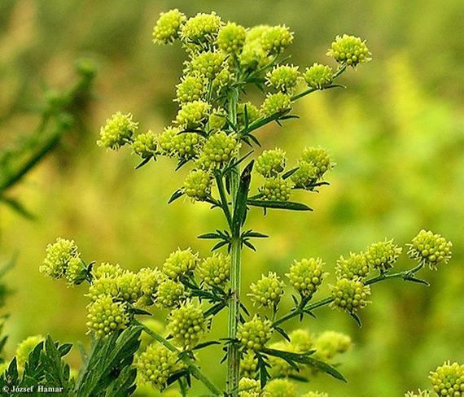
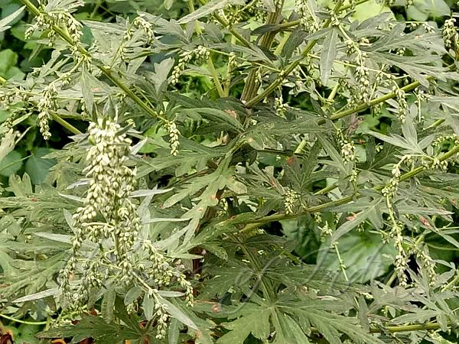
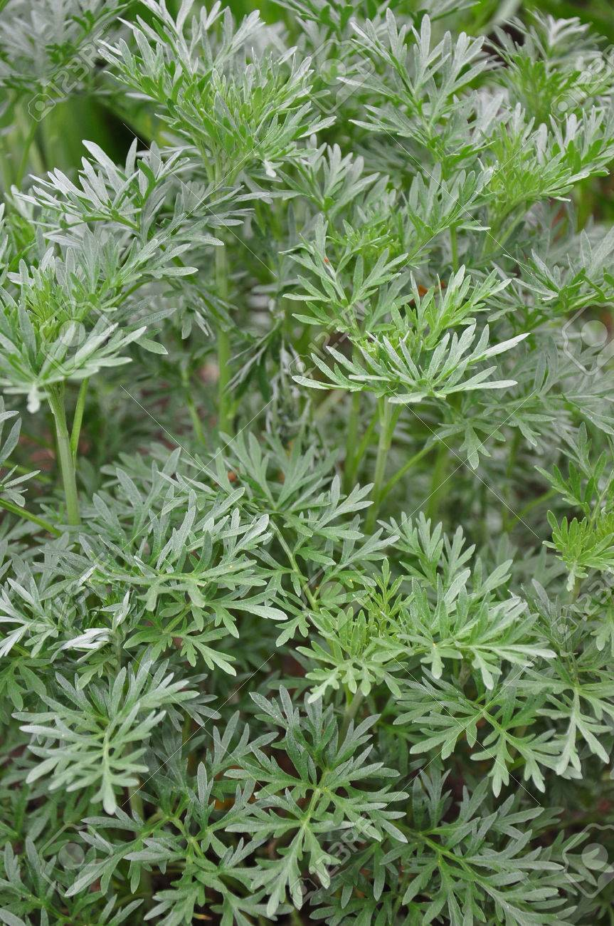
Artemisia (SESQUITERPENOIDS)

Slide 19
Artemisia
Santonica; Worm seeds.
B S: Unexpanded flower-heads of Artemisia cina , Artemisia brevifolia, Artemisia maritima other species Artemisia, family Asteraceae.
Collected late in spring/ early in summer when the flower-heads are young.
Contain not more than 2 % of stems, & not less than 0.75% santonin.

Slide 20
Artemisia
G S: It is found growing wild in the Kurran valley in Pakistan, Turkey and from Kashmir to Kumaon in Himalayas, as well as, in West Tibet, upto an altitude of 4000 metres.
It is also found in Punjab, Uttar Pradesh and Haryana.
Macroscopy: Color- Flowers yellow, other parts whitish-grey, Odor-Aromatic, sweet, Taste-Bitter, camphoraceous
Yellowish or brownish flower-heads, oval shape.
Flowers are fertile, tubular corolla, short cylindrical tube, narrow limb. Calyx absent.

Slide 21
Artemisia
C C: Santonica contains essential oil, 2 crystalline substances i.e. santonin & artemisin.
Volatile oil 1-2%, santonin 2%
Volatile oil- cineole, pinene, resin.
Active constituent- santonin, which is sesquiterpene lactone, an anhydride of santonic acid.
Amount of santonin- varies-with species, time, nature of collection.
When flower-heads r unexpanded & dried fast they yield more than 3% santonin

Slide 22
Artemisia
Identification: Boil 1g powder of drug + 10 ml alcohol, filter, Take filtrate + NaOH+ heat. → liq. Red
Uses: Strong anthelmintic, for round worms, less or no effect on hook & tape worms.
Crude form rarely used in therapeutic, replaced by santonin.
Santonin produces marked disturbances of vision & is cumulative in action.
B.P. variety of drug - Artemisia cina.
Substitutes: Tall aromatic shrub- Artemisia vulgaris (Compositae)- mountaneous districts of India, Mount Abu Rajasthan, Konkan, U P, T N & J &K, sikkim, srilanka

Slide 23
Artimisia annua
Qninghao, Sweet-annie, Worm weed.
B S: Chinese traditional herb Artemisia annua Asteraceae, should contain not less than 0.8% of artemisinin on dried basis.
G S: Endemic to China, grows wild –Europe, America.
Cultivated- Vietnam, China, Iran, Turkey, Australia.
Also cultivated on experimental basis in Gujarat, JK, U P, H P & Karnataka.

Slide 24
Artimisia annua
Cultivation Collection : CIMAP Lucknow developed uniform, high yielding genetically improve variety, cultivated for Aretemisinin. Gives about 29 quintals/hectare of dry leaves & flowering tops containing 0.11% Artemiesinin.
Yield/ hectare 3.19 kg Artemisinin

Slide 25
Artimisia annua
C C: Out of 7 species only A. annua- has Artemisinin, deoxyartemisinin 1%
It is sesquiterpene lactone with internal peroxide linkage.
Artemisinic acid, arteannuin A & B, Amyrin, luteolin, β-sitosterol, stigmasterol.
Artemisinin- does not have heterocyclic ring with N, like other antimalarials.
It is new type of structure
Sparingly soluble in water while it shows decomposition in other solvents.
Volatile oil 0.3 to 0.4% with artemisia alcohol, artemisia ketone, camphor, Caryophyllene & myrcene

Slide 26
Artimisia annua
Uses: Artemisinin- antimalarial by rapid blood schizonticidal activity.
Trophozite development is arrested & pathological consequences not observed.
Acts both against Chloroquine sensitive & resistant P. falciparum & P. vivax malarial parasites.
Artemisinin - most potent drug for cerebral malaria.
Artesunate & artemether, derivatives of artemisinin highly effective.
Artemether-developed by C.D.R.I., Lucknow.
Artemisic acid- antibacterial, cytotoxic, anti-inflammatory actions
Artemisinin- anti-HIV activity

Slide 27
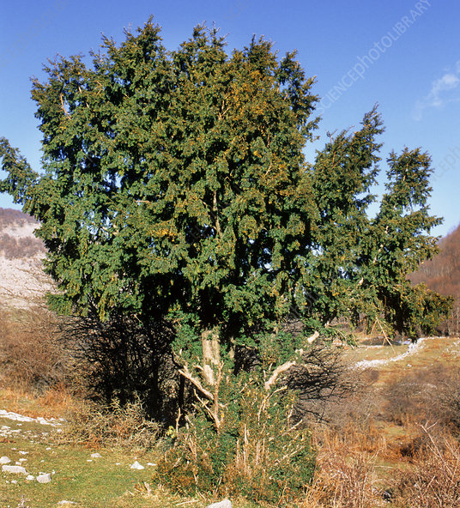
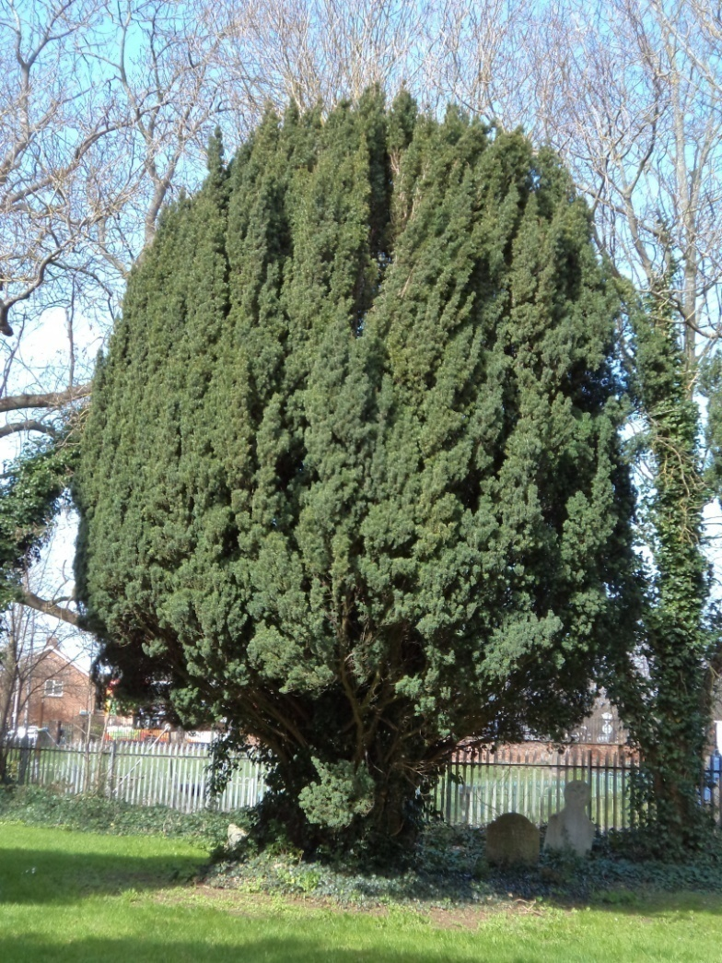
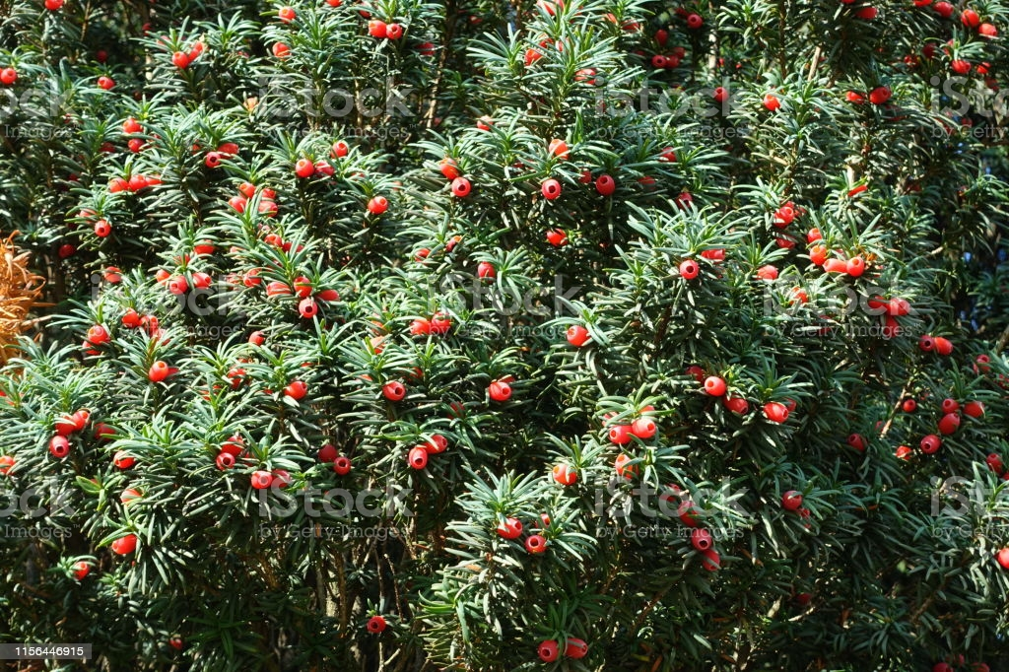
TAXUS
YEW

Slide 28
Taxus (DITERPENOIDS)
Yew, Talispatra, Himalayan yew, Birmi.
B S: dried leaves, bark & roots of various species of Taxus, Taxaceae
Four imp species with parts used are as under.
Taxus baccata (English or European yew) mainly leaves.
Taxus brevifolia (Pacific yew) mainly stem bark
Taxus Canadensis (Canadian or American yew) Leaves & roots.
Taxus cuspidate (Japanese yew) leaves
Taxus wallichiana: Contains not less than 0.04% Paclitaxel (Taxol) calculated on dried basis.

Slide 29
Chemical Constituents
Constituent-paclitaxel or taxol in leaves, roots, bark
Taxanes, diterpenoid structures, 3 imp.- Taxol, cephalomannine & 10 - deacetyl baccatin.
Taxol- 0.007% to 0.01 %.
Mainly obtained from stem bark of T. brevifolia.
Needs at least 60 yrs old 3 - 4 trees to get 1 gm of taxol.
Yields 50-150 mg of taxol from 1 kg dried yew bark.
10 kg bark from an average tree.
Alternative sources- total synthesis or biotechnological route / tissue culture

Slide 30
Chemical Constituents
Leaves contain 10-deacetyl baccatin III, can be converted to Taxol.
Among the various yew species, compounds are anticancer.
Most potent compounds include Taxol (containing a rare oxetane ring & amide side chain), cephalo mannine (0.031 %), baccatin – III (0.084 %), & 10 - deacetyl baccatin III
Derivative of Taxol, called taxotere - have better bio-availability & pharmacological properties & has promising anticancer agent.

Slide 31
USES
Anticancer, analgesic, anti-inflammatory, antipyretic & anti-convulgant.
Biological target of Taxol- microtubules produced from α & β-tubulin.
Microtubules - responsible for formation of mitotic spindle imp. for cell division.
α & β-tubulin polymerise - give microtubules & for this microtubule associated proteins (MAP) & guanosine triphosphate (GTP) are imp.

Slide 32
USES
Taxol brings polymerisation in microtubules in absence of MAP & GTP.
Due to this, microtubule formation increases causing destructive effects on dividing cells leading to blockade of cell cycle.
And multiple abnormal esters are formed from microtubules & get distributed in cytoplasm, these structures are non-functional.
Taxol -inhibits cell migration, prevents spread of metastatic cancer cells.
Taxol-approved USFDA - treatment of refractory ovarian cancer.
Against non-small cell lung carcinoma, gastric, cervical cancers, carcinomas of head, neck, prostate, colon.

Slide 33
Carotenoids (TETRATERPENOIDS)
Called as tetra-terpenoids- are organic pigments – produced by plants & algae, fungi, bacteria
Animals- aphids, spider mites
Composed of 8 isoprene units(C40)
Various colors- mostly yellow to red pigments
Absorb light in 400-500nm region of Visible spectrum
Synthesized from Mevalonate precursors

Slide 34
Carotenoids
Hydroxylated, oxidized, hydrogenated, ring containing derivatives exist
Hydrocarbon carotenoids classified as carotenes.
Those with oxygen- xanthophylls
Classification: 2 general classes
1. Carotene: have only C & H, ex. β-carotene,
2. Xanthophyll: have 1 or more O atoms, ex: lutein

Slide 35
Carotenoids
Chemistry: Belong to category of tetraterpenoids, i.e. contains 40 C atoms, made up of 4 terpene units each with 10 C atoms
Carotenoids take form of polyene HC chain , may be terminated by rings, may or may not have additional O atom.
General structure: polyene chain 9-11 double bonds, possibly terminating rings

Slide 36
Carotenoids
They absorb light energy fro photosynthesis, protect chlorophyll from photo damage
Carotenoids with unsubstituted β -ionone rings (β-carotene, α-carotene, β-cryptoxanthin, γ-carotene)- have Vitamin A activity
i.e. They can be converted to retinol

Slide 37
α, β, Carotenoids, Vitamin A
About 600-700 different carotenoids known
Prominent ones: α, β, Carotene, lycopene, lutein, zeaxanthin
β-Carotene: provitamin A , metabolized to vit A. Vit. A retinol can be transformed to retinal important for vision, or retinoate – for cell proliferation, cell differentiation
Is an antioxidant
Appears in red, orange, yellow fruits, veges,
Lutein, zeaxanthin- green leaves veges

Slide 38
Naphthaquinones
Quinones- widely distributed aromatic compd.
Found in many families of plants, isolated from fungi, algae, bacteria
Classified into benzoquinones, anthraquinones, and naphthaquinones.
Naphthaquinones STRUCTURALLY similar to naphthalene, characterized by 2 carbonyl groups in 1,4 position named as 1,4 naphthaquinones

Slide 39
Naphthaquinones
They are natural phenolic compounds
Ex. Alkannin, Juglone, Lawsone, Plumbagin, Vitamin K etc.
Synthetic: Menadione, Atovaquone, Buparvaquone
They are yellow-orange colored pigments found in families like: Plumbaginaceae, Juglandaceae, Ebenaceae, Boraginaceae, Dioncophyllaceae, Ancistrocladaceae, Iridaceae, Verbenaceae, Scrophulariaceae, Avicenniaceae, Balsaminceae, Bignoniaceae, Gentianaceae, Droseraceae, Nepenthaceae, Lythraceae and Euphorbiaceae

Slide 40
Reference
Pharmacognosy, C.K. Kokate, A.P. Purohit, S.B. Gokhale, 54th Ed. 2017, Nirali Publication, New Delhi
B.Dinda, Pharmacology & Applications of Naturally occuring Iridoids, in Chapter Classification of Iridoids, Springer nature, Switzerland AG 2019.
Emila Andrejewska Golec , The occurrence of iridoids in plants, Acta Societatis Botanicorum Polanaiae, 1995, 64(2): 181-186.
D.S. Seigler,, Plant Secondary Metabolites, In Chapter: Tetraterpenoids or Carotenoids 1998, Springer Science, New York, 486.

