Slide 1
Phenylpropanoids and Flavonoids

Slide 2
PHENYLPROPANOIDS
Phenylpropanoids a diverse family of organic compounds synthesized by plants from the aminoacids phenylalanine & tyrosine
Name derived from the 6-carbon, aromatic phenyl group and the 3-carbon propene tail of coumaric acid, which is the central intermediate in phenylpropanoid biosynthesis
From 4-coumaroyl-CoA - the biosynthesis of countless natural products including lignols (precursors to lignin and lignocellulose), flavonoids, isoflavonoids,
coumarins, aurones, stilbenes, catechin, and phenylpropanoids
coumaroyl component is produced from cinnamic acid

Slide 3
Phenylpropanoids Pathway & Phyenylpropanoid Acetate Pathway

Slide 4
Phenylpropanoids : Products of the shikkimic acid pathway

Slide 5
CLASSIFICATION OF PHENYLPROPANOIDS
The phenylpropanoids- classified on the basis of basic chemical moieties
1. Hydroxycinnamic acids (hydroxycinnamates) are a class of aromatic acids or phenylpropanoids having a C₆–C₃ skeleton. These compounds are hydroxy derivatives of cinnamic acid.
α-Cyano-4-hydroxycinnamic acid
Caffeic acid –3, 4-Dihydroxycinnamic acid. hawthorn, artichoke, pear, basil, thyme, oregano, apple
Cichoric acid
Cinnamic acid – aloe
Chlorogenic acid –strawberries, pineapple, coffee, sunflower, blueberries
Diferulic acids
Coumaric acid
Ferulic acid (3-methoxy-4-hydroxycinnamic acid) – oats, rice, artichoke, orange, pineapple, apple, peanut
Sinapinic acid (3,5-dimethoxy-4-hydroxycinnamic acid or sinapic acid) black mustard

Slide 6
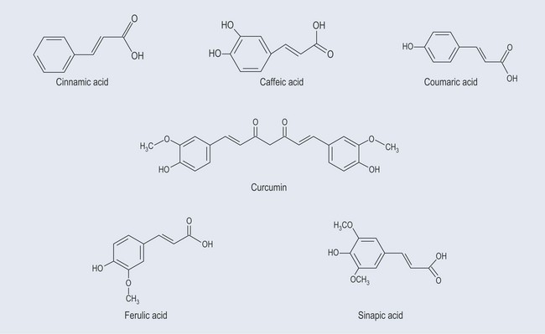
Hydroxycinnamic acids

Slide 7
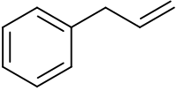
CLASSIFICATION OF PHENYLPROPANOIDS
(ii) Phenylpropenes
phenyl group attached to allyl.
Eugenol, chavicol, estragole, and anethole contribute to the flavor and aroma of a number of important herbs and spices.
Phenylpropenes, a large group of plant volatile compounds that serve in multiple roles in defense and pollinator attraction, contain a propenyl side chain
are precursors for a variety of insecticides.
Myristicin
Anethole
Eugenol

Slide 8
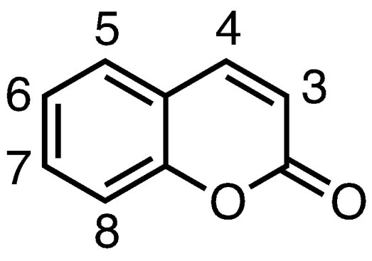
CLASSIFICATION OF PHENYLPROPANOIDS
(iii) Coumarins hydroxy-coumarins
and furanocoumarins
family of benzopyrones
(1,2-benzopyrones or 2H-1-benzopyran-2-ones)
widely distributed in the nature.
Represent important family of naturally occurring and/or synthetic oxygen-containing heterocycles, bearing a typical benzopyrone framework
French term for the Tonka bean, coumarou, seeds of Dipteryx odorata (Coumarouna odorata) (Fabaceae/Leguminosae)
one of the sources from which coumarin was first isolated as a natural product in 1820.

Slide 9
CLASSIFICATION OF PHENYLPROPANOIDS
Coumarins
Has sweet odor, easy to be recognized as the scent of new-mown hay; because of that, coumarin has been used in perfumes since 1882
class of lactones structurally constructed by a benzene ring fused to α-pyrone ring,
Coumarin was first synthesized in 1868, precursor in the synthesis of a number of synthetic anticoagulant pharmaceuticals, starting with dicoumarol
simple coumarins, furocoumarins, dihydrofurocoumarins, pyranocoumarins (linear and angular), phenylcoumarins, and biscoumarins

Slide 10
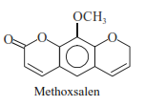
CLASSIFICATION OF PHENYLPROPANOIDS
Coumarins
cis-o-Coumarinic acid lactone; Cumarin; Coumarinic anhydride; Tonka bean comphor.
flavouring agent in pharmaceutical formulations
Hydroxycoumarins: more common ones are based upon the following substances, such as: umbelliferone (7-hydroxy coumarin), aesculetin (6, 7-dihydroxy-coumarin) and scopoletin (6-methoxy-7-hydroxy
coumarin)
Furanocoumarins, a class of more complex coumarins occur in natural plant products. Important members of this class: Psoralen;
Methoxsalen; Bergapten; and Imperatorin,

Slide 11
CLASSIFICATION OF PHENYLPROPANOIDS
(iv) Abridged phenylpropanoids: These possess no side chain or a side chain with one carbon atom
They are acids & phenols, rarely alcohols and aldehydes
Distributed due to beta oxidation of C3 side chain of para coumaroyl CoA and para cinnamoyl CoA followed by oxidative decarboxylation
Classified into
With no side chain: catechol
With side chain having one C atom: gallic acid, benzoic acid, salicin, vanillin, methyl salicylate
With side chain having 2 C atom: phenyl ethanol in essential oils

Slide 12
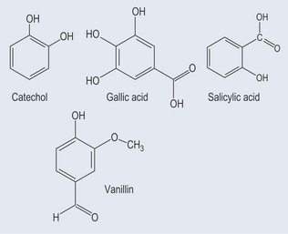
CLASSIFICATION OF PHENYLPROPANOIDS

Slide 13
CLASSIFICATION OF PHENYLPROPANOIDS
(v) Biphenylpropenoid derivatives
The side chains from 2 phenylpropanoids interact with each other to yield Biphenylpropenoid derivatives commonly termed
lignans or neolignans : low mol. Wt. , by the oxidative coupling of para-hydroxyphenylpropene units wherein the two units may be linked by an oxygen bridge, Haworth Lignan compounds that are derived by coupling acid and/or alcohol exclusively; whereas, the compounds which are derived by coupling propenyl and/or allyl derivatives are known as Neolignans
They occur widely and have been obtained from roots, heart wood, foliage, fruit and resinous exudates of plants. They represent the dimer stage intermediate between the monomeric propylphenol units and lignin
examples of lignan are that of etoposide and teriposide
b) Flavonoids

Slide 14
CLASSIFICATION OF PHENYLPROPANOIDS
(vi) High molecular weight phenylpropanoids
Play vital role as buildings units in the formation of high molecular weight polymers in plants. Polymers are broadly classified into
Lignins : natural aromatic organic polymers in vascular
plants. lignins together with cellulose, and hemicellulose, are the major cell wall components of the fibers of all wood and grass species in the plant kingdom
phenolic hydroxy moieties present in the lignins may be either hydrogen bonded or covalently attached to hemicellulose
Lignin is usually composed of coniferyl, p-coumaryl and sinapyl alcohols in varying
used as a source of vanillin, syringic aldehyde and dimethyl sulphoxide, extender for phenolic plastics, strengthen rubber for shoe-soles, to precipitate proteins

Slide 15
CLASSIFICATION OF PHENYLPROPANOIDS
(vi) High molecular weight phenylpropanoids
Tannins: Tannic Acid; Gallotannin; Gallotannic acid; Acidum tannicum.
as a pharmaceutical aid due to its astringent and antiseptic actions., mordant in dyeing, for tanning i.e., making leather from hides of cow, goat, sheep and buffalo skin., for sizing paper and silk. production of gallic acid and pyrogallol., as a reagent in ‘analytical chemistry’. as a coagulant in the manufacture of rubber., employed to clarify beer and wine.

