Slide 1
B.PHARM. 5th SEMESTER BP504 T. PHARMACOGNOSY AND PHYTOCHEMISTRY II (Theory)
UNIT-III
Isolation, Identification and Analysis of Phytoconstituents
a) Terpenoids: Menthol, Citral, Artemisin
Dr. Nisha Sharma
Associate Professor
University Institute of Pharmacy
C.S.J.M. University, Kanpur
nishasharma@csjmu.ac.in

Slide 2
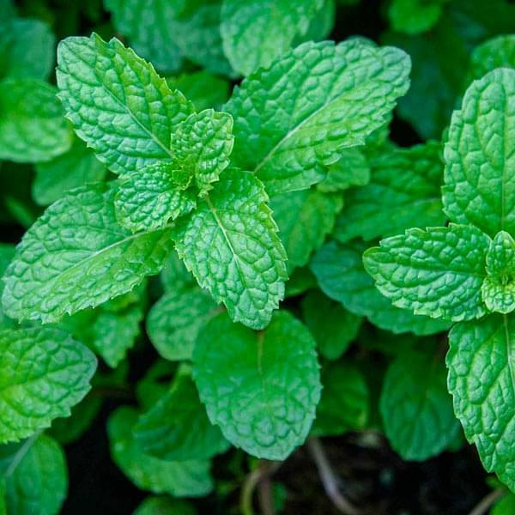
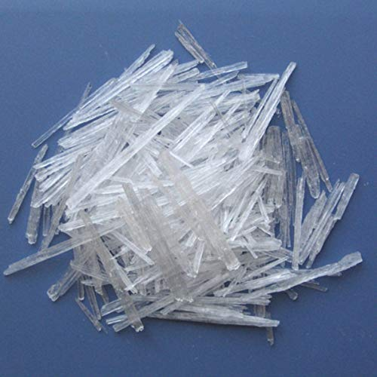
MENTHOL

Slide 3
Menthol
Biological source: Menthol a monoterpene alcohol obtained from oils of Mentha piperita var. Vulgaris (Black peppermint) & Mentha piperita var. officinalis (White peppermint), family- Labiatate. Mentha species contains about 1-3% of volatile oils & oil contains not less than 44%.
Isolation
Menthol is isolated by 2 methods
Method 1: Hydro-distilation
Method 2: Steam distillation

Slide 4
Hydro-distilation
Required quantity of coarse powder leaves of Mentha piperita.
The peppermint oil is extracted by hydrodistillation method by using clevenger apparatus.
The oil is separated from water and allow to cooling. After cooling crystals of (-) menthol will separate out.
The crystals are collected by centrifugation and re- crystallized the menthol by acetone or any other low boiling point solvent

Slide 5
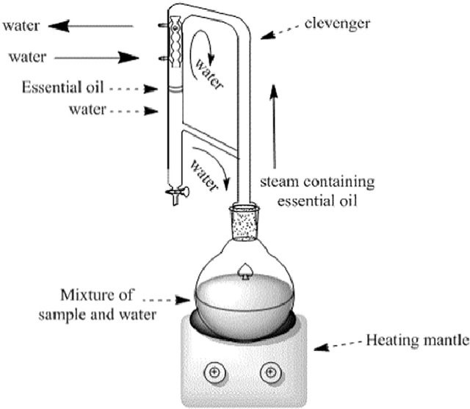
Hydro-distillation by Clevenger apparatus system

Slide 6
2. Steam distillation
Required quantity of air dried mentha plant is charged into stainless steel still having perforated bottom.
The steam under pressure is generated with the help boiler and steam is passed through the drug.
The mixture vapour (water and volatile oil) are passed through the condenser where vapour is cooled and back to liquid form.
The mentha oil is collected in separating can. Mentha oil is floated on top of the water due to lighter than water.
The oil is then decanted and filtered.
The oil is allowed to cool; crystal of menthol will separate out.

Slide 7
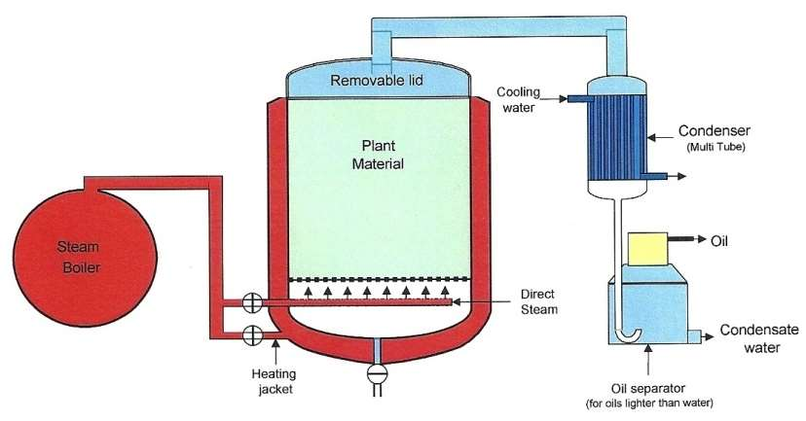
2. Steam distillation

Slide 8
3. Method of Isolation
Pippermint volatile oil- separated by steam & water distillation.
To make oil free of moisture- it is passed through a bed of Na₂SO₄
The moisture free oil is frozen to -60°C for 7days by packing in tightly sealed plastic container.
Menthol in oil separates as flaky crystals, separated by filtration.
Mother liq. Containing some menthol along with other terpenes.
The mother liq is treated with boric acid & further boiled for 3hr, followed by distillation for removal of menthone.
Borate of menthol subjected to saponification with 50ml of NaOH by heating reflux for 1hr
Resultant sol. Is allowed to cool for separation of remaining menthol crystals and mixed, dried in dessicator.

Slide 9
Properties:
Appearance : White crystalline substances, which is solid at room temperature and melts slightly above (m.p. 41 to 43°C).
Odor : Characteristic and pleasant
Taste : Pungent followed by cooling sensation
Solubility : Soluble in 70% alcohol, ether and chloroform, insoluble in water
Identification by chemical test:
Few drops of sample is mixed with 5ml of nitric acid and heated on water bath. Blue color is developed within 5 minutes, after some time it becomes yellow which indicate the presence of menthol.
Small qty of menthol in TT + equal qty of thymol or camphor → liquifaction of contents in TT→ presence of Menthol
Crystals of Menthol in watch glass+ heat on water bath → material evaporates

Slide 10
Analysis by TLC
Sample preparation : 1mg of Menthol is dissolved 1ml of methanol
Standard sample : Menthol
Stationary phase : Silica gel 60 F 254
Mobile phase : Pure Chloroform , hexane:EtOAc::8:2
Detecting agent :1% vanillin – sulphuric acid reagent and heat the plate at 110°C for 10 minutes
Anisaldehyde –sulphuric acid reagent, heat at 115°C – 10min.
RF Value : 0.34, 0.48-0.62
Utilization:
It is used as in various dosage forms for its cooling sensation, flavoring property,
carminative, antispasmodic and antipruritic
Storage condition:
It should be store in well closed and air-tight containers protected from light and in cool place.

Slide 11
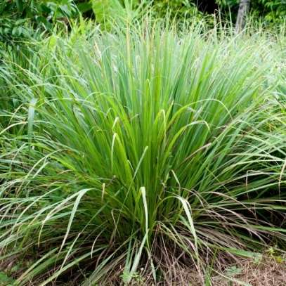
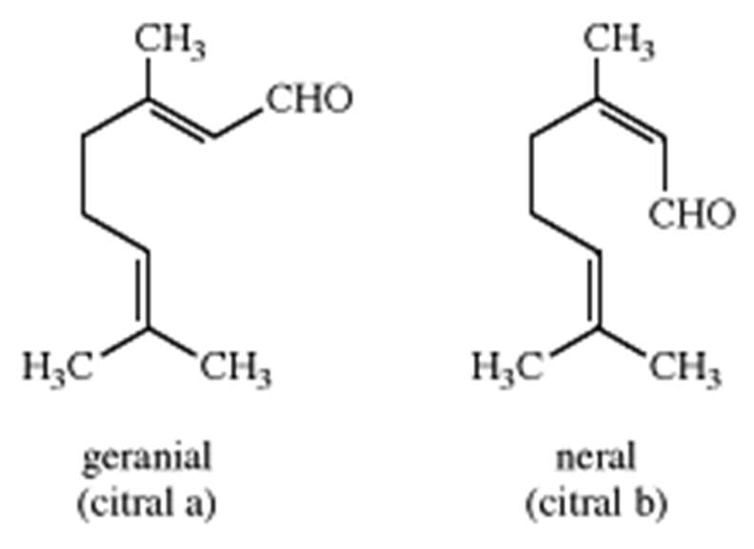
Citral
Cymbopogon flexuosus, C. citratus (Lemon grass),
Lemon oil: Lemony, sweet smell, yellow in color

Slide 12
Citral
Biological source:
Citral is a monoterpene aldehyde obtained from oils of Cymbopogon flexuosus, C. martini belongs to family- Graminae. It contains not less than 75% of aldehyde calculated as Citral. It also present in Lemon oil (Citrus limonus) and Orange oil (Citrus aurantium), family Rutaceae.
Isolation:
Citral is isolated by following methods i.e.
Method 1: Hydro-distilation
Method 2: Fractional crystallization Method

Slide 13
Citral
The fresh plant material is hydro- distilled to obtain lemon grass oil.
It is purified by fractional crystallization. To the total oil, first Sodium sulphite is added, the citrals get converted into its sulphite salt.
The salt crystallizes out of the solution.
The crystals are filtered and washed with ether or chloroform.
The product is then subjected to sodium carbonate treatment to recover Citral.
Citral is found in two form i.e Citral-a (Geranial) and Citral-b (Neral).

Slide 14
Properties:
Appearance : Clear pale yellow liquid
Odor : Strong lemon like odour
Taste : Lemon like taste
Solubility : Soluble in 3 parts of 70% alcohol, chloroform and fixed oil. Insoluble in water.
Boiling point : 224-228O C
Identification by chemical test:
Alcoholic solution of Sudan red III is added to the sample. Red colour is appeared which indicate presence of citral.
Tincture alkane is added to the sample. Red colour is appeared which indicate presence of citral.

Slide 15
Analysis by TLC
Sample preparation : 1mg of Citral is dissolved 1ml of methanol
Standard sample : Citral
Stationary phase : Silica gel –G
Mobile phase : Pure Chloroform
Detecting agent : 2, 4, dinitrophenyl hydrazine reagent
Color spots : Yellow to orange
RF Value : 0.51
Utilization:
It is used as a flavouring agent and perfumery. Commercially citral is act as precursor for the synthesis of ß-ionone. ß-ionone is used as starting material for the synthesis of Vitamin A
Storage condition:
It should be store in well closed and air-tight containers protected from light and in cool place.

Slide 16
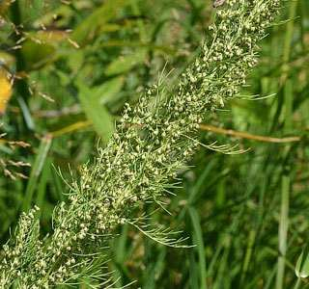
Artemisin
Artemisia cina (Santonica)

Slide 17
Artemisin
Biological source
Artemisin is a sesquiterpenoid lactone, obtained from the unexpanded flower- heads of Artemisia cina Berg, Artemisia brevifolia Wall, Artemisia maritime Linn. and other species belongs to family Asteraceae. It contains 2-3% of essential oil and two crystalline substances i. e Santonin and Artemisin.

Slide 18
Isolation:
The air dried powdered of herb is macerated in methanol for 1 hour with magnetic stirrer having speed of 700 rpm.
This process is repeated until methanol layer become colorless.
The extract is evaporated by rota-evaporator at a temperature of 40° C until volume is reduced to 100ml.
The methanolic extract is partitioned using 50ml hexane (Hexane: Methanol, 1:2) until colorless hexane layer is obtained.
Hexane and methanol extract is separated by using separating funnel. 10ml of distilled water is added to methanolic extract and partitioned by 50ml of ethyl acetate until ethyl acetate layer become colorless.
Again ethyl acetate and methanolic extract is separated. Both extracts are concentrated by using rota evaporater at a temperature of 40°C.
Artemisin is fractionated by column chromatography using silica gel 60 as stationary phase and ethyl acetate: hexane as mobile phase

Slide 19
Identification by chemical test:
Sample is boiled with 10ml of alcohol and filtered. Sodium hydroxide is added to filtrate and heated. Red colour is appeared in liquid .
Analysis by TLC
Sample preparation : 1mg of Artemisin is dissolved Chloroform
Standard sample : Artemisin
Stationary phase : Silica gel –G
Mobile phase : Petroleum ether - Ethyl acetate (1:2)
Detecting agent : p- dimethyl amino benzaldehyde and heat at 80° C to produce color
RF Value : Compare with standard Artemisin

Slide 20
Artemisnin
Analysis by UV
1mg of Artemisin is mixed with 10ml of methanol and analysed λ200-400nm.
Utilization:
It is used as antimalarial. It acts both against chloroquine sensitive and resistant P.
falciperum and P. vivax malarial parasites.
Storage condition:
It should be store in well closed and air-tight containers protected from light and in cool place.

Slide 21
References
Lecture notes by Mr. Ashutosh Meher, Associate professor, Barpali, Bargarh, Odisha

