Slide 1
Linear Filters

Slide 2
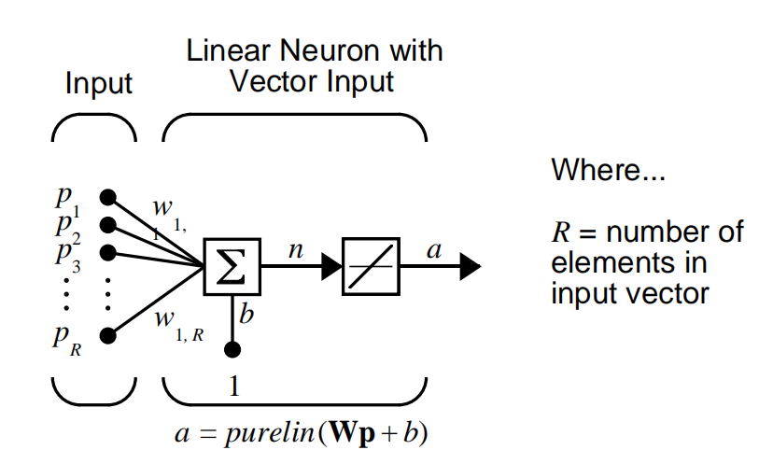
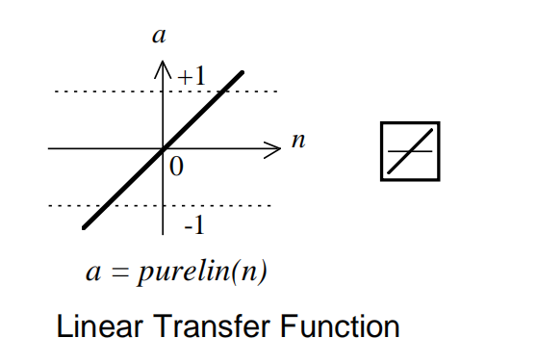
Linera Filters
The linear networks are similar to the perceptron, but their transfer function is linear rather than hard-limiting. This allows their outputs to take on any value, whereas the perceptron output is limited to either 0 or 1. Linear networks, like the perceptron, can only solve linearly separable problems.

Slide 4
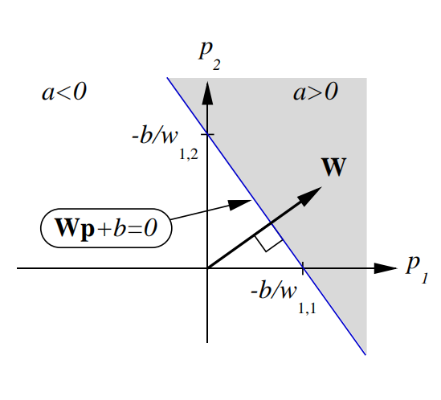

Slide 5
Mean Squared Error
Like the perceptron learning rule, the least mean square error (LMS) algorithm is an example of supervised training, in which the learning rule is provided with a set of examples of desired network behavior:
The error is calculated as the difference between the target output and the network output. We want to minimize the average of the sum of these errors.
The LMS algorithm adjusts the weights and biases of the linear network so as to minimize this mean square error.

Slide 6
LMS Algorithm
The LMS algorithm or Widrow-Hoff learning algorithm, is based on an approximate steepest descent procedure. Here again, linear networks are trained on examples of correct behavior.
We want to minimize the average of the sum of these errors.
The LMS algorithm can be written conveniently in matrix notation:

Slide 7
Train the network using the LMS algorithm, with the initial guess set to zero and a learning rate is 0.25. Apply each reference pattern only once during training. Draw the decision boundary at each stage.

Slide 8
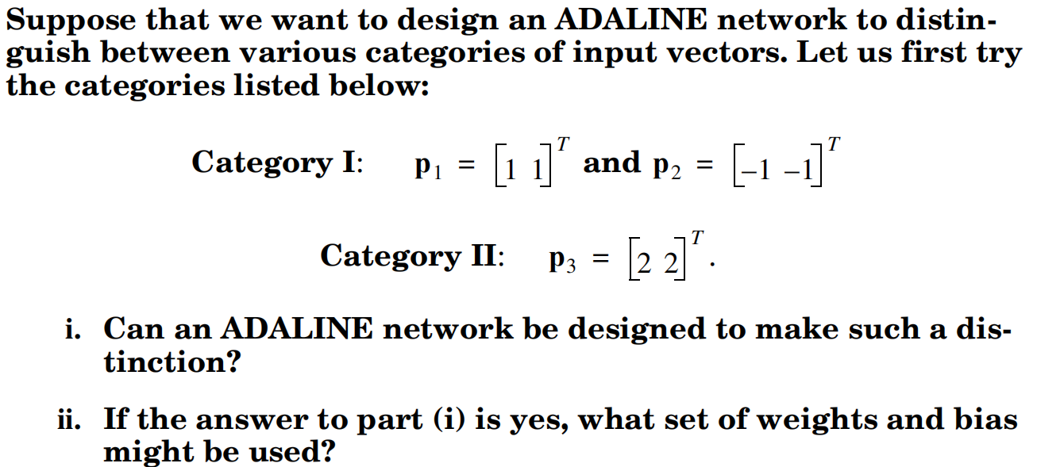

Slide 9
Gradient Descent
Gradient Descent is an optimization algorithm for finding a local minimum of a differentiable function. Gradient descent is simply used to find the values of a function's parameters (coefficients) that minimize a cost function as far as possible.
A gradient measures how much the output of a function changes if you change the inputs a little bit." — Lex Fridman (MIT)
A gradient simply measures the change in all weights with regard to the change in error. You can also think of a gradient as the slope of a function. The higher the gradient, the steeper the slope and the faster a model can learn. But if the slope is zero, the model stops learning.
In mathematical terms, a gradient is a partial derivative with respect to its inputs.

Slide 10
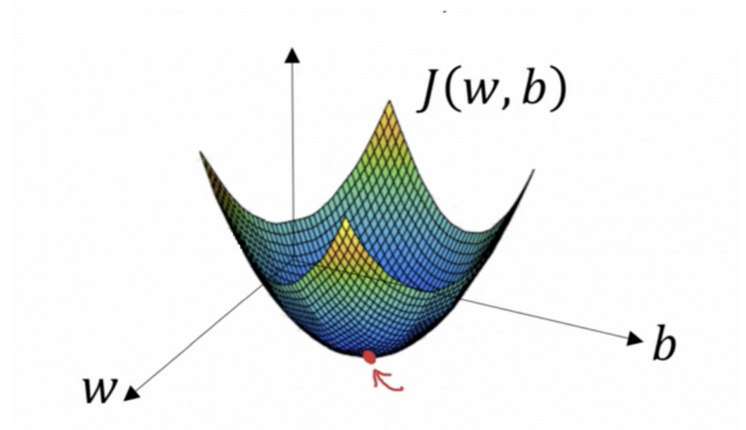
Gradient Descent
The equation below describes what gradient descent does: b is the next position of our climber, while a represents his current position. The minus sign refers to the minimization part of gradient descent. The gamma in the middle is a waiting factor and the gradient term ( Δf(a) ) is simply the direction of the steepest descent.
Want to train your algorithm with gradient
descent to minimize your cost-function J(w,b)
and reach its local minimum by tweaking its
parameters (w and b).Gradient descent is a
convex function.

Slide 11
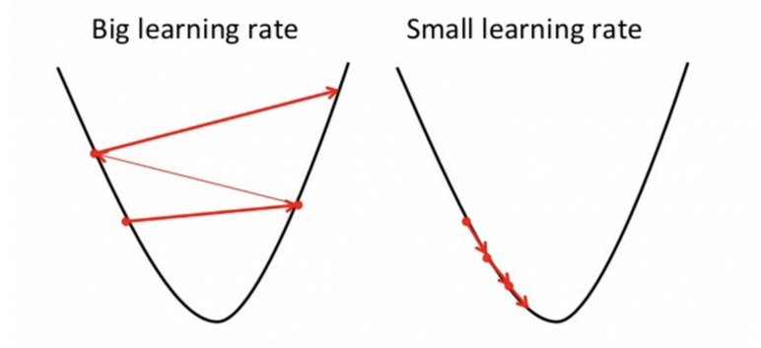
Learning Rate
How big the steps are gradient descent takes into the direction of the local minimum are determined by the learning rate, which figures out how fast or slow we will move towards the optimal weights.
For gradient descent to reach the local minimum we must set the learning rate to an appropriate value, which is neither too low nor too high. This is important because if the steps it takes are too big, it may not reach the local minimum because it bounces back and forth between the convex function of gradient descent (see left image below). If we set the learning rate to a very small value, gradient descent will eventually reach the local minimum but that may take a while (see the right image).

Slide 12
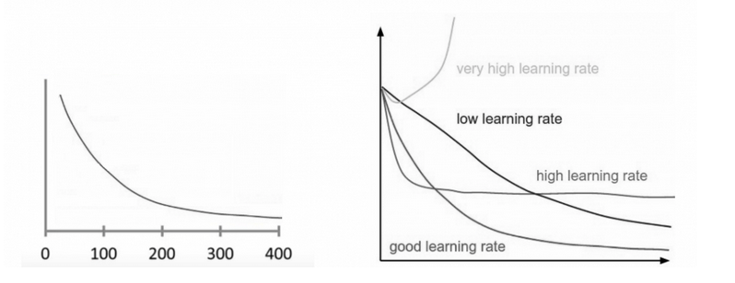
Learning Rate
A good way to make sure gradient descent runs properly is by plotting the cost function as the optimization runs. Put the number of iterations on the x-axis and the value of the cost-function on the y-axis.
If gradient descent is working properly, the cost function should decrease after every iteration.
When gradient descent can’t decrease the cost-function anymore and remains more or less on the same level, it has converged.

Slide 13
Types of Geadient Descent
Batch gradient descent: also called vanilla gradient descent, calculates the error for each example within the training dataset, but only after all training examples have been evaluated does the model get updated. This whole process is like a cycle and it's called a training epoch.
Some advantages of batch gradient descent are its computational efficient, it produces a stable error gradient and a stable convergence. Some disadvantages are the stable error gradient can sometimes result in a state of convergence that isn’t the best the model can achieve. It also requires the entire training dataset be in memory and available to the algorithm.
Stochastic gradient descent: By contrast, stochastic gradient descent (SGD) does this for each training example within the dataset, meaning it updates the parameters for each training example one by one. Depending on the problem, this can make SGD faster than batch gradient descent. One advantage is the frequent updates allow us to have a pretty detailed rate of improvement.
The frequent updates, however, are more computationally expensive than the batch gradient descent approach. Additionally, the frequency of those updates can result in noisy gradients, which may cause the error rate to jump around instead of slowly decreasing.

