Slide 1
Back-propagation

Slide 2
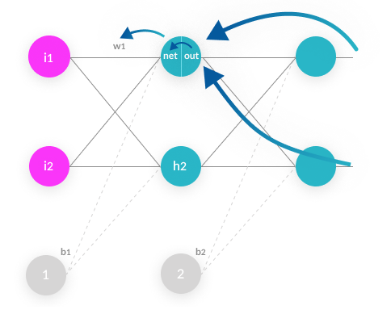
Back-Propagation
Backpropagation is an algorithm commonly used to train neural networks. When the neural network is initialized, weights are set for its individual elements, called neurons. Inputs are loaded, they are passed through the network of neurons, and the network provides an output for each one, given the initial weights.
Backpropagation helps to adjust the weights of the neurons so that the result comes closer and closer to the known true result.

Slide 3
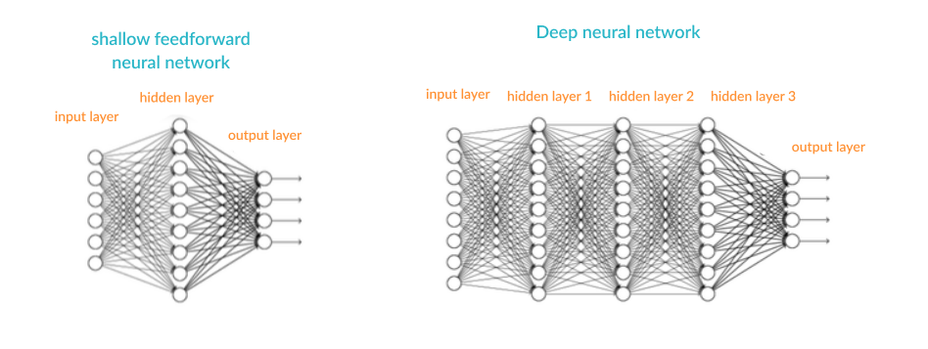
Concept of Back-Propagation
Inputs
Training Sets
Outputs
Activation Fumction
Weight Space
Initilization
Forward Pass
Gradient Descent

Slide 4
Stages of Neural Networks Larning
Neural network or deep learning model training occurs in six stages:
Initialization— initial weights are applied to all the neurons.
Forward propagation— the inputs from a training set are passed through the neural network and an output is computed.
Error function— because we are working with a training set, the correct output is known. An error function is defined, which captures the delta between the correct output and the actual output of the model, given the current model weights (in other words, “how far off” is the model from the correct result).
Backpropagation— the objective of backpropagation is to change the weights for the neurons, in order to bring the error function to a minimum.
Weight update— weights are changed to the optimal values according to the results of the backpropagation algorithm.
Iterate until convergence— because the weights are updated a small delta step at a time, several iterations are required in order for the network to learn. After each iteration, the gradient descent force updates the weights towards less and less global loss function. The amount of iterations needed to converge depends on the learning rate, the network meta-parameters, and the optimization method used.

Slide 5
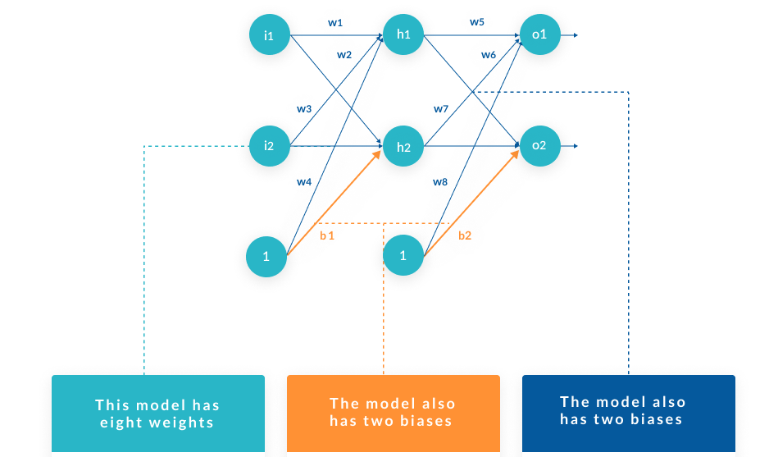
How Backpropagation Works

Slide 11
