Slide 1
CULTURE MEDIA

Slide 2
CULTURE MEDIA
Required to isolate the bacteria from the clinical specimens.
CONSTITUENTS OF CULTURE MEDIA
Constituent | Explanation
1)Water | Distilled water or potable water with low mineral content. Serves as the source of hydrogen and oxygen.
2)Electrolytes | Sodium chloride or other electrolytes.

Slide 3
CONSTITUENTS OF CULTURE MEDIA
Peptone: | Complex mixture of partially digested proteins. Source- from lean meat or other protein material such as heart muscle, casein or fibrin, or soya flour usually by digestion with proteolytic enzymes such as pepsin. Constituents - proteoses, aminoacids, inorganic salts (phosphates, potassium magnesium) and accessory growth factors like nicotinic acid and riboflavin.

Slide 4
CONSTITUENTS OF CULTURE MEDIA
Agar | Used for solidifying agent. Agar (agar-agar) is prepared from the cell wall of variety of seaweeds. Components- Long-chain polysaccharide (D-galctopyranose units) and a small amount of protein-like material, long chain fatty acids and traces of inorganic salts (calcium and magnesium). Agar is preferred over gelatine Bacteriologically inert Melts at 98°C and usually solidifies at 42°C. Does not add any nutritive property to the culture medium. Whereas gelatin is liquefied by a number of bacteria and it melts at 24°C, and remains in liquid state at room temperature.

Slide 5
CONSTITUENTS OF CULTURE MEDIA
Agar | Concentration of agar used: Solid agar preparation - 1-2% Semisolid agar- 0.5% Solid agar to inhibit Proteus swarming- 6% Preparation of agar media- The appropriate amount of agar powder is added to water and the mixture is dissolved and sterilized by placing it in an autoclave. When the temperature of the molten agar comes down to 45⁰C, it is poured to the petri dishes and then allowed to set for 20 minutes.

Slide 6
CONSTITUENTS OF CULTURE MEDIA
Meat extract | Highly concentrated meat stock, usually made from beef, contains protein degradation products, inorganic salts, carbohydrates and growth factors.
Yeast extract | Prepared from washed cells of Baker’s yeast. It contains aminoacids, inorganic salts (potassium and phosphates) and carbohydrates.
Malt extract- | Consists of maltose (about 50%), starch, dextrin, glucose and 5% protein products.

Slide 7
CONSTITUENTS OF CULTURE MEDIA
Blood and serum | Important components of enriched media and provide extra nutrition to fastidious bacteria. Usually 5-10% of sheep blood is used. Horse, ox or human blood also can be used. Blood should be collected aseptically and rendered non-coagulable by defibrillation (by shaking the blood in a bottle containing sterile glass beads) or adding oxalate or citrate. Serum is sterilized by filtration after collection.

Slide 8
TYPES OF CULTURE MEDIA
Based on consistency, culture media are grouped into:
Liquid media (or broth)
Semisolid media
Solid media
2. Based on growth requirements, culture media are classified as-
Routine laboratory media-They are prepared from nutrients such as aqueous extract of meat, peptone etc.
Simple/ basal media
Enriched media
Enrichment broth
Selective media
Differential media
Transport media
Anaerobic media
Defined or synthetic media
Simple synthetic media
Complex synthetic media

Slide 9
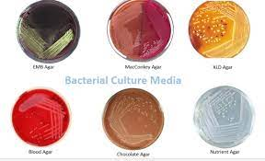
Simple/ basal media
Contain minimum ingredients that support the growth of non-fastidious bacteria.
Peptone water-It contains peptone (1%) + NaCl (0.5%) + water
Nutrient broth- It is made up of peptone water + meat extract (1%).
Nutrient agar-It is made up of nutrient broth + 2% agar.
Semisolid medium: It is prepared by reducing the concentration of agar to 0.2–0.5 %.

Slide 10
Uses of basal media
Testing the non-fastidiousness of bacteria
They serve as the base for the preparation of many other media.
Nutrient broth is used for studying the bacterial growth curve
Nutrient agar is the preferred medium for-
Performing the biochemical tests such as oxidase, catalase and slide agglutination test etc.
To study the colony character
Pigment demonstration

Slide 11
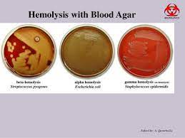
Enriched Media
Basal medium is added with additional nutrients such as blood, serum or egg.
In addition to non-fastidious organisms, they also support the growth of fastidious nutritionally exacting bacteria.
Blood agar -
Prepared by adding 5-10% of sheep blood to the molten nutrient agar at 45⁰C.
Tests the hemolytic property of the bacteria, which may be either- i) partial or α (green) hemolysis and ii) complete or β hemolysis

Slide 12
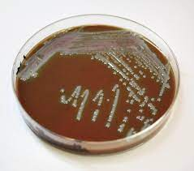
Enriched Media
Chocolate agar
Heated blood agar, prepared by adding 5-10% of sheep blood to the molten nutrient agar at 70⁰C
More nutritious than blood agar, and even supports certain highly fastidious bacteria such as Haemophilus influenzae that does not grow on blood agar.

Slide 13
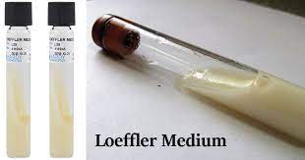
Enriched Media
Loeffler's serum slope- is used for isolation of Corynebacterium diphtheriae.
Blood culture media- Culturing microorganisms from blood specimen. They are either monophasic or biphasic media.
Monophasic medium -brain heart infusion (BHI) broth.
Biphasic medium has a liquid phase containing BHI broth and a solid agar slope made up of BHI agar.

Slide 14
Enrichment broth
Liquid media added with some inhibitory agents which selectively allow certain organism to grow and inhibit others.
Important for isolation of the pathogens from clinical specimens which also contain normal flora (e.g. stool and sputum specimen).
Tetrathionate broth (used for Salmonella Typhi)
Gram negative broth- for isolation of Shigella
Selenite F broth–for isolation of Shigella
Alkaline peptone water (APW)- for Vibrio cholerae

Slide 15
Selective media
Solid media containing inhibitory substances that inhibit the normal flora present in the specimen and allow the pathogens to grow.
Media | Used for isolation of
Lowenstein Jensen (LJ) medium | Mycobacterium tuberculosis
Thiosulphate Citrate Bile salt Sucrose (TCBS) | Vibrio species
DCA (Deoxycholate Citrate Agar) | Salmonella and Shigella from stool
XLD (Xylose Lysine Deoxycholate) agar | Salmonella and Shigella from stool
Potassium tellurite agar (PTA) | Corynebacterium diphtheriae
Wilson Blair bismuth sulphite medium | Salmonella Typhi.

Slide 16
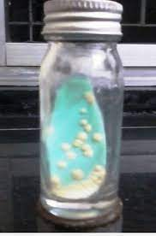
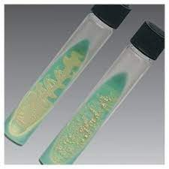
Selective media
Lowenstein LJ Media

Slide 17
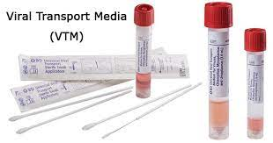
Transport media
Used for the transport of the clinical specimens suspected to contain delicate organism or when the delay is expected while transporting the specimens.
Bacteria do not multiply, they only remain viable.
Organism | Transport media
Streptococcus | Pike’s medium
Neisseria | Amies medium, Stuart’s medium
Vibrio cholerae | VR (Venkatraman-Ramakrishnan) medium Autoclaved sea water Cary Blair medium
Shigella, Salmonella | Buffered glycerol saline Cary Blair medium

Slide 18
Differential media
Differentiate between two groups of bacteria by using an indicator.
Differential media | Features
1)MacConkey agar | Differential and low selective medium -used for the isolation of enteric GNB. Differentiates organisms into LF (pink colonies, e.g. Escherichia coli) and NLF or (colorless colonies, e.g. Shigella). Composition- Peptone, lactose, agar, neutral red (indicator) and taurocholate

Slide 19
Differential media
Differential media | Features
2)CLED agar -Cysteine lactose electrolyte-deficient agar | Similar to MacConkey agar. Used as an alternative to combination of blood agar and MacConkey agar, for the processing of urine specimens Advantages over MacConkey agar-It is less inhibitory than MacConkey agar, supports the growth of Gram positive bacteria (except β hemolytic Streptococcus) and Candida. Advantage over blood agar -It can prevent the swarming of Proteus.

Slide 20
Anaerobic Culture Media
Contain reducing substances which take-up oxygen and create lower redox potential and thus permit the growth of obligate anaerobes such as Clostridium.
Robertson’s cooked meat (RCM) broth
Contains chopped meat particles (beef heart), which provide glutathione (a sulfhydryl group containing reducing substance) and unsaturated fatty acids.
Most widely used anaerobic culture medium.
Also used for maintenance of stock cultures.

Slide 21
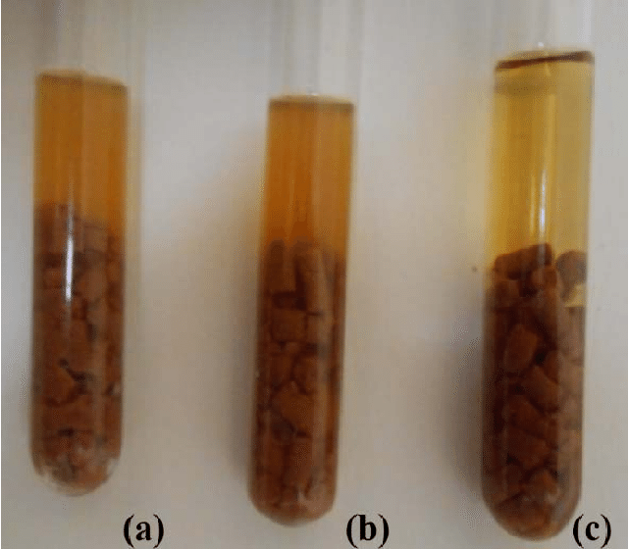
Anaerobic Media

Slide 22
Anaerobic Culture Media (cont..)
Other anaerobic media include
Thioglycollate broth
Anaerobic blood agar
BHIS agar-Brain heart infusion agar with supplements (vitamin K and hemin)
Neomycin blood agar
Egg yolk agar
Phenyl ethyl agar
Bacteroides bile esculin agar (BBE agar)

Slide 23
Synthetic media
Chemically defined media are used for various experimental purposes, prepared exclusively from pure chemical substances and their composition i.e exact quantity of each chemical used is known.

Slide 24
Simple synthetic media
Provide the basic essentials for the growth of many non-fastidious heterotrophs but they will not support growth of fastidious bacteria.

Slide 25
Complex synthetic media -
In addition to the above, certain aminoacids, purines, pyrimidines, and other growth factors are incorporated.
Hence, they can also support the growth of more exacting bacteria.

Slide 26
References
Textbook of Medical Microbiology by Ananthnarayan, Paniker
Textbook of Medical Microbiology by C.P Baweja
Textbook of Medical Microbiology by S. Bhat, A.S.Sastry
Textbook of Medical Microbiology by D.R.Arora, Brij bala Arora

