Slide 1
Production Isocost
Dr. Pooja Singh Assistant Professor, Department of Economics, School of Arts, Humanities And Social Sciences, Chhatrapati Shahu Ji Maharaj University, Kanpur

Slide 2
Production Isocost:
Isocost
Production Isocost or isocost line is defined as the locus of various combination of factors which a firm buys at a given level of output. As isocost line also shows the price of various combination , it is also known as price line.
Denotes different way to produce a given rate of output.
An isocost line is defined as the locus of output.
Isocost line plays a crucial role in determining the combination of inputs.
The slope of the isocost line shows the ratio of the price of labour to the price of capital or vice versa.

Slide 3
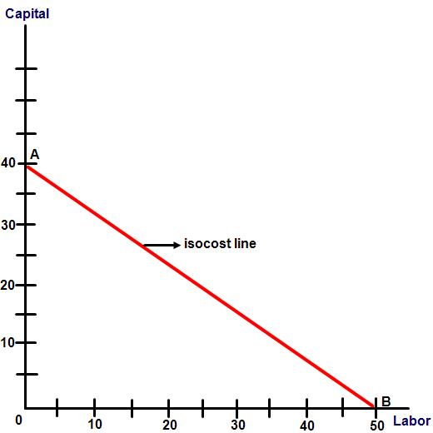
Isocost

Slide 4
References
Isocost
Dwivedi D N, Managerial Economics, Vikas Publishing House Pvt. Ltd, 2006
Samuelson, Paul A; Nordhaus, William D. (2014). Economics. Boston, Mass: Irwin McGraw-Hill

