Slide 1
Least Cost Combination
Dr. Pooja Singh Assistant Professor, Department of Economics, School of Arts, Humanities And Social Sciences, Chhatrapati Shahu Ji Maharaj University, Kanpur

Slide 2
Principle of Least Cost Combination
Least Cost Combination
An isoquant curve is the combination of various factors of production that gives the same level of output.On other hand , isocost line shows the combination prices that a firm incurs . A firm requires a maximum level of output at minimum cost.This can be achieved at the output where the isoquant touches the isocost line which shows the least cost combination available for particular firm.
Equilibrium point is where isoquant is tangent to isocost line.

Slide 3
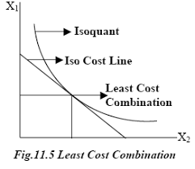
Least Cost Combination
Assumptions:
The assumptions on which this analysis is based are:
There are two factors. Capital and labor.
All units of capital and labor are homogeneous.
The prices of factors of production are given and constant.
Money outlay at any time is also given.

Slide 4
References
Least Cost Combination
Dwivedi D N, Managerial Economics, Vikas Publishing House Pvt. Ltd, 2006
Samuelson, Paul A; Nordhaus, William D. (2014). Economics. Boston, Mass: Irwin McGraw-Hill

