Slide 1
Institute of Hotel & Tourism Management

Slide 2
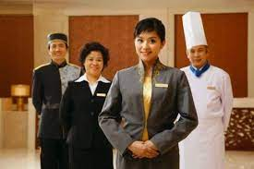
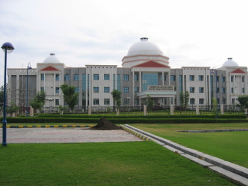
Institute of Hotel & Tourism Management
Chhatrapati Shahu Ji Maharaj University, Kanpur
Types of Service
Presented by – Saurabh Tripathi
IHTM, CSJM University Kanpur

Slide 3
Types of Service
American
Service
English
Service
French
Service
Russian
Service
Table Service

Slide 4
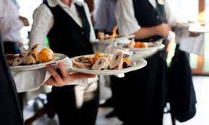
American Service
A table service style in which menu items are produced, portioned, plated & garnished in the kitchen plate (American plate), then carried to each guest directly. Pre plated foods are served by the servers from the right hand side of the guest. This type of service is usually presented in banquets, group events, etc. This service is also called plate service, Blue plate service or Pre-plated service.

Slide 5
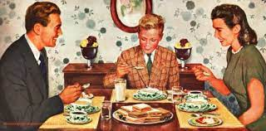
English Service
A table service style in which servers take food on large platters or in large bowls from the kitchen & deliver it to guest tables; the guest at each table then pass the food around their table, serving themselves.
It is also called as Host Service or Family Style Service.

Slide 6
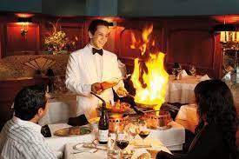
French Service
A table service style in which specially trained staff members prepares menu items besides the guest tables using a cart (or trolley); the food is prepared & plated on the cart, then served to the guest. Generally food items are previously partly or completely (or 75% cooking) prepared in the kitchen & only last touch or finishing is done at the table side. This service is also called as "Cart Service & its famous variation is "Guéridon service"

Slide 7
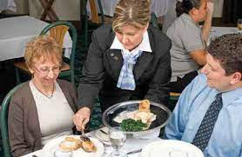
Russian Service
A table service style in which servers carry platters of fully cooked food from kitchen to the dining room and present to the guest for approval. Server has then set hot plates in front of each guest & offer food from the platter onto the guest plates. Steward has to give the service of food from left hand side of the guest with the help of service gears (service spoon + service fork). This service style is also called as "Platter to plate service or "Platter service".

Slide 8
Other specialized Service
Buffet Service
Cafeteria Service
Lounge Service
Room Service
Drive –in & Drive through Service
Take Away
Vending Machine

Slide 9
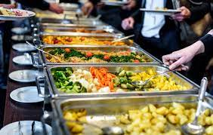
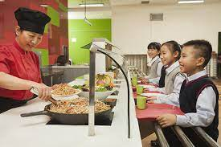
BUFFET SERVICE
CAFETERIA SERVICE

Slide 10
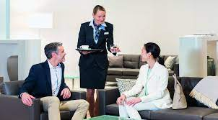
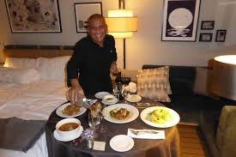
LOUNGE SERVICE
ROOM SERVICE

Slide 11
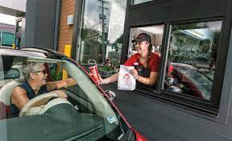
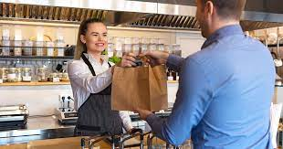
DRIVE –IN & DRIVE THROUGH SERVICE
TAKE AWAY

Slide 12
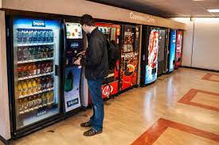
VENDING MACHINE

Slide 13
Thank you

