Slide 1
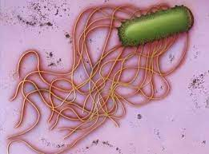
Proteus

Slide 2
PROTEUS
Historical Importance
Proteus species show pleomorphism
Named after Greek God ‘Proteus’ who was able to assume any shape

Slide 3
Naming of H and O antigens
O antigens- Somatic, H Antigens – Flagellar
H antigen
- Ability of flagellated strains of Proteus to grow on agar as a thin film resembling the film of breath on glass (German, ‘Hauch’ = ‘film of breath’)
 O antigen
- thin film is not observed when strains carrying only the somatic antigen (nonflagellated strains) grow on media (German, ‘Ohne Hauch’ = ‘without film of breath’)

Slide 4
Pathogenesis
Proteus mirabilis & P. Vulgaris commonly encountered species
Saprophytes: widely distributed in nature - decomposing animal matter, sewage & soil
Commensals: moist areas of the skin, intestine of humans and animals
Infections produced: opportunistic pathogens - urinary, wound and soft tissue infections and septicemia
Nosocomial outbreaks

Slide 5
Pathogenesis
Struvite stones in bladder: produce urease →breaks down urea to form ammonia that damages the renal epithelium and makes the urine alkaline → deposition of phosphate → renal calculi
Proteus as the basis of Weil–Felix Reaction
- Somatic antigen non-motile Proteus strains OX2, OX19 (from P.vulgaris) and OXK (from P.mirabilis) cross react with antigen of some Rickettsia species
- Proteus antigens are used to detect heterophile antibodies in sera of patients suffering from rickettsial infections

Slide 6
Laboratory Diagnosis
Specimen – According to type of infection
Direct Microscopy: Gram positive pleomorphic bacilli
 Pleomorphism: Proteus species are gram-negative coccobacilli occasionally appear bacillary and infila mentous forms
 Odour: They produce characteristic putrid fishy or seminal odour in cultures

Slide 7
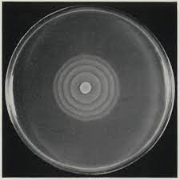
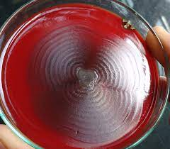
Cultural Characteristics
Swarming: ability to spread on the surface of solid media
Swarming patterns:  Continuous & Discontinuous swarming
Common problems in the laboratory: Proteus tends to swarm and overgrow other bacterial colonies in samples with multiple types ofbacteria.

Slide 8
Cultural Characteristics
Mechanism of swarming: At colony margin sparsely flagellated, short vegetative cells → multinucleated, densely flagellated, elongated cells (20–80 μm) - swarm cells
Swam cells - migrate to surrounding uninoculated
Transition from vegetative cells to swam cells takes place when the cells receive a number of extracellular and intracellular signals

Slide 9
Methods to prevent swarming:
Increased agar concentration to 6%
Incorporation of alcohol, boric acid, chloral hydrate, sodium azide, sulfonamide, surface active agents
Does not occur on MacConkey agar, CLED agar
Organisms exhibiting swarming:
P. mirabilis & P. vulgaris (not other members of tribe Proteeae)
Serratia marcescens, Vibrio parahaemolyticus & Clostridium tetani

Slide 10
Biochemical properties
Both P. mirabilis and P. vulgaris are:
Urease positive
Citrate variable
TSI - alkaline/acid, gas present and H2S present
MR positive but VP negative
Species differentiation
Test | P.vulgaris | P.Mirabilis
Indole Test | Positive | Negative
Ornithne decarboxylation | Negative | Positive

Slide 11
Typing of Proteus can be done by:
Bacteriocin typing
Bacteriophage typing
Ribotyping
- Dienes phenomenon: If swarming of two Proteus isolates inoculated next to each other
- Merge completely – identical strains
- Remain separated – both strains are different

Slide 12
References
Textbook of Medical Microbiology by Ananthnarayan, Paniker
Textbook of Medical Microbiology by C.P Baweja
Textbook of Medical Microbiology by S. Bhat, A.S.Sastry
Textbook of Medical Microbiology by D.R.Arora, Brij bala Arora

