Slide 1
Return to Scale
Dr. Pooja Singh Assistant Professor, Department of Economics, School of Arts, Humanities And Social Sciences, Chhatrapati Shahu Ji Maharaj University, Kanpur

Slide 2
Return to Scale
Return to Scale
Return to Scale refers to the change in output as all factors change by the same proportion .This is a long term conception. All the factors are variable in long run. No factors are fixed.
A production of a product can increase by increasing all factors in similar ratio or different ratios in long run.
Three Stages
Constant return to scale
Input = Output
Increasing return to scale
Output>Input
Decreasing return to scale
Output<Input

Slide 3
Return to Scale

Slide 4
Return to Scale
Increasing Returns to Scale: I Stage
Increasing Returns to Scale occurs when a given percentage increase in all factor inputs (in some constant ratio) causes proportionately greater increase in output.
Constant Returns to Scale :II Stage
Constant returns to scale occurs when a given percentage increase in all factor inputs (in some constant ratio) causes equal percentage increase in output.
Diminishing Returns to Scale :III Stage
Diminishing returns to scale occurs when given percentage increase in all factor inputs (in some constant ratio) causes proportionately less increase in output.

Slide 5
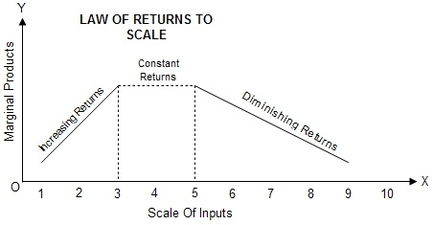
Return to Scale

Slide 6
References
Return to Scale
Dwivedi D N, Managerial Economics, Vikas Publishing House Pvt. Ltd, 2006
Samuelson, Paul A; Nordhaus, William D. (2014). Economics. Boston, Mass: Irwin McGraw-Hill

