Slide 1
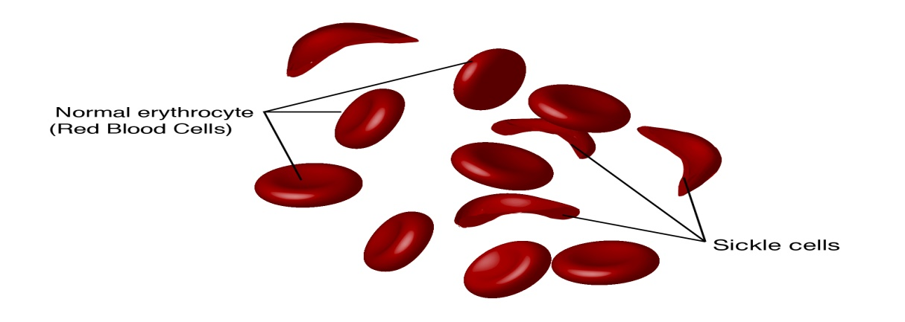
SICKLE CELL ANEMIA
BY
SWARNAKSHI UPADHYAY
ASSISTANT PROFESSOR
SCHOOL OF PHARMACEUTICAL SCIENCES,
CSJM UNIVERSITY

Slide 2
DEFINITION
Sickle cell anemia is one of a group of inherited disorders known as sickle cell disease.
It affects the shape of red blood cells, which carry oxygen to all parts of the body.
Red blood cells are usually round and flexible, so they move easily through blood vessels. In sickle cell anemia, some red blood cells are shaped like sickles or crescent moons. These sickle cells also become rigid and sticky, which can slow or block blood flow.

Slide 3
SYMPTOMS
Anemia. Sickle cells break apart easily and die. Red blood cells usually live for about 120 days before they need to be replaced. But sickle cells typically die in 10 to 20 days, leaving a shortage of red blood cells (anemia). Without enough red blood cells, the body can't get enough oxygen and this causes fatigue.
Episodes of pain
Swelling of hands and feet.
Frequent infections
Delayed growth or puberty
Vision problems

Slide 4
CAUSES
Sickle cell anemia is caused by a change in the gene that tells the body to make the iron-rich compound in red blood cells called hemoglobin. Hemoglobin enables red blood cells to carry oxygen from the lungs throughout the body. The hemoglobin associated with sickle cell anemia causes red blood cells to become rigid, sticky and misshapen.
For a child to be affected, both mother and father must carry one copy of the sickle cell gene — also known as sickle cell trait — and pass both copies of the altered form to the child.

Slide 5
If only one parent passes the sickle cell gene to the child, that child will have the sickle cell trait. With one typical hemoglobin gene and one altered form of the gene, people with the sickle cell trait make both typical hemoglobin and sickle cell hemoglobin.
Their blood might contain some sickle cells, but they generally don't have symptoms. They're carriers of the disease, however, which means they can pass the gene to their children.

Slide 6
PATHOPHYSIOLOGY
HbS is produced when there is a point mutation at position 6 of β-globin chain which change the glutamic acid to non-polar valine.
The absence of polar amino acid in position 6 of β-globin promote non-covalent polymerisation of haemoglobin when it is deoxygenated form.
The polymerisation causes change in shape of red blood cell (sickle).

Slide 7
COMPLICATIONS
Stroke
Acute chest syndrome
Pulmonary hypertension
Organ damage
Splenic sequestration
Blindness
Leg ulcers
Gallstones
Priapism
Deep vein thrombosis
Pregnancy complications

