Slide 1
SPORTS PSYCHOLOGY Dr. Sravan Kumar Yadav, Assistant Professor, Department of Physical Education, CSJMU, Kanpur (UP)

Slide 3
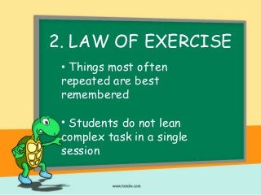

Slide 4
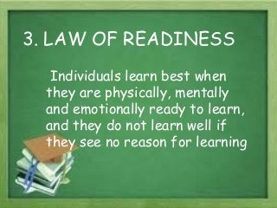

Slide 5
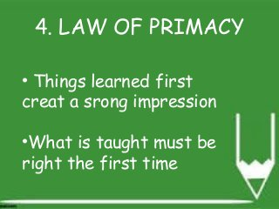

Slide 6
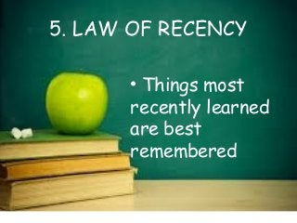

Slide 7
