Slide 1
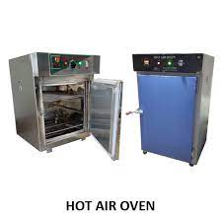
Hot air oven (Dry heat Sterilizer)
Most widely used method of sterilization by dry heat.
It is electrically heated and is fitted with a fan to ensure adequate and even distribution of hot air in the chamber.
It is also fitted with a thermostat which maintains the chamber air at a chosen temperature.
Holding temperature and time of 160°C for 2 hours.

Slide 2
Hot air oven (Dry heat Sterilizer)
Materials sterilized:
Glassware - syringes, petri dishes, flasks, pipettes and test tubes.
Surgical instruments - scalpels, forceps, etc.
Chemicals such as liquid paraffin, fats, glycerol, oil, and glove powder, etc.

Slide 3
Hot air oven - precautions
Overloading of hot air oven should be avoided.
Material should be arranged in a manner so that free circulation of air is maintained.
Material to be sterilized should be dried completely.
Cotton plugs should be used to close the mouths of test tubes, flasks, etc.
Paper wrapping of the items should be done.
Any inflammable material like rubber (except silicone rubber) should not be kept inside the oven.
Oven must be allowed to cool for two hours before opening the doors, since the glassware may crack by sudden cooling.

Slide 4
Hot air oven - Sterilization control
Biological indicator: Spores (10⁶)
Bacillus atrophaeus - to check the effectiveness of sterilization by dry heat. Earlier, non-toxigenic strain of Clostridium tetani was used.
Spores should be destroyed if the sterilization is done properly.
Physical control: For example, digital displays on the equipment displaying temperature and time.

Slide 5
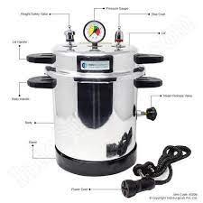
Autoclave
Autoclave comprises of three parts
Pressure chamber
Lid
Electrical heater.

Slide 6
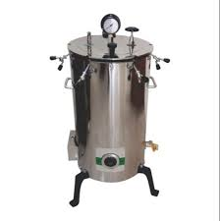
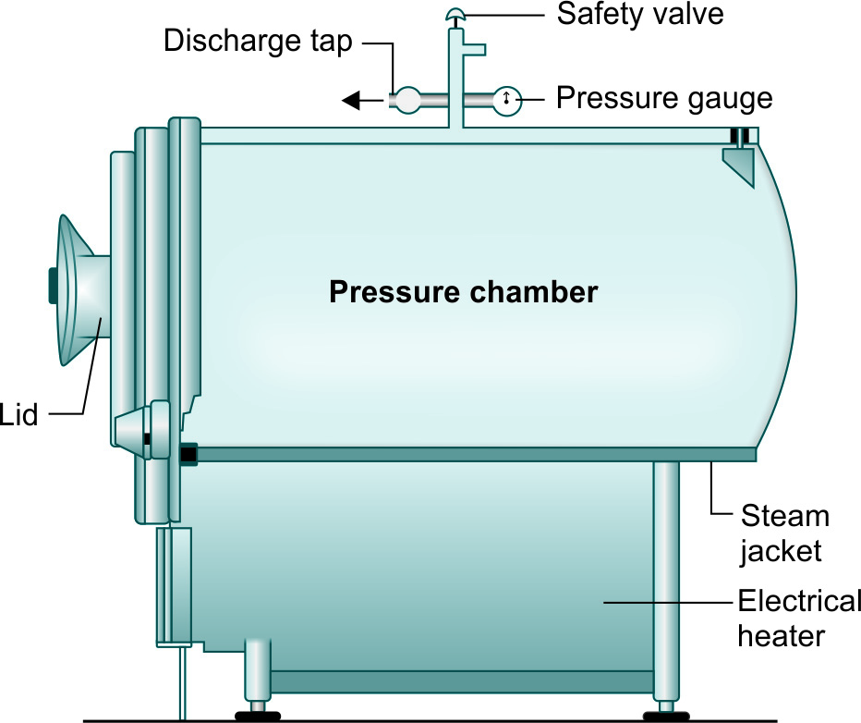
Horizontal autoclave and Vertical autoclave

Slide 7
Sterilization Conditions
Autoclave can be set to provide higher temperatures by adjusting the pressure provided to the vessel.
121⁰C for 15 minutes at pressure of 15 lbs psi.
126 ⁰ C for 10 minutes at pressure of 20 psi.
133 ⁰ C for 3 minutes at pressure of 30 psi.

Slide 8
Uses of Autoclave
Surgical instruments
Culture media
Autoclavable plastic containers
Plastic tubes and pipette tips
Solutions and water
Biohazardous waste
Glassware (autoclave resistible).

Slide 9
Precautions to be taken
Autoclave should not be used for sterilizing waterproof materials
Materials are loaded in such a way that it allows efficient steam penetration (do not overfill the chamber)
Material should not touch the sides or top of the chamber
Clean items and the wastes should be autoclaved separately
olyethylene trays should not be used as they may melt and cause damage to the autoclave.

Slide 10
Types of Autoclaves
Gravity displacement type autoclave: most commonly used.
Positive pressure displacement type autoclave
Negative pressure (vacuum) displacement type.

Slide 11
Sterilization control
Biological indicator: Spores of Geobacillus stearothermophilus (formerly called Bacillus stearothermophilus). Spores are killed in 12 minutes at 121°C
Chemical indicators
Class I - external pack control, (e.g. autoclave tape)
Class II - equipment control (Bowie-Dick test)
Class IV/V - internal pack control.
Physical control: For example, digital displays on the equipment displaying temperature, time and pressure.

Slide 12
References
Textbook of Medical Microbiology by Ananthnarayan, Paniker
Textbook of Medical Microbiology by C.P Baweja
Textbook of Medical Microbiology by S. Bhat, A.S.Sastry
Textbook of Medical Microbiology by D.R.Arora, Brij bala Arora

