Slide 1
LEPTOSPIRA - CLASSIFICATION
Phenotypic Classification
Species: Leptospira
1. L. interrogans (pathogenic for humans): It causes leptospirosis or Weil’s disease involving liver and kidney
2. L. biflexa (saprophyte)
Serovars and serogroups:
- L. interrogans - 26 serogroups → >300 serovars
- Serogroup Icterohaemorrhagiae → serovars Icterohaemorrhagiae, Copenhageni, Lai, Naam and Mwogolo 

Slide 2
LEPTOSPIRA - CLASSIFICATION
Serogroups of Leptospira interrogans
Australis | Grippotyphosa | Sarmin
Autumnalis | Hebdomadis | Sejroe
Ballum | Icterohaemorrhagiae | Semaranga
Bataviae | Javanica | Tarassovi
Canicola | Leptonema | Hurstbridge
Celledoni | Lyme | Ranarum
Cynopteri | Mini | Turneria
Djasiman | Pomona | Manhao

Slide 3
LEPTOSPIRA INTERROGANS
Size: 6–12 μm × 0.1 μm → pass through filters used to sterilize culture medium
Tightly & regularly coiled, with characteristic hooked ends - interrogans— resembling interrogation mark
Single endoflagellum attached at pole →highly motile exhibiting spinning and translational movements
Dark ground or phase contrast microscope
Silver impregnation method and immunofluorescence

Slide 4
Epidemiology
Zoonotic
Source: Rats, dogs, cattle and pigs
Mode of transmission: Direct human-to-human transmission does not occur
Indirect contact with water, moist soil and wet surfaces contaminated with animal urine
Direct contact with urine and products of parturition, placenta of infected animals
Seasonality: Rainy and post monsoon period

Slide 5
Epidemiology
Risk factors that promote transmission
Lower socioeconomic status, Urban and rural slum areas
Rainfall and floods
Occupational exposure: Agricultural workers, fishermen, sewer workers
3R’s: Three important epidemiological determinants - rodents, rainfall and rice field

Slide 6
Pathogenesis
1. First phase (septicemic phase): Entry through mucosa/ abraded skin → bloodstream → disseminate brain, liver, lung, heart & kidney
Vascular damage: capillaries, medium and large -sized vessels
Penetration and invasion of tissues due to active motility and release of hyaluronidase

Slide 7
Pathogenesis
2. Second phase (immune phase):
Antibodies develop, spirochetes disappear from the blood
Antigen antibody complexes are deposited in various organs
 Renal colonization - excreted in urine
Clinical Manifestations
- Incubation period 5–14 days
1. Mild anicteric febrile illness: (90%)
Biphasic; septicemic phase → immune phase
2. Weil’s disease (Hepato-renal-hemorrhagic syndrome): (10% )
- Severe form of icteric illness patients.

Slide 8
Leptospirosis
 | Mild anicteric febrile illness
 | First stage 3-10 days (septicemic) | Second stage 10-30 days (immune)
Clinical Findings | Fever, Myalgia, Headache, Conjunctival, suffusion, Abdominal pain, Pharyngeal, erythema Without , Exudates, Vomiting | Meningitis, Uveitis, optic neuritis, chorioretinitis Rash, Fever Peripheral neuropathy
Isolation | From blood and CSF | From Urine
Serum IgM | Absent | Present
Antibiotics | Susceptible to antibiotics | Refractory to treatment

Slide 9
Leptospirosis
 | Weil’s disease
 | First stage 3-10 days (septicemic) | Second stage 10-30 days (immune)
Clinical Findings | High grade fever, Liver- Jaundice and raised liver enzymes Hemorrhages- Pulmonary hemorrhage, Petechiae & purpura, Conjunctival hemorrhage, Gastrointestinal hemorrhage Kidney- Raised serum urea and creatinine & Renal failure
Isolation | Blood and CSF | Urine
Serum IgM | Absent | Present
Antibiotics | Susceptible to antibiotics | Refractory to treatment

Slide 10
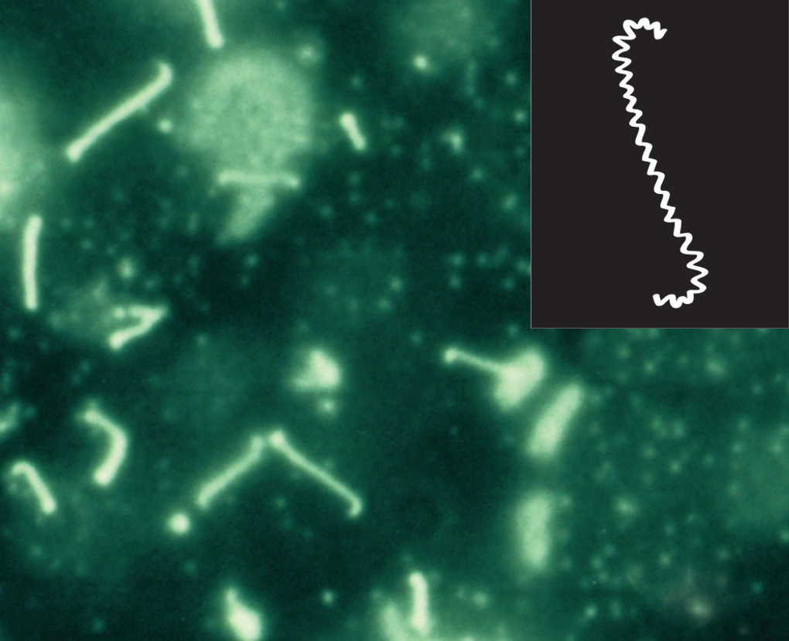
Laboratory Diagnosis
Specimens:
First 10 days - CSF and blood urine
Between 10 and 30 days - Urine
Microscopy:
Wet films: Dark ground or phase contrast microscope
Staining: sliver impregnation stains - Fontana stain & modified Steiner technique

Slide 11
Isolation
Culture condition: Obligate aerobe and slow growing
Incubated at 30ºC for 4–6 weeks at pH 7.2–7.5
Culture fluid examined under dark ground microscope periodically
EMJH medium (Ellinghausen, McCullough, Johnson, Harris) - albumin fatty acid supplement added to the basal media containing 0.1% agar.
Dinger’s ring - Dense ring of growth under surface of the medium

Slide 12
Isolation
Korthof ’s medium with rabbit blood
Fletcher’s semisolid medium
Advantages
Isolation confirms the diagnosis
To maintain the stock culture

Slide 13
Laboratory Diagnosis
Disadvantages of Culture
Laborious, technically demanding and time-consuming
False-positive - contamination of culture media with other organisms or saprophytic leptospires
 False-negative - prior use of antibiotics, or incubating in improper temperature and pH
Animal inoculation: Hamsters (4–6 weeks old) & young guinea pigs → peritoneal fluid is examined for leptospires

Slide 14
Serology for antibody detection:
Genus-specific tests: uses antigen prepared from nonpathogenic L.biflexa Patoc 1 strain
Macroscopic slide agglutination test
Microcapsule agglutination test (MCAT)
Latex agglutination test
ELISA: IgM and IgG detected separately 
Lepto dipstick assay: detects IgM

Slide 15
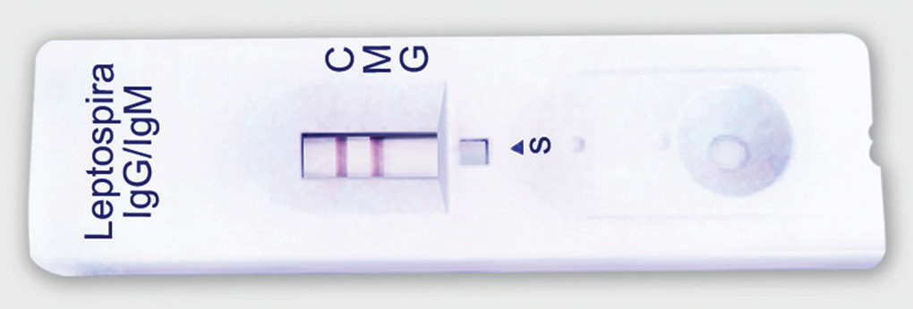
Serology for antibody detection:
Immunochromatographic test (ICT): It detects IgM and IgG antibodies separately

Slide 16
Serology for antibody detection:
Serovar-specific test:
Microscopic agglutination test (MAT) - detects antibodies against specific serovars of L. Interrogans
Gold standard method and reference test 
Cross agglutination and absorption test (CAAT) – detects relatedness between the strains

Slide 17
Laboratory Diagnosis
Molecular methods: PCR
- Useful in severe disease, before seroconversion occurs
Target Genes -16S or 23S rRNA or IS1533 insertion sequence
PCR is not serovar-specific
PCR-RFLP or PFGE - to determine the genomo species
Faine’s criteria: WHO-approved guideline - based on clinical, epidemiological and laboratory findings
Altered renal and liver function – nonspecific finding

Slide 18
Prevention
Vaccine
Whole cell vaccines (mono- or polyvalent)
Route – Subcutaneous
Doses: 2 doses at 15-days interval → third dose 4–6 month later →biannual revaccination
Efficacy rate - 60–100%

Slide 19
Prevention
General Measures
Chemoprophylaxis - doxycycline
General sanitation approaches - proper waste disposal, Rodent control
Avoidance of swimming in contaminated places
Health education

