Slide 1
Production
Dr. Pooja Singh Assistant Professor, Department of Economics, School of Arts, Humanities And Social Sciences, Chhatrapati Shahu Ji Maharaj University, Kanpur

Slide 2
Production:
Production
Production is a process of converting inputs into products or services.
“The relation between a firm’s physical production (output) and the material factors of production (input) is referred to as production function.”
-Watson
Production Function:
It studies the fundamental difference between physical input and output.
Below is its formula.
$$Q=f(K,L)$$
Q= Production function
K= Capital
L= Labour

Slide 3
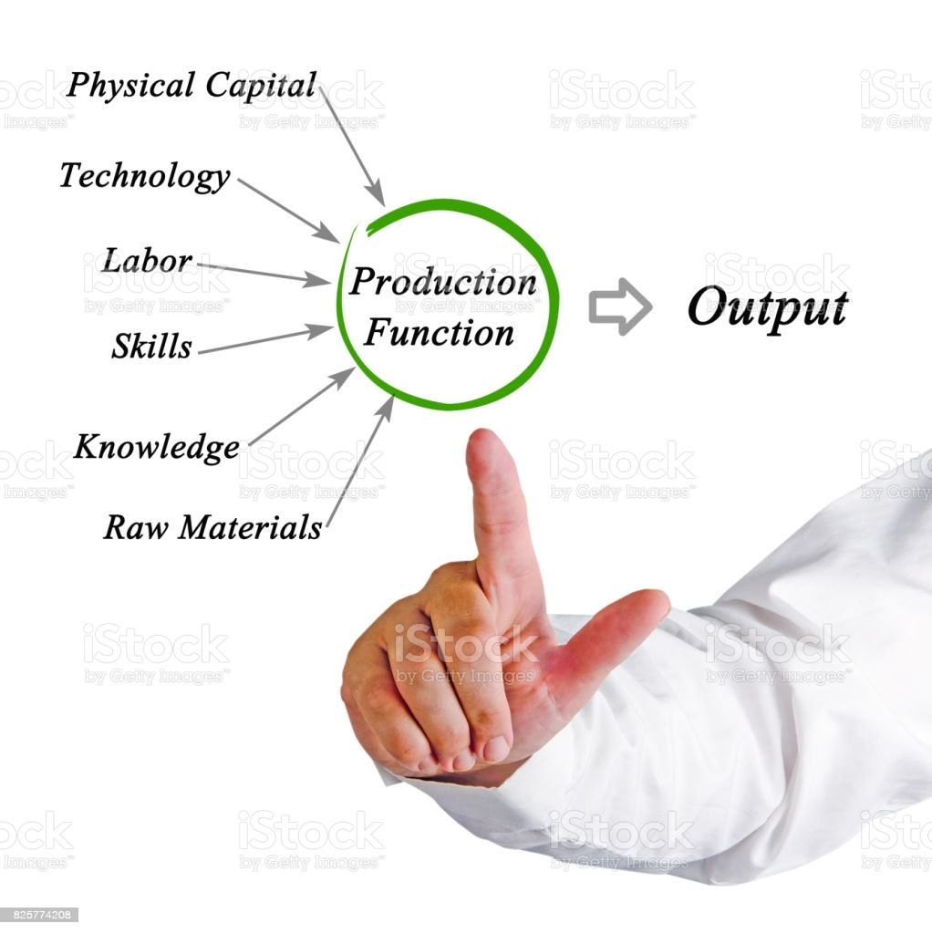
Production
The production function neither provide any information on the least cost capital, nor does it reveal the output rate that will yield the maximum profit.
The production function simply reveal the maximum output that can be obtained from any and all input combination.

Slide 4
Concept of Product
Production
Total product-
It refers to the total amount of output that a firm produces within a given period, utilising given inputs.
Total Product= Average product∗ Labour
Average Product-
Total product per unit of factor employed in the production process.
Average Product= Total product∕ Labour

Slide 5
Production
Marginal Product-
It denotes the addition of variable factor to total product.
$$MP=\frac{ΔQ}{ΔL}$$
In other ways, marginal product leads to an increase of total product with the help of additional worker or input.

Slide 6
Relationship between Total Product and Marginal Product:
Production Function
When TP increases at an increasing rate, MP increases.
When TP increases at diminishing rate MP declines.
When TP reaches its maximum then MP becomes zero.
When TP begins to decline then MP becomes negative.
Marginal Product = ∑ Total Product

Slide 7
Relationship between Average Product and Marginal Product:
Production
Marginal product remains above an average product when AP rises.
Average product and marginal product become equal at the maximum AP.
Similarly, MP remains below AP, in case AP declines.
MP becomes negative and AP declines but will always be greater than zero

Slide 8
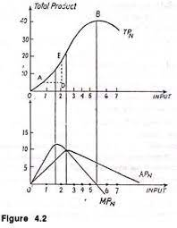
Production

Slide 9
References
Production Function
Dwivedi D N, Managerial Economics, Vikas Publishing House Pvt. Ltd, 2006
Samuelson, Paul A; Nordhaus, William D. (2014). Economics. Boston, Mass: Irwin McGraw-Hill.

