Slide 1
Return to Factor
Dr. Pooja Singh Assistant Professor, Department of Economics, School of Arts, Humanities And Social Sciences, Chhatrapati Shahu Ji Maharaj University, Kanpur

Slide 2
Return to Factor
Return to Factor
The process of changing the quantity of production when all the factors are stable and only the variable inputs are changed is called Return to a Factor.
Returns to a factor relates to the behaviour of total output as one variable input, say labour, is varied.
It is a short-run concept.
In modern time, it is called Law of Variable Proportions. It can also be said the Law of Diminishing Marginal Product, Diminishing Marginal Returns or Diminishing Returns.

Slide 3
Assumptions:
Return to Factor
There are only two factors of production, labour and capital.
Labour is the variable factor and capital is the fixed factor.
One factor of production is variable while others are fixed.
All units of variable factors are equal or expertise.
There is no change in production technique

Slide 4
Three Stages of Production:
Return to Factor
Stage 1: Increasing Return to a Factor:
The inputs of variable factors increase in the first stage, the marginal production increases. Thus, TP increases in increasing rate.
Stage 2: Diminishing Return to a Factor:
The marginal production decreases by inputs of variable factors. Thus, TP increases in decreasing rate.
Stage 3:Negative Return to a Factor:
The marginal production gets negative by inputs of variable factors. Thus the total production gets declined.

Slide 5
Return to Factor
Fixed Factor (Land)(acres) | Variable Factor (Labour) | Total Product (units) | Marginal Product (units) | Stages
1 | 1 | 10 | 10 | Stage I: Increasing Returns to a Factor
1 | 2 | 30 | 20
1 | 3 | 45 | 15 | Stage II: Diminishing Returns to a Factor
1 | 4 | 52 | 7
1 | 5 | 52 | 0
1 | 6 | 48 | -4 | Stage III: Negative Returns to a Factor

Slide 6
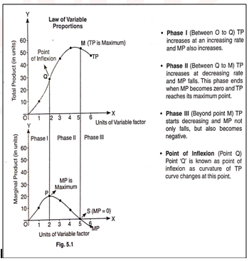
Diagrammatic Representation :
Return to Factor

Slide 7
References
Return to Factor
Dwivedi D N, Managerial Economics, Vikas Publishing House Pvt. Ltd, 2006
Samuelson, Paul A; Nordhaus, William D. (2014). Economics. Boston, Mass: Irwin McGraw-Hill

