Slide 1
Enterobacteriaceae
Salmonella

Slide 2
Classification
Clinical Classification
Oldest, user friendly classification widely used
Typhoidal Salmonella:
Includes serotypes S. Typhi and S. Paratyphi
Restricted to human hosts → enteric fever (typhoid/paratyphoid fever)
2. Non-typhoidal Salmonella or NTS:
Colonize intestine of animals
Also infect humans → gastroenteritis & septicemia

Slide 3
ANTIGENIC STRUCTURE
Three important antigens on their cell wall
1. Somatic antigen (O)
2. Flagellar antigen (H)
3. Surface envelope antigen (Vi)—found in some species
- Fimbrial antigens - present in some strains
- Nonspecific, widespread among other members of Enterobacteriaceae

Slide 4
Features of O and H Antigen
O antigen | H antigen
Somatic antigen Part of cell wall lipopolysaccharide (LPS) | Flagellar antigen Made up of proteins –flagellin confers motility to the bacteria.
Heat stable , Alcohol stable | Heat labile, Alcohol labile
Formaldehyde labile | Formaldehyde stable
In Widal test- O antigen of S.Typhi is used | In Widal test- H antigens of S.Typhi, S.Paratyphi A and B are used
O Ag is less immunogenic | H Ag is more immunogenic

Slide 5
Features of O and H Antigen
O antigen | H antigen
O antibody appears early, disappears early – indicates recent infection | H antibody appears late, disappears late- Indicates convalescent stage
When O antigen reacts with O antibody- forms compact, granular, chalky clumps Agglutination takes place slowly. Optimum temperature for agglutination is 55⁰C | When H antigen reacts with H antibody- forms large, loose, fluffy clumps. Agglutination takes place rapidly. Optimum temperature for agglutination is 37⁰C

Slide 6
Features of O and H Antigen
O antigen | H antigen
Serogrouping is based on the O antigen | Serogroups are differentiated into serotypes based on H antigen
Also called Boivin antigen- extracted from bacterial cell by treatment with trichloracetic acid, first shown by Boivin | Flagellar antigens exist in two alternative phases – Phase I and II. Most of them are biphasic except, (monophasic - S.Typhi)

Slide 7
Vi Antigen
Surface polysaccharide envelope or capsular antigen covering the O antigen
Named with belief that Vi antigen is related to virulence
Expressed in only few serotypes - S. Typhi, S.Paratyphi C, S. dublin and some stains of Citrobacter freundii (Ballerup-Bethesda group)
Renders the bacilli inagglutinable with O antiserum → agglutinable after boiling / heating at 100°C for 1 hour, which removes Vi antigen

Slide 8
Vi Antigen
Poorly immunogenic & antibody titers are low → Not helpful in diagnosis of cases
Complete absence of Vi antibody → poor prognosis
Disappears early in convalescence. If persists → carrier state
Phage typing of S. Typhi - using Vi specific bacteriophages
Vi antigens - used for vaccination

Slide 9
TYPHOIDAL SALMONELLA
S. Typhi and S. Paratyphi A, B and C which cause enteric fever
Pathogenesis
Transmitted - feco oral
Infective dose- Minimum 10³–10⁶ bacilli
Risk factors that promote transmission: Conditions that decrease:
Stomach acidity (<1 year age, antacid ingestion, or achlorhydria or prior Helicobacter pylori infection)
Intestinal integrity (inflammatory bowel disease, prior GIT surgery or suppression of the intestinal flora by Antibiotics)

Slide 10
Pathogenesis
Entry through epithelial cells (M cells) lining the intestine
- Bacteriamediated endocytosis (BME) - mediated by type III secretion system
Entry into macrophages: Salmonellae containing vacuoles cross epithelial layer to reach submucosa → phagocytosed by macrophages
Survival inside macrophages: induces certain alterations on its surface → insusceptible to the lysosomal enzymes

Slide 11
Pathogenesis
Primary bacteremia: From inside macrophages spread via the lymphatics to enter the blood stream (transient primary bacteremia)
Spread: Disseminate throughout reticuloendothelial tissues (liver, spleen, lymph nodes and bone marrow → further multiplication
Secondary bacteremia occurs from the seeded organs → clinical disease

Slide 12
Clinical Manifestations
Incubation period - 10–14 days
Fever (step ladder pattern type of remittent fever):
Other symptoms: Headache, chills, cough, sweating, myalgia and arthralgia
Rashes (called rose spots): Faint, salmon-colored, blanching, maculopapular rash - trunk and chest (30%)
Early intestinal manifestations - abdominal pain, nausea, vomiting and anorexia
 Important signs - hepatosplenomegaly, epistaxis and relative bradycardia

Slide 13
Clinical Manifestations
Complications: Gastrointestinal bleeding and intestinal perforation – in third and fourth weeks of illness
Neurologic manifestations –
- Meningitis, cerebellar ataxia and neuropsychiatric symptoms ( “muttering delirium” or “coma vigil”)
- Paranoid psychosis, hysteria, delirium and aggressive behavior

Slide 14
Laboratory Diagnosis
Duration of illness | Specimen used and test done
First week | Culture of– Blood, Bone marrow aspirate, Duodenal aspirate
Second week and Third week | Serum- For antibody detection by Widal test For antigen detection Stool and urine culture
Fourth week | Stool and urine culture
Carriers | Stool and urine culture Serum- for detection of antibodies to Vi antigen Sewage culture- indirect way

Slide 15
Laboratory Diagnosis - Culture and identification
Blood Culture
Sensitivity 90% in first week
Clot culture: Blood is centrifuged → serum for Widal test and clot for culture
Culture medium:
Conventional: Brain heart infusion broth, Castaneda’s biphasic medium (BHI agar slope and BHI broth)
Automated blood culture systems - BACTEC orBacT/ALERT

Slide 16
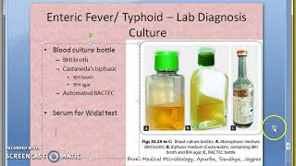
Media for Blood culture

Slide 17
Isolation
Sodium polyanethol sulfonate (SPS): Anticoagulant, Counteracts bactericidal action of blood
Incubation: at 37°C for up to 1 week.
Repeat subcultures:
Monophasic BHI medium: Periodical subcultures onto blood agar and MacConkey agar
Biphasic medium BHI is preferred over monophasic - subcultures in the same bottle
Automated blood culture systems – monitor growth continuously & positive growth flagged → subcultures done

Slide 18
Isolation
Enrichment broth - Selenite F broth, tetrathionate broth and gram-negative broth are used
Selective media such as:
Low selective media - MacConkey agar – Colourless colonies

Slide 19
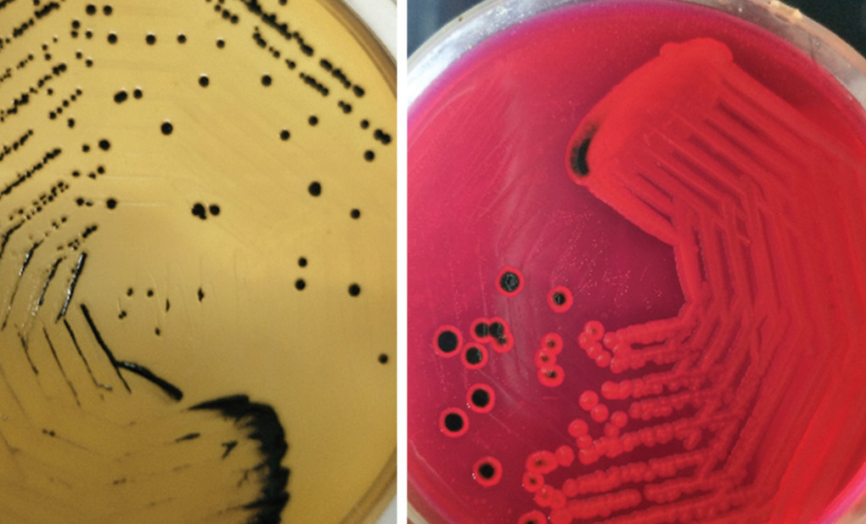
Isolation
Highly selective media:
DCA (deoxycholate citrate agar): pale colonies with black center
XLD agar (xylose lysine deoxycholate): red colonies with black center

Slide 20
Isolation
SS agar (shigella Salmonella agar): colorless with black centers
Hektoen enteric agar: Bluegreen colonies with black centers
Wilson Blair’s brilliant green Bismuth sulfite medium –jet black colored colonies with a metallic sheen due to production of H2S

Slide 21
Other Specimens
Bone marrow culture - first week of illness (55–90% sensitive) when blood culture is negative, especially when patient is on antibiotics
Duodenal aspirate culture - first week of illness if both blood and bone marrow cultures turn negative
Combination of blood, bone marrow, and intestinal secretions culture is the best method in the first week, which shows a sensitivity of more than 90%

Slide 22
Identification
Culture Smear and Motility Testing
Gram-negative, non-sporing and non–capsulated bacilli
Motile with peritrichous flagella
Biochemical Identification
Catalase positive and oxidase negative
Indole test—negative
Citrate test—positive (except for S. Typhi and S. Paratyphi A, which are citrate negative)
Urease test—negative

Slide 23
Biochemical Identification
Biochemical Identification of Salmonellae
TSI shows: Alkaline/acid, Gas present (except for S. Typhi, which is anaerogenic),
Abundant H2S present except for:
S. Paratyphi A and S. Choleraesuis: H2S not produced 
S. Typhi: Speck of H2S
MR positive and VP negative

Slide 24
Biochemical Identification
Sugar fermentation test: Gluocse, mannitol, arabinose, Maltose, dulcitol and sorbitol are fermented
Decarboxylation test
S. Typhi—only lysine is decarboxylated
S. Paratyphi A— only ornithine is decarboxylated
S. Paratyphi B— positive for all, i.e. lysine, arginine and ornithine

Slide 25
Demonstration of Serum Antibodies
Widal Test
Principle: Tube agglutination test where H and O antibodies against S. Typhi and S. Paratyphi A and B are detected
Antigens used: Four antigens are used
1. O antigens of S. Typhi (TO)
2. H antigens of S. Typhi (TH)
3. H antigens of S. Paratyphi A (AH)
4. H antigens of S. Paratyphi B (BH)

Slide 26
Widal Test
Procedure of Widal test:
Patient’s serum is serially diluted in normal saline in test tubes from 1 in 10 to 1 in 640 dilutions
Four such sets are made
To each set of diluted sera, respective four antigen suspensions (TO, TH, AH, BH) are added
Control tubes containing the antigens and normal saline should be kept to check for autoagglutination
Test tubes are incubated in water bath at 37°C overnight

Slide 27
Widal Test
Results:
O agglutination - compact granular chalky clumps (disk-like pattern), with clear supernatant Fluid 
H agglutination - loose fluffy cotton-woolly clumps, with clear supernatant fluid
No agglutination - button formation & supernatant fluid remains hazy

Slide 28
Widal Test - Interpretation
Widal test result | Suggestive of -
Rise of TO and TH antibody | Enteric fever due to S.Typhi
Rise of TO and AH antibody | Enteric fever due to S.Paratyphi A
Rise of TO and BH antibody | Enteric fever due to S.Paratyphi B
Rise of only TO antibody | Recent infection -Due to any serotype -S.Typhi or S.Paratyphi A or B
Rise of only TH antibody | ? Convalescent stage/ Anamnestic response
Rise of all three TH, AH, BH antibodies- | Post TAB vaccination

Slide 29
Widal Test
Titer: The highest dilution of sera, at which agglutination occurs
Significant titer: In India
H agglutinin titer more than 200
O agglutinin titer more than 100
Low titers should be ignored and considered as baseline titers in endemic areas

Slide 30
Widal Test
False-positive:
Anamnestic response: Transient rise of titer due to unrelated infections (malaria, dengue) in persons who have had prior enteric fever
Antigen suspensions are not free from fimbriae
Persons with inapparent infection
Persons with prior immunization (with TAB vaccine)
Fourfold rise in antibody titer demonstrated by testing paired sera at 1 week interval is more meaningful

Slide 31
Widal Test
False-negative:
Early stage (1st week of illness) & Late stage (after fourth week)
Carriers
Patients on antibiotics
Prozone phenomena (antibody excess)— this can be obviated by serial dilution of sera
O agglutinins appear early and disappear early and indicate recent infection. H agglutinins appear late and disappear late

Slide 32
Widal test
O antibodies are serotype nonspecific. H antibodies are specific
Other Antibody Detection Tests
Typhidot test: OMP (outer membrane protein) antigen is used, detects both IgM and IgG antibodies
IDLTubex test: O9 antigen is used, detects only IgM antibodies against S. Typhi
IgM dip stick test and ELISA detect anti-LPS IgM antibodies
Dot blot assay: Flagellar antigen is used, detects only IgG antibodies

Slide 33
Other Tests
Demonstration of Salmonella Antigen
- Present blood & urine - ELISA
Molecular Methods
PCR-based methods - detect and differentiate typhoidal salmonellae - flagellin gene, Iro B and fliC gene
Other Nonspecific Methods
WBC count: Neutropenia (15–25%), Leukocytosis - children
Liver function tests moderately deranged
Muscle enzyme levels moderately elevated

Slide 34
Detection of Carriers
 Culture: Stool and bile culture (detects fecal carriers) and urine culture (detects urinary carriers)
Detection of Vi antibodies:
Tube agglutination test using S. Typhi suspension carrying Vi antigen (Bhatnagar strains)
Titer of 1:10 is also considered as significant
Isolation of salmonellae from sewage: To trace the carriers in the communities
Sewer–swab technique & Filtration

Slide 35
Typing of Salmonellae (Typhoidal and Non-typhoidal)
For surveillance and determining the source of food-borne infections and outbreaks in hospitals
Phenotypic methods: have low discriminatory power
Phage typing is done for S. Typhi - Vi phage II.
- Phage types most widespread and abundant throughout the world are E1 and A, followed by B2, C1, D1, and F1
Bacteriocin typing and biotyping
Antibiogram typing

Slide 36
Typing of Salmonellae (Typhoidal and Non-typhoidal)
Genotypic methods: They have good discriminating ability
Insertion sequence (IS) 200 typing
Pulse field gel electrophoresis (PFGE)
Ribotyping
PCR-based methods: Random amplified polymorphic DNA typing (RAPD) and PCR-RFLP (Restriction fragment length polymorphism)
Sequence-based typing

Slide 37
Prophylaxis
Control of Reservoir
Control of Cases
Early diagnosis and prompt effective treatment
Disinfection of stool or urine soiled clothes with 5% cresol, 2% chlorine or by steam sterilizer
Follow up examination of stool and urine culture to detect carriers (twice, at 3–4 months and at 12 months)

Slide 38
Prophylaxis
Control of Carriers
Early detection of carriers by stool/urine culture or by detection of Vi antibodies
Effective treatment of carriers by:
Ampicillin or amoxicillin (4–6 g/day) plus probenecid (2 g/day) for 6 weeks
Surgery: Cholecystectomy plus ampicillin

Slide 39
Prophylaxis
Sanitation measures
Protection and purification of drinking water supplies
Handwashing and improvement of basic sanitation
Promotion of food hygiene & Health education
Vaccine
Provides short time protection, Indications
Travellers going to endemic areas, those attending melas and yatras
Household contacts & People at increased risk (school children)

Slide 40
Clinical Manifestations
Gastroenteritis: most common - nausea, vomiting, watery diarrhea, fever and onset of abdominal cramps
Bacteremia: Up to 8% of patients → endovascular infection or seedling to various organs → metastatic localized infection
- Risk factors for bacteremia:
NTS serotype: Most common - S. Choleraesuis & S. Dublin
Age: Infants and elderly people are at higher risk
HIV and other conditions with low immunity
Endovascular infections - endocarditis and arteritis

Slide 41
Metastatic localized infections :
Intra-abdominal infections - hepatic or splenic abscesses or cholecystitis
Meningitis (commonly in infants)
Pulmonary infections - lobar pneumonia and lung abscess
Pyelonephritis & cystitis – Calculi & urinary tract abnormality
Genital tract infections - ovarian, testicular abscesses, prostatitis and epididymitis
Osteomyelitis: associated with sickle cell disease
Reactive arthritis (Reiter’s syndrome) - HLA-B27

Slide 42
References
Textbook of Medical Microbiology by Ananthnarayan, Paniker
Textbook of Medical Microbiology by C.P Baweja
Textbook of Medical Microbiology by S. Bhat, A.S.Sastry
Textbook of Medical Microbiology by D.R.Arora, Brij bala Arora

