Slide 1
PLANT TISSUE
CULTURE
Syllabus
Historical development
of
plant
tissue
culture,
types
growth
of
and
cultures,
Nutritional
requirements,
their
maintenance.
Applications
of
plant tissue culture in pharmacognosy.
1

Slide 2
INTRODUCTION
Tissue
Culture
Plant
Tissue Culture
Animal
Tissue Culture


Definition:
Plant-tissue culture is in-vitro
cultivation of plant cell or tissue under
aseptic
and
controlled environment
conditions,
in
liquid or
on
semisolid well defined nutrient medium for the production of primary
and secondary metabolites or to regenerate plant.

In other words it is an experimental technique through which a mass of
cells (callus) is produced from an explant tissue.
The callus produced through this process can be utilized directly to regenerate palntlets or to extract or manipulate some primary and secondary metabolites.

2

Slide 3
▪
The plant tissue culture refers to the cultivation of a plant cell
which normally forms a multicellular tissue.
When grown on agar medium, the tisse forms a callus or a mass
▪
of
undifferentiated
cells. The
technique of
cell culture is
convinient for starting and maintaining cell lines, as well as, for
studies pertaining to organogensis and meristem culture.
▪
The technique of in-vitro cultivation of plant cells or organs is
primarily devoted to solve two basic problems:
1.
To keep the plant cells or organs free from microbes
2.
To
ensure
the
desired development in cells and organs
by
providing
condition.
suitable
nutrient
media
and
other
environmental
3

Slide 4
Advantages of tissue culture
1. Availability of raw material
Some plants are difficult to cultivate and are also not available
in abundance and tissue culture technique
is considered a better
source
for
regular and uniform
supply
for
of raw
material
for
of
medicinal
plant
industry
production
phytopharmaceuticals.
2. Fluctuation in supplies and quality
The method of production of crude drugs
is variable in quality
due to changes in climate, crop diseases and seasons. All these
problems can be
overcome by tissue culture.
3. New methods
for isolation
It is possible to
obtain new methods for isolation and
newer
Patent
compounds from plant by this technique and for which
rights can be obtained.
4

Slide 5
4. Biotransformation (Process through which the functional group of
organic compound are modified by living
using plant-cell cultures.
cells) reactions are feasible
6. Disease free and desired propagule
Large
scale
production of
plant
with
disease free
and
desired
propagule could be stored and maintained
transportation for subsequent plantation.
without any damage during
7. Biosynthetic pathway
Tissue culture can be used for tracing the biosynthetic pathways of
secondary metabolites using labelled precursor in the culture medium.
8. Immobilization of cells
Tissue culture can be used for plants preservation by immobilization
(entrapment)of
cell
further
facilitating
transportation
and
biotransformation.
5

Slide 6
9 Continuous, uniform biomass is obtained.
10. Medicinally important compound can be synthesized, which can’t
be synthesized chemically.
11. Useful natural compounds can be produced, independent of soil
condition & change in climatic conditions.
12. Improvement
of medicinal plant
species.
13.
Propogation
of
plant
without
seeds
in
defined
and
controlled
condition.
6

Slide 7
Disadvantages of tissue culture
1.
2.
3.
High level of expertise is required.
A small error may lead to complete collapse of product/plant.
Lots of chemicals are required for plant tissue culture which must contain
high purity.
There is no chance for evaluation of mutation.
Culture on artificial medium may lead to the depression of unusual
4.
5.
metabolic pathways, which may not be beneficial to biotechnologist.
6.
7.
In majority cases amount of secondary metabolites produced is negligible.
The protocols for individual plants differ very widely and Change in the
medium constitution & environmental parameters affect the rate of cell
growth & accumulation of secondary metabolites.
8.
To
maximize
on
the cell mass produced
the
cell suspension
culture
eventually becomes very dense and these presents problems of even
aeration.
9.
10.
11.
12.
Instability
Slow growth
Expensive process
Aseptic conditions are to be maintained through out the growth of plant.
7

Slide 8
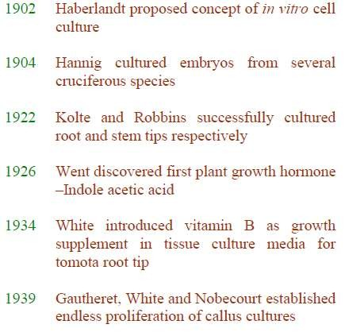
Historical development of plant tissue culture
The principles of tissue
Schleiden and Schwann.
culture
were
involved
in
cell
theory
advanced
by
8

Slide 9
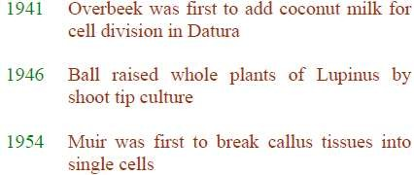
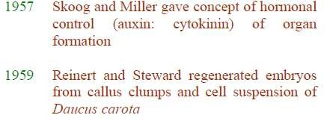
9

Slide 10
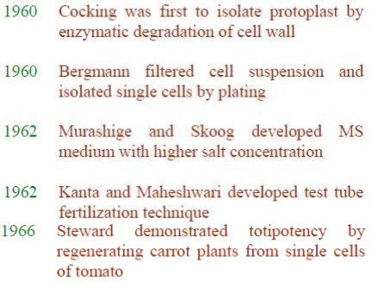
10

Slide 11
Basic requirements of Plant Tissue
•Plant material
•Equipments and Glasswares
•Aseptic Condition
•Washing and storage facilities
•Media preparation room
•Sterilization room
•Nutrient medium
•Transfer room
•Culture room or incubators
•Proper and optimum aeration
Culture:
•Well equipped observation or recording area
11

Slide 12
Plant material
•The plant material should be disease free and should not be too old.
•Also the particular species/variety/genotype which are used should be the right one.
•Generally in-vitro germinated seedlings are frequently chosen as seed
is often also much more readily sterilized than softer plant tissues.
•When plants are healthy and at the desired stage for use, it is often the case that only a specific part of these plants will give the best explants. E.g. A particular internode, the youngest fully expanded leaf etc.
Equipments and Glasswares
•Incubating chamber or laminar airflow cabinet with UV light fitting for
aseptic transfer
•Incubator with temperature control ± 0.5ºC generally temperature
recommended for most tissue culture studies is 36ºC.
•Autoclave-for sterilization of glassware, media etc.
•Refrigerators and freezers-For storage of reagents, tissue culture stock
solutions, chemicals etc.
12

Slide 13
•Hot air oven-for dry sterilization of glassware, media etc.
•Microscope-Simple and special microscope with a provision to take
camera are required. The stage of this microscope should be large
enough to accommodate large roller bottles in specific cases.
•pH meter- for adjusting the pH of the medium
•A spirit burner or gas micro burner for flame sterilization of
instruments
•Washing up equipments- Washing facilities for glassware, pipette etc.
in
deep
soaking baths
or
washing
sinks
of
stainless steel
or
polypropylene are suitable for manual washing and rinsing of almost
all types of glassware except pipettes.
Standard siphon type pipette washers are suitable for washing the pipettes soaked in detergent for overnight. The washed pipettes should be rinsed with deionised water and dried in a stainless steel pippette dryer.
•Water purifier- Pure water is required at most of the plant tissue
culture study.
•Centrifuge- To increase the concentration of cell suspension culture
13

Slide 14
•Shakers- To maintain cell suspension culture
•Balance- To weigh various nutrients of the preparation of the medium
•Shelves- Build from rigid wire mesh to allow maximum air movement
and minimum shading should be used in the culture room.
•Scissors, scalpels and forceps- For explant preparation from excies plant
parts are for their transfer
•Culture vessels- Usually borosilicate glass vessels are preferred, it
includes test tubes, conical flasks, bottles, special flat tubes etc.
Now, the common vessels are 100 ml conical flasks or large test tubes of
25 × 150 mm size.
•Glasswares- Like measuring cylinders, beakers, funnels, petri dishes,
graduated
pipette,
conical
flask
etc.
Are
required
for
preparation
of
nutrient media.
•Miscellaneous-Non absorbent cotton plug, screw cap or polyurethane
foam is required to close the mouth of the culture vessel. Aluminium foil
is required to cover the exposed part of plug from becoming wet when
autoclaved. Labels, marking pencils, hand lens, plastic disposables like syringes, plastic bottles, hot plate, stirrer etc.
•Microwave- not essential but it melts the solidified media for pouring in
culture vessels like petri dishes etc.
14

Slide 15
Aseptic Condition
•The plant materials (tissues), equipments, culture media and
the room should be free from microorganisms.
•Usually dry heat, wet heat, ultrafiltration and chemicals are
used for the sterilisation process.
•Surface sterilisation of plant materials such as seed, fruit, stem,
leaf
etc. by agents like
•9-10% calcium hypochlorite for 5-30 minutes
•2% sodium hypochlorite solution for 5-30 minutes. The materials need to be washed thoroughly in double-distilled water, after sterilising in these solutions.
•10-12% of hydrogen peroxide solution for 5-15 minutes.
•1-2% bromine water, for 2-10 minutes
•1% solution of chlorine water, mercuric chloride, silver
nitrate or antibiotics etc. can also be used.
•Absolute alcohol is used for hard tissues
15

Slide 16
•Dry heat method is used for sterilisation of equipments in hot
air oven.
•Sterilisation of equipment with chromic acid-sulphuric acid
mixture, hydrochloric acid, nitric acid strong detergent solution,
alcohol, incubator or autoclaves etc. are use for this purpose.
•Wet heat method is used for sterilisation of glassware, culture
media in autoclave at 121°C and 15 lb pressure for 15 minutes.
•Ultrafiltration is used for sterilisation of liquid media which are
unstable at high temperature.
•Antibiotics are added to medium to prevent the growth of the
microorganisms
e.g. Potassium benzyl
penicillin,
strptomycin
sulphate, gentamycin etc.
•Chemicals like alcohol are used for sterilisation of working area
and the instruments.
•Sterilisation of the environment is done by fumigation method,
the inoculation chamber is generally laminar airflow cabinet is
widely used these days.
16

Slide 17
•Washing and storage facilities
•Fresh water supply and disposal of waste water facility should
be available.
•Space for distillation unit for the supply of distilled and double
distilled water and de-ionized water should be available.
•Working table, sink or wash basin for apparatus/equipment washing should be acid and alkali resistant.
•Sufficient space is required for placing hot air oven, washing
machine, pipette washers etc.
•For storage of dried glassware separate dust proof cupboards or cabined should be provided.
•Media preparation room
•It should be spacious to accommodate lab ware, culture vessels,
equipments, chemicals etc. The preparation
well equipped with refrigerator, freezer etc. and stock solutions.
room should also be
for storage of media
17

Slide 18
•Sterilization room
•In the tissue culture lab it is desirable to have separate sterilization room for
sterilization of culture media, glassware, metallic equipments like scissors,
scalp etc. Generally sterilisation is done in autoclave or hot air oven.
•Nutrient medium
•Media is composed of
•Inorganic nutrients which includes macronutrients like nitrogen,
phosphorous,
potassium,
calcium
etc. and micronutrients
like boron,
copper, iron, manganese, zinc etc.
•Organic nutrients includes Vitamins like Vitamin B₁, B₆, B₃, B₅ etc.
Amino acids like L-arginine, L-asparagine, L-cysteine HCL, L-glutamine
etc, Carbon source like glucose or maltose, Growth hormones/regulators
like auxin, cytokinins and gibberellins, ethylene, abscisic acid.
•Others media substances like protein hydrolysates, yeast extaracts,
fruit (e.g. banana) extracts, coconut milk, solidifying agents like agar,
alginate, gelatin etc., Iron source e.g.EDTA, Antibiotics.
•pH of the medium should be in a range of 5.6-6.0 before autoclaving the
culture medium
18

Slide 19
•Transfer room
•It is provided with the laminar flow hood where most of the work
of culture initiation and subsequent sub culturing is performed.
Culture
re-plantation,
transfer
or re-initiation in
a
clean
media,
harvesting of ‘ripe’ cultures is also performed in this area.
•Culture room or incubators
•Cultures are incubated on shelves or in incubators under specific
condition of temperature, humidity, air circulation and light.
•Incubation chamber or area should have both light and
temperature controlled devices managed for 24 hours period.
• Generally high output, cool, white fluorescent light is preferred for a photo-period duration (specified period for total darkness as well as for higher intenesity light) with a temperature range of 25 ±
2°C (range 18-25°C).
•The rooms are required to be maintined at a relative humidity upto
70-75% (range of 20-90% controllable to ±3%) and uniform forced air circulation.
19

Slide 20
•Proper and optimum aeration
•Adequate aeration is required for cell to grow.
•Tissues which are cultured on semisolid media do not require any
special
method
for
aeration,
but
tissues
which
are grown
in
suspension cultures, require special devices for aeration.
•Aeration for submerged cultures can be provided by following
methods:
•Placing the culture vessel with the liquid medium on an automatic shaker.
•The two ends of the filter paper are dipped in a medium and
the middle horizontal portion on which the tissue is placed remains above the level of the medium this method is called as filter paper bridge method.
•Passing sterilised air through the medium and by stirring the
medium.
•The culture vessels are closed with non-adsorbent cotton covered in cheese cloth. This process allows proper aeration but prevents the entry of microorganisms.
20

Slide 21
•Well equipped observation or recording area
•At regular intervals growth and maintenance of the tissue culture
in the incubators should
be recorded. All observations should
be
done in aseptic environment.
•For microscopic examination separate dust free space shold
be
marked
for
microscopic
work.
21

