Slide 1
The general technique used in the isolation and growth of culture:
Preparation of suitable nutrient medium: depends on plant
Selection of explant: excised part of healthy plant e.g. Bud, leaf, root, seed
Sterilization of explants: by sodium hypochlorite, mercuric chloride etc and washed aseptically for 6-10 times with sterilised water.
Inoculation (Transfer): The sterile explant inoculated on
solidified nutrient medium under aseptic condition.
Incubation: Cultures are incubated at of 25±2°C and at RH 50-70%. 16 hrs
of photo period.
Regeneration: Plantlets regenerated after transferring a portion
of callus into another medium and induction of roots and shoots
Hardening: Is the gradual exposure of plantlets for acclimatization to environment condition
Plantlet transfer: Plantlet are transferred to green house or field conditions

Slide 2
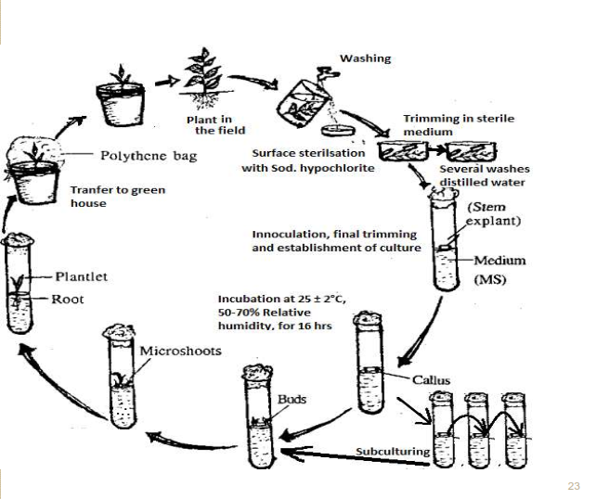

Slide 3
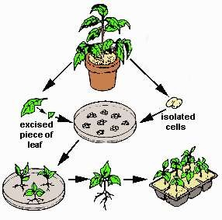
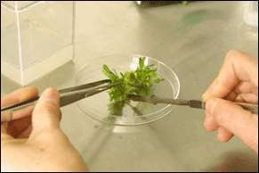
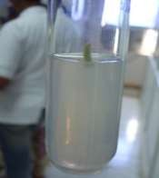
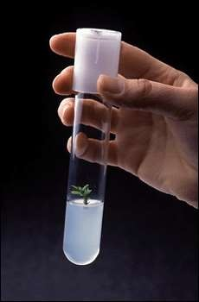
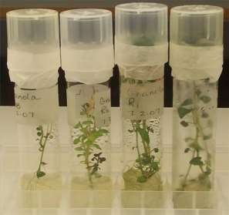
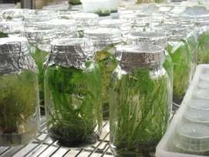
Preparation of an explant
Inoculation
After incubation
Selection
of
plant
Various stages of plant growth
Plant ready to be transferred into
green house or hardening stage
Regeneration of a plant from an explant
25

Slide 4
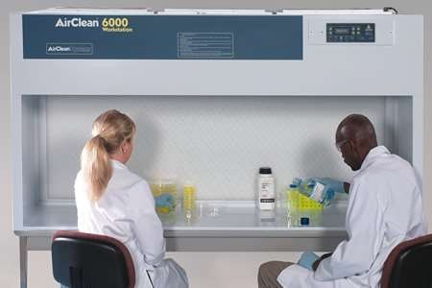
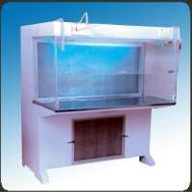
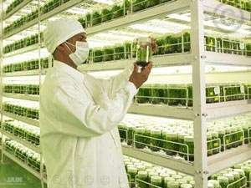
Laminar air flow
Tissue culture rack
26

Slide 5
Types of Cultures
Depending upon the type of medium
Depending on the part used for culture
1.
2.
1.
Depending
upon
the type of medium
Culture
Suspensi on culture
Static culture
(Callus culture)
Semi-
Continuous
culture
Batch culture
continuous culture
Open type
Closed type
Turbidostats
chemostats
27

Slide 6
2.
Depending on the part used for culture
a)
Organ Culture
i.
ii.
iii.
iv.
v.
vi.
vii.
viii.
ix.
x.
xi.
xii.
xiii.
Root tip culture (Meristem - root tip culture)
Shoot tip culture (Meristem - shoot tip culture)
Leaves or leaf primordia culture
Flower culture (Meristem - floral
Anther and pollens culture
Ovule and embryo culture
Ovaries culture
Nucellus culture
Seed culture
Cotyledon culture
Endosperm culture
Fruit culture
Plant cell culture
culture)
b)
c)
Hairy Root Culture
Protoplast Culture and Somatic Hybridization
28

Slide 7
STATIC CULTURE (CALLUS
CULTURE)

Callus – a mass of undifferentiated plant cells grown on solid
from plant part/explant.
It may initiate from explants of any multi-cellular plant.
The organs such as root, stem tips, leaves, flowers and fruit are on solid media.
The cell groups are initiated from:
media


grown

-
Explant/Segments of root, stem or leaf either from the mature or
embryogenic plant
Explant/Excised fragments of parenchyma or mixed tissue containing
cambium or endosperm
The longer the tissue explant the more complex the range of cell types
& greater the possibilities of initiating a culture of mixed cells.
-


Callus
can
be
induced
to undergo
organogenesis and/or
embryogenesis
nutrient medium.
and
eventually
whole
plant
by
providing
suitable

To study the biosynthetic pathway of various metabolic processes by
using tracer elements in callus culture.

It is useful for the production of secondary metabolites.
29

Slide 8
SUSPENSION CULTURE

It
involves
active
proliferation
of
callus
as
undivided unit suspended or submerged in a
liquid medium.

The
nutrient
medium
in this
case
is
in
constant agitation so as to prevent the cells
from settling or aggregating in to clumps.

Suspension
cultures
are
normally
initiated
by
transferring
pieces
of
undifferentiated
callus to
a
liquid
medium
which
is
agitated
during incubation.
30

Slide 9
Batch Suspension Culture

It
means
‘Culture
in
a fixed
volume
of
culture
medium’.

In
general,
a
nutrient
medium
and
cellular
inoculum are mixed, aerated and allowed to grow
In Batch cultures, as the cells grow, the medium is

depleted
of
nutrients
and
metabolic
byproducts
from the cells accumulate.
Batch cultures are characterized by

-
-
continuous changes in the medium
continuous
internal
changes
in
cellular
composition
-
accumulation of metabolic products.

The system is “closed” with respect to additions or
removal of culture, except for circulation of air.
31

Slide 10
Semicontinuous Suspension Culture


Here, the system is ‘open’.
There
is
periodic
removal
of
culture
and
the
addition of fresh medium, due to which
the culture is continuously maintained.
growth
of
Continuous Suspension Culture


The system is ‘open’ here also.
In
this
systems,
and
volume
of
culture
remains
added growing
constant
fresh
medium
volume
is
of
continuously
to
a
fixed
culture and withdrawn.
32

Slide 11


-
Cell proliferation takes place under constant condition.
This system allows
Establishment
metabolism.
of
steady
states
of
growth
and
-
Study of the changes which occur in transitions from
steady state to another.
Identification of the controlling factors.
one
-
Two types of Continuous Suspension
Culture
1.
Open type
Regulated new medium and balancing
volume of culture
Chemostat
harvest of equal


Continuous new medium input is set at a predetermined
rate
and determine
the
nature
of the
resulting
equilibrium.
Useful to study the steady states.


Desired rate
of
growth
is
maintained
by
adjusting
the
level of concentration of nutrient

Slide 12


Turbidostat
Cell
level
density
is
set
at
a
by
predetermined
(as
monitored
the
optical
properties of the culture)
and new medium
is
added
to
maintain
cell
density
within
limits.
Particularly densities.

valuable
for
work
at low
cell

Offers
effects
a
of
simplified
physical
system
factors
for
study
of
and
growth
regulating
associated
substance
in
growth
rate
and
metabolism.
34

Slide 13
2.
Closed type
The
used
medium
is
replaced
with
fresh
medium,
hence,
the
cells
from used
medium
are mechanically separated and added back to
the
culture
and
thus,
the
cell
biomass
keeps
increasing.
35

Slide 14
Organogenesis
Organogenesis is a process involving redifferentiation meristematic cells present in callus into shoot buds or root even whole plantlets.
❖
of
or
❖
The formation of organs is called organogenesis. The
de-navo
genesis
of plant organ is broadly defined
as
organogenesis.
36

Slide 15
❖ The shoot buds are monopolar structures which in turn give rise
to leaf primordial and the apical meristem.
❖ The stimulation of shoot bud differentiation in plants depends
on many factors which differ for different plant species.
Skoog showed that auxin could stimulate rooting and inhibit
shoot formation.
Other factors affecting organogenesis are size and source of the
explant.
Light intensity plays an important role in organogenesis.
High light intensity has been shown to be inhibitory for shoot
bud formation in tobacco.
37

Slide 16
Even the quality of light has effect as blue light has been
shown to
induce shoot
formation
while
red
light
stimulates
rooting in tobacco.
The optimum temperature required may vary with plant
species.
A medium solidified with agar favours bud formation although
there are some reports about the development
of
leafy
shoot
buds
on
cultures
grown
as
suspension.

Slide 17
Embryogenesis
Embryo is defined as the earliest recognisable multicellular stage
of
an
individual that
occurs
before
the
development
of
characteristic organs of the given species.
Production of embryo like structure from callus is known
as
embryogenesis. In higher plants such embroys usually arise from
zygote formation and are termed as zygotic embryos.
Various types of cells and tissues can be used as source of
embryogenic
cells. It
may be
microspores
(1n),
zygote
(2n),
somatic cells (2n) or somatic hybrids (4n).
Embryogenesis can be induced in such cells by nonproliferative or
proliferative direct embryogenesis or by
growing embryogenic
callus which in turn germinates and develops into whole plant.
Embryogenesis can be initiated in an explant only from the more
juvenile or meristematic tissues.
Immature zygotic embryos, cotyledons and hypocotyl dissected from ungerminated seeds are common explants.
Isolated somatic cells can develop into embroys.
39

Slide 18
Embryo development occurs through an organised sequence of cell
division, enlargement and differentiation.
The final stages of development towards maturation are
distinguished
morphology.
by
overall
enlargement
and
matured
embryo
Somatic embryogenesis involves three distinct steps which are
absent in organogenesis
1. Induction
It is the initiative phase where cells of callus are induced to divide
and
differentiate
into
groups
of
meristematic cells
called
embryogenic clumps (ECs).
These ECs develop into initial
globular stage.
2. Maturation
stages of somatic embryo i.e.
In this phase somatic embryos develop into mature embryos by
differentiating from globular to heart shaped and the mature embryo here undergoes biochemical changes to acquire hardness.
3. Conversion
Embryos germinate to produce seedlings.
40

Slide 19
Advantages of Organogenesis & Embryogenesis
1.
Efficiency of process (reduction in labour cost and time, the
formation of plantlets is fewer steps)
2.
The potential for the production of much higher number of
plantlets and morphological and cytological uniformity of the plantlets.
3.
Production of several plants on
commercial scale
includes food
crops,
plants.
vegetables,
spices,
and
fruits,
medicinal
and
aromatic
41

Slide 20
2.
Depending on the part used for culture
a)
Organ Culture
i.
ii.
iii.
iv.
v.
vi.
vii.
viii.
ix.
x.
xi.
xii.
xiii.
Root tip culture (Meristem - root tip culture)
Shoot tip culture (Meristem - shoot tip culture)
Leaves or leaf primordia culture
Flower culture (Meristem - floral
Anther and pollens culture
Ovule and embryo culture
Ovaries culture
Nucellus culture
Seed culture
Cotyledon culture
Endosperm culture
Fruit culture
Plant cell culture
culture)
b)
c)
Hairy Root Culture
Protoplast Culture and Somatic Hybridization
42

