Slide 1
Apache OpenOffice
Version 4.1
Getting Started
AOO Documentation Team

Slide 2
Copyright
This document is Copyright © 2023 by The Apache Software Foundation. You may distribute it and/or modify it under the terms of the Creative Commons Attribution License, version 3.0 or later (https://creativecommons.org/licenses/by/3.0/).
Apache, Apache OpenOffice, and OpenOffice.org are trademarks of the Apache Software Foundation. Used with permission. .
Acknowledgments
This book is updated from Taming Apache OpenOffice 3.4 (by Jean Hollis Weber), which was adapted from Getting Started with OpenOffice.org 3.3 (by the OOoAuthors team) with additional material adapted from Getting Started with LibreOffice 3.4 (by the ODF Authors Team).
Publication date and software version
Published 05 May 2023 . Based on Apache OpenOffice 4.1.

Slide 3
Contents
Chapter 4
Getting Started with Calc 5
What Is Calc? 5
Spreadsheets, Sheets, and Cells 5
Parts of the Main Calc Window 6
Title Bar 6
Menu Bar 6
Toolbars 6
Formula Bar 7
Individual Cells 7
Sheet Tabs 8
Status Bar 8
Opening and Saving CSV files 9
Opening a CSV File 9
Saving as a CSV File 10
Navigating Within Spreadsheets 11
Going to a Particular Cell 11
Moving from Cell to Cell 12
Moving from Sheet to Sheet 14
Selecting Items in a Sheet or Spreadsheet 14
Selecting Cells 14
Selecting Columns and Rows 15
Selecting Sheets 16
Working with Columns and Rows 16
Inserting Columns and Rows 16
Deleting Columns and Rows 17
Working with Sheets 18
Inserting New Sheets 18
Moving and Copying Sheets 19
Deleting SheetsSheets can be Deleted Individually or in Groups. 20
Renaming Sheets 20
Viewing Calc 21
Using Zoom 21
Freezing Rows and Columns 21
Splitting the Screen 22
Entering Data Using the Keyboard 24
Entering Numbers 24
Entering Text 25
Entering Numbers as Text 25
Entering Dates and Times 26
Deactivating Automatic Changes 26
Speeding Up Data Entry 26
Using the Fill Tool on Cells 26
Using Selection Lists 29
Validating Cell Contents 29
Editing Data 30
Removing Data from a Cell 30
Replacing All the Data in a Cell 30
Changing Part of the Data in a Cell 30
Formatting Data 31
Formatting Multiple Lines of Text 31
AOO41GS5 Getting Started with Calc | 3

Slide 4
Shrinking Text to Fit the Cell 32
Formatting Numbers 33
Formatting the Font 34
Formatting the Cell Borders 35
Formatting the Cell Background 35
Auto-formatting Cells and Sheets 35
Defining a New AutoFormat 36
Formatting Spreadsheets Using Themes 36
Using Conditional Formatting 37
Hiding and Showing Data 37
Outline Group Controls 38
Filtering Which Cells Are Visible 39
Sorting Records 39
Using Formulas and Functions 40
Analyzing Data 40
Printing 41
Using Print Ranges 41
Selecting the Page Order, Details, and Scale 42
Printing Rows or Columns on Every Page 43
Page Breaks 44
Headers and Footers 45
4 | AOO41GS5 Getting Started with Calc

Slide 5
Chapter 4
Getting Started with Calc
What Is Calc?
Calc is the spreadsheet component of Apache OpenOffice. You can enter data (usually numerical) in a spreadsheet and then manipulate this data to produce certain results.
Alternatively you can enter data and then use Calc in a ‘What if…’ manner by changing some data and observing the results without having to retype the entire spreadsheet
Other features provided by Calc include:
Functions, which can be used to create formulas to perform complex calculations on data
Database functions, to arrange, store, and filter data
Dynamic charts; a wide range of 2D and 3D charts
Macros, for recording and executing repetitive tasks
Ability to open, edit, and save Microsoft Excel spreadsheets
Import and export of spreadsheets in multiple formats, including HTML, CSV, PDF, and PostScript
Spreadsheets, Sheets, and Cells
Calc works with documents called spreadsheets. Spreadsheets consist of a number of individual sheets, each sheet containing cells arranged in rows and columns. A particular cell is identified by its row number and column letter.
Cells hold the individual elements—text, numbers, formulas—that make up the data to display and manipulate.
Each spreadsheet can have many sheets, up to 256, and each sheet can have many individual cells. Each sheet can have a maximum of 1,048,576 rows and 1024 columns.
Chapter 4 Getting Started with Calc | 5

Slide 6
Parts of the Main Calc Window
When Calc is started, the main window looks similar to Figure 1.
Title Bar
The Title bar, located at the top, shows the name of the current spreadsheet. When the spreadsheet is newly created, its name is Untitled X, where X is a number. When you save a spreadsheet for the first time, you are prompted to enter a name of your choice.
Menu Bar
Under the Title bar is the Menu bar. (On a Mac, the Menu bar is at the top of the screen, above the Title bar, the same location as for other Mac applications.) When you choose one of the menus, a sub menu appears with other options. You can modify the Menu bar, as discussed in Chapter 11 (Setting up and Customizing Apache OpenOffice).
Menu bar
Title bar
Standard toolbar Formatting toolbar
Formula bar
Name box
Active cell
Column headers
Row headers
Sheet tabs
Status bar
Sidebar
Figure 1: Parts of the Calc window
Toolbars
Three toolbars are located under the Menu bar by default: the Standard toolbar, the Formatting toolbar, and the Formula Bar.
The icons (buttons) on these toolbars provide a wide range of common commands and functions. You can also modify these toolbars, as discussed in Chapter 11 (Setting Up and Customizing Apache OpenOffice).
In the Formatting toolbar, the three boxes on the left are the Apply Style, Font Name, and Font Size lists. They show the current setting for the selected cell or area. (The Apply Style list may not be visible by default.) Click the down-arrow to the right of each box to open the list.
6 | Chapter 4 Getting Started with Calc

Slide 7
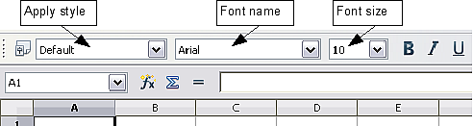
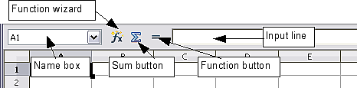
Figure 2. Apply Style, Font Name and Font Size lists
Formula Bar
On the left-hand side of the Formula bar is a small text box, called the Name Box, with a letter and number combination in it, such as D7. This combination, called the cell reference, is the column letter and row number of the selected cell.
To the right of the Name box are the Function Wizard, Sum, and Function buttons.
Clicking the Function Wizard button opens a dialog from which you can search through a list of available functions This can be very useful because it also shows how the functions are formatted.
Figure 3. Formula Bar
In a spreadsheet the term function covers much more than just mathematical functions. See Chapter 7 in the Calc Guide for more details.
Clicking the Sum button inserts a formula into the current cell that totals the numbers in the cells above the current cell. If there are no numbers above the current cell, then the cells to the left are placed in the Sum formula.
Clicking the Function button inserts equals (=) sign into the selected cell and the Input line, thereby enabling the cell to accept a formula.
When you enter new data into a cell, the Sum and Equals buttons change to Cancel
and Accept buttons .
The contents of the current cell (data, formula, or function) are displayed in the Input line, which forms the remainder of the Formula Bar. You can edit the contents of the current cell on the Input line or in the cell itself. To edit on the Input line, click in the line, then type your changes. To edit within the current cell, just double-click the cell.
Individual Cells
The main section of the screen displays the cells in the form of a grid, with each cell being at the intersection of a column and a row.
At the top of the columns and at the left end of the rows are a series of gray boxes containing letters and numbers. These are the column and row headers. The columns start at A and go on to the right, and the rows start at 1 and go down.
Chapter 4 Getting Started with Calc | 7

Slide 8
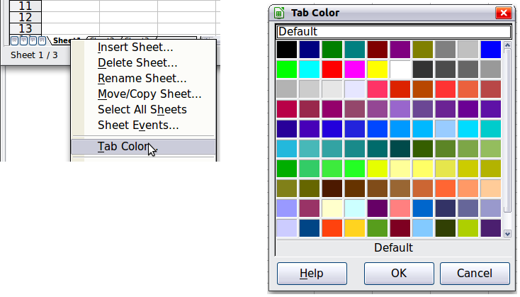
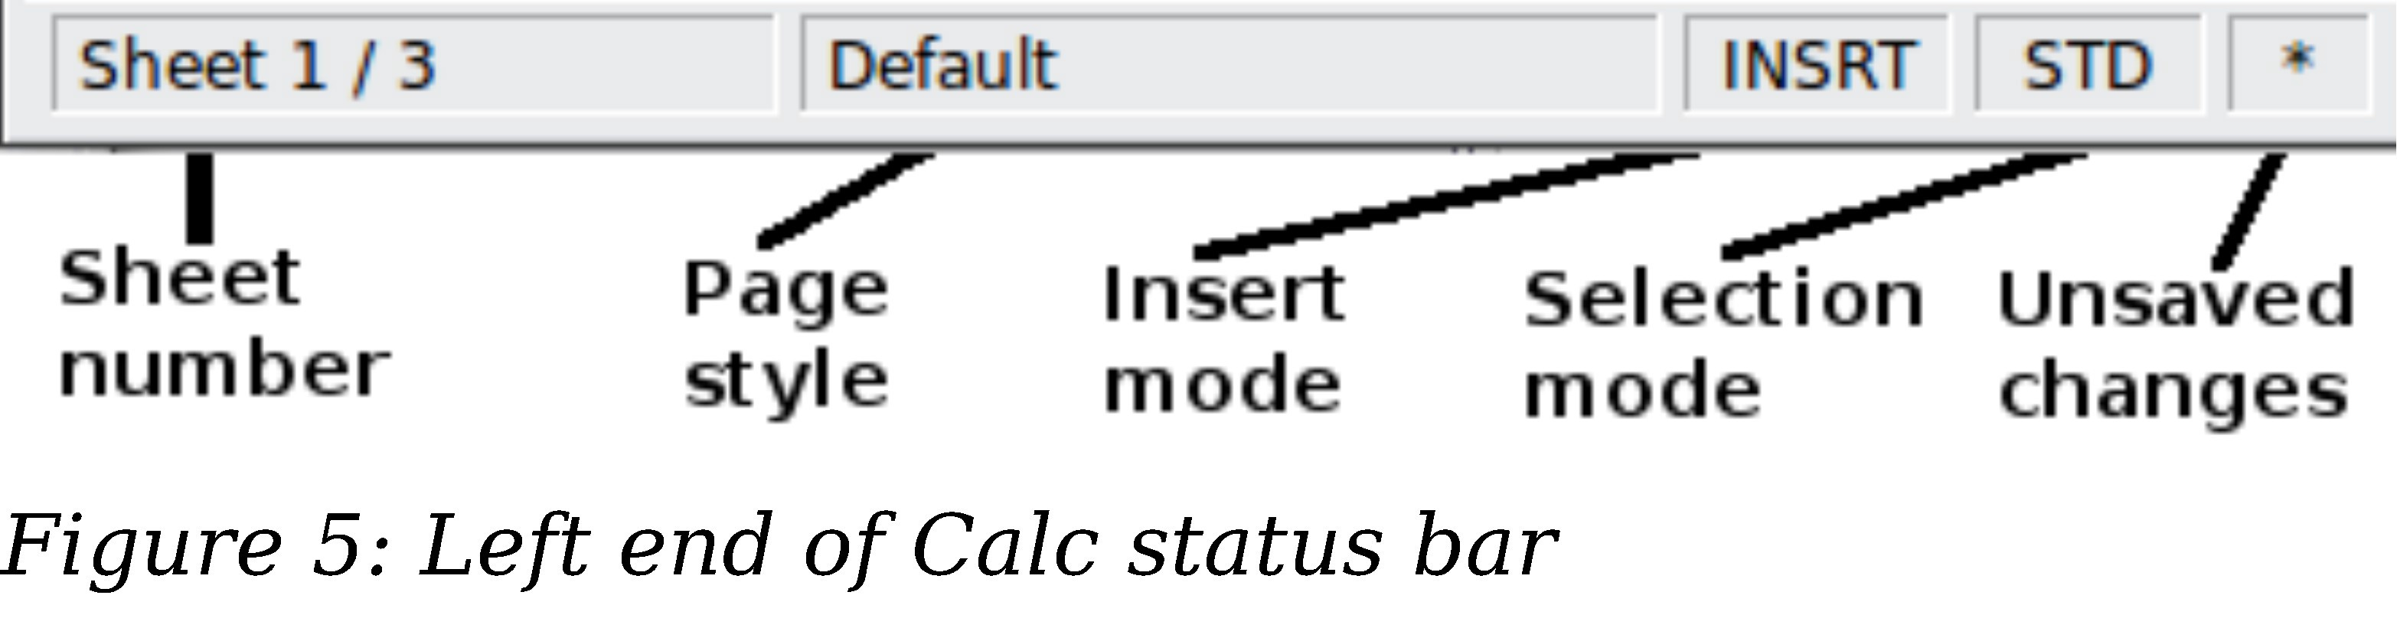
These column and row headers form the cell references that appear in the Name Box on the Formula Bar (Figure 3). You can turn these headers off by selecting View > Column & Row Headers.
Sheet Tabs
At the bottom of the grid of cells is the sheet tabs. These tabs enable access to each individual sheet, with the visible (active) sheet having a white tab. You can choose colors for the different sheet tabs by right-clicking the space, choosing Tab Color, and choosing a color from the palette.
Clicking on another sheet tab displays that sheet, and its tab turns white. You can also select multiple sheet tabs at once by holding down the Ctrl key while you click the names.
Figure 4: Choosing a tab color
Status Bar
At the very bottom of the Calc window is the status bar, which provides information about the spreadsheet and convenient ways to quickly change some of its features. Most of the fields are similar to those in other components of Apache OpenOffice; see Chapter 1 (Introducing Apache OpenOffice). Right-clicking on the Cell or object information field brings up a menu of functions that summarize the cells selected in the sheet. Among the options are Sum, Average, Minimum and Maximum. See Selecting Cells for information about selecting multiple cells.
8 | Chapter 4 Getting Started with Calc

Slide 9
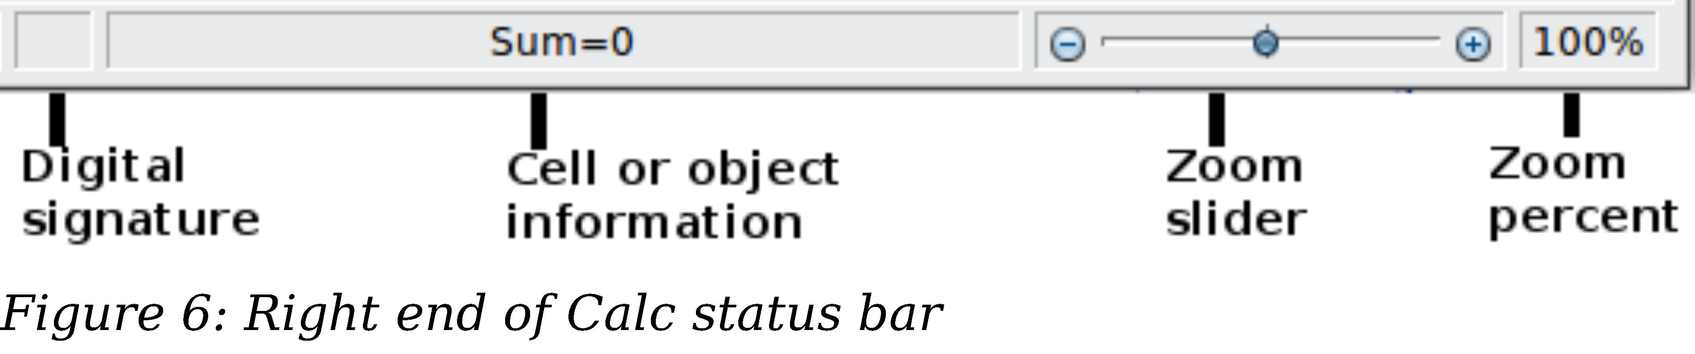
Opening and Saving CSV files
Chapter 1 (Introducing Apache OpenOffice) includes instructions on starting new Calc documents, opening existing documents, and saving documents.
A special case for Calc is opening and saving comma-separated-values (CSV), which are text files that contain the cell contents of a single sheet. Each line in a CSV file represents a row in a spreadsheet. Commas, semicolons, or other characters are used to separate the cells. Text may be entered in quotation marks, numbers are entered without quotation marks.
Opening a CSV File
To open a CSV file in Calc:
Choose File > Open.
Locate the CSV file that you want to open.
If the file has a *.csv extension, select the file and click Open.
If the file has another extension (for example, *.txt), select the file, select Text CSV (*.csv;*.txt) in the File type box (scroll down into the spreadsheet section to find it) and then click Open.
On the Text Import dialog (Figure 7), select the Separator options to divide the text in the file into columns.
You can preview the layout of the imported data at the bottom of the dialog. Right-click a column in the preview to set the format or to hide the column. Selecting Detect special numbers allows values with formatting such as currency symbols and some date formats to be read correctly. They will otherwise be read as text, which is a common source of difficulty with subsequent calculations.
If the CSV file uses a text delimiting character that is not in the Text delimiter list, click in the Other box and type the character.
Click OK to open the file.
Chapter 4 Getting Started with Calc | 9

Slide 10
Figure 7: Text Import dialog, with Comma (,) selected as the separator and double quotation mark (“) as the text delimiter.
Saving as a CSV File
To save a spreadsheet as a comma separated value (CSV) file:
Choose File > Save As.
In the File name box, type a name for the file.
In the File type list, select Text CSV (.csv) and click Save.
You may see the message box shown below. Click Keep Current Format.
10 | Chapter 4 Getting Started with Calc

Slide 11
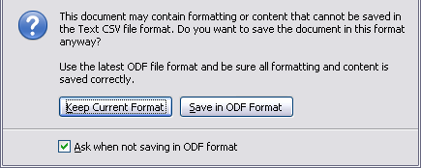
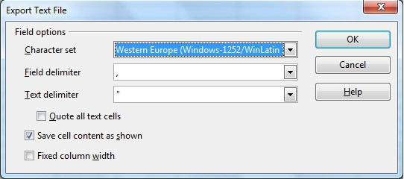
4) In the Export of text files dialog, select the options you want and then click OK. You will get a warning that only the current sheet was saved. CSV files do not support multiple sheets.
Figure 8: Choosing options when exporting to Text CSV
Navigating Within Spreadsheets
Calc provides many ways to navigate within a spreadsheet from cell to cell and sheet to sheet. You can generally use whatever method you prefer.
Going to a Particular Cell
Using the mouse
Place the mouse pointer over the cell and click.
Using a cell reference
Click on the little inverted black triangle just to the right of the Name Box (Figure
3). The existing cell reference will be highlighted. Type the cell reference of the cell you want to go to and press Enter. Or just click into the Name box, backspace over the existing cell reference and type in the cell reference you want and press Enter.
Using the Navigator
To open the Navigator, click its icon on the Standard toolbar, or go to the Navigator deck of the Sidebar, or press F5, or choose View > Navigator on the
Chapter 4 Getting Started with Calc | 11

Slide 12
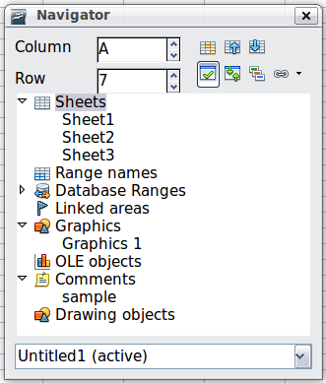
Menu bar, or double-click on the Sheet Sequence Number in the Status Bar. Type the cell reference into the top two fields, labeled Column and Row, and press Enter. In Figure 9 the Navigator would select cell A7.
You can dock the Navigator to either side of the main Calc window or leave it floating. (To dock or float the Navigator, hold down the Ctrl key and double-click in an empty area near the icons in the Navigator dialog.) If you want a docked Navigator, using the Sidebar is typically the easiest approach. The Sidebar is described in Chapter 1. Introducing Apache OpenOffice.
Figure 9: The Navigator in Calc
The Navigator displays lists of all the objects in a document, grouped into categories. If an indicator (plus sign or arrow) appears next to a category, at least one object of this kind exists. To open a category and see the list of items, click on the indicator.
To hide the list of categories and show only the icons at the top, click the
Contents icon . Click this icon again to show the list.
Moving from Cell to Cell
In the spreadsheet, one cell normally has a darker black border. This black border indicates where the focus is (see Figure 10). If a group of cells is selected, they have a highlight color, with the focus cell having a dark border.
Using the mouse
To move the focus using the mouse, simply move the mouse pointer to the cell where you want the focus to be and click the left mouse button. This changes the focus to the new cell. This method is most useful when the two cells are a large distance apart.
Using the Tab and Enter keys
Pressing Enter or Shift+Enter moves the focus down or up, respectively.
Pressing Tab or Shift+Tab moves the focus to the right or to the left, respectively.
12 | Chapter 4 Getting Started with Calc

Slide 13
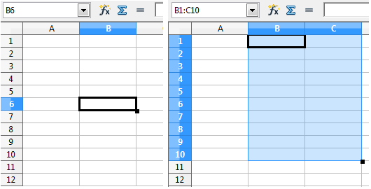
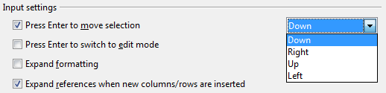
Figure 10. (Left) One selected cell and (right) a group of selected cells
Using the arrow keys
Pressing the arrow keys on the keyboard moves the focus in the direction of the arrows.
Using Home, End, Page Up and Page Down
Home moves the focus to the start of a row.
End moves the focus to the column furthest to the right that contains data.
Page Down moves the display down one complete screen and Page Up moves the display up one complete screen.
Combinations of Ctrl and Alt with Home, End, Page Down, Page Up, and the cursor keys move the focus of the current cell in other ways. See the Help or Appendix A (Keyboard Shortcuts) in the Calc Guide for details.
Tip
Use one of the four Alt+Arrow key combinations to resize a cell.
Customizing the Enter Key
You can customize the direction in which the Enter key moves the focus, by selecting
Tools > Options > OpenOffice Calc > General.
The four choices for the direction of the Enter key are shown on the right-hand side of Figure 11. It can move the focus down, right, up, or left. Depending on the file being used or on the type of data being entered, setting a different direction can be useful.
The Enter key can also be used to switch into and out of editing mode. Use the first two options under Input settings in Figure 11 to change the Enter key settings.
Figure 11: Customizing the effect of the Enter key
Chapter 4 Getting Started with Calc | 13

Slide 14
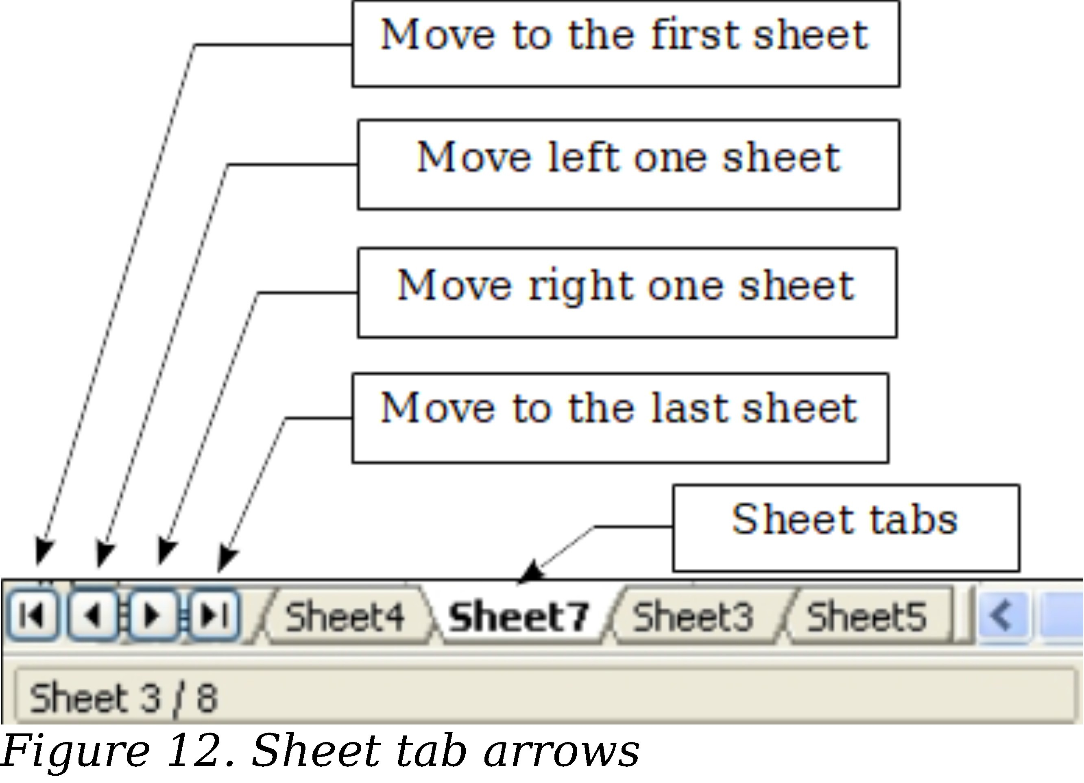
Moving from Sheet to Sheet
Each sheet in a spreadsheet is independent of the others, though they can be linked with references from one sheet to another. There are three ways to navigate between different sheets in a spreadsheet.
Using the Navigator
When the Navigator is open (Figure 9), double-clicking on any of the listed sheets selects the sheet.
Using the keyboard
Pressing Ctrl+Page Down moves one sheet to the right and pressing Ctrl+Page Up
moves one sheet to the left.
Using the mouse
Clicking on one of the sheet tabs at the bottom of the spreadsheet selects that sheet.
If you have a lot of sheets, then some sheet tabs may be hidden behind the horizontal scroll bar at the bottom of the screen. If this is the case, then the four buttons at the left of the sheet tabs can move the tabs into view. Figure 12 shows how to do this.
Notice that the sheets here are not numbered in order. Sheet numbering is arbitrary; you can name a sheet as you wish.
Note
The sheet tab arrows that appear in Figure 12 only appear if you have some sheet tabs that are hidden by the horizontal scrollbar. Otherwise, they will appear faded as in Figure 1.
Selecting Items in a Sheet or Spreadsheet
Selecting Cells
Cells can be selected in a variety of combinations and quantities.
Single cell
Left-click in the cell. The result will look like the left side of Figure 10. You can verify your selection by looking in the Name box.
14 | Chapter 4 Getting Started with Calc

Slide 15
Range of contiguous cells
A range of cells can be selected using the keyboard or the mouse.
To select a range of cells by dragging the mouse:
Click in a cell.
Press and hold down the left mouse button.
Move the mouse around the screen.
Once the desired block of cells is highlighted, release the left mouse button.
To select a range of cells without dragging the mouse:
Click in the cell which is to be one corner of the range of cells.
Move the mouse to the opposite corner of the range of cells.
Hold down the Shift key and click.
To select a range of cells without using the mouse:
Select the cell that will be one of the corners in the range of cells.
While holding down the Shift key, use the cursor arrows to select the rest of the range.
The result of these methods looks like the right side of Figure 10. To select all the occupied cells in one direction:
Click the first cell in the desired range.
Hold the Ctrl + Shift keys and press the arrow to move in the desired direction. The cursor will jump to the last occupied cell.
You can also directly select a range of cells using the Name box. Click into the Name Box as described in “Using a cell reference” on page 11. To select a range of cells, enter the cell reference for the upper left-hand cell, followed by a colon (:), and then the lower right- hand cell reference. For example, to select the range that would go from A3 to C6, you would enter A3:C6.
Tip
Range of noncontiguous cells
Select the cell or range of cells using one of the methods above.
Move the mouse pointer to the start of the next range or single cell.
Hold down the Ctrl key and click or click-and-drag to select a range.
Repeat as necessary.
Selecting Columns and Rows
Entire columns and rows can be selected very quickly in Apache OpenOffice.
Single column or row
To select a single column, click on the column identifier letter (see Figure 1).
To select a single row, click on the row identifier number.
Multiple columns or rows
To select multiple columns or rows that are contiguous:
Click on the first column or row in the group.
Hold down the Shift key.
Click the last column or row in the group.
Chapter 4 Getting Started with Calc | 15

Slide 16

To select multiple columns or rows that are not contiguous:
Click on the first column or row in the group.
Hold down the Ctrl key.
Click on all the subsequent columns or rows while holding down the Ctrl key.
Entire sheet
To select the entire sheet, click on the small box between the A column header and the 1 row header. You can also press Ctrl+A to select the entire sheet.
Figure 13. Select All box
Selecting Sheets
You can select either one or multiple sheets. It can be advantageous to select multiple sheets at times when you want to make changes to many sheets at once.
Single sheet
Click on the sheet tab for the sheet you want to select. The active sheet becomes white (see Figure 14).
Multiple contiguous sheets
To select multiple contiguous sheets:
Click on the sheet tab for the first desired sheet.
Move the mouse pointer over the sheet tab for the last desired sheet.
Hold down the Shift key and click on the sheet tab.
All the tabs between these two sheets will turn white. Any actions that you perform will now affect all highlighted sheets.
Multiple noncontiguous sheets
To select multiple noncontiguous sheets:
Click on the sheet tab for the first sheet.
Move the mouse pointer over the second sheet tab.
Hold down the Ctrl key and click on the sheet tab.
Repeat as necessary.
The selected tabs will turn white. Any actions that you perform will now affect all highlighted sheets.
All sheets
Right-click any one of the sheet tabs and choose Select All Sheets from the pop-up menu.
Working with Columns and Rows
Inserting Columns and Rows
Columns and rows can be inserted individually or in groups.
16 | Chapter 4 Getting Started with Calc

Slide 17
When you insert a single new column, it is inserted to the left of the highlighted column. When you insert a single new row, it is inserted above the highlighted row.
Cells in the new columns or rows are formatted like the corresponding cells in the column or row before (or to the left of) which the new column or row is inserted.
Note
Single column or row
Using the Insert menu:
Select the cell, column, or row where you want the new column or row inserted.
Choose either Insert > Columns or Insert > Rows.
Using the mouse:
Select the cell, column, or row where you want the new column or row inserted.
Right-click the header of the column or row.
Choose Insert Rows or Insert Columns.
Multiple columns or rows
Multiple columns or rows can be inserted at once rather than inserting them one at a time.
Highlight the required number of columns or rows by holding down the left mouse button on the first one and then dragging across the required number of identifiers.
Proceed as for inserting a single column or row above.
Deleting Columns and Rows
Columns and rows can be deleted individually or in groups.
Single column or row
A single column or row can only be deleted by using the mouse:
Select the column or row to be deleted.
Right-click on the column or row header.
Select Delete Columns or Delete Rows from the pop-up menu.
Multiple columns or rows
Multiple columns or rows can be deleted at once rather than deleting them one at a time.
Highlight the required number of columns or rows by holding down the left mouse button on the first one and then dragging across the required number of identifiers.
Proceed as for deleting a single column or row above.
Chapter 4 Getting Started with Calc | 17

Slide 18
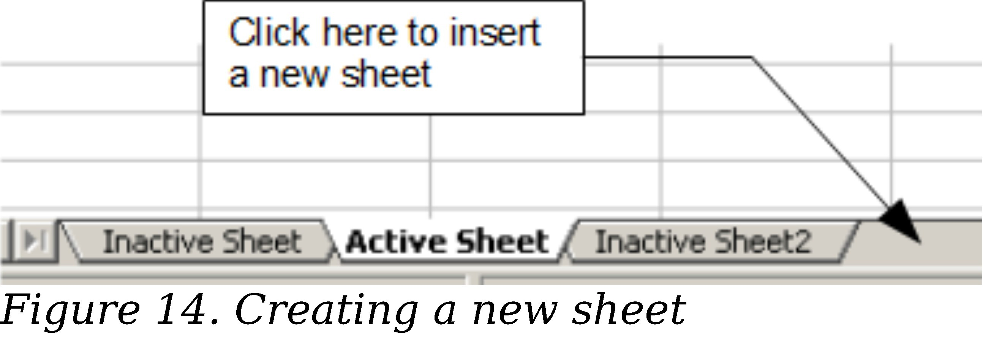
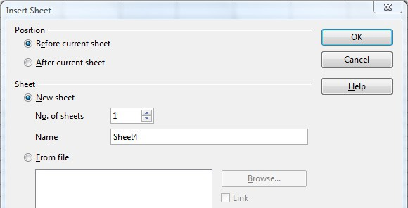
Working with Sheets
Like any other Calc element, sheets can be inserted, deleted, and renamed.
Inserting New Sheets
There are several ways to insert a new sheet. The first step for all the methods is to select the sheets that the new sheet will be inserted next to. Then any of the following options can be used.
Choose Insert > Sheet from the menu bar.
Right-click on the sheet tab and choose Insert Sheet.
Click in an empty space at the end of the line of sheet tabs.
Each method will open the Insert Sheet dialog (Figure 15). Here you can select whether the new sheet is to go before or after the selected sheet and how many sheets you want to insert. If you are inserting only one sheet, there is the opportunity to give the sheet a name.
Figure 15. Insert Sheet dialog
18 | Chapter 4 Getting Started with Calc

Slide 19

Moving and Copying Sheets
You can move or copy sheets within the same spreadsheet by using either the mouse (drag and drop) or a dialog. Drag and drop does not work if you wish to move or copy a sheet to a different spreadsheet; instead, you need to use the dialog.
Using the Mouse
To move a sheet to a different position within the same spreadsheet, click on the sheet tab and drag it left or right. Two little triangles indicate where the sheet will be dropped (see Figure 16). The mouse pointer (not shown in the illustration) may change to include an indicator; the indicator symbol varies with your operating system.
Figure 16: Dragging a sheet to move it
To copy a sheet within the same spreadsheet, hold down the Ctrl key (Option key on Mac) while you click on the sheet tab and drag it. The mouse pointer may change to include a plus sign or other indicator; the symbol varies with your operating system.
Using a dialog
The Move/Copy dialog provides the opportunity to specify exactly where you want the sheet to go (in the same or a different document), at the same time as moving or copying occurs.
Note
When moving or copying sheets between different spreadsheets, be sure that both documents are open.
Follow these steps:
In the current document, right-click on the sheet tab you wish to move or copy.
Select Move/Copy Sheet from the context menu.
On the Move/Copy Sheet dialog (Figure 17):
  Select or deselect the Copy option at the bottom.
  To document: select the document in which you want to place the sheet. By default, the field will show the current document. If you have another spreadsheet open, its name will appear in the drop-down list along with— new document.
Insert before: select the position within the target document.
When you are done, click OK.
Chapter 4 Getting Started with Calc | 19

Slide 20
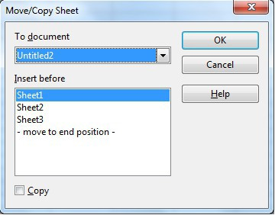

Figure 17: Move/Copy Sheet dialog
If you choose—new document—as the location, a new spreadsheet will be created. This may cause conflicts with formulas linked to other sheets in the previous location. If you accidentally move a sheet, you can fix it by moving or copying the sheet back to the original location.
This caution also applies to moving sheets to other existing documents.
Caution
Deleting SheetsSheets can be Deleted Individually or in Groups.
Single sheet
Right-click on the tab of the sheet you want to delete and choose Delete Sheet
from the pop-up menu, or choose Edit > Sheet > Delete from the menu bar.
Multiple sheets
To delete multiple sheets, select them as described earlier, then either right-click over one of the tabs and select Delete Sheet from the pop-up menu, or choose Edit > Sheet > Delete from the menu bar.
Renaming Sheets
The default name for a new sheet is SheetX, where X is a number. While this works for a small spreadsheet with only a few sheets, it becomes awkward when there are many sheets.
To give a sheet a more meaningful name, you can:
Enter the name in the Name box when you create the sheet, or
Right-click on a sheet tab and choose Rename Sheet from the pop-up menu; replace the existing name with a better one.
Double-click on a sheet tab to pop up the Rename Sheet dialog.
20 | Chapter 4 Getting Started with Calc

Slide 21
Note
Sheet names must start with either a letter or a number. Apart from the first character of the sheet name, allowed characters are letters, numbers, spaces, and the underline character. Attempting to rename a sheet with an invalid name will produce an error message.
Viewing Calc
Using Zoom
Use the zoom function to change the view to show more or fewer cells in the window. For more about zoom, see Chapter 1 (Introducing Apache OpenOffice) in this book.
Freezing Rows and Columns
Freezing locks a number of rows at the top of a spreadsheet or a number of columns on the left of a spreadsheet or both. Then when scrolling around within the sheet, any frozen columns and rows remain in view.
Figure 18 shows some frozen rows and columns. The heavier horizontal line between rows 3 and 14 and the heavier vertical line between columns C and H denote the frozen areas. Rows 4 through 13 and columns D through G have been scrolled off the page. The first three rows and columns remained because they are frozen into place.
You can set the freeze point at a row, a column, or both a row and a column as in Figure 18.
Freezing single rows or columns
Click on the header for the row below where you want the freeze or for the column to the right of where you want the freeze.
Choose Window > Freeze.
A dark line appears, indicating where the freeze is put.
Freezing a row and a column
Click into the cell that is immediately below the row you want frozen and immediately to the right of the column you want frozen.
Choose Window > Freeze.
Two lines appear on the screen, a horizontal line above this cell and a vertical line to the left of this cell. Now as you scroll around the screen, everything above and to the left of these lines will remain in view.
Unfreezing
To unfreeze rows or columns, choose Window > Freeze. The check mark by
Freeze will vanish.
Chapter 4 Getting Started with Calc | 21

Slide 22
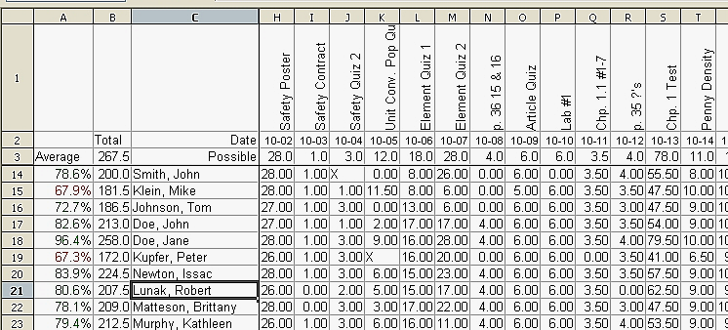
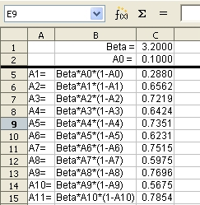
Figure 18. Frozen rows and columns
Splitting the Screen
Another way to change the view is by splitting the window, also known as splitting the screen. The screen can be split either horizontally or vertically or both. You can therefore have up to four portions of the spreadsheet in view at any one time.
Why would you want to do this? Imagine you have a large spreadsheet and one of the cells has a number in it which is used by three formulas in other cells. Using the split screen technique, you can position the cell containing the number in one section and each of the cells with formulas in the other sections. Then you can change the number in the cell and watch how it affects each of the formulas.
Figure 19. Split screen example
Splitting the Screen Horizontally
To split the screen horizontally:
1) Move the mouse pointer into the vertical scroll bar, on the right-hand side of the screen, and place it over the small button at the top with the black triangle. Immediately above this button you will see a thick black line.
22 | Chapter 4 Getting Started with Calc

Slide 23
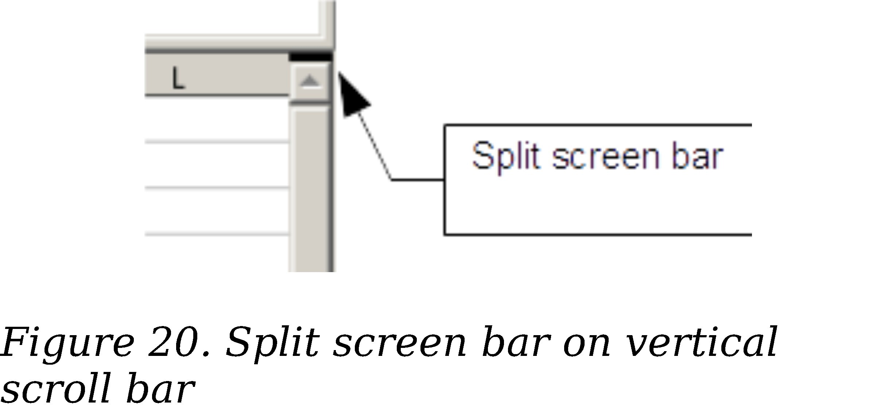

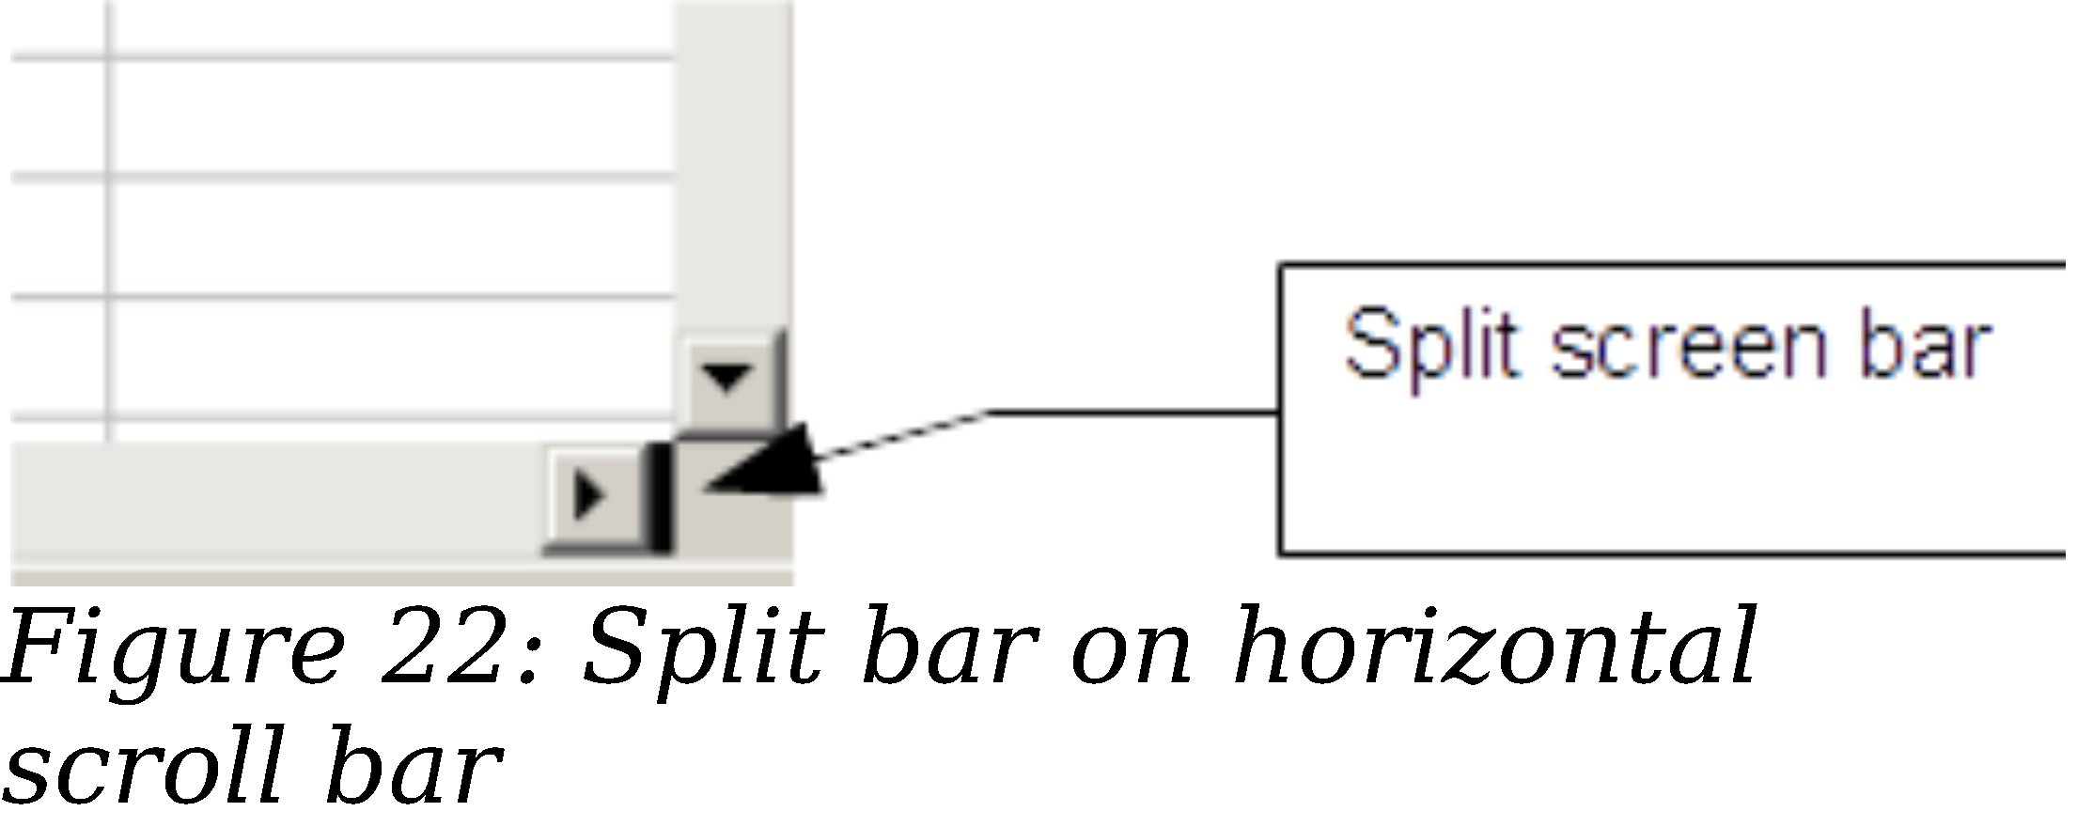
2) Move the mouse pointer over this line, and it turns into a line with two arrows, as in Figure 21.
Figure 21. Split screen bar on vertical scroll bar with cursor
Hold down the left mouse button. A gray line appears, running across the page. Drag the mouse downwards and this line follows.
Release the mouse button and the screen splits into two views, each with its own vertical scroll bar. You can scroll the upper and lower parts independently.
Notice in Figure 19, the Beta and the A0 values are in the upper part of the window and other calculations are in the lower part. Thus, you can make changes to the Beta and A0 values and watch their effects on the calculations in the lower half of the window.
Tip
You can also split the screen using a menu command. Click in a cell immediately below and to the right of where you wish the screen to be split, and choose Window > Split.
Splitting the Screen Vertically
To split the screen vertically:
1) Move the mouse pointer into the horizontal scroll bar at the bottom of the screen and place it over the small button on the right with the black triangle. Immediately to the right of this button is a thick black line.
2) Move the mouse pointer over this line, and it turns into a line with two arrows.
Chapter 4 Getting Started with Calc | 23

Slide 24
Hold down the left mouse button, and a gray line appears, running up the page. Drag the mouse to the left and this line follows.
Release the mouse button and the screen is split into two views, each with its own horizontal scroll bar. You can scroll the left and right parts of the window independently.
Removing Split Views
To remove a split view, do any of the following:
Double-click on each split line.
Click on and drag the split lines back to their places at the ends of the scroll bars.
Choose Window > Split to remove all split lines at the same time.
Entering Data Using the Keyboard
Most data entry in Calc can be accomplished using the keyboard.
Entering Numbers
Click in the cell and type in the number using the number keys on either the main keyboard or the numeric keypad.
To enter a negative number, either type a minus (–) sign in front of it or enclose it in parentheses (brackets), like this: (1234).
By default, numbers are right-aligned and negative numbers have a leading minus symbol.
Note
If a number beginning with 0 is entered in to a cell, Calc will drop the 0 (for example 01234 becomes 1234).
24 | Chapter 4 Getting Started with Calc

Slide 25
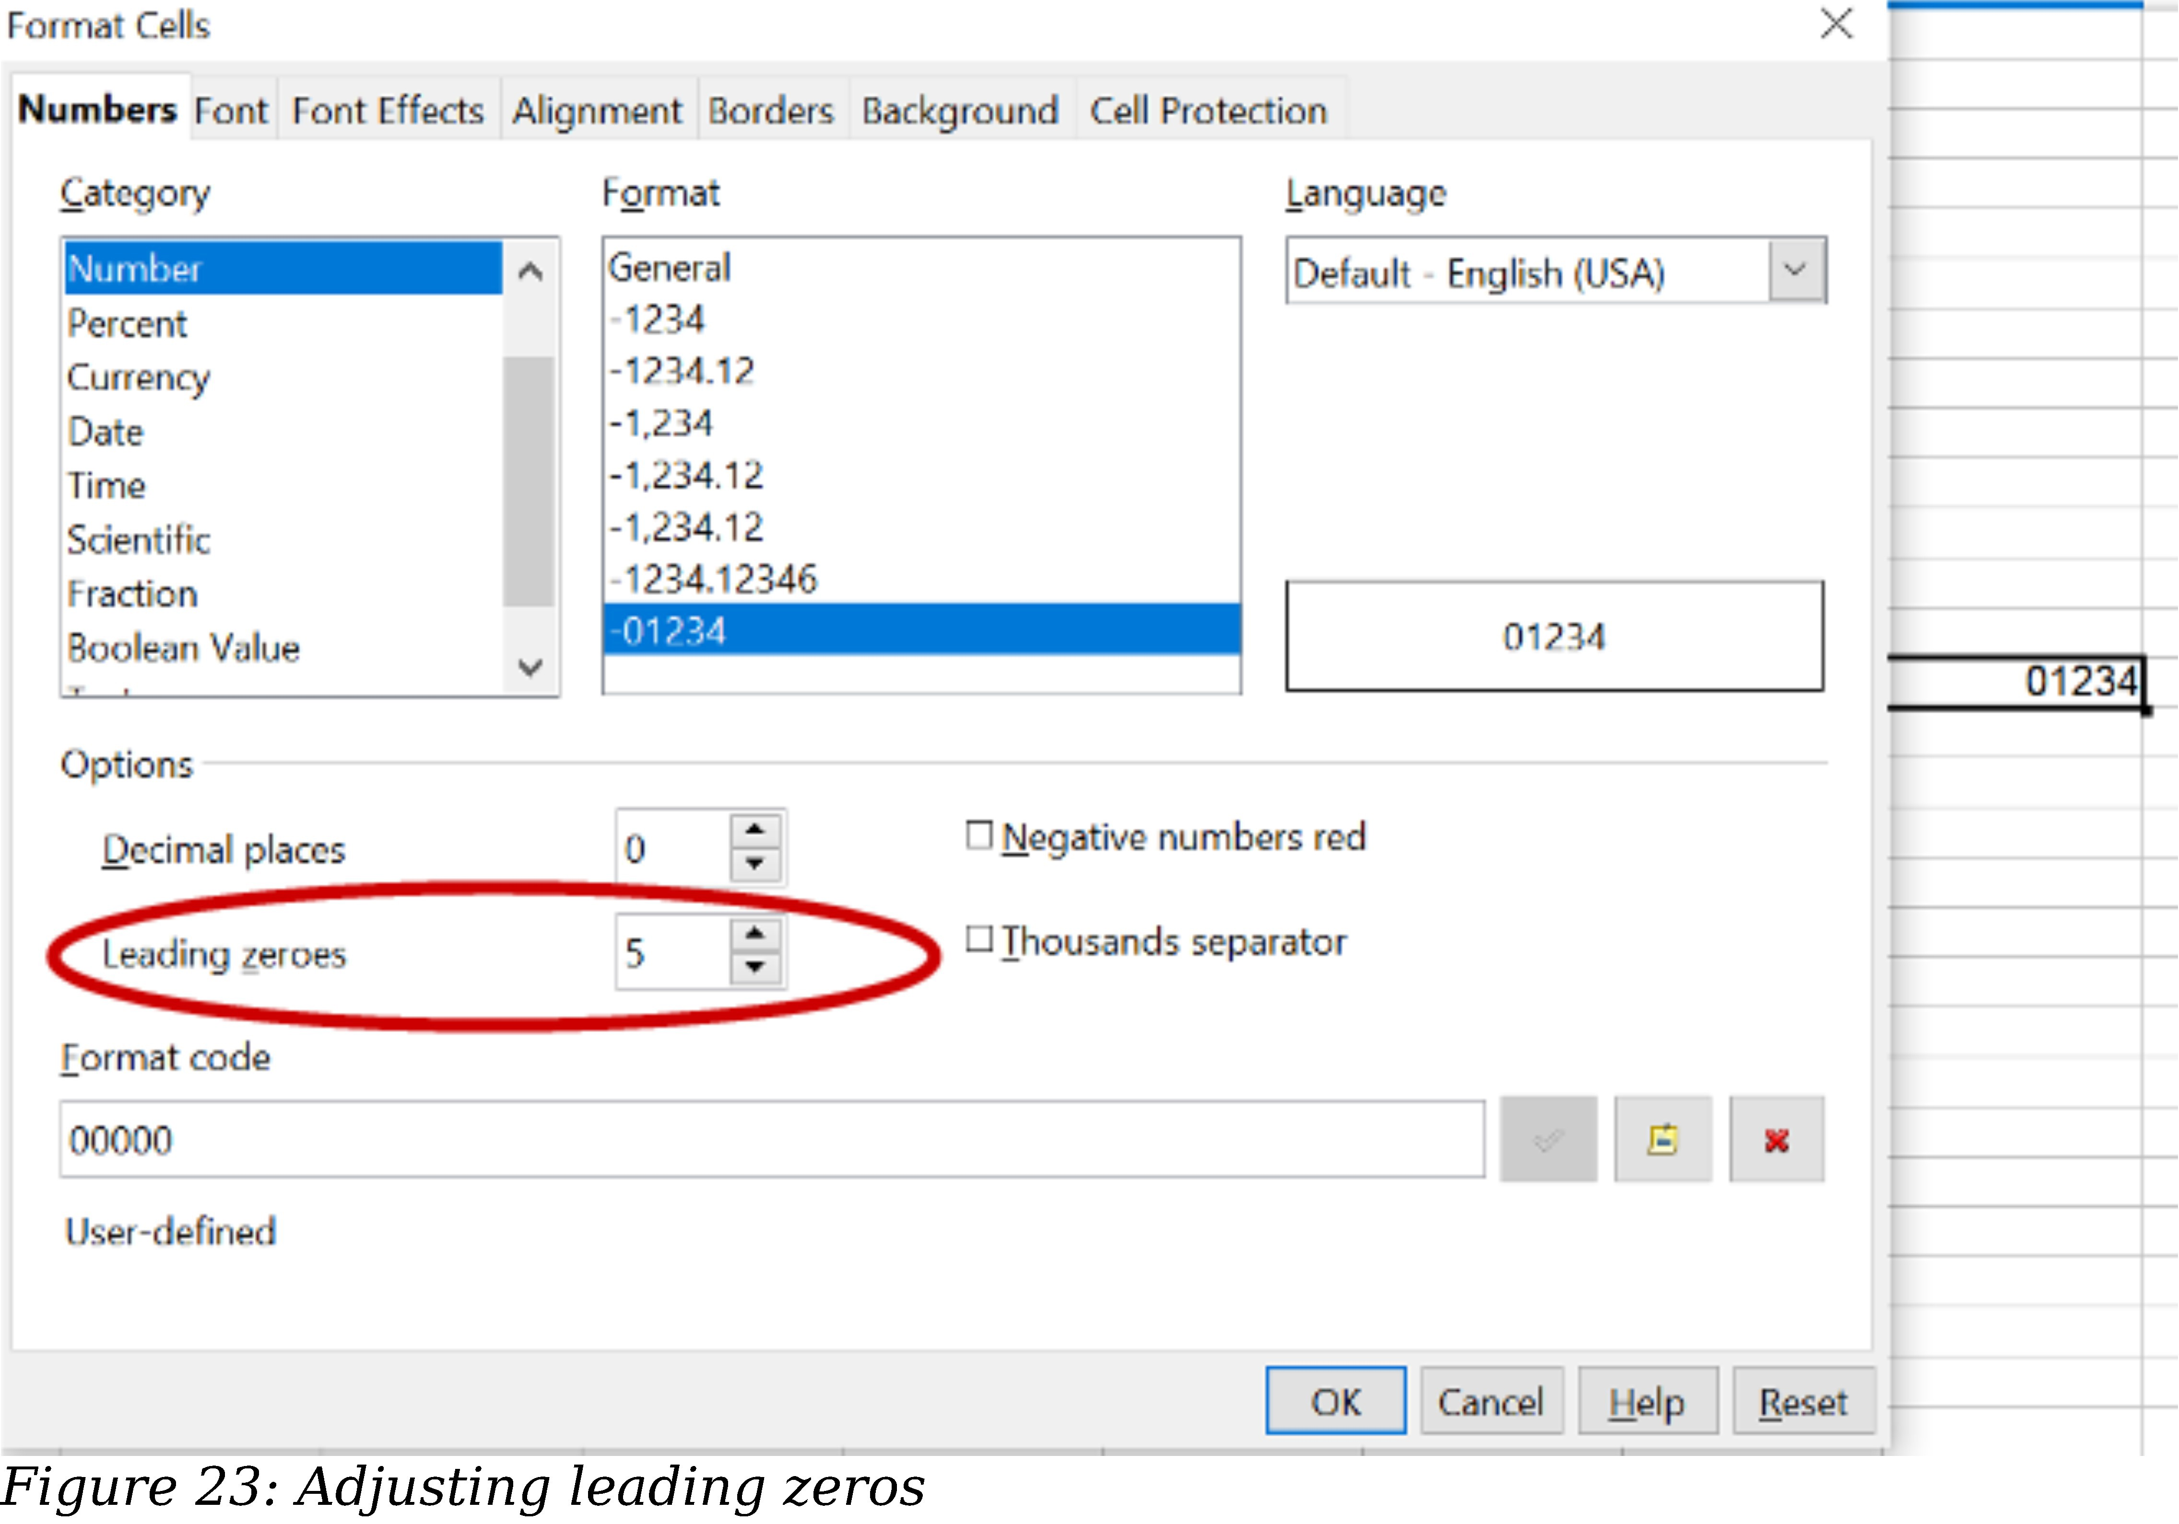
To enter a number and retain the leading 0, right-click on the cell and choose Format
> Cells > Numbers. In the Format Cells dialog (Figure 23), under Options select the required number of Leading zeros.
The number selected for leading zeros needs to be one higher than the digits in a number. For example, if the number is 1234, the number entered for the leading zero will be 5.
Entering Text
Click in the cell and type the text. Text is left-aligned by default.
Entering Numbers as Text
A number can be entered as text to preserve a leading zero by entering an apostrophe before the number, like this: '01481.
The data is now regarded as text by Calc and displayed exactly as entered. Typically, formulas will treat the entry as a zero and functions will ignore it. Take care that the cell containing the number is not used in a formula.
If “smart quotes” are used for apostrophes, the apostrophe remains visible in the cell.
To choose the type of apostrophe, use Tools > AutoCorrect Options > Localized Options. The selection of the apostrophe type affects both Calc and Writer.
Note
Chapter 4 Getting Started with Calc | 25

Slide 26
Entering Dates and Times
Select the cell and type the date or time. You can separate the date elements with a slant (/) or a hyphen (–) or use text such as 10 Oct 20. Calc recognizes a variety of date formats. You can separate time elements with colons such as 10:43:45. Calc may change the appearance of the entered value to match the current cell format. You can adjust the cell appearance through the menu Format > Cells. See the section Formatting Numbers for more details.
Deactivating Automatic Changes
Calc automatically applies many changes during data input, unless you deactivate those changes. You can also immediately undo any automatic changes with Ctrl+Z.
AutoCorrect changes
Automatic correction of typing errors, replacement of straight quotation marks by curly (custom) quotes, and starting cell content with an uppercase (capital letter) are controlled by Tools > AutoCorrect Options. Go to the Localized Options, Options, or Replace tabs to deactivate any of the features that you do not want.
On the Replace tab, you can also delete unwanted word pairs and add new ones as required.
AutoInput
When you are typing in a cell, Calc automatically suggests matching input found in the same column. To turn the AutoInput on and off, set or remove the check mark in front of Tools > Cell Contents > AutoInput.
Automatic date conversion
Calc automatically converts certain entries to dates. To ensure that an entry that looks like a date is interpreted as text, type an apostrophe at the beginning of the entry. The apostrophe is not displayed in the cell. You can also set the cell format to Text through the menu Format > Cells, using the Numbers tab.
Speeding Up Data Entry
Entering data into a spreadsheet can be very labor-intensive, but Calc provides several tools for removing some drudgery from input.
The most basic ability is to drop and drag the contents of one cell to another with a mouse. Calc also includes several other tools for automating input, especially of repetitive material. They include the Fill tool, selection lists, and the ability to input information into multiple sheets of the same document.
Using the Fill Tool on Cells
At its simplest, the Fill tool is a way to duplicate existing content. Start by selecting the cell to copy, then drag the mouse in any direction (or hold down the Shift key and click in the last cell you want to fill), and then choose Edit > Fill and the direction in which you want to copy: Up, Down, Left or Right.
Caution
Choices that are not available are grayed out, but you can still choose the opposite direction from what you intend, which could cause you to overwrite cells accidentally.
26 | Chapter 4 Getting Started with Calc

Slide 27
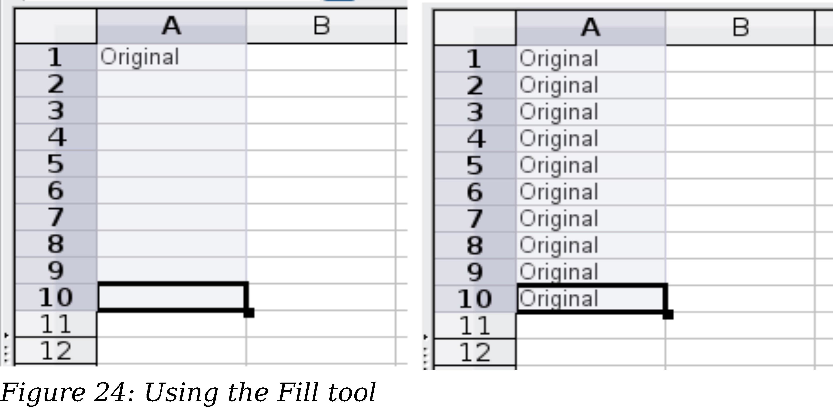
Tip
A shortcut way to fill cells is to grab the “handle” in the lower right- hand corner of the cell and drag it in the direction you want to fill. If the cell contains a number, the number will fill in series. If the cell contains text, the same text will fill in the direction you choose.
Using a Fill Series
A more complex use of the Fill tool is to use a fill series. The default lists are for the full and abbreviated days of the week and the months of the year, but you can create your own lists as well.
To add a fill series to a spreadsheet, select the cells to fill, choose Edit > Fill > Series. In the Fill Series dialog (Figure 25), select AutoFill as the Series type, and enter as the Start value an item from any defined series. The selected cells then fill in the other items on the list sequentially, repeating from the top of the list when they reach the end of the list. The available lists can be seen at Tools > Options > OpenOffice Calc > Sort Lists.
You can also use Edit > Fill > Series to create a one-time fill series for numbers by entering the start and end values and the increment. For example, if you entered start and end values of 1 and 7 with an increment of 2, you would get the sequence of 1, 3, 5, 7. If you set a Start value but no End value, the series will fill all the selected cells. If you set both a Start and an End value the behavior depends on the number of selected cells, If there are at least enough cells selected to contain the series, the series will stop at the End value, possibly leaving some selected cells empty. If there are not enough cells selected, the series will stop at the last selected cell and not reach the End value.
In all these cases, the Fill tool creates only a momentary connection between the cells. Once they are filled, the cells have no further connection with one another.
Chapter 4 Getting Started with Calc | 27

Slide 28
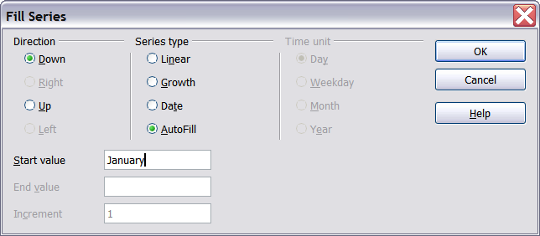
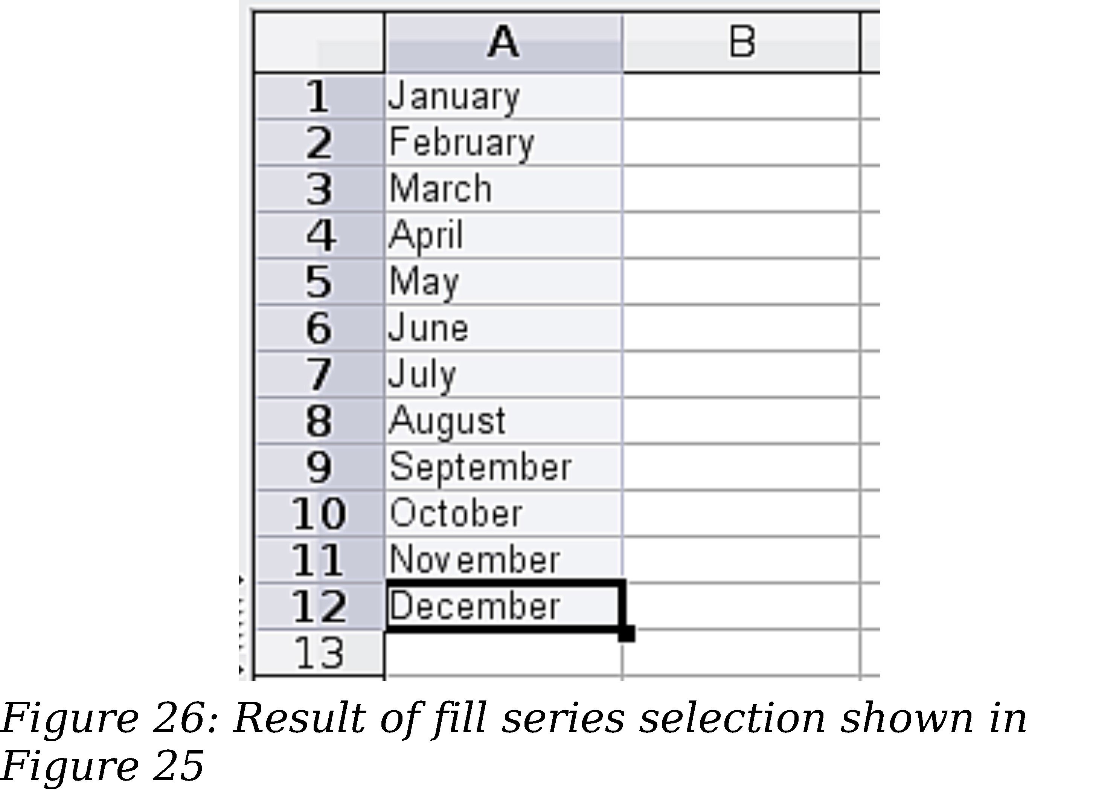
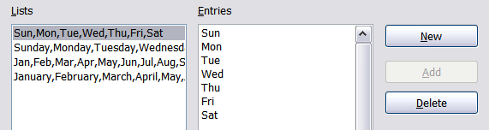
Figure 25: Specifying the start of a fill series (result is in Figure 26)
Defining a Fill Series
To define your own fill series:
1) Go to Tools > Options > OpenOffice Calc > Sort Lists. This dialog shows the previously-defined series in the Lists box on the left, and the contents of the highlighted list in the Entries box.
Figure 27: Predefined fill series
2) Click New. The Entries box is cleared.
28 | Chapter 4 Getting Started with Calc

Slide 29
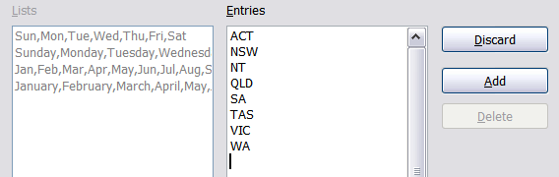
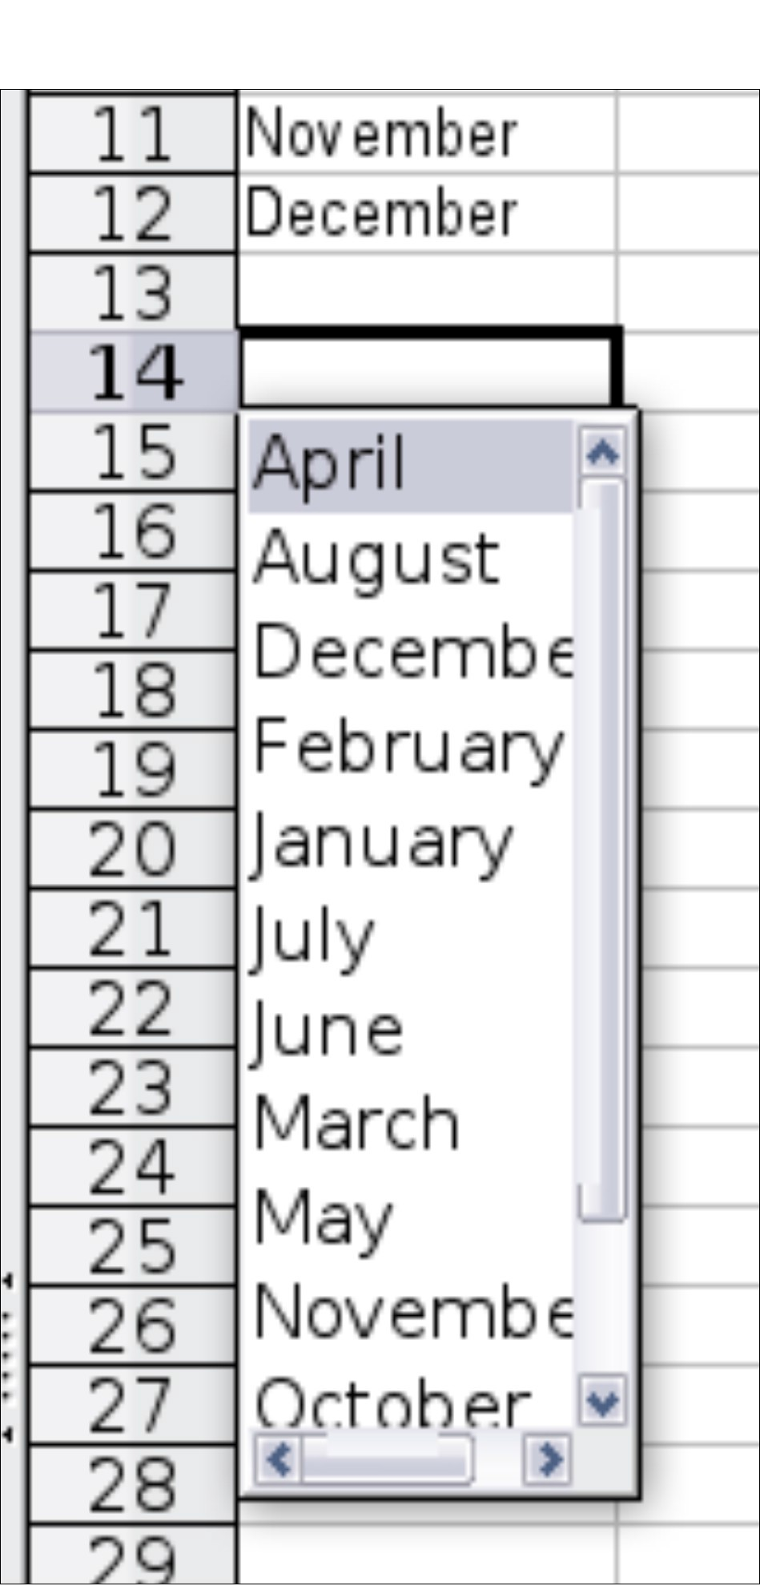
Type the series for the new list in the Entries box (one entry per line). Click
Add. The new list will now appear in the Lists box.
Click OK at the bottom of the dialog to save the new list.
Figure 28: Defining a new fill series
Using Selection Lists
Selection lists are available only for text, and are limited to using only text that has already been entered in the same column.
To use a selection list, select a blank cell and press Ctrl+D. A drop-down list appears of any cell in the same column that either has at least one text character or whose format is defined as Text. Click on the entry you require.
Validating Cell Contents
When creating spreadsheets for other people to use, you may want to make sure they enter data that is valid or appropriate for the cell. You can also use validation in your own work as a guide to entering data that is either complex or rarely used.
Fill series and selection lists can handle some types of data, but they are limited to predefined information. To validate new data entered by a user, select a cell and use Data > Validity to define the type of contents that can be entered in that cell. For example, a cell might require a date or a whole number, with no alphabetic characters or decimal points; or a cell may not be left empty. Valid values may also be defined by the contents of a cell range.
Depending on how validation is set up, the tool can also define the range of contents that can be entered and provide help messages that explain the content rules you have set up for the cell and what users should do when they enter invalid content.
You can also set the cell to refuse invalid content, accept it with a warning, or start a macro when an error is entered.
Chapter 4 Getting Started with Calc | 29

Slide 30
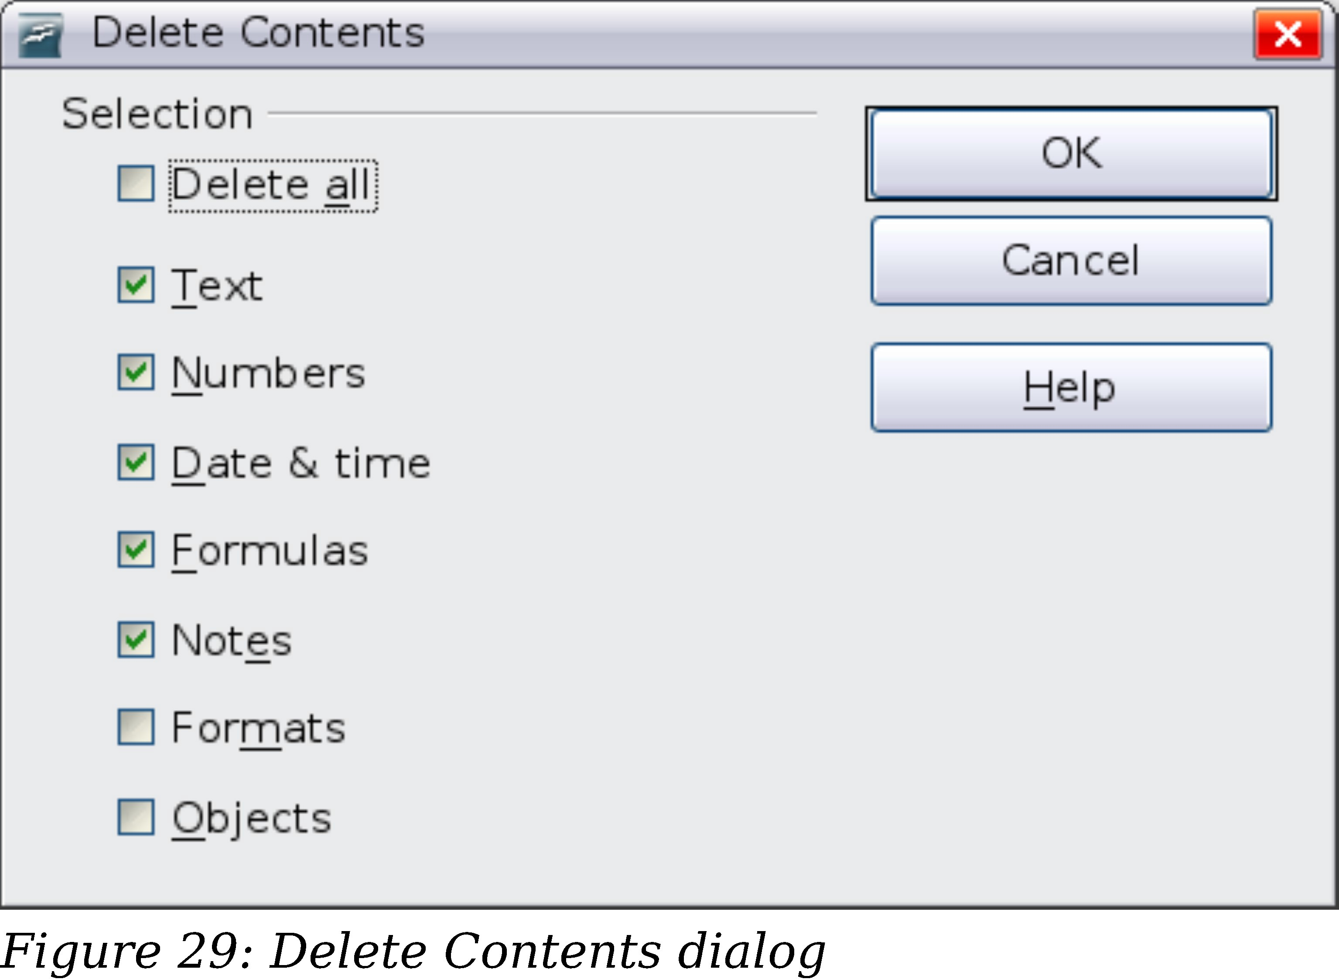
See Chapter 2 (Entering, Editing, and Formatting Data) in the Calc Guide for more information.
Editing Data
Editing data is done in much the same way as entering data. The first step is to select the cell containing the data to be edited.
Removing Data from a Cell
Data can be removed (deleted) from a cell in several ways.
Removing data only
The data alone can be removed from a cell without removing any of the formatting of the cell. Click in the cell to select it, and then press the Backspace key.
Removing data and formatting
The data and the formatting can be removed from a cell at the same time. Press the Delete key (or right-click and choose Delete Contents, or use Edit > Delete Contents) to open the Delete Contents dialog. From this dialog, the different aspects of the cell can be deleted. To delete everything in a cell (contents and format), check Delete all.
Replacing All the Data in a Cell
To remove data and insert new data, simply type over the old data. The new data will retain the original formatting.
Changing Part of the Data in a Cell
Sometimes it is necessary to change the contents of cell without removing all the contents, for example if the phrase “See Dick run” is in a cell, and it needs to be changed to “See Dick run fast.” It is often useful to do this without deleting the old cell contents first.
The process is the similar to the one described above, but you need to place the cursor inside the cell. You can do this in two ways.
30 | Chapter 4 Getting Started with Calc

