Slide 1
BLUETOOTH

Slide 2
Bluetooth is developed by a group of electronics manufacturers that will allow any sort of electronic equipment -- from computers and cell phones to keyboards and headphones -- to make its own connections, without wires, cables or any direct action from a user.

Slide 3
The Bluetooth Special Interest Group comprises more than 1000 companies.The major companies who created the technology include
Intel
3 com
Ericcson
IBM
Motorola
Nokia
Toshiba

Slide 4
The Name –Bluetooth?
The name is attributed to Harald Bluetooth was king of Denmark .
Choosing this name for the standard indicates how important companies from the Baltic region (nations including Denmark, Sweden, Norway and Finland) are to the communications industry

Slide 5
Present wireless technology like infra red data communication has two problems –1)Line of Sight 2) One to One
Using data synchronizing– e.g. syn on a PDA --- problem of using the right cradle and cable.
BLUETOOTH OVERCOMES THESE PROBLEMS

Slide 6
It provides agreement at the physical level -- Bluetooth is a radio-frequency standard.
Provides agreement at the data link level where products have to agree on
when bits are sent
how many will be sent at a time
how the parties in a conversation can be sure that the message received is the same as the message sent

Slide 7
The Basic Idea
Bluetooth is a standard for a small , cheap radio chip to be plugged into computers, printers, mobile phones, etc
Bluetooth chip is designed to replace cables.Information normally carried by the cable, is transmitted at a special frequency to a receiver Bluetooth chip.
These devices can form a quick ad-hoc secure “piconet” and start communication.
Connections in the “piconets” can occur even when mobile.

Slide 8
“Piconet”
A collection of devices connected via Bluetooth technology in an ad hoc fashion.
A piconet starts with two connected devices, and may grow to eight connected devices.
All Bluetooth devices are peer units and have identical implementations. However, when establishing a piconet, one unit will act as a Master and the other(s) as slave(s) for the duration of the piconet connection.

Slide 9
Requirements
Low cost as cables – chip $5
Secure as cables – must support authentication and encryption
Must support both data and voice.
Must connect to a variety of devices.
Must be able to function in a noisy environment.
Data rates – 721kbps , using the 2.45Ghz radio frequency band –I.S.M (Industrial, scientific and medical)
Must support many simultaneous and private “piconets”.
Must be low power, compact and global.

Slide 10
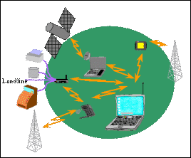
Usage Models- Voice/Data Access Points
Connecting a computing device to a communicating device.
Allows any device with a bluetooth chip to connect to the internet while located within the range of the access point.
Example- a notebook could link to the internet using a mobile phone as an access point.

Slide 11
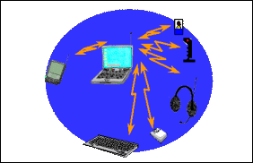
Usage models-Peripheral Interconnects
Standard peripheral devices like keyboard, mice, headsets etc working over a wireless link.
The same device can be used in multiple functions e.g a headset can access phones while in the office and can interface with a cellular phone when mobile.

Slide 12
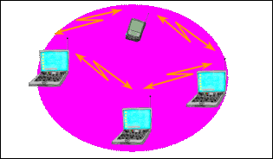
Usage model- Personal Area Networking.(PAN)
Allows dynamic formation and breakdown of “PICONETS”--ad-hoc personal networks.

Slide 13
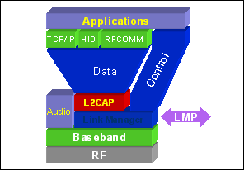
Bluetooth Architecture
Core Specification -Deals with the lower layers of the architecture and describes how the technology works.
Profile Specification -
Focuses on how to build interoperating devices using the core technology.

Slide 14
RF Layer
The Radio (layer) is the lowest defined layer of the Bluetooth specification.
It defines the requirements of the Bluetooth transceiver device operating in the 2.4GHz ISM band.

Slide 15
In order to minimize interference the nominal antenna power is 1 mW which can be extended to 100mW.
The low power limits the range to about 10 centimeters to 10 meters. With higher power of 100mW range of 100meters can be achieved.
It uses a packet switching protocol based on a technology called spread-spectrum frequency hopping to spread the energy across the ISM band.

Slide 16
Spread-Spectrum frequency hopping
A device will use 79 individual randomly chosen frequencies within a designated range, changing from one to another on a regular basis.
The designated range is from 2.402GHz to 2.480GHz, in steps of 1MHz.
The frequency hopping is done at a rate of 1600 times a second.
This allows more devices to use the limited time slice and secondly reduces the chance of two transmitters being on the same frequency at the same time.

Slide 17
Baseband layer – This layer defines the timing, framing, packets and flow control on the link.
Link Manager – Responsible for managing connection states(authentication & encryption), enforcing fairness among slaves & power mangt.
Logical Link Layer – Handles multiplexing, segmentation and reassembly of large packets and device discovery.
Audio – The audio data is directly mapped to the baseband layer.

Slide 18
Bluetooth Frame
Each frame consists of a transmit packet and a receive packet.
Each packet may have either 1, 3 or 5 slots of 625ùs.
Single slot packet – max data rate of 172Kbps
Multislot frames support higher rates– 721Kbps or a max. of 3 voice channels.

Slide 19
Network Topology
All units have a unique global ID(BD_Addr) address( 48 bits)
The unit that initializes the connection is assigned as the master which controls the traffic of the connection.
A master can simultaneously connect upto seven slaves.
The master/slave roles can be swapped.
A device can be a master in only one “piconet” at a time.

Slide 20
Forming a piconet
Needs two parameters --- a) Hopping pattern of the radio it wishes to connect. b) Phase within the pattern i.e. the clock offset of the hops.
The global ID defines the hopping pattern.
The master shares its global ID and its clock offset with the other radios which become slaves.
The global ID and the clock parameters are exchanged using a FHS (Frequency Hoping Synchronization) packet.

Slide 21
Devices not connected to a piconet are in STANDBY mode, using low power.
A connection is made by either a PAGE command if the address is known or by the INQUIRY command followed by a PAGE
When a radio sends an INQUIRE command, all the listening radios respond with their FHS packets, which tells the inquiring radio of all the radios in the area.
All listening radios perform a page scan and/or an inquiry scan every 1.25 seconds.
The master radio sends an FHS to the paged radio.

Slide 22
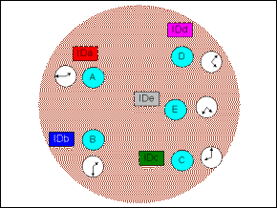
Shows a bunch of bluetooth devices in proximity of each other.
Each device has its own ID and its clock offset

Slide 23
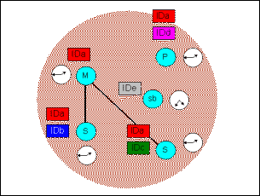
Radio A has become the master and has formed a piconet with B and C as the slaves.
Both B and C now share A’s ID and and clock offset.

Slide 24
When a radio joins a piconet it is assigned a 3 bit Active Member Address(AMA).
Once the piconet has eight radios, the master assigns puts a radio into the PARK mode.
This is one of the low power states, in which the radio releases its AMA for a 8 bit PMA (Passive Member Address).
The freed AMA can be assigned to another radio wishing to join the piconet.
Though upto 256 radios can actively reside on a piconet, only 8 of them with AMA’s can transfer data.

Slide 25
Once a radio joins the piconet and has an AMA it can direct data to other devices on the piconet.
In order to remain in the connected state within a piconet, the radio needs to maintain the frequency hopping pattern and offset while consuming low power.
To achieve this the connected radios can be placed in either PARK, HOLD or SNIFF modes.

Slide 26
HOLD MODE
When data needs to be transmitted very infrequently, thus conserving power.
In this mode only an internal timer is running.
No data is transferred when in HOLD mode.
The master can put slaves on HOLD mode.
SNIFF MODE
A slave device listens to the piconet at a reduced rate.
The SNIFF interval is programmable.
In both the HOLD and SNIFF states the device retains its AMA.

Slide 27
PARK MODE
The device has given up the AMA and has become passive.
The parked device will occasionally listen to see if the master has sent any broadcast data asking it to become active.

Slide 28
Types of Links and Packets
Synchronous Connection Oriented(SCO)
Point to point full duplex link.
Typically used for voice data.
These packets do not use CRC and are not retransmitted.
Needs an asynchronous connectionless (ACL) type link to be first established.

Slide 29
Asynchronous Connectionless Link
This is a packet switched link between a master and slave.
Supports both isochronous and asynchronous data.
Error Correction Schemes
Forward error correction(1/3 and 2/3)
Automatic Repeat Request scheme.

Slide 30
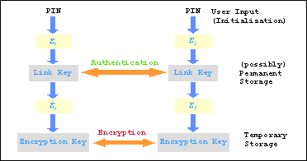
Security
Authentication and encryption is provided at the Link Manager layer.
The PIN is translated into a 128 bit link key which is used for authentication.
After authentication the radios will settle on a suitable length encryption key to be used.
Bluetooth relies on PIN codes to establish trusted relationships between devices.

