Slide 1
Subject Name: Information System: Analysis Design & Implementation Subject Code : BCA 602 (N) Topic : CASE Architecture
HIMANSHU SHUKLA
Department of Computer Application
UIET, CSJM University, Kanpur

Slide 2
Architecture of CASE tool
User Interface : A standard interface toolkit with common presentation protocol. The user interface contain software for human –computer interface management and library of display object.
It is communication medium between the interface and CASE.
Toolkit Layer: It is a set of tool management services with the CASE tools . Tool Management Services control the behaviour of tools within the environment. If multitasking is used during the execution of one or more tools TMS performs multitask synchronisation and communication , flow of information from repository and object management system OMS into the tool .

Slide 3
Object Management Layer: It performs the configuration management function .It is framework that provides architecture mechanism for tools integration .Easy CASE tool is plugged onto object management layer .
Repository Layer: It is a CASE database and access control functions that enable the Object Management Layer t interact with database .Data integration is achieved by object management and shared repository layer.

Slide 4
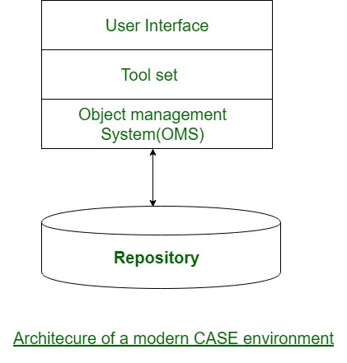

Slide 5
Use of CASE Tools in Analysis Design & Implementation of Information system
Diagramming Tools
Computer display and report generator tool
Analysis tool
Central Repository
Documentation generator
Code generator
Configuration management tools
Programming tools
Prototyping tool
Web development tools
Quality assurance tool
Maintenance tool
Online help

Slide 6
CASE Tools used within SDLC Phase
SDLC Phase | Activity | CASE Tool Usage
Project Identification and selection | Display and structure high level organizational information | Diagramming and matrix tool to create and structure information
Project initiation and planning | Develop project scope and feasibility | Repositories and documentation to develop plan
Analysis | Determine a structured system | Diagramming tool to create process logic and data models
Design | Create new system design | Form report generation to prototype design , analysis and documentation to define specification
Implementation | Translate design into information system | Code generator and analysis
Maintenance | Overall information system | All tools are used according to SDLC

Slide 7
Advantages of CASE Tools
CASE tools provide maintenance support as a result of storing system specification in central repositories.
Revision of system description easily and graphical representation.
Support system prototyping through the capability to change specification and determine the impact of system performance.

Slide 8
Disadvantages of CASE Tools
Conflicting use of diagrams
Human task remain critical
Limited function support
Absence of standard methodology support

