Slide 1
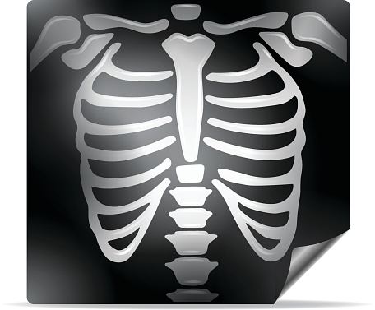
CHEST X-RAY

Slide 2
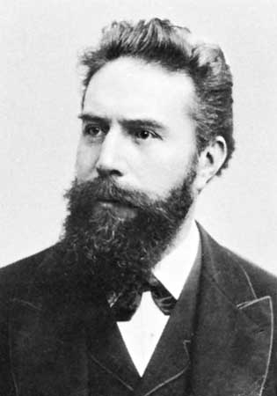
Wilhelm Konrad Roentgen, received the first Nobel Prize for Physics in 1901 for his work in defining the major properties of x-rays and the conditions necessary for their production. It was Roentgen who coined the term “x-ray.”

Slide 3
Chest radiographs provide a static view of the anatomy of the chest, and as such, they may be used to screen for abnormalities, to provide a baseline from which subsequent assessments can be made, or to monitor the progress of a disease process or treatment intervention.
X-rays have very short wavelengths of electromagnetic radiation that penetrate matter. A traditional radiograph is created when X-rays penetrate body structure and produce images on a piece of photographic film usually contained in a cassette.

Slide 4
CXR- PROJECTIONS
PA VIEW- The x-rays penetrate through the back of the patient on to the film.
AP VIEW- The x-rays penetrate through the front of the patient on to the film.
LATERAL VIEW- With either the right or left side of the patient against the film.

Slide 5
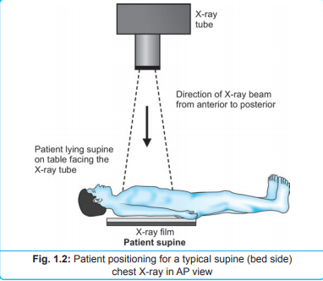
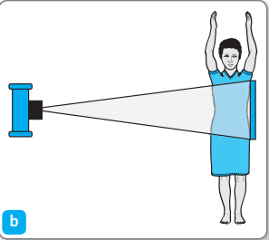

Slide 8
RIGHT LATERAL CXR

Slide 9
Technical Factors of Viewing for Chest Radiographs

Slide 10
PENETRATION/EXPOSURE
Able to see ribs through the heart.
Barely see the spine through the heart

Slide 11
UNDERPENETRATED FILM
Hemi diaphragms are obscured.

Slide 12
OVER PENETRATED FILM
Lung fields darker than normal
See spine well beyond the diaphragms
Inadequate lung detail.

Slide 13
RESPIRATION
Ideally CXR should be taken with the patient in full inspiration.
A CXR in full inspiration should have the diaphragm as low as possible, atleast at the level of the sixth rib anteriorly and eighth rib posteriorly. If one can count 10 posterior ribs above the diaphragm, it is an excellent inspiratory film.
When less than 10 ribs can be counted above the diaphragm, it is either poor inspiratory effort or a sign of low lung volume. Low lung volume from a poor inspiration effort can crowd and compress the lung markings, producing the impression that a lower lobe pneumonia is present.

Slide 16
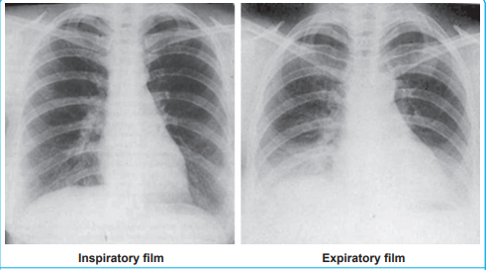

Slide 17
ROTATION
Identify the medial ends of the clavicles and select one of the vertebral spinous processes that falls between them. The medial ends of the clavicles should be equidistant from the spinous process. If one clavicle is nearer than the other, then the patient is rotated and the lung on that side will appear whiter. A patient with a thoracic scoliosis may appear to have a rotated film. Check whether the spinous processes on the vertebral column are aligned. If they are, it is more likely that the patient is rotated.

Slide 19
 BASIC PRINCIPLES OF CHEST X-RAY INTERPRETATION
Radiographic Density

Slide 20
When referring to radiographic shadowing, the term ‘density’ refers to the radio-opacity of a lesion and this will be influenced fundamentally by the degree of exposure of the film.
The principal objects shown on a chest radiograph are air, fat, water, tissue, and bone.
Air in the lungs has a very low density and thus allows greater x-ray penetration, resulting in a dark image on the radiograph (radiolucency). At the opposite extreme is bone, which, because it is denser, allows fewer x-rays to penetrate and results in a white image on a radiograph (radiopacity).

Slide 21
The four basic radiographic densities are:
Gas (air), which appears black or radiolucent; examples are gas or air in trachea, bronchi, or stomach
Fat, which appears gray or less radiolucent than air; an example subcutaneous fat
Water (soft tissue), which appears white with slight radiopacity; examples are the heart, blood vessels, muscle, and diaphragm
Bone (or metal), which appears all white or completely radiopaque; examples are bones, ribs, clavicles, etc

Slide 22
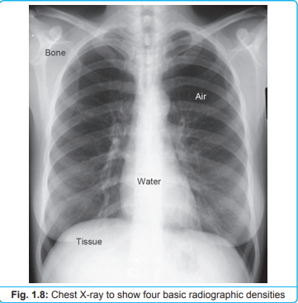

Slide 23
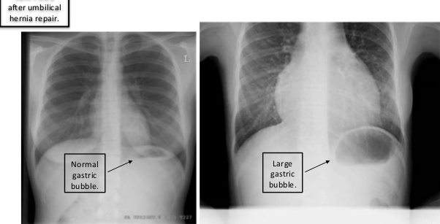
RIGHT OR LEFT
Normally Gastric bubble is on left side.

Slide 24
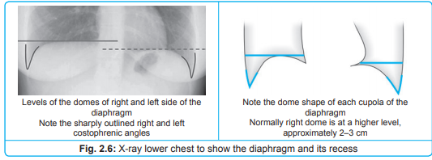
DIAPHRAGM
The diaphragm is considered in two halves (left and right “hemidiaphragms”) though anatomically there is only one diaphragm. Diaphragm is normally rounded and dome shaped. The right hemidiaphragm is higher than the left, on full inspiration by 2–3 cm.

Slide 25
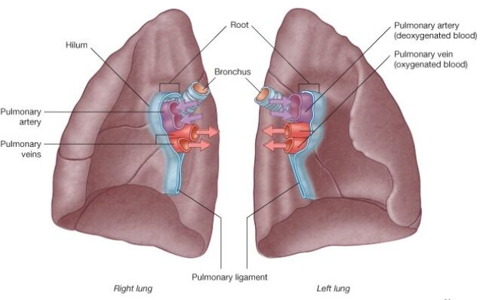
THE HILA
Formed by the root of the lungs (comprising the pulmonary blood vessels, the bronchi and a group of lymph nodes) the hila are at about the T4-T5 level and appear as poorly defined areas of variable density in the medial part of the central portion of the lung fields. The left hilum is partially obscured by the overlying shadow of the heart and great vessels, and it lies at a slightly higher level than the right hilum.

Slide 27
HEART
Size
Shape
Silhouette- margins should be sharp
Diameter (> ½ thoracic diameter is enlarged heart)
NOTE- AP views make heart appear larger than it actually is.
Thus you cannot comment on the presence or absence of cardiomegaly on an AP film.

Slide 29
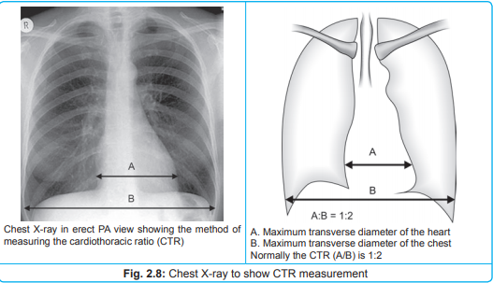
The heart lies in the middle mediastinum in midline. The width of the heart should be no more than half the width of the chest. This is the normal cardiothoracic ratio (CTR).

Slide 30
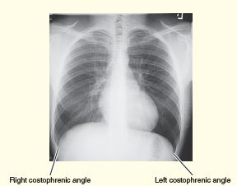
COSTO-PHRENIC ANGLE
Margins should be sharp.

Slide 31
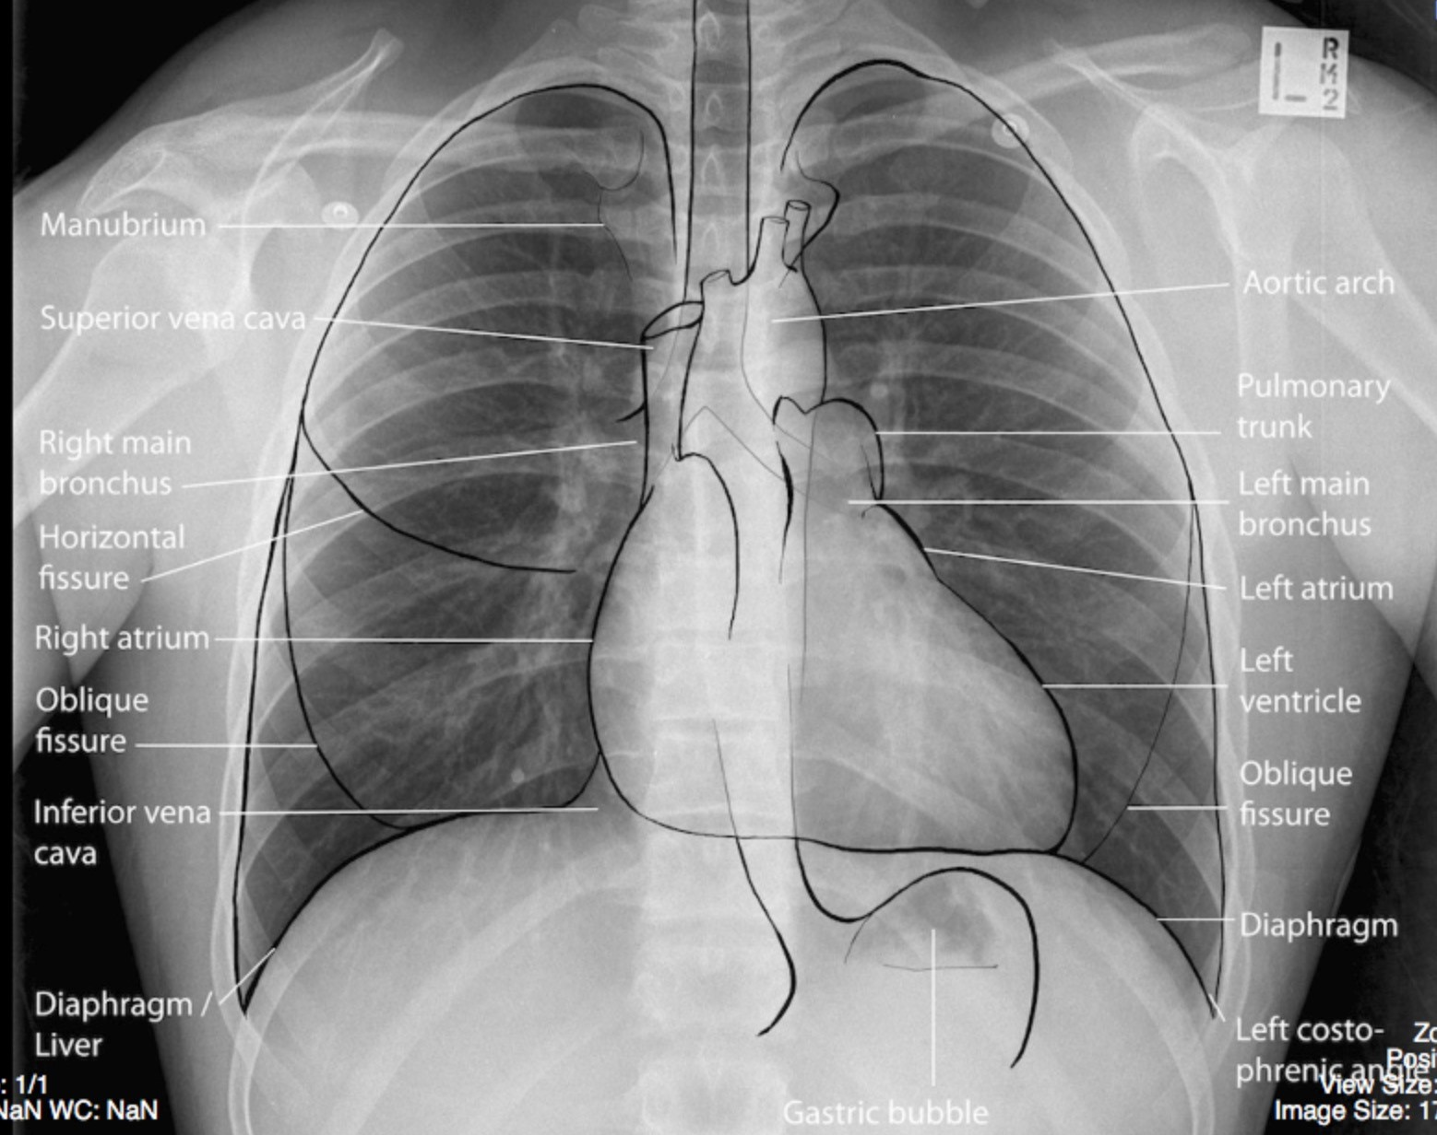
NORMAL ANATOMICAL STRUCTURES- CXR

Slide 32
SILHOUETTE SIGN
The edges of structures such as the heart, diaphragm and masses are visible only if a difference in density exists between them and the adjacent tissue. This is the silhouette sign. It is helpful because if an edge of a structure that is usually visible is no longer visible, it means that the adjacent lung is of the same density, i.e. more solid than usual.
It is caused by consolidation and/or atelectasis of the adjacent lung, by a large mass, or by contiguous pleural fluid.

Slide 33
For example, a silhouette sign would be expected in an area of consolidation in the right middle lobe of the lung because this lobe borders the right sides of the right atrium and the mediastinum. Because both the area of consolidation and the heart are water densities (white), the right border of the right atrium cannot be distinguished from the border of the right middle lobe of the lung. That is the right heart border is obscured, if the adjacent lung (right middle lobe) is consolidated.

Slide 34
