Slide 1
4th Semester: BP-405T, PHARMACOGNOSY-I Unit V Fibers: Cotton, Jute, Hemp Hallucinogens, Teratogens, Natural allergens
DR. NISHA SHARMA
Associate professor
UNIVERSITY INSTITUTE OF PHARMACY
C.S.J.M. UNIVERSITY, KANPUR

Slide 2
Fibers
Definition: Any hair-like raw material directly obtainable from an animal, vegetable, or mineral source and convertible into nonwoven fabrics such as felt or paper or, after spinning into yarns, into woven cloth.
Classification of Natural fibres based on origin:
1. The vegetable or cellulose-base: includes cotton, flax, and jute, banana, hemp
2. The animal or protein-base fibres: wool, silk.
3. Regenerated and synthetic fibres: Nylon, Terylene, Orlon, Viscose, Alginate fibres, etc.
4. Mineral fibre: Asbestos, glass

Slide 3
Cotton : Absorbent/ Raw/purified cotton
Biological source: Epidermal trichomes of the seeds of cultivated species of the Gossypium herbaceum and other species of Gossypium (G. hirsutum, G. barbadense) freed from impurities, fats and sterilized, belonging to family Malvaceae.
Chemical Constituents : 90% of cellulose, 7–8% of moisture, wax, fat and oil 0.5% and cell content about 0.5%. Purified cotton has almost cellulose and 6–7% of moisture.
Chemical Tests:
1. Dry cotton + N/50 I₂ + 80% w/w H₂SO4 → Blue color
2. Dry cotton + ammon. Copper oxide → Dissolves with ballooning
3. Dry cotton + Phloroglucinol+ HCl → No red color
USES: Used in surgical dressing, filtering media, insulation, absorbent cotton used for absorbing blood, mucus, pus.

Slide 4
JUTE : Gunny
Biological source: consists of phloem fibres from the stem of various species of the Corchorus; C. capsularis Linn, C. olitorius Linn, and other species like C. cunninghamii, C. junodi etc., belonging to family Tiliaceae.
Chemical Constituents : composed of 50–53% cellulose, 20% hemicellulose & 10–11% lignin, moisture not more than 12–13%, fats, wax, and ash contributing to 1% each.
Chemical Tests:
Middle lamella is lignified, gives red color with Phloroglucinol+ HCl.
USES: used in the manufacture of tows, padding splints, filtering, and straining medium. Jute is used for the preparation of coarse bags.

Slide 5
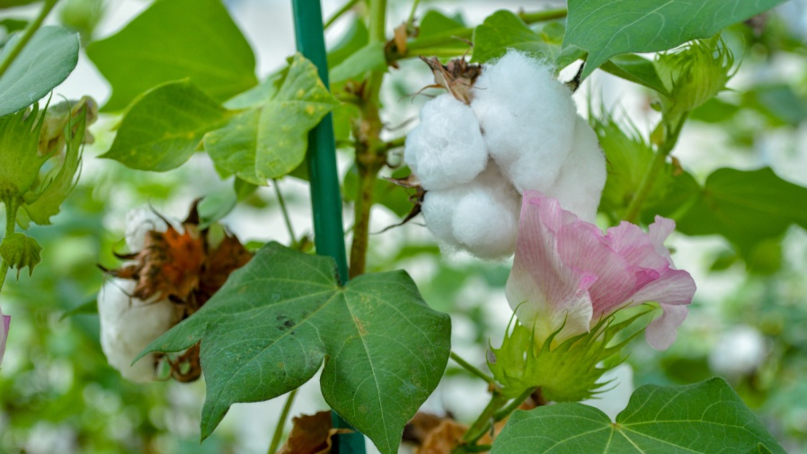
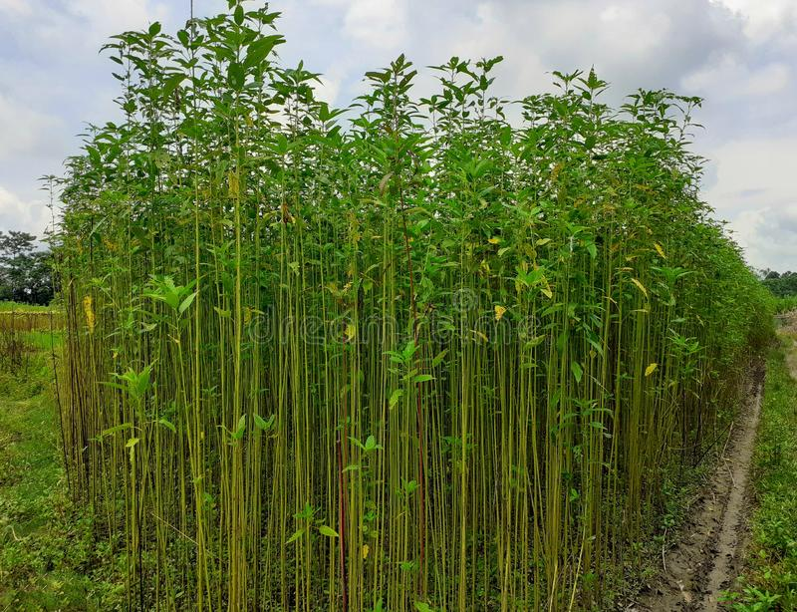
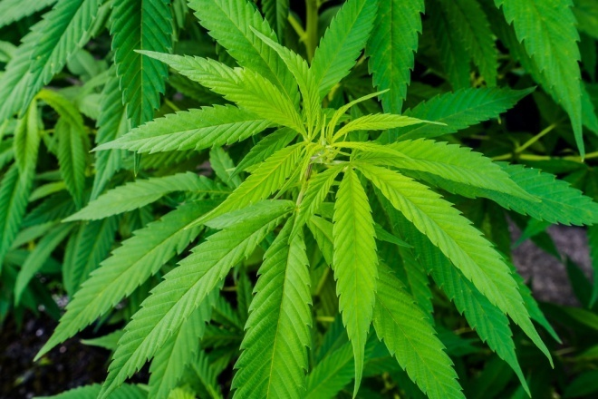
HEMP:
Biological source: Hemp is the pericyclic fibre obtained from Cannabis sativa Linn., belonging to family Cannabinaceae..
Chemical Constituents : mainly consist of cellulose and lignin.
USES: printing, inks, paints, varnishes, paper, bibles, bank notes, food,, textiles (the original Levi’s jeans were made from Hemp cloth), canvas and building materials. Due to its high tensile strength, bast fibres are ideal for such specialized paper products as: tea bags, industrial filters, currency paper, or cigarette paper.
COTTON
JUTE
HEMP

Slide 6
HALLUCINOGENS
Hallucinogens are natural and synthetic (synthesized) substances.
When Taken into the body they alter state of consciousness.
Hallucinogenic compounds cause people to see/ think to see random colours, patterns, events and objects that do not exist.
Other names of hallucinogens are Cartoon acid, Microdot, California sunshine, Psilocybin, Magic mushrooms.
Marijuana and hashish—two substances derived from the hemp plant (Cannabis sativa)- feeling of relaxation, faster heart rate
Form of LSD first produced in 1938, Albert Hoffman, a Swiss research chemist at Sandoz Laboratories, synthesized many important ergot alkaloids (organic plant bases), including Hydergine, LSD-25 and psilocybin.
LSD is so powerful that a tiny amount can have a hallucinogenic effect.

Slide 7
HALLUCINOGENS: Datura
Biological source: Datura consists of the dried leaves and flowering tops of Datura metel and D. metel var. fastuosa Safford. It belongs to family Solanaceae. contain not less than 0.20 per cent of total alkaloids of Datura, calculated as l-hyoscyamine.
Chemical Constituents : upto 0.5 per cent of total alkaloids, among which hyoscine (scopolamine) is the main alkaloid, while l-hyoscyamine (scopoline) and atropine are present in very less quantities (see belladonna herb).
USES: its main alkaloid hyoscine are parasympatholytic with anticholinergic and central nervous system depressant effects. The drug is used in cerebral excitement. used in treatment of asthma and cough. Hyoscine hydrobromide is used in motion sickness, gastric or duodenal ulcers.

Slide 8
HALLUCINOGENS: BETEL NUT
Biological source: dried ripe seeds of Areca catechu, belonging to family Palmae.
Chemical Constituents : arecaine and arecoline alkaloids which are comparable to nicotine in its stimulating, mildly intoxicating and appetite-suppressing effects on the mind. It also contains the alkaloids arecaidine, arecolidine, guracine (guacine) and guvacoline.
USES: Arecoline: parasympathomimetic.
Sialogogue properties, consumed as masticatory in India. May cause oral leukoplakia. anthelmentic drug and used as vermicide and taenifuge in veterinary practice.
Other Hallucinogenics: KAVA KAVA, Henbane, Belladona, Hyoscyamus niger, Argemone mexicana etc.

Slide 9
TERATOGENS:
Teratogen is a an agent that can disturb the development of embryo/ fetus. They halt pregnancy or produce a congenital malformation i.e. birth defect. Classes of teratogens : Radiation, chemicals and drugs
1. Tobacco: It consists of dried leaves of Nicotiana tobaccum, belonging to family Solanaceae.
CC: alkaloids nicotine, nicotianin, nicotinine, nicoteine, nicoteline. After leaves are smoked the nicotine decomposes into pyridine, furfurol, collidine, hydrocyanic acid, carbon monoxide, etc.
USES: sedative, diuretic, expectorant, discutient and sialagogue
Nicotine is vasoconstrictor, results in uterine vascular cnstriction and intrauterine growth retardation. Ciggarette smoking during pregnancy results in perinatal mortality & morbidity risk, CO from smoke crosses placenta & ↑ses blood carboxyhemoglobin with long half life in fetal blood.

Slide 10
TERATOGENS: Marijuana or Cannabis
B.S. dried flowering tops of the pistillate plants of Cannabis sativa Linn., belonging to family Cannabinaceae.
C.C : 15 to 20% resin, The most important active constituents present in cannabis are: cannabidiol, cannabidolic acid, cannabinol, cannabichromene, and trans-tetrahydrocannbinol. Cannabis also contains Cannabidiolic acid, cannabidiol A ,
8, 9, tetrahydrocannabinol, cannabinol A9, Tetrahydrocannabinol (THC), volatile oil, trigonelline, and cholene.
it is psychotive drug- tetrahydrocannbinol
8,9 tetrahydrocannbinol crosses placenta & persists in fetus for around 30 days. Growth retardation in first trimester
Uses: Cannabis resin is tonic, sedative, analgesic, intoxicant, stomachic,
antispasmodic, antianxiety, anticonvulsant, antitussive, and narcotic. Cannabis causes only pshycic dependence and act upon the nervous system.

Slide 11
TERATOGENS:
Ergotamine from Ergot
Fenugreek: Trigonella foenum
Asparagus racemosus
Malus domestica seeds of apple
Prunus cerasus cherry seeds
Solanum tuberosum , Solanum melangena Lycopersicon esculentum : suspected teratogens: solanidines, spirosolanes
Astragalus
Colchicum autuminale
Vinca rosea
Veratrum
Indigofera spicata
Datura stramonium ETC.

Slide 12
NATURAL ALLERGENS
Allergens are inciting agents of allergy, i.e. the substances capable of sensitizing the body in such a way that an unusual response occurs in hypersensitive person.
may be biologic, chemical or of synthetic origin.
Defined as a specific immunologic reaction to an immunogen—a normally harmless substance (allergen).
First defined in 1906 by von Pirquet who described allergy as changed or altered reaction in the body of an individual, in response to a substance or condition that is harmless to others.

Slide 13
NATURAL ALLERGENS
Types of Allergens
1. Inhalant allergens: airborne substances as chemicals, include pollens, dust, mites, mould spores and animal allergy (epidermis or dander).
Pollens produced by plain looking plants, e.g. trees (oak, walnut); grasses (bermuda grass and timothy) and weeds (ragweed, plantain). Alfalfa, almond, apple, acacia, barley, blue grass, canary grass, cherry, eucalyptus, gladiolus, hazelnut, juniper, mulberry, mustard, lemon and related species of citrus.
2. Ingestant allergens: in food stuff and swallowed: skin rash, puffed lips and tongue, migraine, rhinitis or symptoms like severe eczema of hand and feet.
Tomato rash, strawberry rash, eating oranges, chocolate or shellfish, walnut, cashew nut, etc. soy lecithin, gluten, soy flour, rice flour, alfalfa, potato starch and gum acacia.

Slide 14
NATURAL ALLERGENS
3. Injectant zallergens: Injectant allergens cause symptoms similar to those of the antibiotics, e.g. penicillin, cephalosporin and semisynthetic penicillin, etc. natural sources of injectable allergens are produced by the sting of bees, hornets and wasps.
4. Contactant allergens: Ancardiaceae family, primarily the genus Toxicodendron (Rhus) and includes poison ivy, oak and sumac.
called urushiols (a phenolic compound) are found in the oleoresin fraction and are derivatives of pentadecylcatechol or heptadecylcatechol.
Ruta graveolens, asparagus, ornamental ‘dumb cane’ (Dieffenbachia seguine), buck wheat, butter cups, catalpa leaves, chrysanthemums, ginkgo leaves, lobelia, marigolds etc
5. Infectant allergens : caused by the metabolic product of living microorganism: bacteria, protozoas, moulds, helminthes parasites

Slide 15
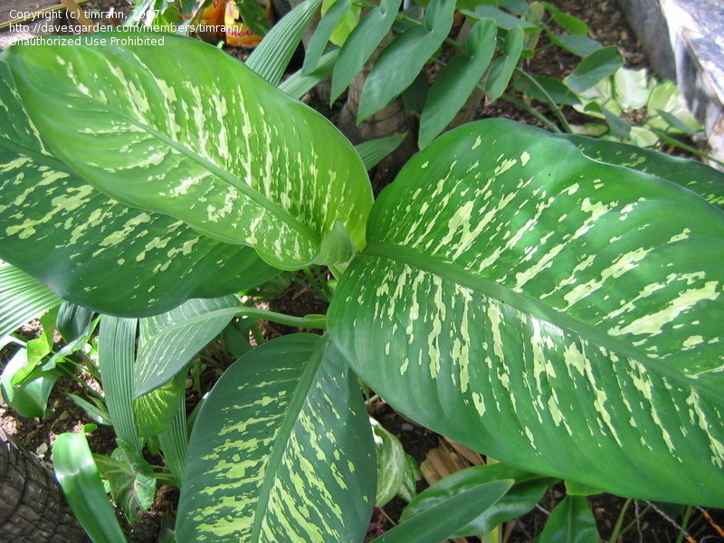
Natural allergens: Dieffenbachia seguine (dumb cane)
It is the plant Dieffenbachia seguine belonging to family araceae
CC. proteolytic enzyme (named dumbcain), a cyanogenic glycoside, a substance which causes contraction of smooth muscles , asparagine protoaenomoine: swelling of larynx & pharynx
Uses: treat gout, dropsy, sexual impotence, and frigidity

Slide 16
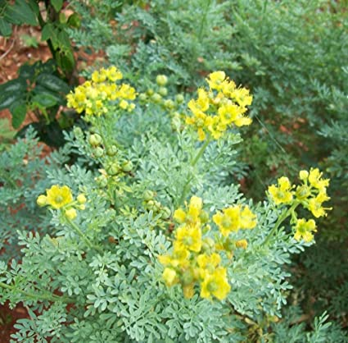
Natural allergens :Ruta graveolens
Ruta graveolens L., is a odoriferous herb belonging to the family Rutaceae.
CC: acridone alkaloids, coumarins, essential oils, flavonoides, and fluoroquinolones have been found in the roots and aerial parts
USES: potassium channel blocker, neuromuscular problems,
antispasmodic effect
Abortifacient
Causes photodermatitis

