Slide 1
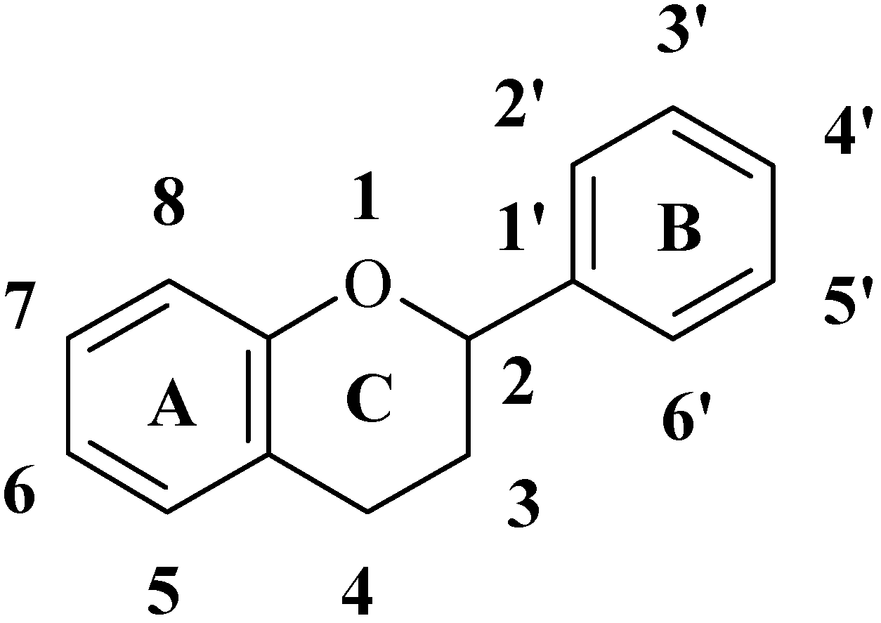
FLAVONOIDS
Class of plant secondary metabolites
Word Flavonoids derived from latin word: “Flavus”= yellow
Group of polyphenolic compounds which are found in fruits, flowers, seeds & vegetable
Structure of flavonoids The flavonoids are possessing 15 carbon atoms; two benzene rings joined by a linear three carbon chain the skeleton can be represented as the C6 - C3 - C6 system.

Slide 2
PROPERTIES OF FLAVONOIDS
Physical Properties
Crystalline solids, sharp MP
Solubility: in H2O & alcohol (Flavonoid glycoside)
Non glycosidic flavonoid: Aglycon part-sol. in organic solvents
3. Color: Flavonones, Flavanol, Isoflavones- Colorless
Flavonols, Flavones: Yellow, Chalchones, aurones: Y, Orange
Anthocyanidine acid med.: Red
In basic: Blue
4. Flavanols: optically active
Chemical properties:
15 C skeleton, 2 benzene linked by heterocyclic pyran ring
Being phenolic, dissolves in alkalies → Yellow sol. +HCl → colorless
Glycosidic linkage located at 3 or 7 C
Flavanones, Flaonoes are unstable compound , on oxidation → Chalcones, leucocyanidines
Flavonoid + FeCl₃→ green/ purple/ red brown color

Slide 3
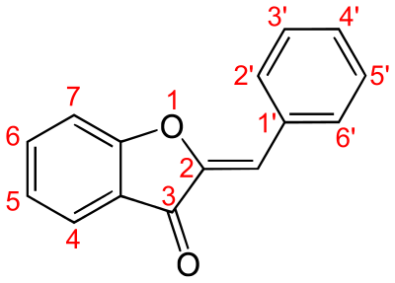
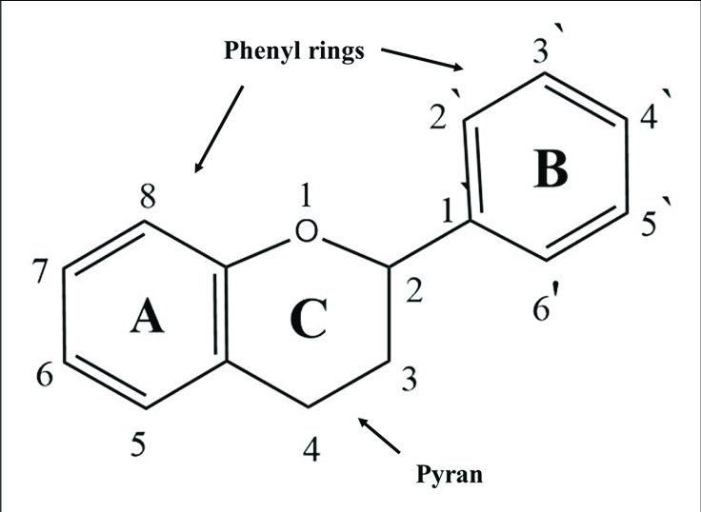
FLAVONOIDS
The three-carbon (-C3-) may be included through an oxygen bond between the two phenyl rings into:
1- A five-membered heterocyclic ring (furan) as in aurones.
2- A six-membered heterocyclic ring (pyran) to give flavonoids which constitute the largest group. The flavonoid aglycone consists of a benzene ring (A) condensed with a six membered ring (C) pyran ring, which at 2nd position adds a phenyl ring (B) as a substituent. C6-C3-C6 structure

Slide 4
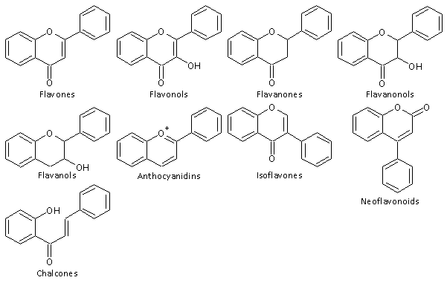

Slide 5
CLASSIFICATION OF FLAVONOIDS
Depending on the carbon of the C ring on which B ring is attached, and the degree of unsaturation and oxidation of the C ring.
B ring is linked in position 3 of the ring C are called isoavones;
B ring is linked in position 4, neoavonoids,
B ring is linked in position 2 further subdivided on the basis of the structural features of the C ring.
These subgroup are: avones, avonols, avanones, avanonols, avanols or catechins and anthocyanins.
Finally, avonoids with open C ring are called chalcones.

Slide 6
CLASSIFICATION OF FLAVONOIDS
1. Flavones (2-phenylchromen-4-one)
Have a double bond between positions 2 and 3 and a ketone in position 4 of the C ring. ex:- Apigenin, Luteolin
2. Flavonols (3-hydroxy-2-phenylchromen-4-one)
Have a hydroxyl group in position 3 of the C ring, which may also be glycosylated. Ex: Kaempferol, Rutin, Myricetin, Quercetin.
3. Flavanones/ dihydroavones (2,3-dihydro-2-phenylchromen-4- one
Have C ring saturated; the double bond between positions 2 and 3 is saturated, ex: Hesperetin, Hespereidin, Naringenin
Subclassified: furanoavanones, prenylated avanones, pyranoavanones or benzylated avanones
4. Flavanonols (dihydroavonols)/ 3-hydroxy-2,3-dihydro-2-phenyl chromen-4-one
Are 3-hydroxy derivatives of avanones; ex:Taxifolin, Silymarin

Slide 7
CLASSIFICATION OF FLAVONOIDS
5. Isoflavones / phytoestrogens.3-Phenylchromen-4-one skeleton
subgroup of avonoids in which the B ring is attached to position 3 of the C ring. have structural similarities to estrogens, such as estradiol
6. Neoflavonoids , Isoflavonoids and the Neoflavonoids can be regarded as abnormal flavonoids.
They have the B ring attached to position 4 of the C ring.
7. Flavanols or avan-3-ols or catechins
Also referred to avan-3-ols as the hydroxyl group is bound to position 3 of C ring
Another important feature of avanols, particularly of catechin and epicatechin, is the ability to form polymers called as proanthocyanidins or condensed tannins. Ex: Catechin (β-OH) 2- Epicatechin (α-OH)
8. Anthocyanidins (Flavylium (2-Phenylchromenylium) ion skeleton
Sugar units are bound mostly to position 3 of the C ring and they are often conjugated with phenolic acids, such as ferulic acid.
Color of the anthocyanins depends on pH, methylation or acylation at the hydroxyl groups on the A and B rings. Ex: Cyanidin. 2- Delphenidin.
9. Chalcones Chalcones and dihydrochalcones are avonoids with open structure

Slide 8
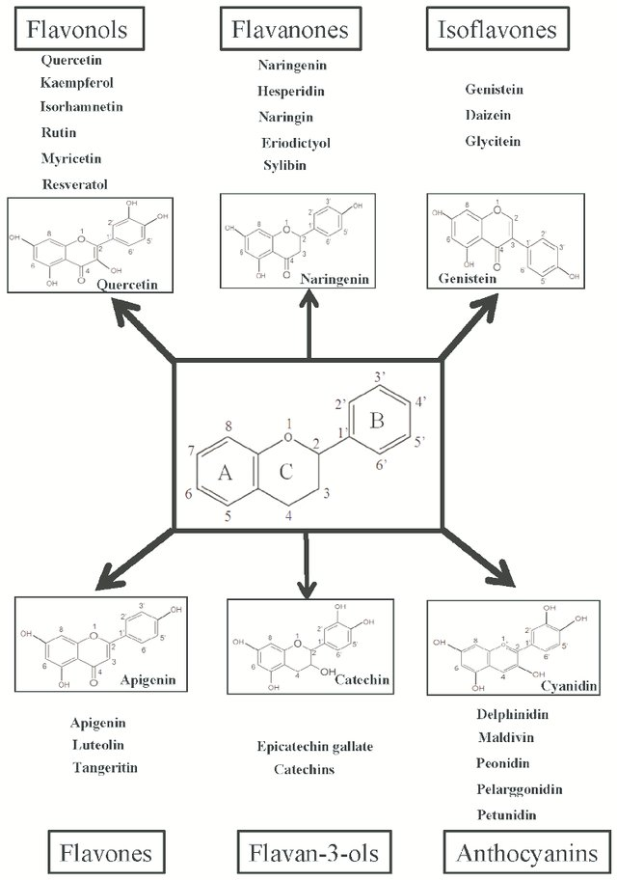

Slide 9
IDENTIFICATION OF FLAVONOIDS
1. Reaction with AlCl₃ : Give yellow color with AlCl₃ but fluoresce differently in UV as shown in the following table .
2. Lead subacetate test:- all flavonoids give yellowish precipitate with Pb subacetate.
3. Shinoda test for flavanones and flavonols:
alcoholic solution + Mg metal ⁄ HCl → orange, red or violet color
4. Antimony pentachloride test for chalcones:
alcoholic solution + SbCl5⁄ CCl4 → red or violet color
Light | Flavones | Flavonols | Flavanones
Visible | Yellow | Yellow | Yellow
UV | Green | Yellowish- Yell. Green | Pale brown

