Slide 1
Fryette’s laws:

Slide 2
Fryette’s laws:
are created by Harrison Fryette an osteopathic specialist.
They are 3 laws.
They describe the spine motion.
These laws are also known as coupled motion.

Slide 3
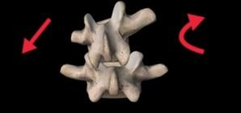
Law 1:
when the spine is in neutral side bending to one side will be accompanied by horizontal rotation to opposite side. Called type I motion.
Neutral position is side bending and rotation.

Slide 4
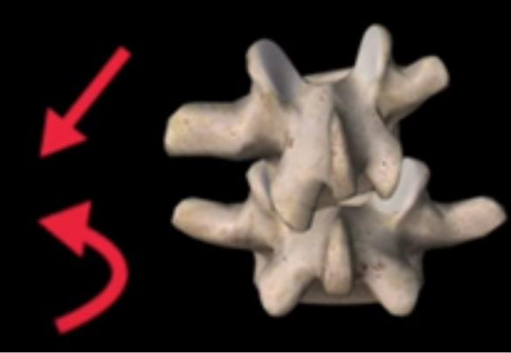
Law 2:
when the spine is in a flexed or extended position with side bending and rotation this is called non neutral position .
Side bending to one side will be accompanied by rotation to the same side. Called type II motion.

Slide 5
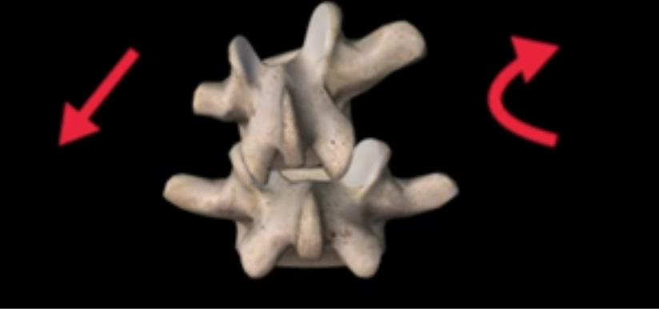
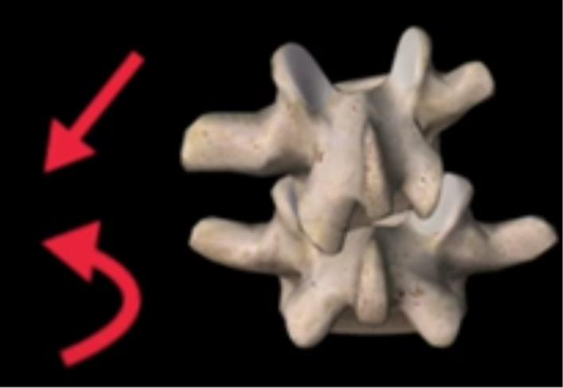
Law 1 and 2 are applied to thoracic and lumbar spines.
Type I motion Type II motion

Slide 6
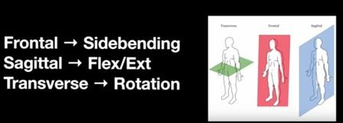
Law 3:
when motion is introduced in one plane it will modify (reduce) motion in other two planes.

Slide 7
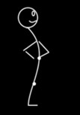
Extension
Flexion

Slide 8
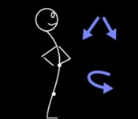
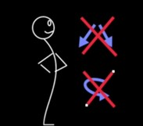
Will be limited or reduced
Motion in other planes

Slide 9
Law three is applied in entire spine.
Law 3 is applied in entire spine.

Slide 10
Coupled motion is rotation and side bending.
There are two types of coupled motion:
Type I: rotation occur opposite to side bending. (rotation to Rt. And side bending to Lt).
Type II: rotation occur the direction of side bending. (rotation to Rt. and side bending to Rt).

Slide 11
Thanks

Slide 12
References
Grill Solberg, 2008. Postural Disorders & Musculoskeletal Dysfunction Diagnosis Prevention & Treatment. © Elsevier. 1- 296
Kisner and Cobly . Therapeutic exercises foundation and techniques. The Spine: Structure, Function, and Posture. 6th edition Philadelphia: Elsevier 2012, Chapter 14: 409 - 437

