Slide 1
History of Ergonomics
Aakanksha Bajpai
Assistant Professor
School of Health Sciences

Slide 2
The concept of ergonomics (also called human factors) existed during the Stone Age (humans constructed tools to fit their own hands for hunting and gathering needs), the first documented mention of the field came in 1857, when Wojciech Jastrzebowski published An Outline of Ergonomics, or The Science of Work Based upon the Truths Drawn from the Science of Nature.
According to Jastrzebowski, the study of work, or ergonomics, should involve all aspects of useful work, the four main components of which are physical, aesthetic, rational, and moral.

Slide 3
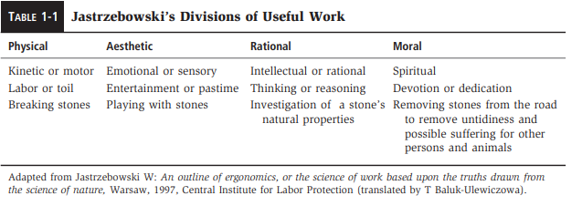

Slide 4
Jastrzebowski primarily applied his theories to able-bodied persons, with the ultimate objective of bettering humankind.
Ergonomics as a specialty made gains as technologic developments emerged during the industrial revolution.

Slide 5
After World War II, the Ergonomics Research Society (the current Ergonomics Society) was founded in England, and the first ergonomics text, Applied Experimental Psychology: Human Factors in Engineering Design by Chapanis, Garner, and Morgan, was published. In 1957, the Human Factors Society was formed in the United States, and Ergonomics, the journal of the Ergonomics Research Society, began publication. The International Ergonomics Association was formed in 1959 to join ergonomics societies from several countries.

Slide 6
Other areas that are experiencing considerable growth in awareness of ergonomic issues involve designing for special populations including children, older adults, and persons with disabilities.

Slide 7
Ergonomics developed from the common interests of a number of professions, particularly engineering, psychology, and medicine. It has remained a multidisciplinary field of study. Ergonomists include professionals with degrees in psychology, engineering, ergonomics, industrial design, education, physiology, medicine, health and rehabilitation sciences, business administration, computer science, and industrial hygiene. However, as the discipline evolved, specific areas of knowledge and practice have been identified, giving rise to bachelor’s, master’s, and doctoral degree programs, specifically in ergonomics or human factors. The Human Factors and Ergonomics Society (www.hfes.org) offers an accreditation process for these programs. Individual certification is also offered through the Board of Certification in Professional ergonomics.

Slide 8
THANK YOU

