Slide 2
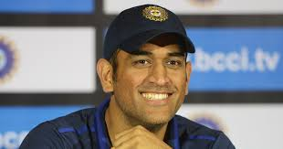
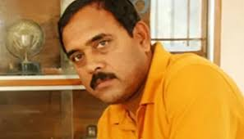
Mechanism for developing personality of KHO-KHO Coach and Players
Personality word came from Greek Word PERSONA MEANS MASK

Slide 3
PERSONALITY TYPES
Internal Personality External Personality
Internal Fitness .Appearance
Intellectual . Dressing Sense
Education Qualification .Language

Slide 4
1. Personality Development Tips Most Important Improvement Tips
Personality does not mean that you should have looks
Dress up well
Learn social skills:
Know your positives
Don’t Give Up
Be funny & don’t be serious always
Come Across As A Leader
Get Out Of Your Comfort Zone
Don’t Fear Failure

Slide 5
Mechanism CHANGE YOUR HABITS
SELF IMPROVE
MAKE GOOD COMPANY
READ GOOD BOOKS
( 80 BOOKS READ BY BILLGATES) SUCH A HUGE KNOWLEDGE

Slide 6
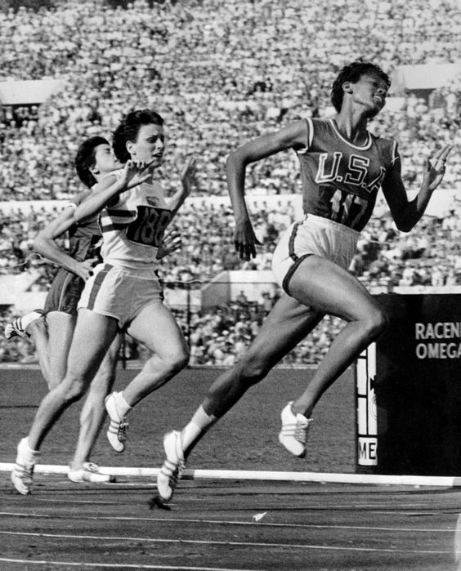
9 Things To Do To Improve Your Personality & Be The Best Version Of Yourself

Slide 7
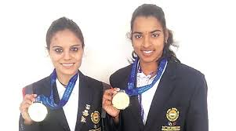
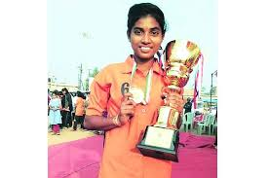
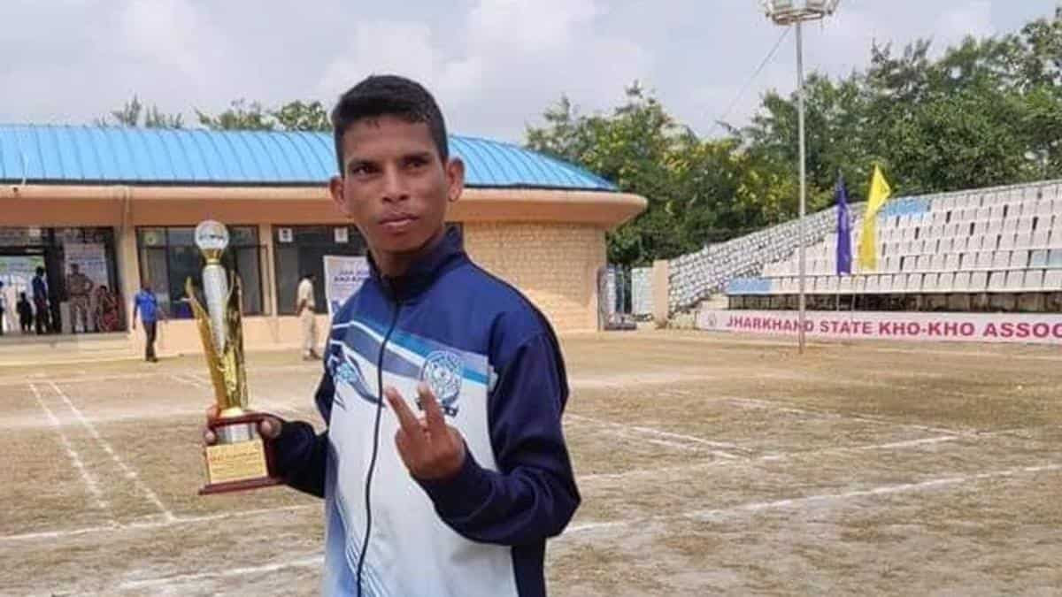
1.Recognize The Difference Between Who You Are & Who You Want To Be

Slide 8
2. Take Action To Make A Change

Slide 9
3. Stop Comparing Yourself To Others

Slide 10
4. Accept Your Personality Type & Know Yourself

Slide 11
5. Empathize With Others

Slide 12
6. Make An Effort To Add Positivity & Depth To Your Interactions

Slide 13
7. Find Confidence Within

Slide 15
8. Be Ready & Willing To Open Up At Any Moment
Tamil Nadu's Dharun Ayyasamy rewrote the national record books when he clocked 48.96 seconds in the men's 400m hurdles event to bag the silver medal at the Asian Games in Jakarta. Dharun improved his own national mark of 49.45 seconds set at the 22nd Federation Cup at Patiala this year.

Slide 16
9. Promote Your Assets 2026 Asian games is going to be rock in Our Game KHO -KHO

Slide 17
IOA HOPES TO HAVE KHO KHO INCLUDED IN THE ASIAN GAMES ROSTER
The IOA secretary general Rajeev Mehta is working towards getting the traditional Indian sport included in the 2026 Asian Games .Games to be hosted by Nagoya, Japan.

Slide 18
Kho-Kho is going to Rock
If things are to go as per plan, traditional Indian sport kho kho might feature in the 2026 Asian Games.
The Indian Olympic Association (IOA) secretary general Rajeev Mehta is hopeful that that sport, recognised by the Olympic Council of Asia in 2018, will soon be granted a full status making it eligible to be included in the roster of events for the 2026 Games to be hosted by Nagoya, Japan.
“Kho Kho was formally recognised by the Olympic Council of Asia during the 18th Asian Games held in Jakarta, Indonesia, in 2018. I hope it gets full status in the 2026 Asian Games,” said Mehta, who is also the president of the Asian Kho Kho Federation.
“My dream is to see Kho Kho eventually grow to the level of Commonwealth Games and Olympics.”

Slide 19
Kho kho hopes to make it big
Meanwhile the chief of the international kho kho body, Sudhanshu Mittal said that he was hoping to see the game feature in the 2022 Asian Games in Hangzhou, China as a ‘demonstration game’.
Kho kho is currently played by 25 countries across the world and the IOA secretary general informed that efforts were made to help more nations take up the sport at the international level.

Slide 20
Sarika Kale, captain of India’s women’s kho-kho team recently led the national team to clinch a gold at the 12th South Asian Games (SAG) in Guwahati.

Slide 21
Pankaj Malhotra, He was the captain of Jammu Kashmir State Kho Kho Team and represented​ India in the India- Nepal Kho-Kho 5-Match Test Series, being held in India from May 22, 2018.

Slide 22
Kho Kho Team Captain Living In “Very Poor Condition” Under Lockdown Nasreen Sheikh, Indian women’s Kho Kho team Captain, and her family are struggling for survival under the coronavirus lockdown. A 2019 gold medalist Nasreen’s

Slide 23
Nasreen Sheikh, Indian women’s Kho Kho team Captain, and her family are struggling for survival under the coronavirus lockdown. A 2019 gold medalist Nasreen’s father can’t feed his family now, as he is not allowed to sell steel utensils on the streets like he used to before lockdown. Nasreen struck gold at South Asian Games (SAG) in 2019. The 23-year-old​ was offered a contractual job with the Airports Authority of India (AAI) last year, but she’s been unable to go to work because of the lockdown. Thus she and her family are facing financial hardships under current circumstances.

Slide 24
Move from Taker to Giver
For the healthy growth and development of KHO- KHO GAME JOIN UR HANDS together ..
team work
I FOR ILLNESS
W FOE WELLNESS

