Slide 1
Lexical Analysis
Dr. Alok Kumar
Department of Computer Science and Engineering
UIET, CSJM University, Kanpur

Slide 2
Topic Covered
Role of Lexical Analyzer
Tokens, Patterns, Lexemes
Lexical Errors and Recovery
Specification of Tokens
Recognition of Tokens
Finite Automata
Tool lex
Conclusion

Slide 3
Lexical analyzer
The main task of lexical analysis is to read input characters in the code and produce tokens.
"Get next token" is a command which is sent from the parser to the lexical analyzer.
On receiving this command, the lexical analyzer scans the input until it finds the next token.

Slide 4
Role of lexical analyzer

Slide 5
Why to separate Lexical analysis and parsing
Simplicity of design
Improving compiler efficiency
Enhancing compiler portability

Slide 6
Tokens, Patterns and Lexemes
A token is a pair – a token name and an optional token value
A pattern is a description of the form that the lexemes of a token may take
A lexeme is a sequence of characters in the source program that matches the pattern for a token

Slide 7
Example

Slide 8
Attributes for tokens
E = M * C ** 2
<id, pointer to symbol table entry for E>
<assign-op>
<id, pointer to symbol table entry for M>
<mult-op>
<id, pointer to symbol table entry for C>
<exp-op>
<number, integer value 2>

Slide 9
Lexical errors
Some errors are out of power of lexical analyzer to recognize:
– fi (a == f(x)) …
However it may be able to recognize errors like:
– d = 2r
Such errors are recognized when no pattern for tokens matches a character sequence

Slide 10
Error recovery
Panic mode: successive characters are ignored until we reach to a well formed token
Delete one character from the remaining input
Insert a missing character into the remaining input
Replace a character by another character
Transpose two adjacent characters

Slide 11
Input Buffering
Sometimes lexical analyzer needs to look ahead some symbols to decide about the token to return
In C language: we need to look after -, = or < to decide what
token to return
In Fortran: DO 5 I = 1.25
We need to introduce a two buffer scheme to handle large look-aheads safely

Slide 12
Specification of tokens
In theory of compilation regular expressions are used to formalize the
specification of tokens
Regular expressions are means for specifying regular languages
Example:
letter(letter | digit)*
Each regular expression is a pattern specifying the form of strings

Slide 13
Regular Expressions
Ɛ is a regular expression denoting the language L(Ɛ) = {Ɛ}, containing only the empty string
If a is a symbol in ∑then a is a regular expression, L(a) = {a}
If r and s are two regular expressions with languages L(r) and L(s), then
r|s is a regular expression denoting the language L(r)∪L(s), containing all strings of L(r) and L(s)
rs is a regular expression denoting the language L(r)L(s), created by
concatenating the strings of L(s) to L(r)
r* is a regular expression denoting (L(r))*, the set containing zero or more occurrences of the strings of L(r)
(r) is a regular expression corresponding to the language L(r)

Slide 14
Regular definitions
d1 -> r1
d2 -> r2
…
dn -> rn
Example:
letter_ -> A | B | … | Z | a | b | … | Z | _
digit -> 0 | 1 | … | 9
Id -> letter_ (letter_ | digit)*

Slide 15
Extensions
One or more instances: (r)+
Zero of one instances: r?
Character classes: [abc]
Example:
letter_-> [A-Za-z_]
digit-> [0-9]
ID-> letter_(letter_|digit)*

Slide 16
Examples with ∑= {0,1}
(0|1)*: All binary strings including the empty string
(0|1)(0|1)*: All nonempty binary strings
0(0|1)*0: All binary strings of length at least 2, starting and ending with 0s
(0|1)*0(0|1)(0|1)(0|1): All binary strings with at least three characters in which the third-last character is always 0
0*10*10*10*: All binary strings possessing exactly three 1s

Slide 17
Recognition of tokens
Starting point is the language grammar to understand the tokens:
stmt -> if expr then stmt
| if expr then stmt else stmt
| Ɛ
expr -> term relop term
|term term -> id
| number

Slide 18
Recognition of tokens (cont.)
The next step is to formalize the patterns:
digit -> [0-9]
Digits -> digit+
number -> digit(.digits)? (E[+-]? Digit)?
letter -> [A-Za-z_]
id -> letter (letter|digit)*
If -> if
Then -> then
Else -> else
Relop -> < | > | <= | >= | = | <>
We also need to handle whitespaces:
ws -> (blank | tab | newline)+

Slide 19
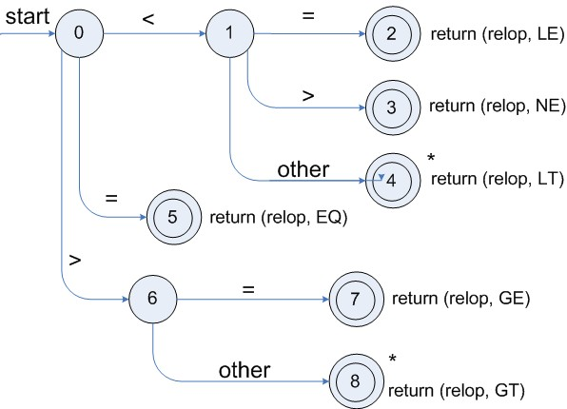
Transition diagrams
Transition diagram for relop

Slide 20
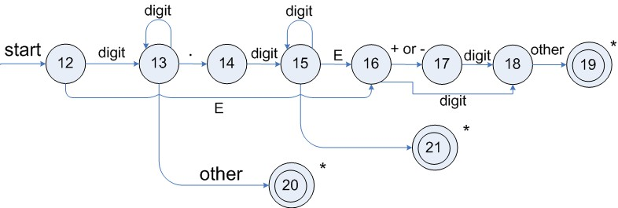
Transition diagrams (cont.)
Transition diagram for reserved words and identifiers
Transition diagram for unsigned numbers

Slide 21
Architecture of a transition-diagram-based lexical analyzer
TOKEN getRelop()
{
TOKEN retToken = new (RELOP)
while (1) { /* repeat character processing until a
return or failure occurs */
switch(state) {
case 0: c= nextchar();
if (c == ‘<‘) state = 1;
else if (c == ‘=‘) state = 5;
else if (c == ‘>’) state = 6;
else fail(); /* lexeme is not a relop */
break;
case 1: …
…
case 8: retract();
retToken.attribute = GT; return(retToken);
}

Slide 22
Finite Automata
Regular expressions = specification
Finite automata = implementation
A finite automaton consists of
An input alphabet Σ
A set of states S
A start state n
A set of accepting states F ⊆ S
A set of transitions state → state

Slide 23
Lexical Analyzer Generator - Lex

Slide 24
Structure of Lex programs
declarations
%%
translation rules
%%
auxiliary functions
Pattern {Action}

Slide 25
Example
.
%{
/* definitions of manifest constants LT, LE, EQ, NE, GT, GE,
IF, THEN, ELSE, ID, NUMBER, RELOP */
%}
/* regular definitions
delim
ws
letter[A-Za-z] digit [0-9]
id number
[ \t\n]
{delim}+
{letter}({letter}|{digit})*
{digit}+(\.{digit}+)?(E[+-]?{digit}+)?
%%
{ws} {/* no action and no return */} if {return(IF);}
then {return(THEN);} else {return(ELSE);}
{id} {yylval = (int) installID(); return(ID); }
{number} {yylval = (int) installNum(); return(NUMBER);}
…

Slide 26
Conclusion
Words of a language can be specified using regular
expressions
NFA and DFA can act as acceptors
Regular expressions can be converted to NFA
NFA can be converted to DFA
Automated tool lex can be used to generate lexical analyser for a language

