Slide 1
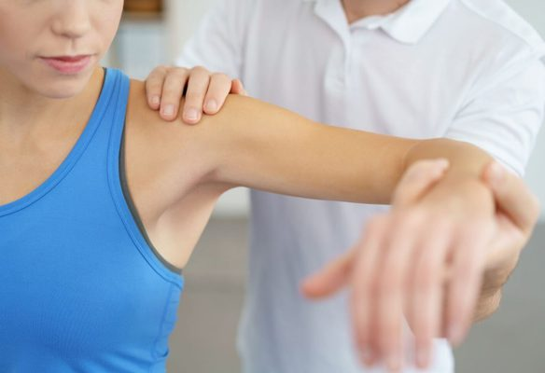
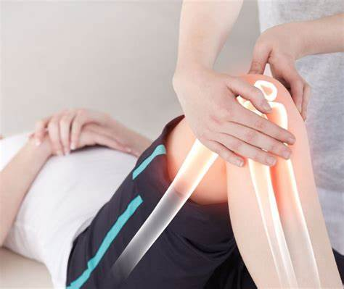
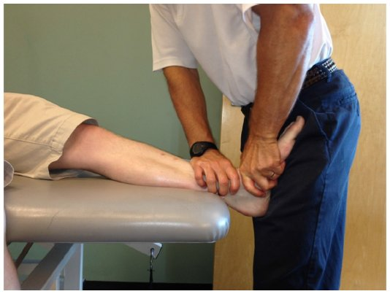
MAITLAND MOBILISATION

Slide 2
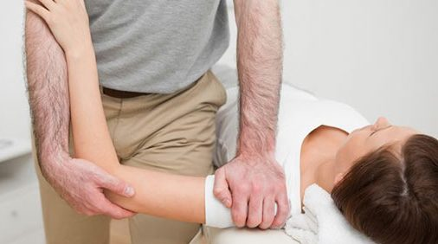
DEFINITION
MOBILISATION
Maitland defines “mobilisation as passive movement that is performed with a rhythm and a grade in a manner in which the patient is able to prevent the technique from being performed”
Wise C, Beatti P, John S,et ol. Orthopaedic Manual Physical Therapy from art to evidence.2005;17.

Slide 3
MANIPULATION
Manipulation as “an accurately localized, single, quick and decisive movement of small amplitude following careful positioning of the patient”
Wise C, Beatti P, John S,et ol. Orthopaedic Manual Physical Therapy from art to evidence.2025;17.

Slide 4
KEY TERMS
Accessory Movement
Physiological Movement
Injuring Movement
Overpressure

Slide 5
KEY CONCEPTS OF MAITLAND TECHNIQUES
Patient centred approach to dealing with movement disorder
The brick wall approach

Slide 6
THE PATIENT- CENTERED APPROACH TO DEALING WITH MOVEMENT DISORDERS
Through the conscious use of communication techniques and respect of the individual experience of a person.

Slide 7
THE BRICK WALL APPROACH

Slide 8
PRINCIPLE OF ASSESSMENT
The continuous assessment before, during and after the application of each technique during each treatment session to session throughout treatment.
The gentleness of the initial treatment techniques.
The responses, both during and after application of treatment must be assessed and analysed before progressing.

Slide 9
PRINCIPLE OF MOBILISATION AND MANIPULATION TECHNIQUES
Rate of force application
Location in range of available movement
Direction of force
Target of force
Patient position

Slide 10
METHODS OF MOBILISATION
Place joint in resting position
Determine treatment plane
Determine direction of mobilisation using concave convex rule
Patient’s body well supported
Patient and therapist relaxed

Slide 11
Stabilize one bone and mobilize the other. Usually stabilize proximal bone
Contact should not be painful
Therapist’s hands should be close to joint surfaces as possible
Stop the mobilisation test or treatment if too painful
Initial mobilisation are in the loose pack position
Assess before and after treatment

Slide 12
CONCAVE CONVEX RULE

Slide 13
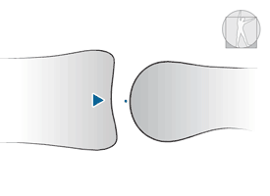
concave surface is fixed and the convex surface is moving
Convex surface is fixed and the concave surface is moving
Notes:
1-Eg shoulder joint, hip joint
2-eg. Wrist joint and knee joint

Slide 14
GRADES OF MOBILISATION
Grade 1 - Small amplitude movement performed at the beginning of the range
Grade 2 - large amplitude movement performed within the range
Grade 3 - large amplitude movement performed up to the range
Grade 4 - small amplitude movement performed at the limit of the range
Grade 5 – high velocity thrust performed at the limit of the range
Notes:
Grade 1and2 - for pain
Grade 3 and 4- for increase ROM

Slide 16
INDICATION OF MAITLAND MOBILISATION

Slide 17
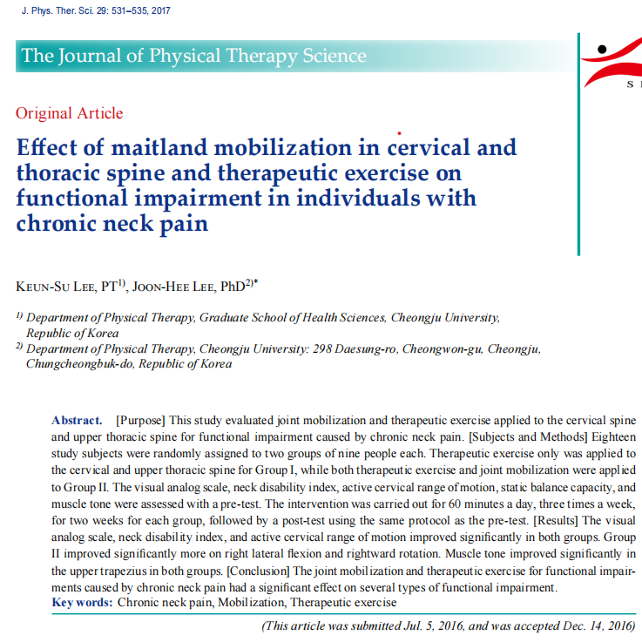
PAIN

Slide 18
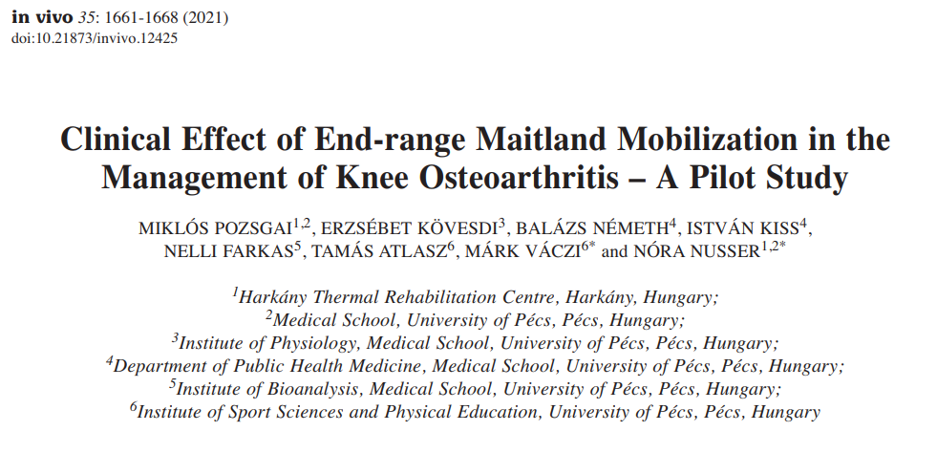
HYPOMOBILITY
Notes:
Conservative therapy
Conservative therapy +mobilisation

Slide 19
POSTURAL DYSFUNCTION
FOR JOINT MOBILIZATION

Slide 20
CONTRAINDICATION OF MOBILISATION
Malignancy
Unhealed or recent fracture
Excessive pain
Acute inflammation
Osteoporosis
Pregnancy
Hypermobility
Dizziness
Neurological signs
Spondylolisthesis

Slide 21
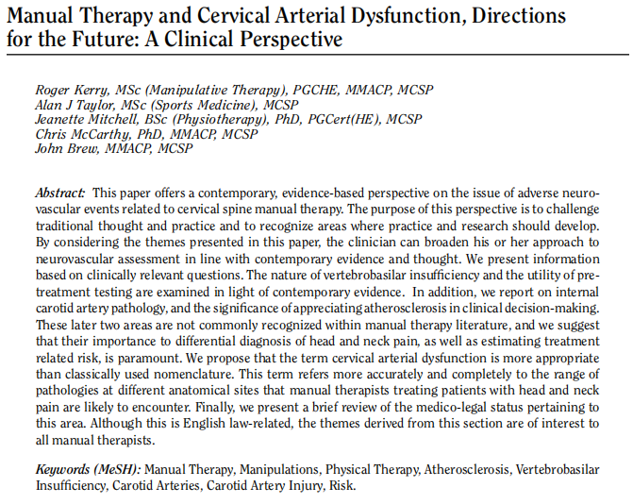
CONTRAINDICATION OF MANIPULATION Vertebrobasilar insufficiency Spinal canal stenosis

Slide 22
REFERENCES
Wise C, Beatti P, John S, et al. Orthopaedic Manual Physical Therapy from art to evidence.2025;17.
Donatelli A R, Wooden J M. Orthopaedic Physical Therapy. 2001;4:
Cook E C. Orthopaedic Manual Therapy An evidence based approach. 2007;1-11.
Hengeveld E, Banks K. Maitland’s peripheral manipulation. 2005;4:1-25.
Lee K, Lee K. Effect of maitland mobilisation in cervical and thoracic spine and therapeutics exercise and functional impairement in individuals with chronic neck pain. The journal of physical therapy science.2017;29:531-535.
Kerry R, Taylor A ,Mitchell J, et al. Manual therapy and cervical arterial dysfunction , directions for the future: A Clinical perspective. The journal of manual and manipulative therapy. 2008; 16:39-48.
Pozsgai M, Kovesdi E, Nemeth B, et al. clinical effect of end range maitland mobilisation in the management of knee osteoarthritis: A pilot study. In vivo. 2021;35:1661-1668.

Slide 23
THANK YOU

