Slide 1
Subject Name: Machine Learning Subject Code: MCA-4014 Subject Topic: Linear Regression Analysis
Abhishek Dwivedi
Assistant Professor
Department of Computer Application
UIET, CSJM University, Kanpur

Slide 2
Linear Regression in Machine Learning
Linear regression is one of the easiest and most popular Machine Learning algorithms. It is a statistical method that is used for predictive analysis. Linear regression makes predictions for continuous/real or numeric variables such as sales, salary, age, product price, etc.
Linear regression algorithm shows a linear relationship between a dependent (y) and one or more independent (x) variables, hence called as linear regression. Since linear regression shows the linear relationship, which means it finds how the value of the dependent variable is changing according to the value of the independent variable.
The linear regression model provides a sloped straight line representing the relationship between the variables. Consider the below image:

Slide 3
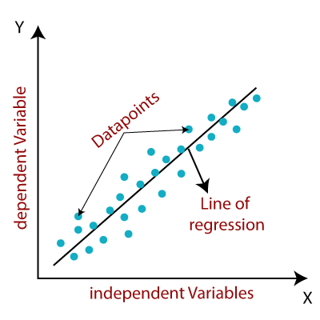
Mathematically, we can represent a linear regression as:
Y= a0+a1X
Here,
Y= Dependent Variable (Target Variable) X= Independent Variable (predictor Variable) a0= intercept of the line (Gives an additional degree of freedom) a1 = Linear regression coefficient (scale factor to each input value).

Slide 4
Types of Linear Regression:
Linear regression can be further divided into two types of the algorithm:
Simple Linear Regression: If a single independent variable is used to predict the value of a numerical dependent variable, then such a Linear Regression algorithm is called Simple Linear Regression.
Multiple Linear regression: If more than one independent variable is used to predict the value of a numerical dependent variable, then such a Linear Regression algorithm is called Multiple Linear Regression.

Slide 5
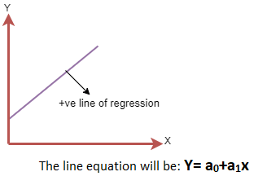
Linear Regression Line:
A linear line showing the relationship between the dependent and independent variables is called a regression line. A regression line can show two types of relationship:
Positive Linear Relationship: If the dependent variable increases on the Y-axis and independent variable increases on X-axis, then such a relationship is termed as a Positive linear relationship.

Slide 6
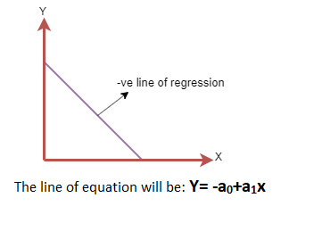
Negative Linear Relationship: If the dependent variable decreases on the Y-axis and independent variable increases on the X-axis, then such a relationship is called a negative linear relationship.

Slide 7
Finding the best fit line:
When working with linear regression, our main goal is to find the best fit line that means the error between predicted values and actual values should be minimized. The best fit line will have the least error.
The different values for weights or the coefficient of lines (a₀, a₁) gives a different line of regression, so we need to calculate the best values for a₀ and a₁ to find the best fit line, so to calculate this we use cost function.
Cost function:
The different values for weights or coefficient of lines (a₀, a₁) gives the different line of regression, and the cost function is used to estimate the values of the coefficient for the best fit line.
Cost function optimizes the regression coefficients or weights. It measures how a linear regression model is performing.
We can use the cost function to find the accuracy of the mapping function, which maps the input variable to the output variable.

Slide 8
For Linear Regression, we use the Mean Squared Error (MSE) cost function, which is the average of squared error occurred between the predicted values and actual values. It can be written as:
MSE =
Where,
N=Total number of observation Yi = Actual value (a1x_{i}+a0)= Predicted value.
Gradient Descent:
Gradient descent is used to minimize the MSE by calculating the gradient of the cost function.
A regression model uses gradient descent to update the coefficients of the line by reducing the cost function.
It is done by a random selection of values of coefficient and then iteratively update the values to reach the minimum cost function.

