Slide 1

MONOLITHIC IC
Somesh Kr Malhotra,Assistant Professor,ECE DEPARTment,UIET

Slide 2
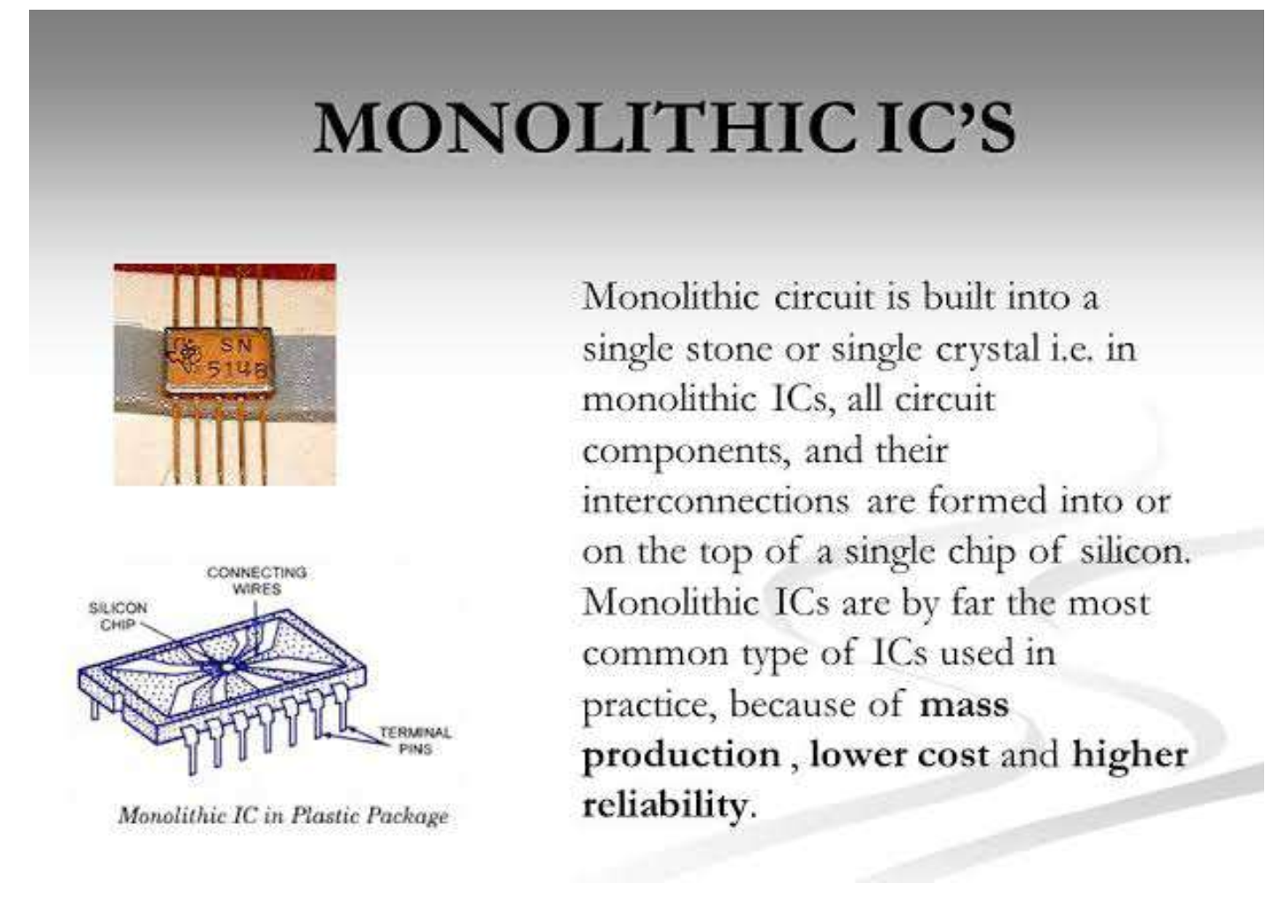
Introduction

Slide 3
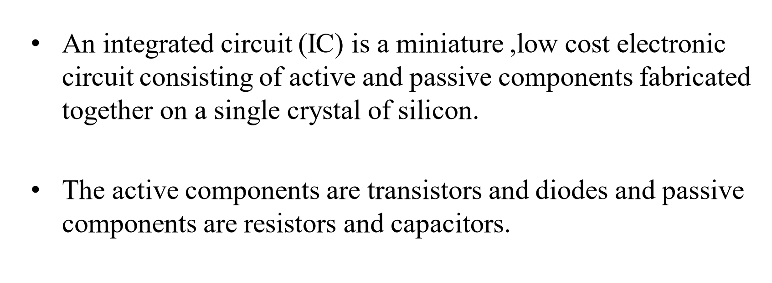
Monolithic ic

Slide 4
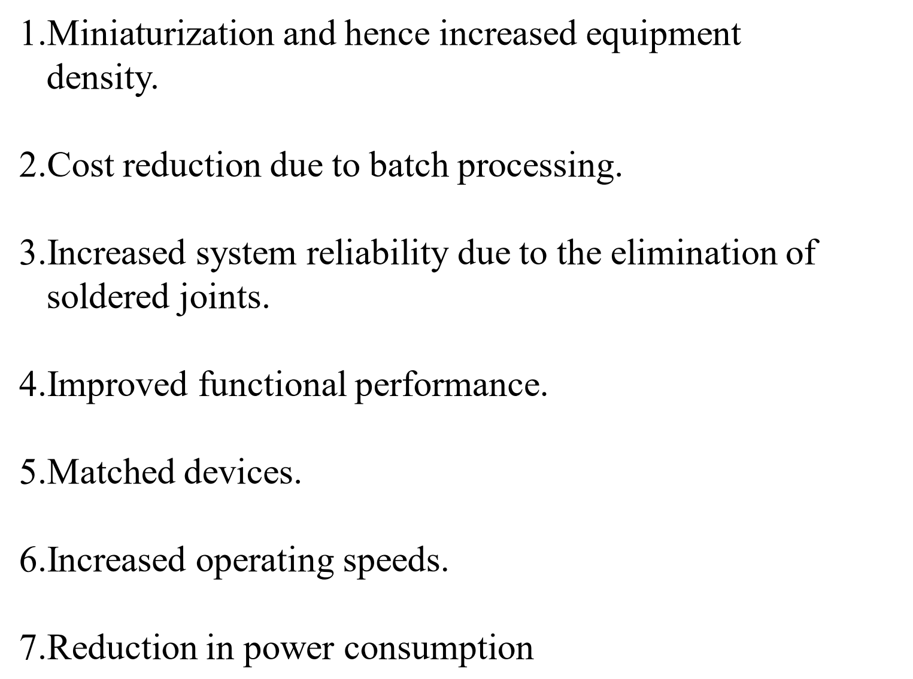
Advantage of integrated circuit

Slide 5
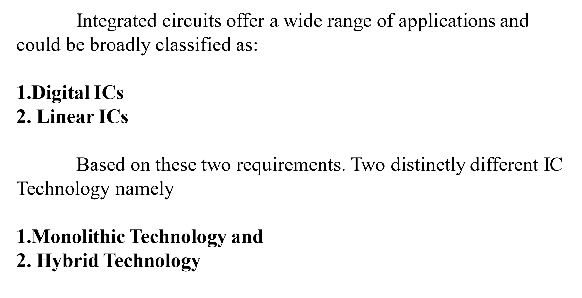
Classification of IC

Slide 6
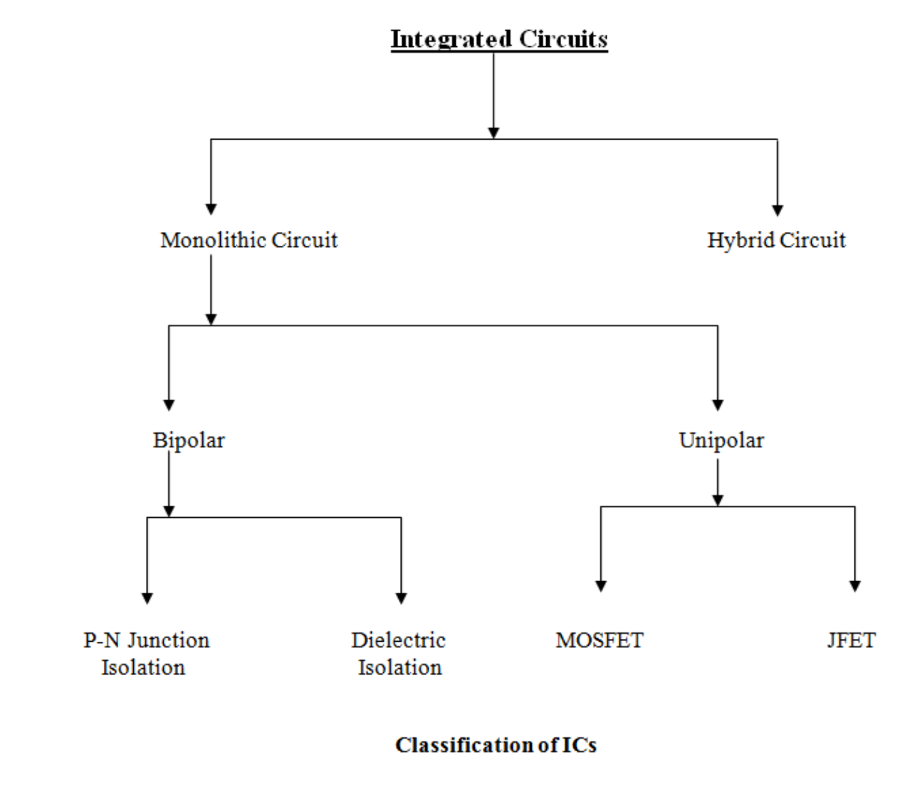
Classification of IC

Slide 7
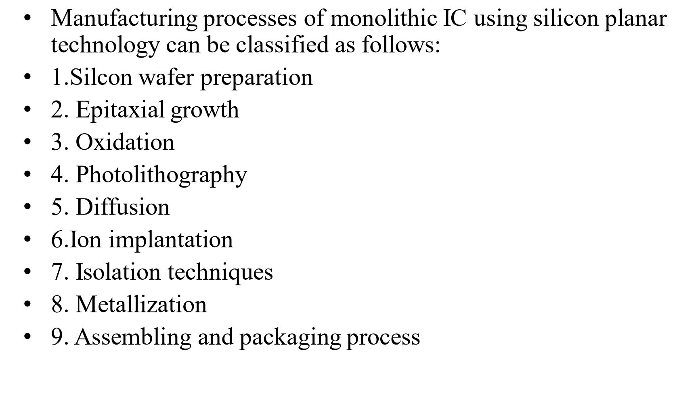
Manufacturing process of monolithic ic

Slide 8
