Slide 1
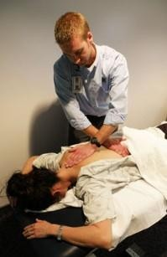
Myofascial Release in Physical Therapy

Slide 2
Introduction of Myofacial Releaase
MFR is a type of therapy that uses hands on techniques to release muscles shortness and tightness.
This is done by providing gentle susstained pressure into Myofascial connective tissue that’s located under the muscles.

Slide 3
Myofascial Release
John F. Barnes was the founder for MFR.
He was a physical therapist that graduated from University of Pennsylvania, and strongly believed in mind/body concept.
He learned about MFR after his weigh lifting injury when fracturing his L5 and ripping some of the lumbar ligaments.
He tried everything but nothing work to relieve his pain until he came up with this new technique that which gave permanents results.

Slide 4
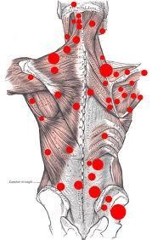
Technique
Therapist provides gentle pressure for some period of time used to soften and liquify hard or tender areas within the fluid components of connective tissue, while stretching, separating and straightening its fibrous components.
MFR technique does not require any kind of lotion compared to message therapy, only special kind of pressure is provided to certain areas of the body, where pain is present and is held there for some period of time in order to release unwanted tension and relive the pain.
Trigger points are sometimes the main target to provide the pressure to, because they are the most sensitive spots in skeletal muscles.
https://www.youtube.com/watch?v=Fuaz-nWnr5M

Slide 5
Importance of MFR in PT field
MFR is used for any population seeking for physical therapy. Patients come to PT for many reasons like: back pain, cervical pain, scoliosis, rehab after surgeries, carpal tunnel, neurological dysfunction and many more which all of them can be treated my MFR depending on their condition.
Anyone can benefit from MFR starting from teen agers that play sports that either might have tight of pulled muscle the way to geriatrics diagnosed which can have some kind of contracture or specific disease.
Therapist provide hands on work, to treat the patients, relieve them from pain their experiencing, and get them back to their ADLS permanently.
Continuing education course might be required in order to
specialize in MFR techniques, depending on the facilities.
MFR would be billed as Manual Treatment.

Slide 6
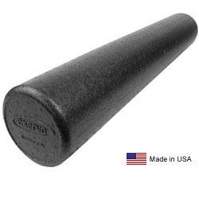
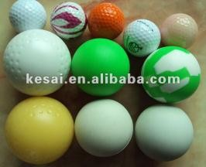
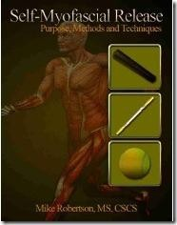
Self-Myofascial Relief
Foam roller are used to perform MFR technique on yourself, doesn’t require therapist just foam roller, tennis ball, pvc pipe or field hockey ball depending on the body part being worked on.
Gently roll out the body part on the foam roller until you feel tender spot, staying on that exact spot for 20+ seconds will relieve muscle tension that’s present.
So many body parts can be worked on by this technique.
Good example for patients home exercise program, can be used anywhere, any time.

Slide 7
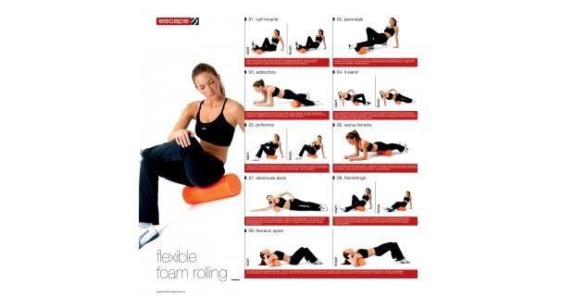
Example of Self-Myofascial Release

Slide 8
Tests, Progression, Intervention
There are no special test for this technique, but you can always measure ROM , mark pain scale, test strength before and after the treatment, that way there are results to compare and see if it’s effective.
Intervention would be for therapist to apply more firmer pressure in order to release more tension, and progressing from softer to harder foam roller for
self-myofascial release. When patient can tolerate
rolling a body part on harder surface, since it can get though.
Progression would be comparing how the patient is feeling before and after the treatments of MFR

Slide 9
Sources for more infromation on MFR
myofascialrelease.com
https://www.youtube.com/watch?v=PWRuS9xAbMo
Mercer Country Community College online data base
http://www.performbetter.com/webapp/wcs/stores/ servlet/PBOnePieceView?storeId=10151&catalogId
=10751&languageId=-1&pagename=91
http://massagemag.com/massage-blog/myofascial- release/

Slide 10
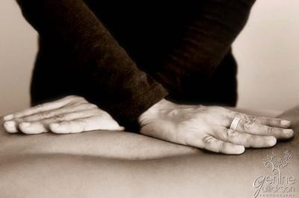
MFR

Slide 11
Reference
Doraisamy, Magesh Anand, et al. "Chronic Tension Type Headache and the Impact of Myofascial Trigger Point Release in the Short Term Relief of Headache." Global Journal of Health Science 2.2 (2010): 238-44. OxResearch; ProQuest Central; ProQuest Health Management. Web. 7 Mar. 2013.
Back Pain; Sepi Aeen, MPT, Eliminates Pain with Myofascial Release Therapy." Medical Devices & Surgical Technology Week (2012): 2821. OxResearch; ProQuest Central; ProQuest Health Management. Web. 7 Mar. 2013.
Barnes John “Myofascial Release.” “Myofascial Release Treatment
Centers and Seminars.” Feb 19, 2013
Owed Dodge “Massage Therapy compared to Myofascial Release
2. “ Triangle Body Therapy.” July 29, 2010. Copyright © 2013 ·
Prose Theme on Genesis Framework
<http://www.trianglebodytherapy.com/myofascial-versus-
massage/

