Slide 1
Dr.Priti Pandey Associate Professor S.N.Sen B.V.P.C.College,Kanpur.
2018 Dec. 2019 Aug. 2020 March

Slide 2
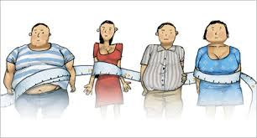
OBESITY Dr.Priti Pandey

Slide 3
DEFINITION

Slide 4
CAUSES
ETIOLOGY OF OBESITY
1. Genetic factors a) Sex b) Case of identical twins and kids of obese parents c) Genetic syndromes ( d) ob gene (leptin) and db gene (leptin receptor)
2. Environmental factors a) Metabolic imbalances (hypothyroidism) b) Socio-cultural and economic factors c) Physical inactivity d) Sleep deprivation e) Obesigenic viral infections?

Slide 5
BALANCE

Slide 6
IMBALANCE

Slide 11
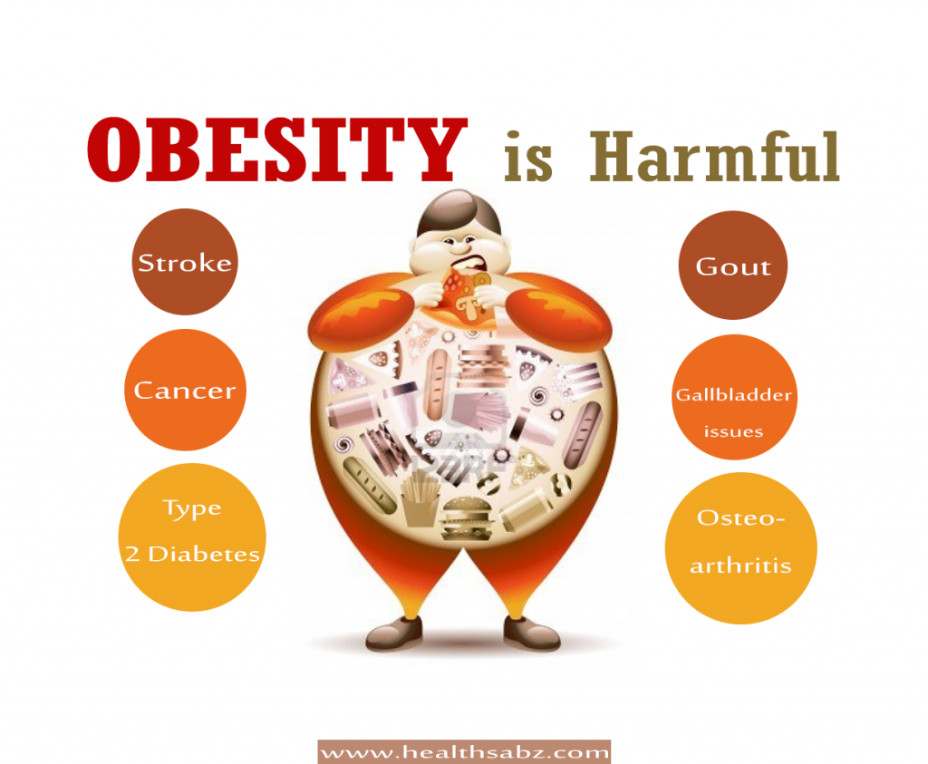

Slide 12
Type of Obesity 1.Android Obesity /Central Obesity:-Fat accumulate in upper segment …Apple shape (more promt to disease) 2. Gynecoid Obesity:- fat accumulate in lower segment …Pear shape 1.Endogenous Obesity 2.Exogenous Obesity

Slide 13
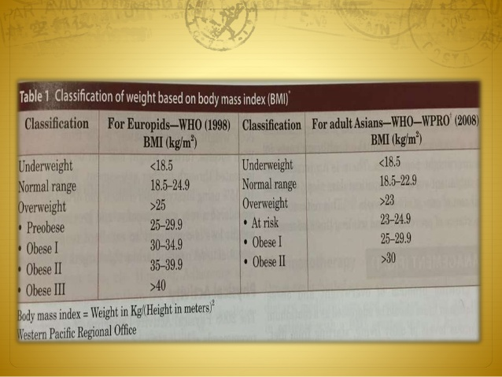

Slide 14
Body Mass Index is a simple calculation using a person's height and weight. The formula is BMI = kg/m² where kg is a person's weight in kilograms and m² is their height in metres squared. A BMI of 25.0 or more is overweight, while the healthy range is 18.5 to 24.9. BMI applies to most adults 18-65 years.

Slide 17
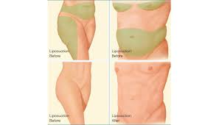
LIPOSUCTION

