Slide 1
Subject Name: Information System: Analysis Design & Implementation Subject Code : BCA 602 (N) Topic : Object Oriented Design
HIMANSHU SHUKLA
Department of Computer Application
UIET, CSJM University, Kanpur

Slide 2
Object Oriented Design
After the analysis phase, the conceptual model is developed further into an object-oriented model using object-oriented design .
In Object Oriented Design, the technology-independent concepts in the analysis model are mapped onto implementing classes, constraints are identified, and interfaces are designed, resulting in a model for the solution domain.
A detailed description is constructed specifying how the system is to be built on concrete technologies.
Design is concerned with the mapping of objects in the problem space into objects in solution space and creating an overall structure and computational model of the system.

Slide 3
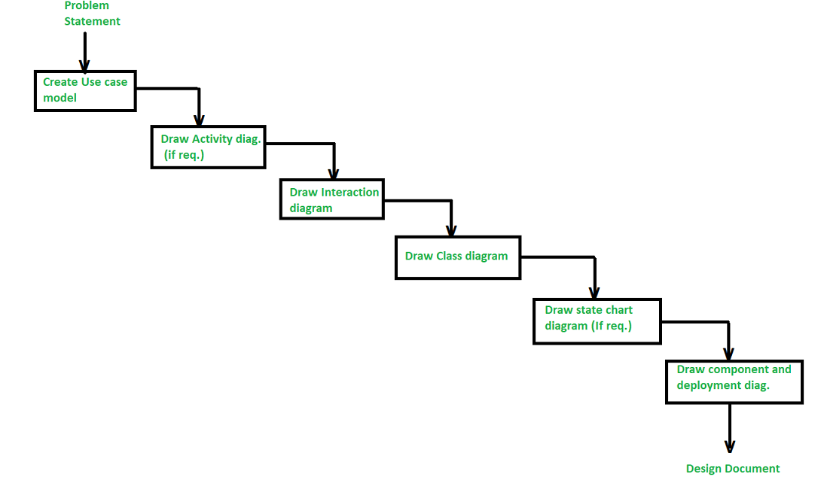
Steps in the Analysis and Design of an Object Oriented System

Slide 4
1.Create a Use case model
The first step in the analysis and design of an object-oriented system is to recognize the actors interlinked with the system. After that, create the use case and draw the use case diagram.
2. Draw activity diagram (If required)
The activity Diagram demonstrates the dynamic nature of a system by creating the flow of control form activity. An activity addresses a procedure on some class in the framework that outcomes in an adjustment of the condition of the system. The below figure shows the activity graph handling a request to convey a few products.

Slide 5
3. Draw the interaction diagram :
A interaction diagram shows a collaboration, comprising a bunch of articles and their relationship, including the messages that might be dispatched among them. Interaction diagram address the unique perspective on a system.
Steps for drawing interaction diagrams :
Initially, we ought to distinguish that the objects as for each use case.
Then we draw the sequence diagrams for each use case.
Then we draw the collaboration diagrams for each use case.

Slide 6
4. Draw the class diagram : The class diagram is responsible for showing the relationship between the classes. There are four types of relationships available in class diagrams Association – It is a semantic connection between classes. At the point when an association associates two classes, each class can send messages to the next in sequence or a collaboration diagram. They may be bi-directional or unidirectional in nature.
Dependencies – They connect two classes and are always unidirectional in nature and display that one class, depends on the definitions of another class.
Aggregations – They are a stronger form of association that shows the relationship between a whole and its parts.
Generalizations – They are used to display an inheritance relationship between the two classes.

Slide 7
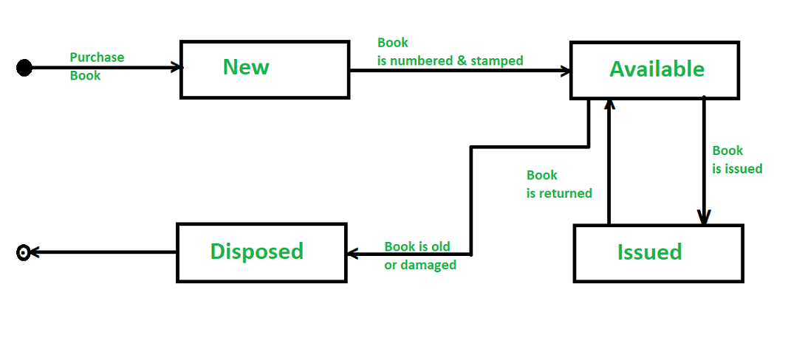
5. Design of State chart diagrams : A state chart is utilized to show the state space of a given class, the occasion that influences progress starting with one state then onto the next, and the activity that outcome from a state change. A state change graph for a “book” in the library management system is shown below

Slide 8
6. Draw component and development diagram : These diagrams address the static execution perspective on a system they are identified with class diagrams in that a segment ordinarily guides to at least one class, interface, or coordinated effort.

Slide 9
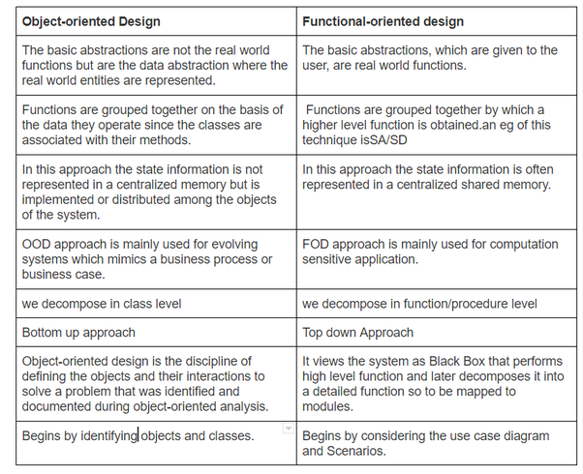
Object Oriented Design Vs Function Oriented Design

Slide 10
References:
www.tutorialspoint.com
www.geeksforgeeks.org
www.javatpoint.com
V. Raja Raman : Analysis and Design of Information Systems
Jeffrey L Whitten & Lonnie D Bently: System Analysis and Design Methods

