Slide 1
Project Scheduling

Slide 2
Project Scheduling
Project Scheduling in a project refers to roadmap of all activities to be done with specified order and within time slot allotted to each activity.
Project managers tend to define various tasks, and project milestones and arrange them keeping various factors in mind.
They look for tasks lie in critical path in the schedule, which are necessary to complete in specific manner (because of task interdependency) and strictly within the time allocated.
Arrangement of tasks which lies out of critical path are less likely to impact over all schedule of the project.

Slide 3
How to schedule Project Plan
To schedule the project plan, a software project manager wants to do the following :
Identify all the functions required to complete the project.
Break down large functions into small activities.
Determine the dependency among various activities.
Establish the most likely size for the time duration required to complete the activities.
Allocate resources to activities.
Plan the beginning and ending dates for different activities.
Determine the critical path.

Slide 4
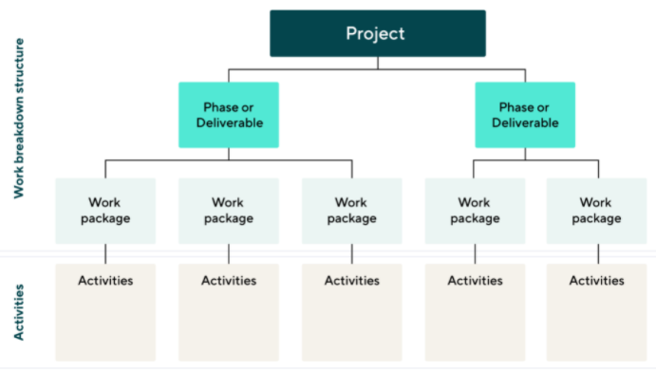
Work Breakdown Structure ( WBS )
Work breakdown structure (WBS) in project management is a method for completing a complex, multi-step project. It's a way to divide and conquer large projects to get things done faster and more efficiently.
The goal of a WBS is to make a large project more manageable. Breaking it down into smaller chunks means work can be done simultaneously by different team members, leading to better team productivity and easier project management.

Slide 5
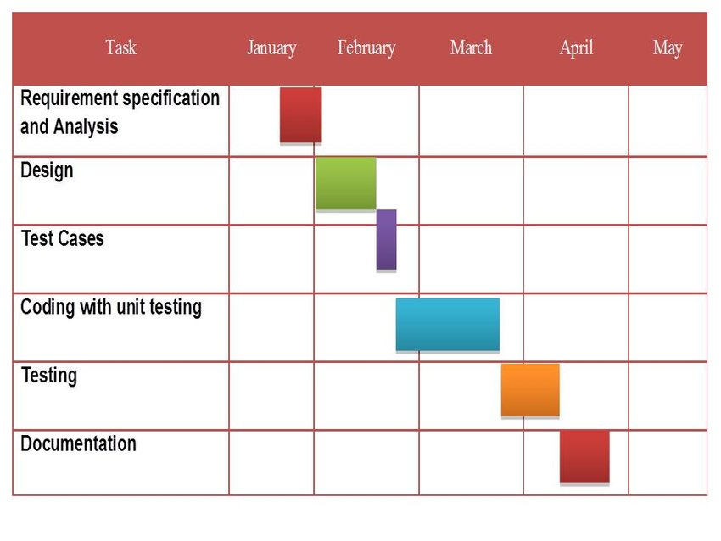
Gantt Chart
Gantt charts was devised by Henry Gantt (1917).
It represents project schedule with respect to time periods.
It is a horizontal bar chart with bars representing activities and time scheduled for the project activities.
This are mainly used to allocate resources to activities.

