Slide 1
Name of the Content Creator: Dr. Nisha Sharma
Designation: Associate Professor
Email: nishasharma@csjmu.ac.in
Email of Registrar: registrarcsjmuknp@gmail.com
Institute Name: University Institute of Pharmacy
University Name: C.S.J.M. University Campus, Kanpur

Slide 2
B.PHARM. 4th SEMESTER PHARMACOGNOSY & PHYTOCHEMISTRY-I
RESINS
Dr. Nisha Sharma
Associate Professor
University Institute of Pharmacy
C.S.J.M. University
Kanpur

Slide 3
RESINS
Resins : Solid/semisolid amorphous products of complex chemical nature containing large number of C atom.
These are mixture of essential oil, oxygenated products of terpenes & carboxylic acids.
Source: Natural- found in Most of the plant parts or excudate of plant because of injury or incision made
Ex: In plants: Asafoetida (Hing), Benzoin (lobaan), Ginger, Podophyllum, Capsicum etc
From animals: Shellac (Lac), From Fossils ex: Copal
Distributes mainly in Spermatophyta i.e. seed plants, sometimes in ferns (Pteridophyta)
In higher plants- they are end products of their metabolites

Slide 4
RESINS
Occurance: secreted in special form of structures (may be internally or surface)
In Ginger: Resin cells, In cannabis- Glandular hair, In pine- Schizogenous or schizolysogenous ducts or cavities
Schizogenous: developed by separation or splitting apart of cells, enclosing a cavity which then enlarges, lined by secretory epithelial cells, formed by the division of surrounding cells.
Lysigenous: cavities in the bodies of plants form because of break down of certain cells. considered to originate from a single cell by the division in different directions forming a solid mass of secreting cells and then by the gradual disintegration or solution of the resulting cells starting from the center.
Schizolysigenous: develops at first schizogenously but, then increases in size by the break down of the bounding cells producing secretion

Slide 5
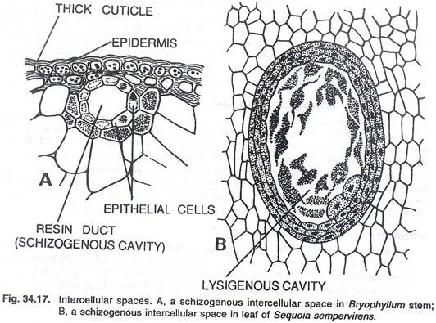
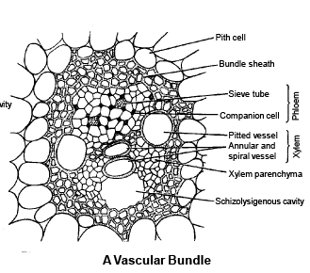

Slide 6
PROPERTIES OF RESINS
PHYSICAL
Transparent/ Translucent in nature (solid/ semisolid)
Specific gravity greater than water i.e. heavier than water (0.9-1.25)
When heated- soft, melt as sticky or adhesive fluid
Amorphous rarely crystalline
Solubility : insol. In H₂O
Soluble in organic solvents
Exception colophony insol. in ether
Resin + Heat → Burn smoky flame
CHEMICAL
Present as mixture of various chemical compd.
Complex mixture of resin acid, ester, alcohol, HC etc.
Enriched with Carbon, but no N, some have O
Amorphous mixture of essential oil, oxygenated product of terpenes, carboxylic acid
Get darken on atmospheric oxidation
Acid resin + aklali → Resin Soap

Slide 7
CLASSIFICATION OF RESINS
1. Based on formation
Physiological resin: Formed as normal product of metabolism Ex: cannabis, podophyllum, ginger
Pathological resins: Formed as a result of wound, injury or abnormal circumstances: Ex: benzoin, asafoetida, guggul
2. On the basis of occurance with other secondary metabolites (Resin combination)
Oleo resin : Naturally occuring mixture of resin & volatile oil ex: Ginger, capsicum, copaiba
Gum Resin: Resin associated with gum example: colophony, cannabis
Oleo Gum Resin: Mixture of volatile oil, Gum & resin Ex: Guggul, Asafoetida, Myrrh
Balsam Resin: Resinous mixture of benzoic acid/ cinnamic acid or esters of tehse acids in free or combined form
Ex: Benzoin, Tolu balsam, peru balsam
v) Glycoresins: occur in combination with sugar by Glycoside linkage Ex: Jalap, Podophyllum, Ipomoea

Slide 8
CLASSIFICATION OF RESINS
3) Depending upon the chemical nature pf predominent chemical constituent
i) Resin acid (Resinolic acid) : Found in free or esterified form, Large proportion of oxy acids, soluble in alkali forming soap
derivatized as Metallic salt forming Resinates, E: Abietic acid- Colophony, commiphoric acid- Myrrh, Ferulic acid- Asafoetida
ii) Resin alcohol (Resinols): Complex alcohol of high mol. Weight, found in free or ester with balsamic acid or acid resin, gives
–ve test with FeCl₃, Ex: Cannabinol- cannabis, Gingerol- Ginger, Nenzoresinol- Benzoin
iii) Resin Phenol (Resinotannols): Contain phenolic group, high Mol. Wt. , Give color reaction with FeCl₃, occur as free or ester Ex: Peruresinotannol- Balsam of peru

Slide 9
CLASSIFICATION OF RESINS
4) Resin ester: Ester is chief constituent- Ester of resinols/ resinoltannols with resin acid/ Balsamic acid Ex: Coniferyl benzoate, Benzyl benzoate- Benzoin, Cinnamyl cinnmate- Storax
5) Resones: Complex natural inert substances, don’t undergo hydrolysis, don’t form salt, no specific chemical properties
Ex: Asaresenes- Asafoetida,
6) Glucoresin : combined with sugar by glycosylation & produce glucoresin. Can be hydrolysed to aglycon & glycon portions.

Slide 10
IDENTIFICATION TEST FOR RESIN
1. Benzoin: Benzoin + Ether → shake→ Extract +H₂SO₄→ sumatra benzoin deep brown color & siam benzoin (deep purple color)
2. Colophony : Drug + acetic anhydride + 1 drop of Conc. H₂SO₄
Purple color that rapidly changes to violet color
3. Myrrh: Triturate with solvent ether→ Filter→ Evaporate thin film → violet color on contact with Br₂ vapor
Triturate with water→ Yellow emulsion
4. Podophyllum: Drug+ alcohol→ Macerate → Filter→ Filtrate + strong copper acetate solution→ Brown ppt
5. Tolu balsam: Acidic to litmus
Drug + FeCl₃ →Green color (Resinotannol)

Slide 11
REFERENCES
Pharmacognosy, C.K. Kokate, A.P. Purohit, S.B. Gokhale, 54th Ed. 2017, Nirali Publication, New Delhi
Text Book of Pharmacognosy & Phytochemistry, Biren Shah & AK Seth, 1st Edition, 2010, Elsevier India Pvt. Ltd, New Delhi.

