Slide 1
Replacement Model
All industrial and military equipment gets worn with time and usage and it functions with decreasing efficiency.
For example : A machine requires higher operating cost, a transport vehicle such as a car or airplane requires more and more maintenance cost.
A railway timetable becomes more and more out of date with the passage of time.
The ever increasing repair, maintenance and operating cost necessitates the replacement of the equipment. However, there is no sharp, clearly defined time which indicates the need for this replacement.

Slide 2
The replacement policy, in this case, consists of calculating the increased operating cost, maintenance cost, forced idle time cost together with cost of the new equipment and scrap value of the old.
Types of Failures
There are two types of failures:
Gradual failure : Gradual failure is progressive in nature. As the life of the equipment increases, its operational efficiency decreases. This results in
increased running (repair, maintenance and operating) costs.
decreased productivity.
decreased resale or scrap value.
Machines, vehicles, tyres, tubes, pistons, piston rings, bearings, etc. fall in this category.

Slide 3
2. Sudden Failure: Some items do not deteriorate with time. They give the desired level of service for some period, after which they fail. The period of desired service is not constant but follows some frequency distribution which may be progressive, retrogressive or random in nature.
Progressive failure: If the probability of failure of an item increases with increase in its life, then such a failure is called a progressive failure. Electric bulbs and tubes fall under this category of failure.
Retrogressive failure: If the probability of failure of an item is more in the beginning but decreases with the life of an item, then such a failure is called a retrogressive failure. Automobile engines fall under this category.
Random failure: If the probability of failure of the item is due to random causes such as physical shock, irrespective of its age, then such a failure is called a random failure. failure of vacuum tubes and electronic items is generally random in nature

Slide 4
Que no. 1 : The cost of a machine is Rs. 6100. and its scrape value is Rs. 100 the maintenance cost per year are as follows :
Year | Maintenance
1 | 100
2 | 250
3 | 400
4 | 600
5 | 900
6 | 1200
7 | 1600
8 | 2000
When should be the machine be replaced?

Slide 5
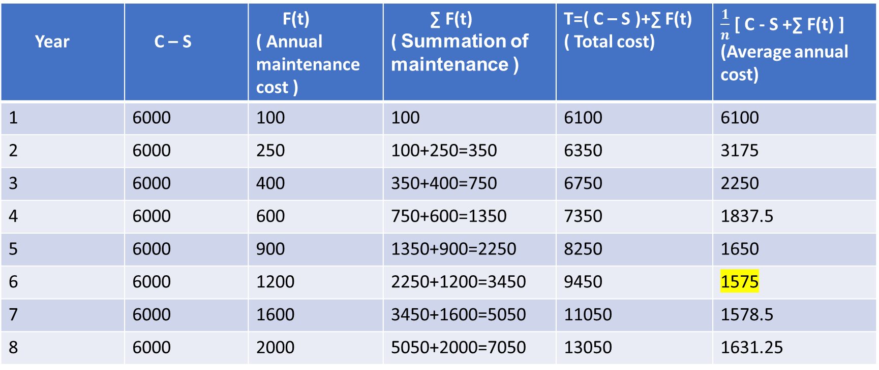
NOTE : If running cost ( Operating and maintenance cost) for the next year {f(n)+1} is more than the average annual cost n^{th} year then replace at the end of year.
HERE : Cost of machine(C) = 6100, Scrape value(s)=100, n = Number of years,
we observe from the table that the average annual cost is minimum(Rs.1575) during the 6th year and then rises . Hence the machine should be replaced after 6th year.
Year | C – S | F(t) ( Annual maintenance cost ) | ∑ F(t) ( Summation of maintenance ) | T=( C – S )+∑ F(t) ( Total cost) | $\frac{1}{n}$ [ C - S +∑ F(t) ] (Average annual cost)
1 | 6000 | 100 | 100 | 6100 | 6100
2 | 6000 | 250 | 100+250=350 | 6350 | 3175
3 | 6000 | 400 | 350+400=750 | 6750 | 2250
4 | 6000 | 600 | 750+600=1350 | 7350 | 1837.5
5 | 6000 | 900 | 1350+900=2250 | 8250 | 1650
6 | 6000 | 1200 | 2250+1200=3450 | 9450 | 1575
7 | 6000 | 1600 | 3450+1600=5050 | 11050 | 1578.5
8 | 6000 | 2000 | 5050+2000=7050 | 13050 | 1631.25

Slide 6
Que no.2 :- A taxi owner estimates from his past record that the cost/year for operating a taxi. where purchase price when new is Rs. 60000.
Age | Operating cost
1 | 10,000
2 | 12,000
3 | 15,000
4 | 18,000
5 | 20,000
After fifth year the operating cost is 6000k. Where k=6,7,8,9,10. { k denoting age in years}.
If the resale value decreases by 10% of the purchase price each year what is the best replacement policy ?

Slide 7
How to calculate the resale value :
10% of purchase price = Rs. 60,000 X10/100 = Rs. 6,000.
Thus the resale value decreases by Rs. 6,000 every year.
which means that ( C – S ) increases by Rs. 6,000 every year.

Slide 8
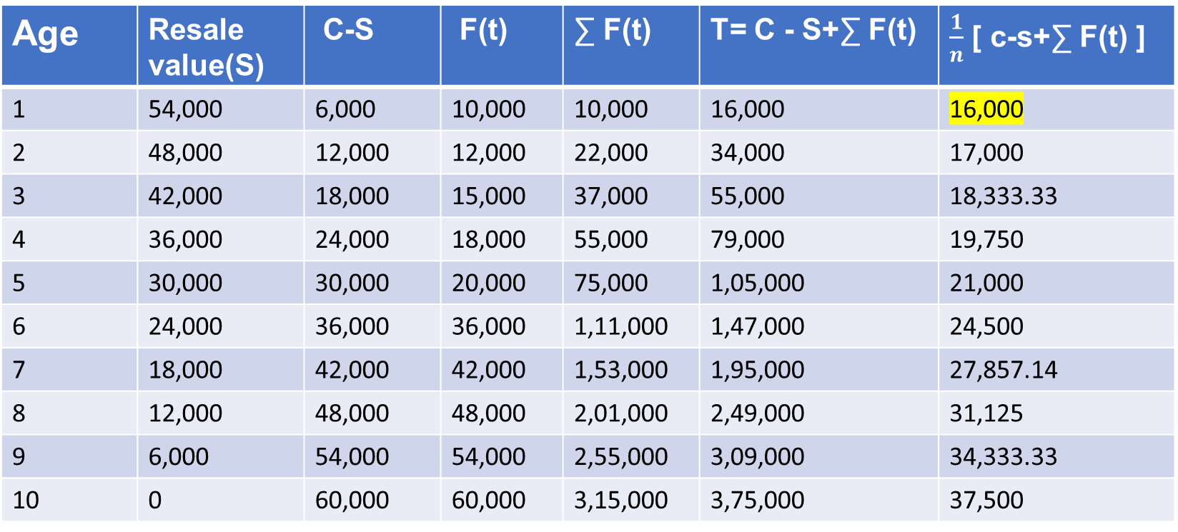
Age | Resale value(S) | C-S | F(t) | ∑ F(t) | T= C - S+∑ F(t) | $\frac{1}{n}$ [ c-s+∑ F(t) ]
1 | 54,000 | 6,000 | 10,000 | 10,000 | 16,000 | 16,000
2 | 48,000 | 12,000 | 12,000 | 22,000 | 34,000 | 17,000
3 | 42,000 | 18,000 | 15,000 | 37,000 | 55,000 | 18,333.33
4 | 36,000 | 24,000 | 18,000 | 55,000 | 79,000 | 19,750
5 | 30,000 | 30,000 | 20,000 | 75,000 | 1,05,000 | 21,000
6 | 24,000 | 36,000 | 36,000 | 1,11,000 | 1,47,000 | 24,500
7 | 18,000 | 42,000 | 42,000 | 1,53,000 | 1,95,000 | 27,857.14
8 | 12,000 | 48,000 | 48,000 | 2,01,000 | 2,49,000 | 31,125
9 | 6,000 | 54,000 | 54,000 | 2,55,000 | 3,09,000 | 34,333.33
10 | 0 | 60,000 | 60,000 | 3,15,000 | 3,75,000 | 37,500
Hence 1st year is the optimal replacement period.

